Slide 1

Community Agreement
Hubbard Richard Resident Association
Detroit International Bridge Company
City of Detroit
February 15, 2024

Slide 2
ENGAGEMENT TIMELINE
Jan. 2022 – May 2023 | 12+ meetings DIBC + HRRA &/or City (CMs Santiago-Romero & Waters)
May 12, 2023 | MOU signed by HRRA, DIBC & City
May 2023 – Sept. 2023 | Additional meetings/negotiations re: MOU ⮕ Community Agreement
October 20, 2023 | Community Agreement executed

Slide 3
COMMUNITY AGREEMENT
DIBC donates:
9 lots & 1 house to HRRA (+ $20k/lot)
4.5-acre development site to HRRA
Roberto Clemente lot to City
New, fully constructed 16th Street

Slide 4
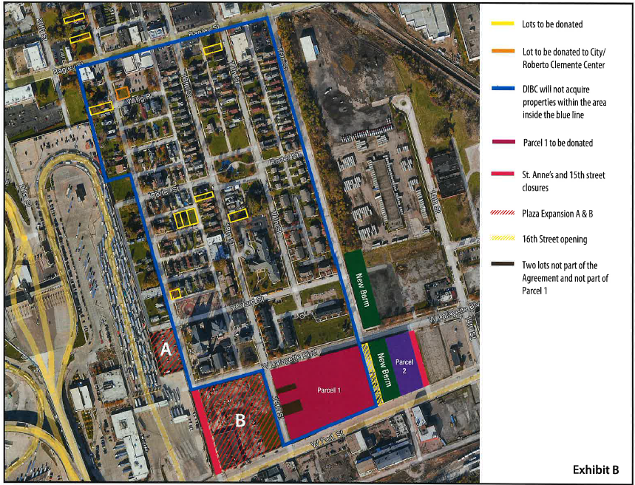

Slide 5
COMMUNITY AGREEMENT
DIBC will not:
Acquire additional properties in Hubbard Richard
Route trucks east of vacated St. Anne
Seek closure of West Lafayette St.

Slide 6
COMMUNITY AGREEMENT
Plaza expansion features:
Vegetative buffer
Undergrounded utility lines
Context-appropriate wall

Slide 7
COMMUNITY AGREEMENT
"Effective Date":
- Bridge Plaza Expansion approvals
(including required rezoning)
- City Council approval of
Community Agreement

Slide 8
Appendix

Slide 9
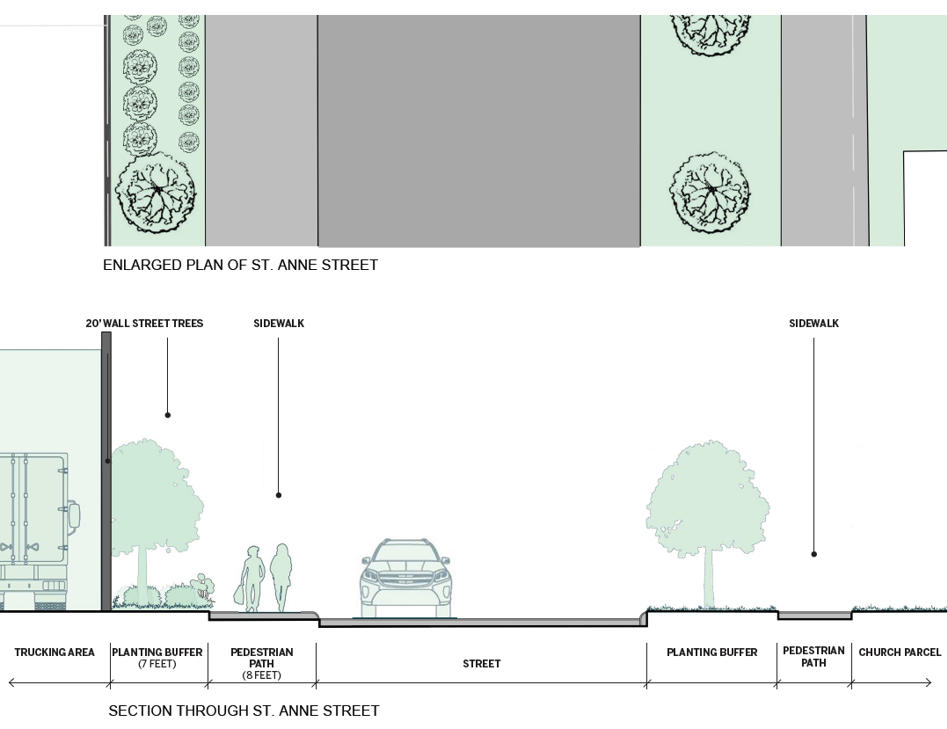

Slide 10
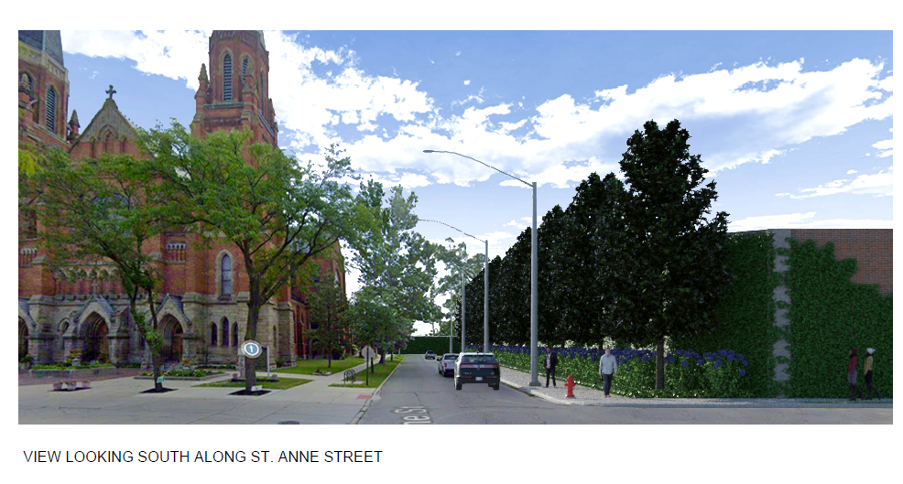

Slide 11
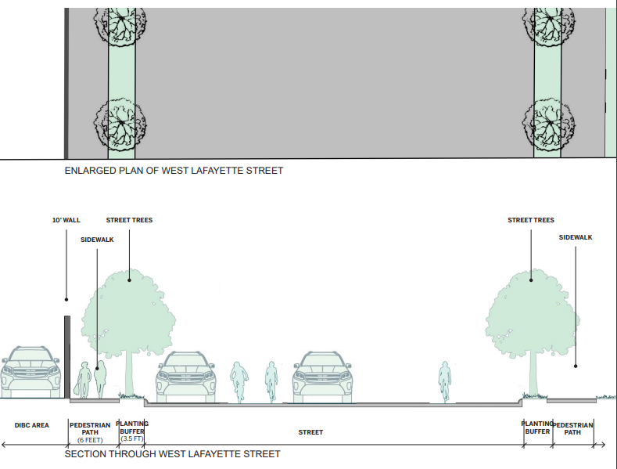

Slide 12
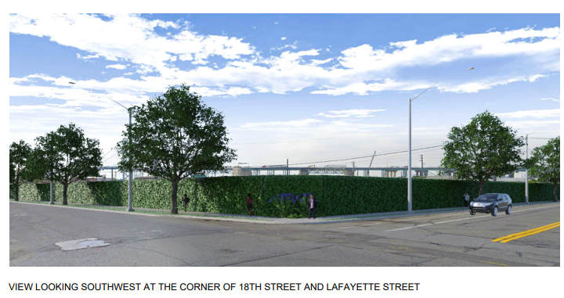

Slide 13
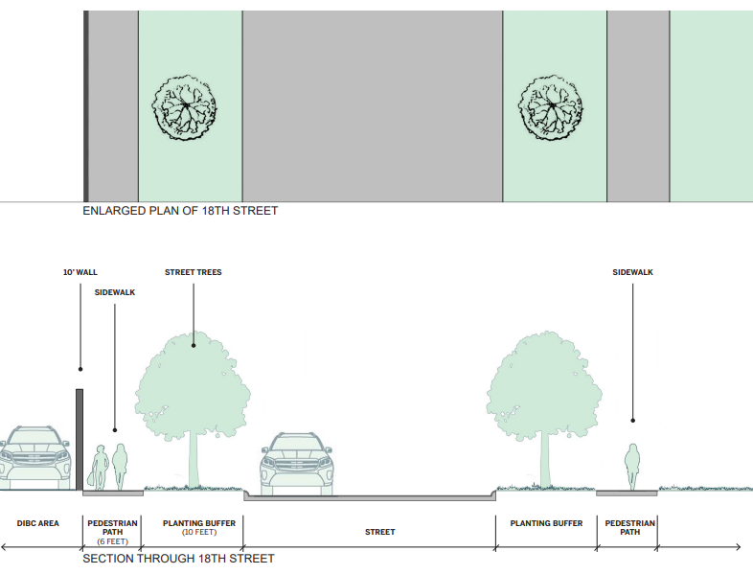

Slide 14
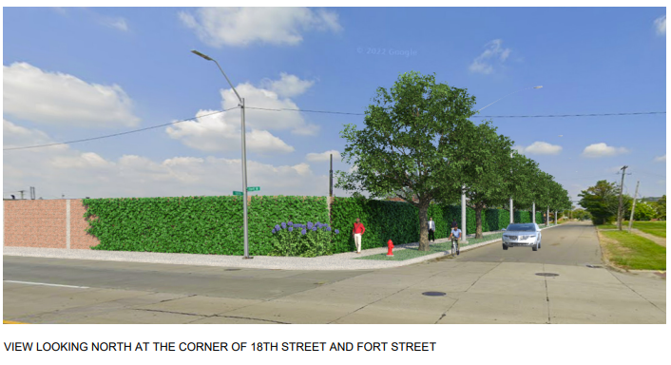

Slide 15
