Slide 1
Downtown Detroit Wayfinding Signage System
Downtown Detroit Partnership

Slide 2
1
Project Goals & Timeline

Slide 3
Project Goals
To increase pedestrian wayfinding for people unfamiliar to the area and give people a sense of place and place-literacy
To encourage and promote a “park-once” trip to Downtown Detroit by communicating distances between Detroit neighborhoods and destinations
To enhance the streetscape in Downtown Detroit with well-designed and informative signage
To promote and enhance access to Detroit businesses and public space
This user-friendly and adaptable approach not only facilitates accessibility but also allows for the system's expansion into various neighborhoods, fostering a comprehensive and unified connection throughout Detroit.
Complement the digital interactive kiosks that DDP will install in partnership with the City of Detroit
Notes:
1806: City of Detroit incorporated (before Michigan is admitted into the Union which happened in 1837)
1903: Ford Motor Company launched with $28,000 from 12 investors
1909: First mile of concrete highway paved along Woodward Avenue
1909: Ford Building, Detroit’s first modern skyscraper completed, at 23 stories tall
1912: Tiger Stadium opened as Navin Field, home to the Detroit Tigers and Lions
1923: General Motors relocated HQ to New Center along Grand Blvd
1929-1930: The Ambassador Bridge completed, connecting Detroit to Windsor, Canada; Detroit–Windsor Tunnel completed
1950 Population: 1,849,568 people (population peak)
1953: John C. Lodge Freeway/M-10 opened with the first full freeway-to-freeway interchange in U.S. at Edsel Ford Freeway/I-94
1955: Edsel Ford Freeway/I-94 completed to connect I-96 across Downtown to Russell Street
Highway construction is significant because it expanded Detroit accessibility to the metro area (suburb growth, population loss)

Slide 4
Project Timeline
2019/2020
Community Engagement and Wayfinding Working Group Established
A local consultant, Projects and People, was selected to lead a community engagement process.
Downtown stakeholder steering committee:
Cayla Chamberlain, Rocket Community Fund
Leo Mendez, Olympia Development
Elise Fields, Midtown Detroit, Inc
Karen Dumas-Perry, Detroit RiverFront Conservancy
Keven Waskelis, DTE Energy
Erika Linenfelser, City of Detroit, DPW
John Sivills, City of Detroit Planning and Development
RFQ Released – Conceptual Plan & Fabrication Document
2021
MKSK Studios selected to provide planning design and community outreach for the project
Working Group & MKSK complete engagement and concept plan
2022
Designs delivered(Add Year) Implementation and coordination plan
2022/2023
Fundraising
RFP Released with DEGC – Signage Fabricator and Contractor
November 2023 - DDP with Giffels Webster Engineering begins City of Detroit Permitting Process
Notes:
1806: City of Detroit incorporated (before Michigan is admitted into the Union which happened in 1837)
1903: Ford Motor Company launched with $28,000 from 12 investors
1909: First mile of concrete highway paved along Woodward Avenue
1909: Ford Building, Detroit’s first modern skyscraper completed, at 23 stories tall
1912: Tiger Stadium opened as Navin Field, home to the Detroit Tigers and Lions
1923: General Motors relocated HQ to New Center along Grand Blvd
1929-1930: The Ambassador Bridge completed, connecting Detroit to Windsor, Canada; Detroit–Windsor Tunnel completed
1950 Population: 1,849,568 people (population peak)
1953: John C. Lodge Freeway/M-10 opened with the first full freeway-to-freeway interchange in U.S. at Edsel Ford Freeway/I-94
1955: Edsel Ford Freeway/I-94 completed to connect I-96 across Downtown to Russell Street
Highway construction is significant because it expanded Detroit accessibility to the metro area (suburb growth, population loss)

Slide 5
2
Project Design and Locations

Slide 6
X
Notes:
1806: City of Detroit incorporated (before Michigan is admitted into the Union which happened in 1837)
1903: Ford Motor Company launched with $28,000 from 12 investors
1909: First mile of concrete highway paved along Woodward Avenue
1909: Ford Building, Detroit’s first modern skyscraper completed, at 23 stories tall
1912: Tiger Stadium opened as Navin Field, home to the Detroit Tigers and Lions
1923: General Motors relocated HQ to New Center along Grand Blvd
1929-1930: The Ambassador Bridge completed, connecting Detroit to Windsor, Canada; Detroit–Windsor Tunnel completed
1950 Population: 1,849,568 people (population peak)
1953: John C. Lodge Freeway/M-10 opened with the first full freeway-to-freeway interchange in U.S. at Edsel Ford Freeway/I-94
1955: Edsel Ford Freeway/I-94 completed to connect I-96 across Downtown to Russell Street
Highway construction is significant because it expanded Detroit accessibility to the metro area (suburb growth, population loss)

Slide 7
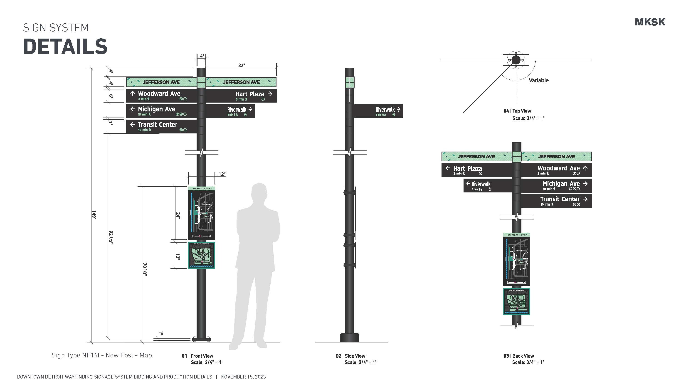
X
Notes:
1806: City of Detroit incorporated (before Michigan is admitted into the Union which happened in 1837)
1903: Ford Motor Company launched with $28,000 from 12 investors
1909: First mile of concrete highway paved along Woodward Avenue
1909: Ford Building, Detroit’s first modern skyscraper completed, at 23 stories tall
1912: Tiger Stadium opened as Navin Field, home to the Detroit Tigers and Lions
1923: General Motors relocated HQ to New Center along Grand Blvd
1929-1930: The Ambassador Bridge completed, connecting Detroit to Windsor, Canada; Detroit–Windsor Tunnel completed
1950 Population: 1,849,568 people (population peak)
1953: John C. Lodge Freeway/M-10 opened with the first full freeway-to-freeway interchange in U.S. at Edsel Ford Freeway/I-94
1955: Edsel Ford Freeway/I-94 completed to connect I-96 across Downtown to Russell Street
Highway construction is significant because it expanded Detroit accessibility to the metro area (suburb growth, population loss)

Slide 8
X
Notes:
1806: City of Detroit incorporated (before Michigan is admitted into the Union which happened in 1837)
1903: Ford Motor Company launched with $28,000 from 12 investors
1909: First mile of concrete highway paved along Woodward Avenue
1909: Ford Building, Detroit’s first modern skyscraper completed, at 23 stories tall
1912: Tiger Stadium opened as Navin Field, home to the Detroit Tigers and Lions
1923: General Motors relocated HQ to New Center along Grand Blvd
1929-1930: The Ambassador Bridge completed, connecting Detroit to Windsor, Canada; Detroit–Windsor Tunnel completed
1950 Population: 1,849,568 people (population peak)
1953: John C. Lodge Freeway/M-10 opened with the first full freeway-to-freeway interchange in U.S. at Edsel Ford Freeway/I-94
1955: Edsel Ford Freeway/I-94 completed to connect I-96 across Downtown to Russell Street
Highway construction is significant because it expanded Detroit accessibility to the metro area (suburb growth, population loss)

Slide 9
X
Notes:
1806: City of Detroit incorporated (before Michigan is admitted into the Union which happened in 1837)
1903: Ford Motor Company launched with $28,000 from 12 investors
1909: First mile of concrete highway paved along Woodward Avenue
1909: Ford Building, Detroit’s first modern skyscraper completed, at 23 stories tall
1912: Tiger Stadium opened as Navin Field, home to the Detroit Tigers and Lions
1923: General Motors relocated HQ to New Center along Grand Blvd
1929-1930: The Ambassador Bridge completed, connecting Detroit to Windsor, Canada; Detroit–Windsor Tunnel completed
1950 Population: 1,849,568 people (population peak)
1953: John C. Lodge Freeway/M-10 opened with the first full freeway-to-freeway interchange in U.S. at Edsel Ford Freeway/I-94
1955: Edsel Ford Freeway/I-94 completed to connect I-96 across Downtown to Russell Street
Highway construction is significant because it expanded Detroit accessibility to the metro area (suburb growth, population loss)

Slide 10
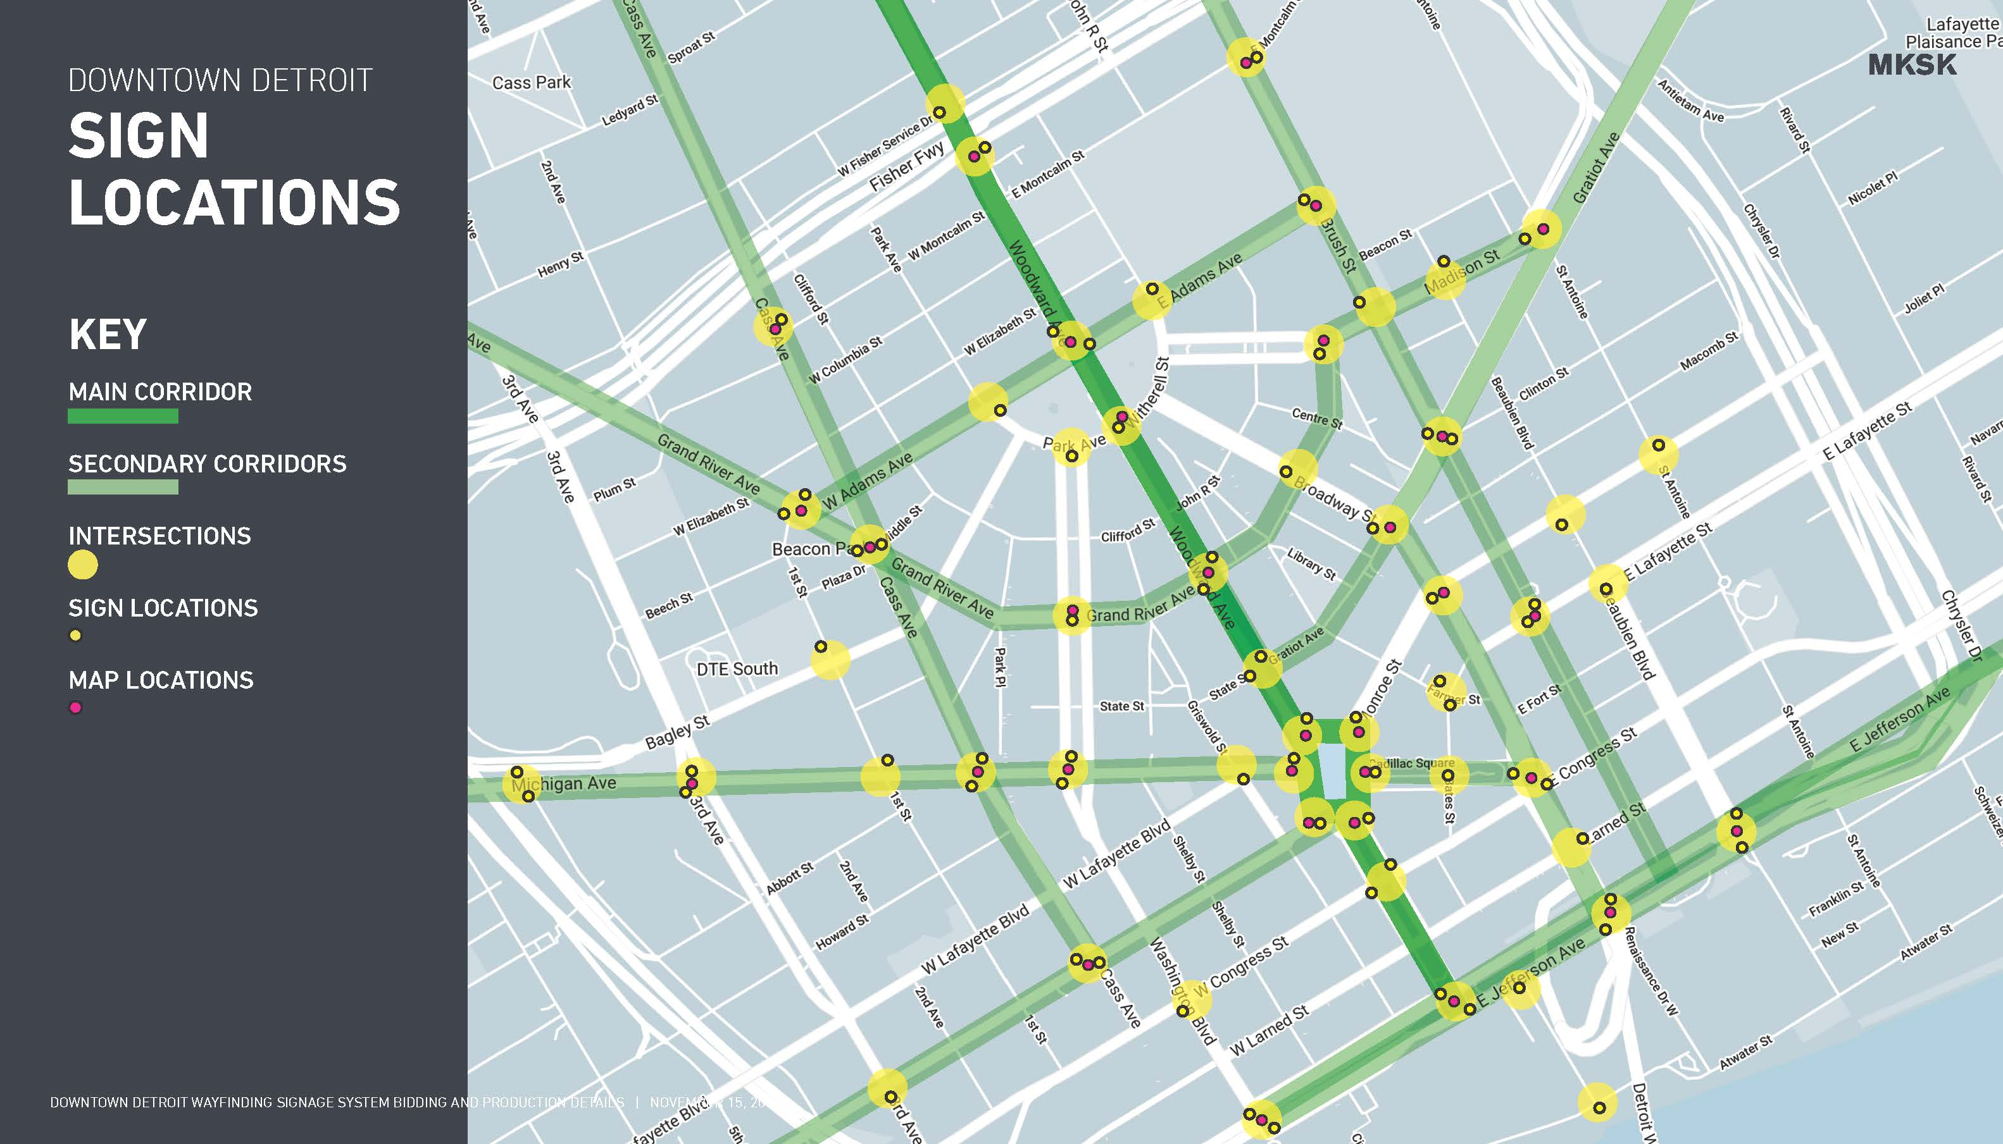
X
Notes:
1806: City of Detroit incorporated (before Michigan is admitted into the Union which happened in 1837)
1903: Ford Motor Company launched with $28,000 from 12 investors
1909: First mile of concrete highway paved along Woodward Avenue
1909: Ford Building, Detroit’s first modern skyscraper completed, at 23 stories tall
1912: Tiger Stadium opened as Navin Field, home to the Detroit Tigers and Lions
1923: General Motors relocated HQ to New Center along Grand Blvd
1929-1930: The Ambassador Bridge completed, connecting Detroit to Windsor, Canada; Detroit–Windsor Tunnel completed
1950 Population: 1,849,568 people (population peak)
1953: John C. Lodge Freeway/M-10 opened with the first full freeway-to-freeway interchange in U.S. at Edsel Ford Freeway/I-94
1955: Edsel Ford Freeway/I-94 completed to connect I-96 across Downtown to Russell Street
Highway construction is significant because it expanded Detroit accessibility to the metro area (suburb growth, population loss)

Slide 11
Phase 1
Notes:
1806: City of Detroit incorporated (before Michigan is admitted into the Union which happened in 1837)
1903: Ford Motor Company launched with $28,000 from 12 investors
1909: First mile of concrete highway paved along Woodward Avenue
1909: Ford Building, Detroit’s first modern skyscraper completed, at 23 stories tall
1912: Tiger Stadium opened as Navin Field, home to the Detroit Tigers and Lions
1923: General Motors relocated HQ to New Center along Grand Blvd
1929-1930: The Ambassador Bridge completed, connecting Detroit to Windsor, Canada; Detroit–Windsor Tunnel completed
1950 Population: 1,849,568 people (population peak)
1953: John C. Lodge Freeway/M-10 opened with the first full freeway-to-freeway interchange in U.S. at Edsel Ford Freeway/I-94
1955: Edsel Ford Freeway/I-94 completed to connect I-96 across Downtown to Russell Street
Highway construction is significant because it expanded Detroit accessibility to the metro area (suburb growth, population loss)

