Slide 1
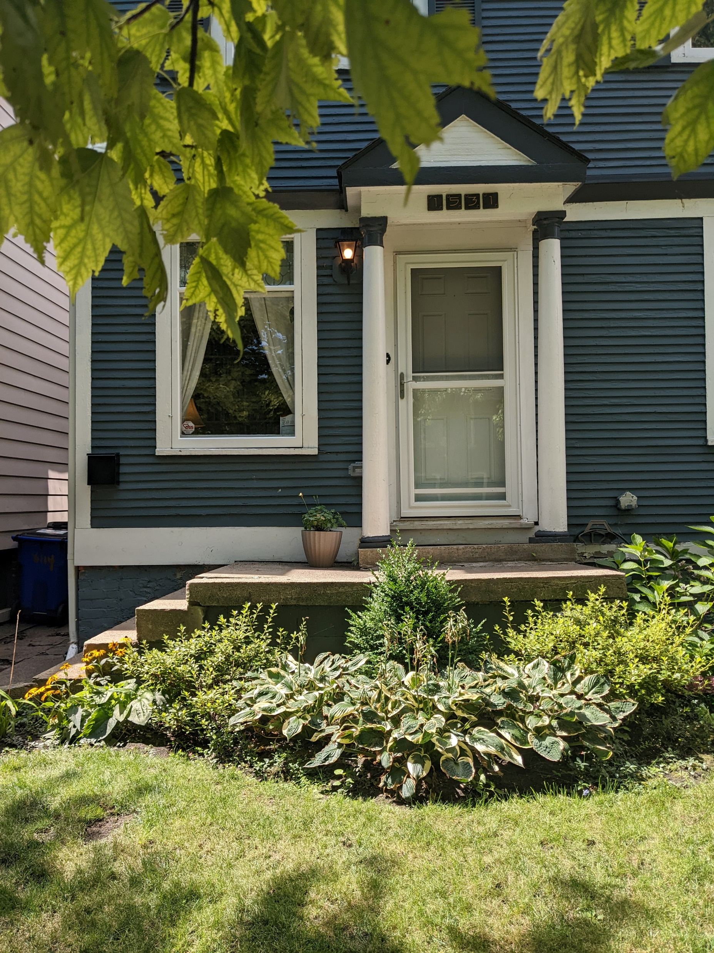
1531 Parker St
Current Front Porch

Slide 2
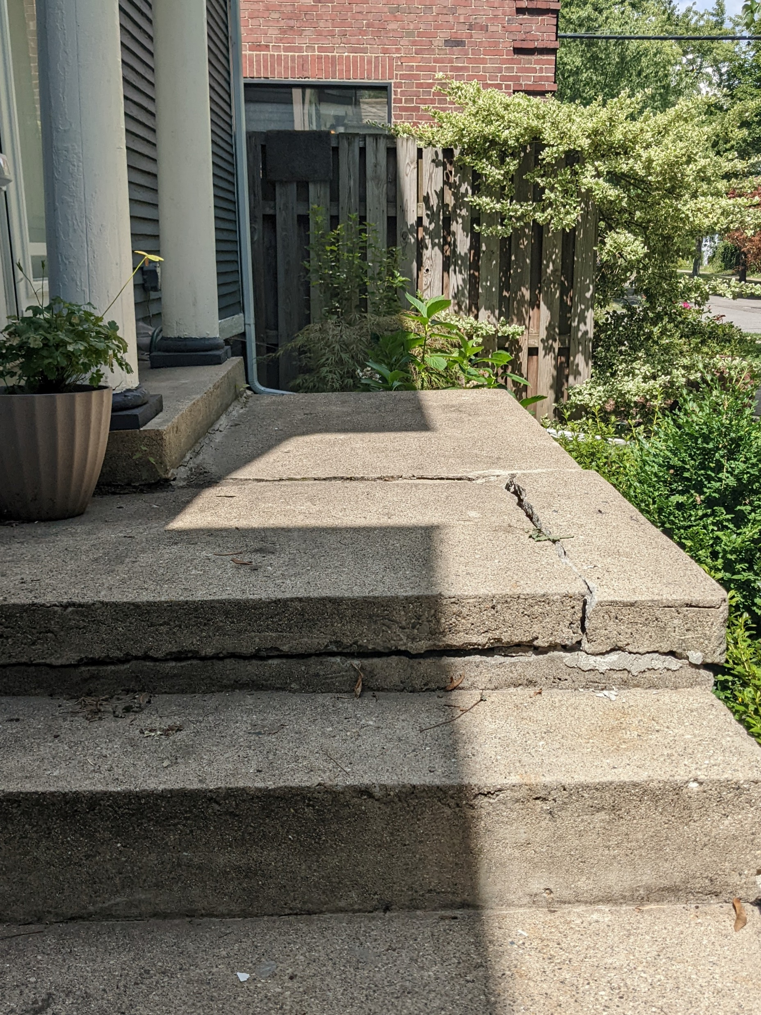
1531 Parker St
Current cracked front porch viewed from stairs

Slide 3
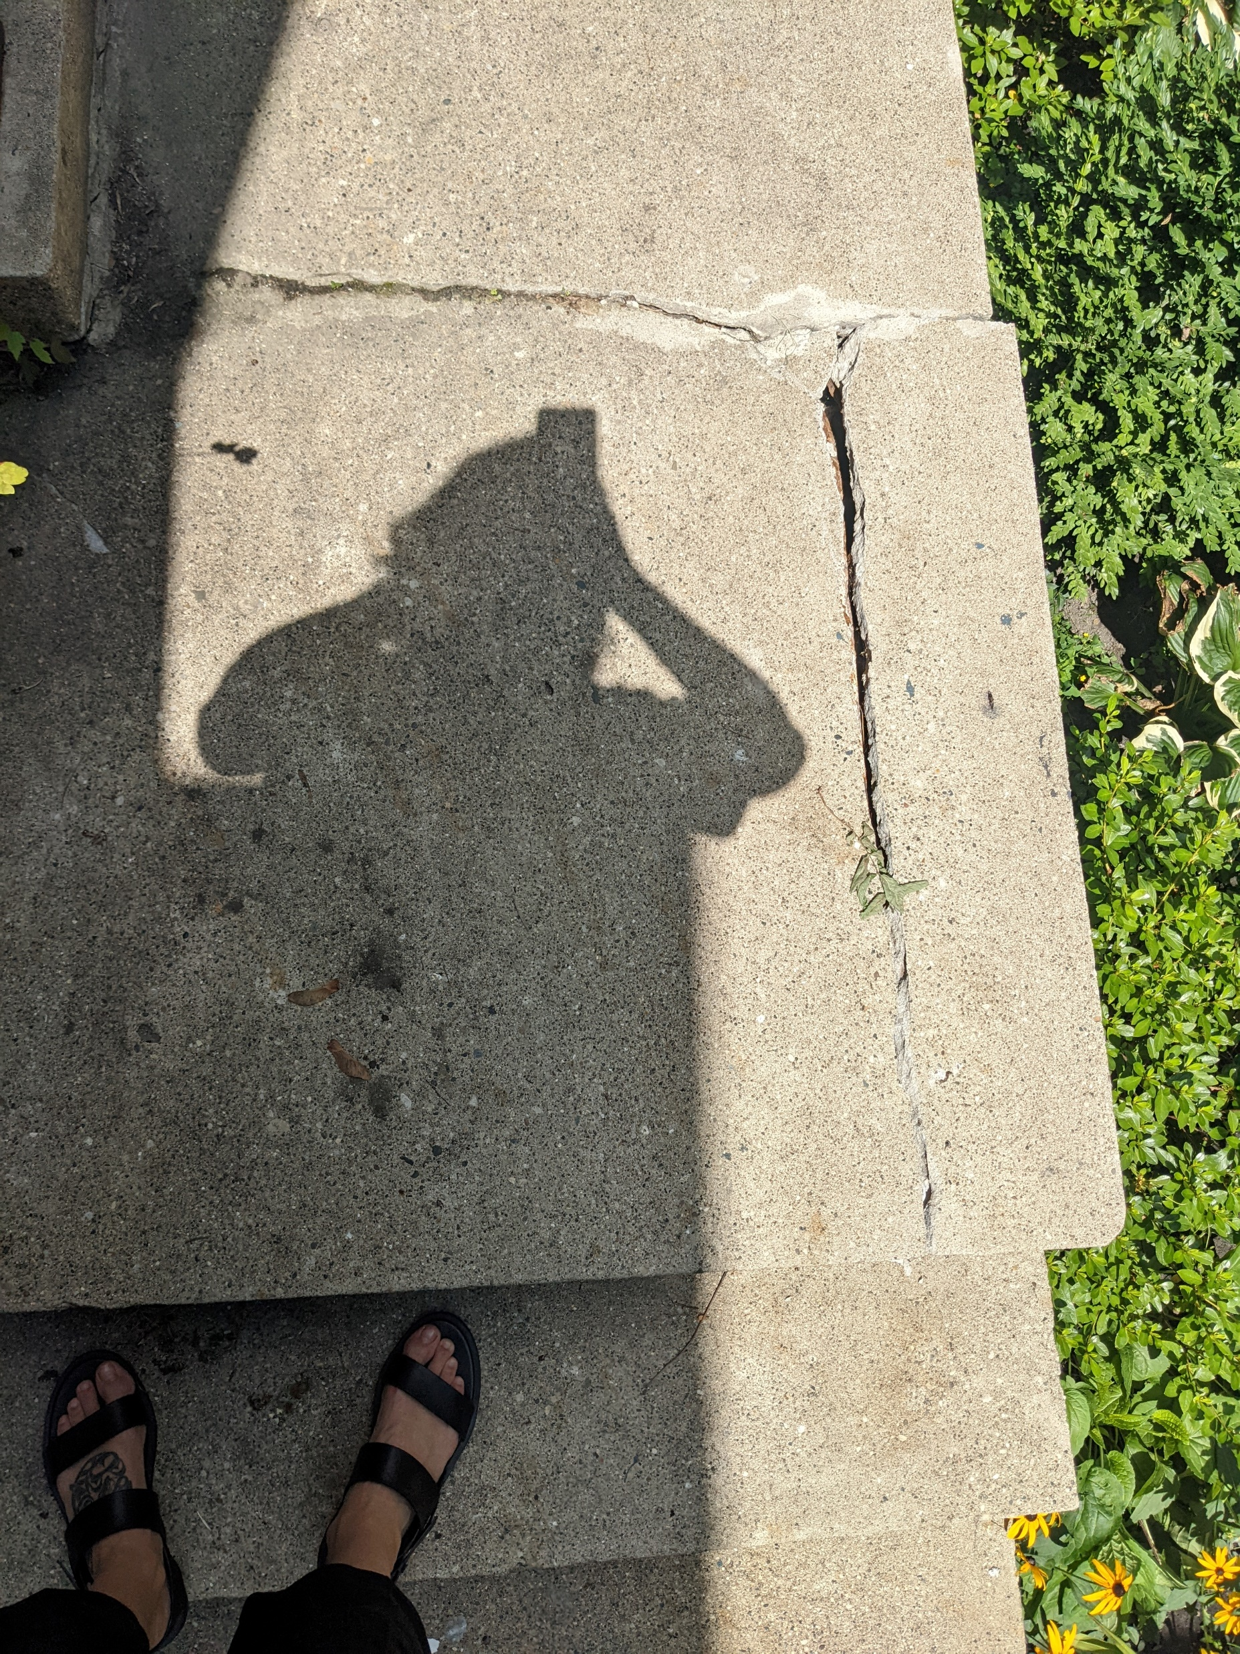
1531 Parker Street
Cracked patio viewed from above

Slide 4
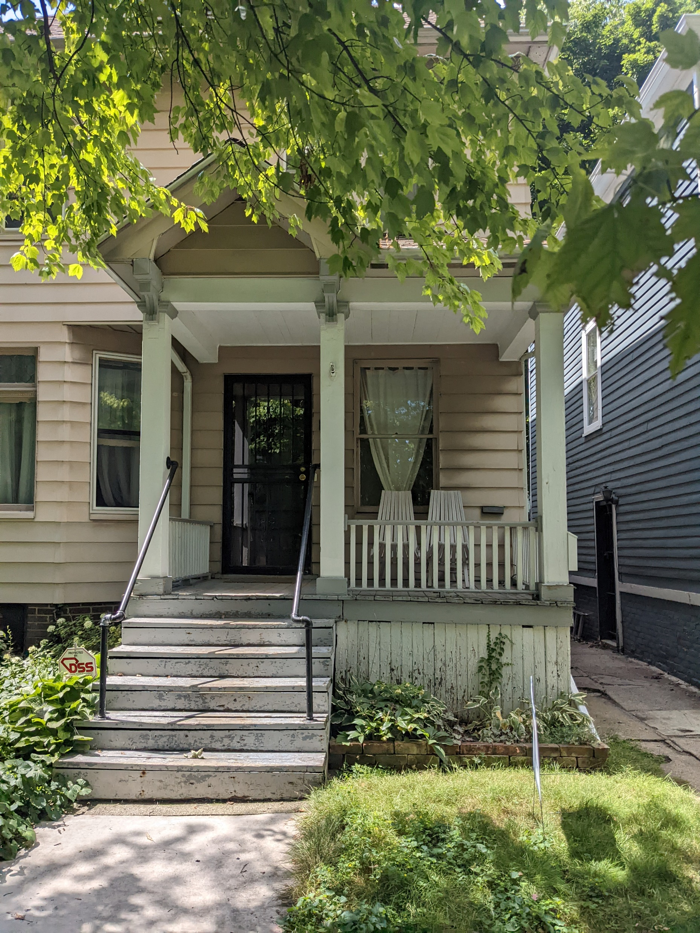
Neighbor’s wooden porch

Slide 5
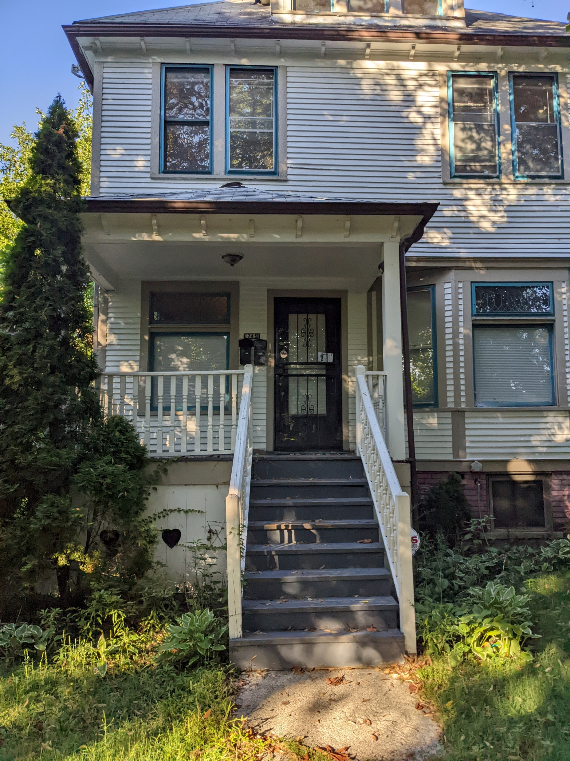
Another example of wooden porch on Parker Street

Slide 6
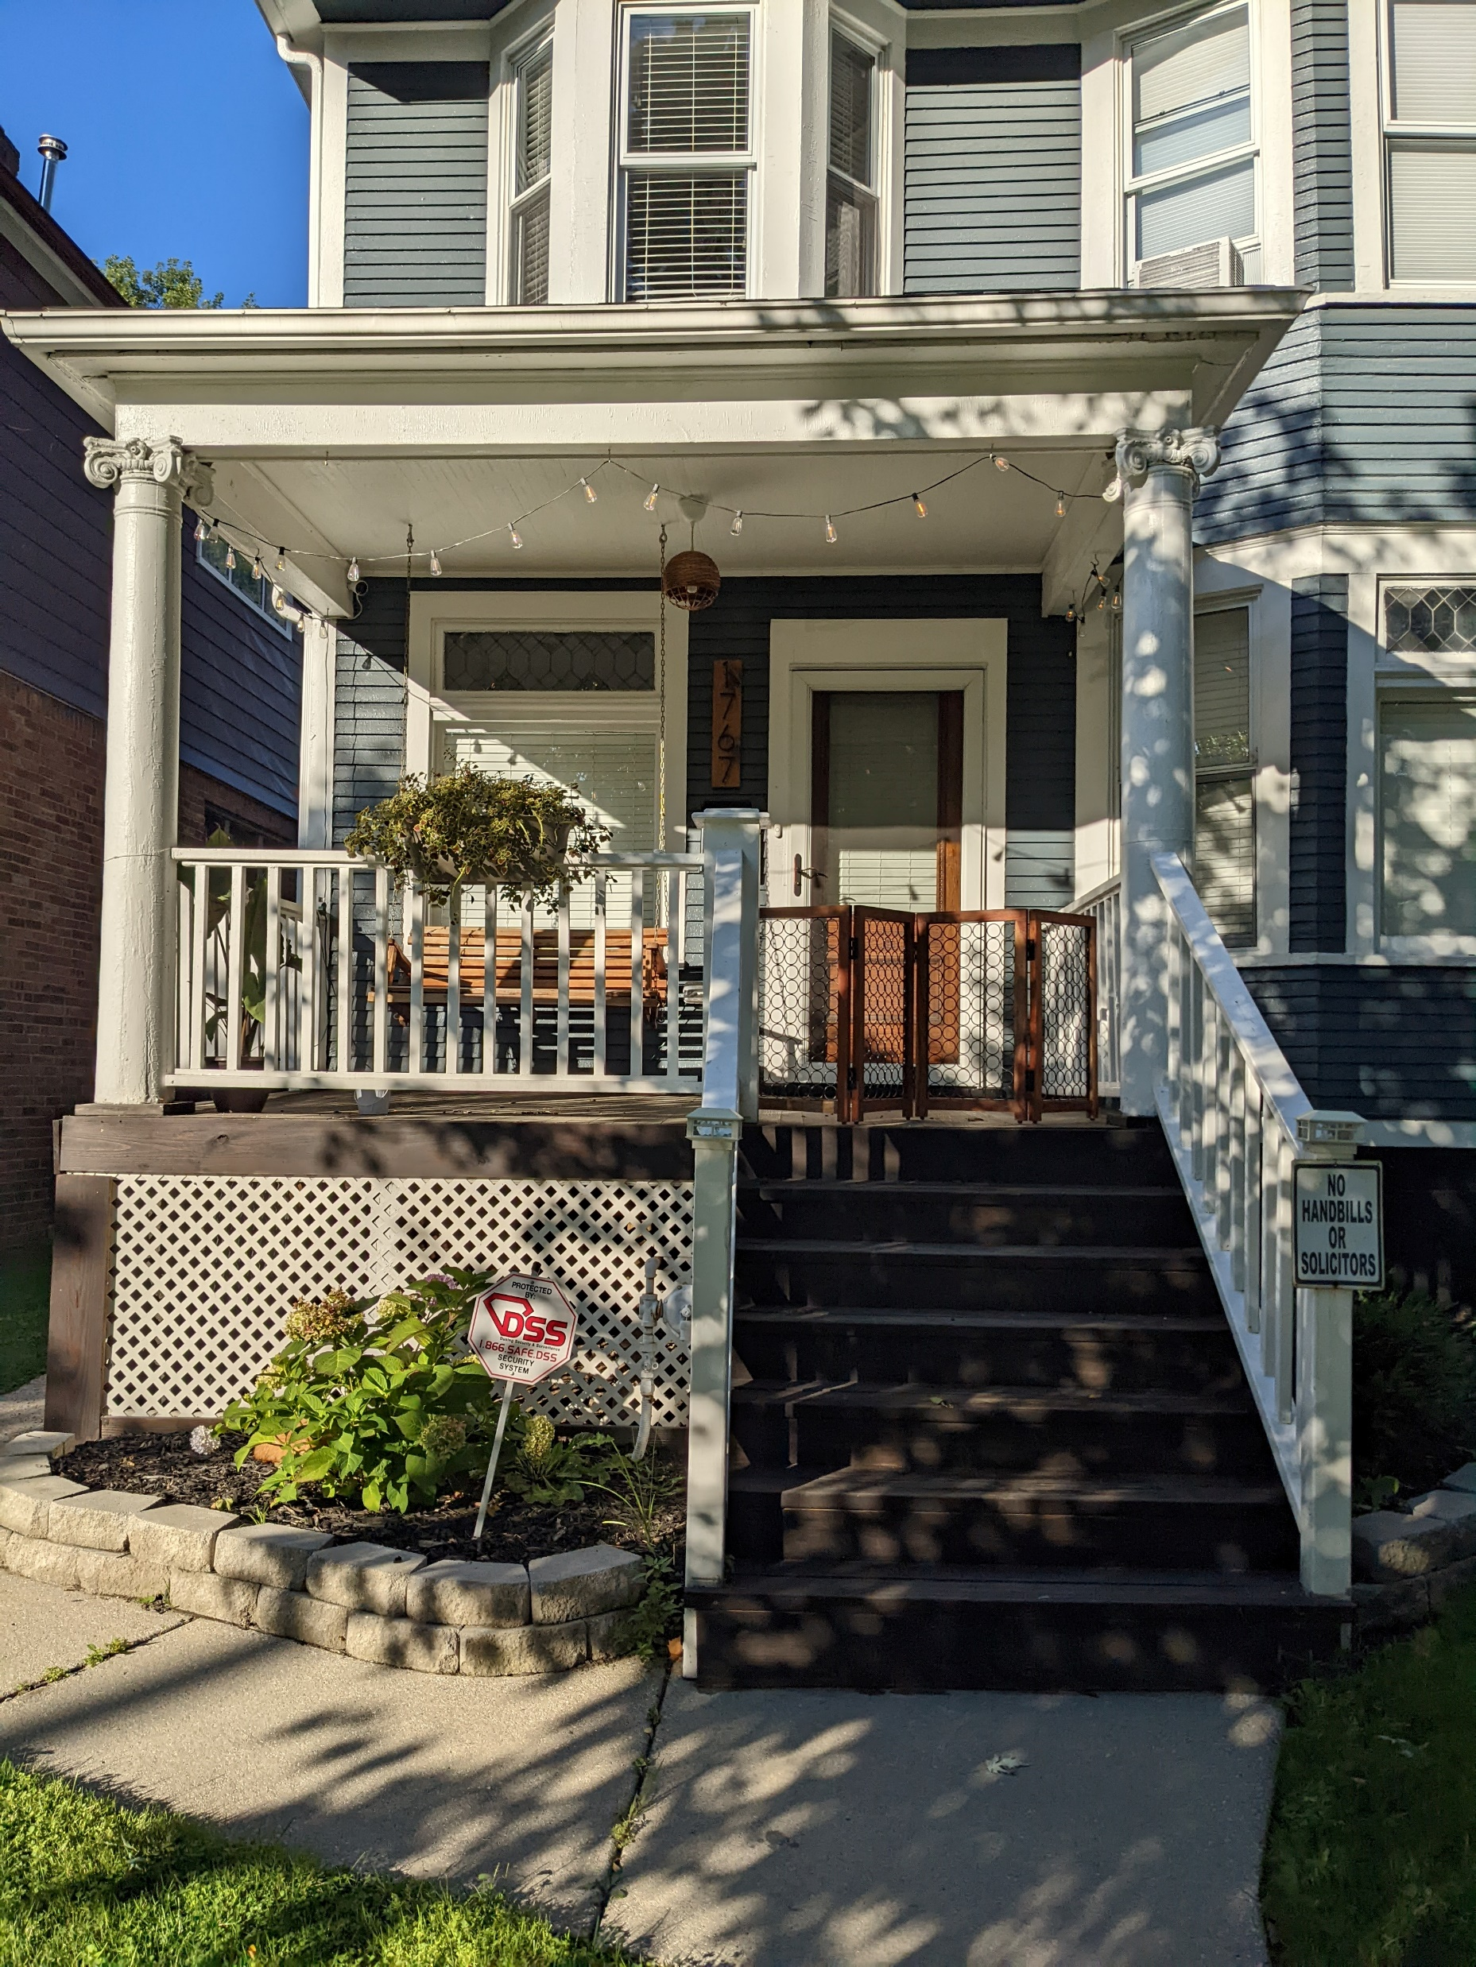
Another example of wooden porch on Parker Street

Slide 7
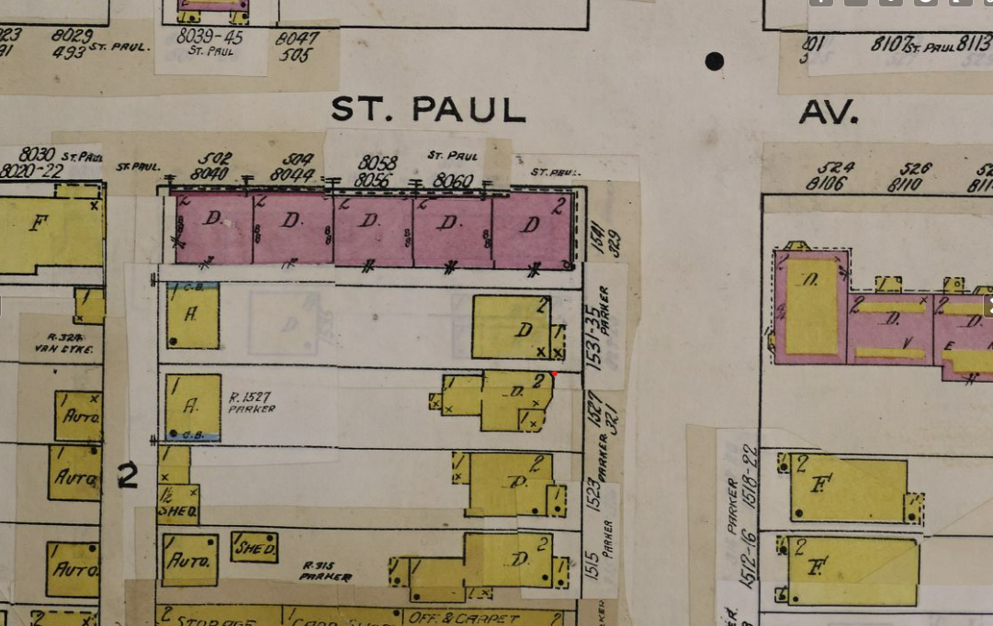
Sanborn Map ca. 1950 indicating original porch was likely made of wood

