Slide 1
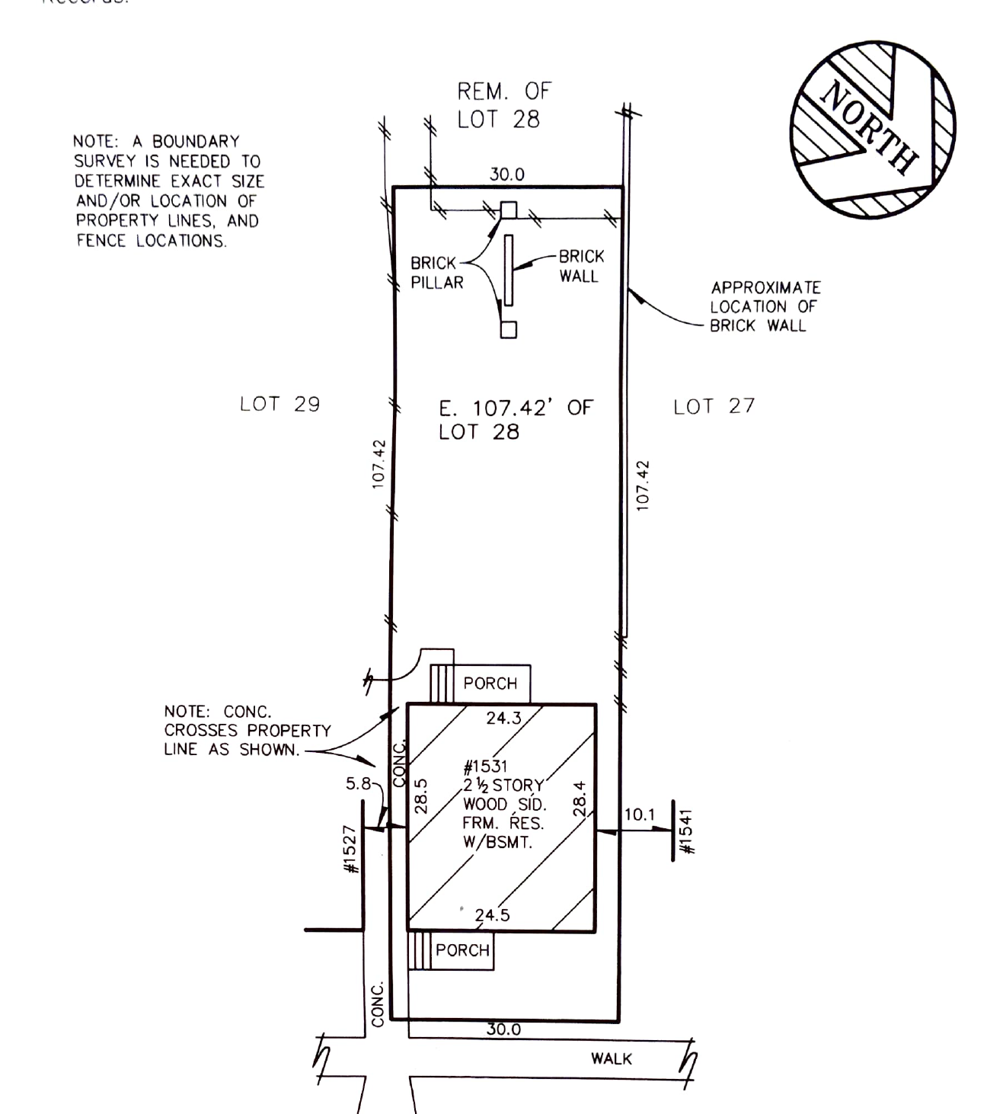
1531 Parker Street
Porch Proposal
Existing Porch
Update Proposal
Proposal:
Remove existing cinderblock and concrete Porch
Replace Porch With Wooden Porch
New Porch to maintain same footprint and height as existing porch
Move stairs to face walkway.
Plan to match atheistic of neighbors porches (without cover)
Dimensions and reference images noted on next page
Existing Porch Highlighted in red

Slide 2
4
5
2.5
12
4.5
2
28 in.
4
12

