Slide 1
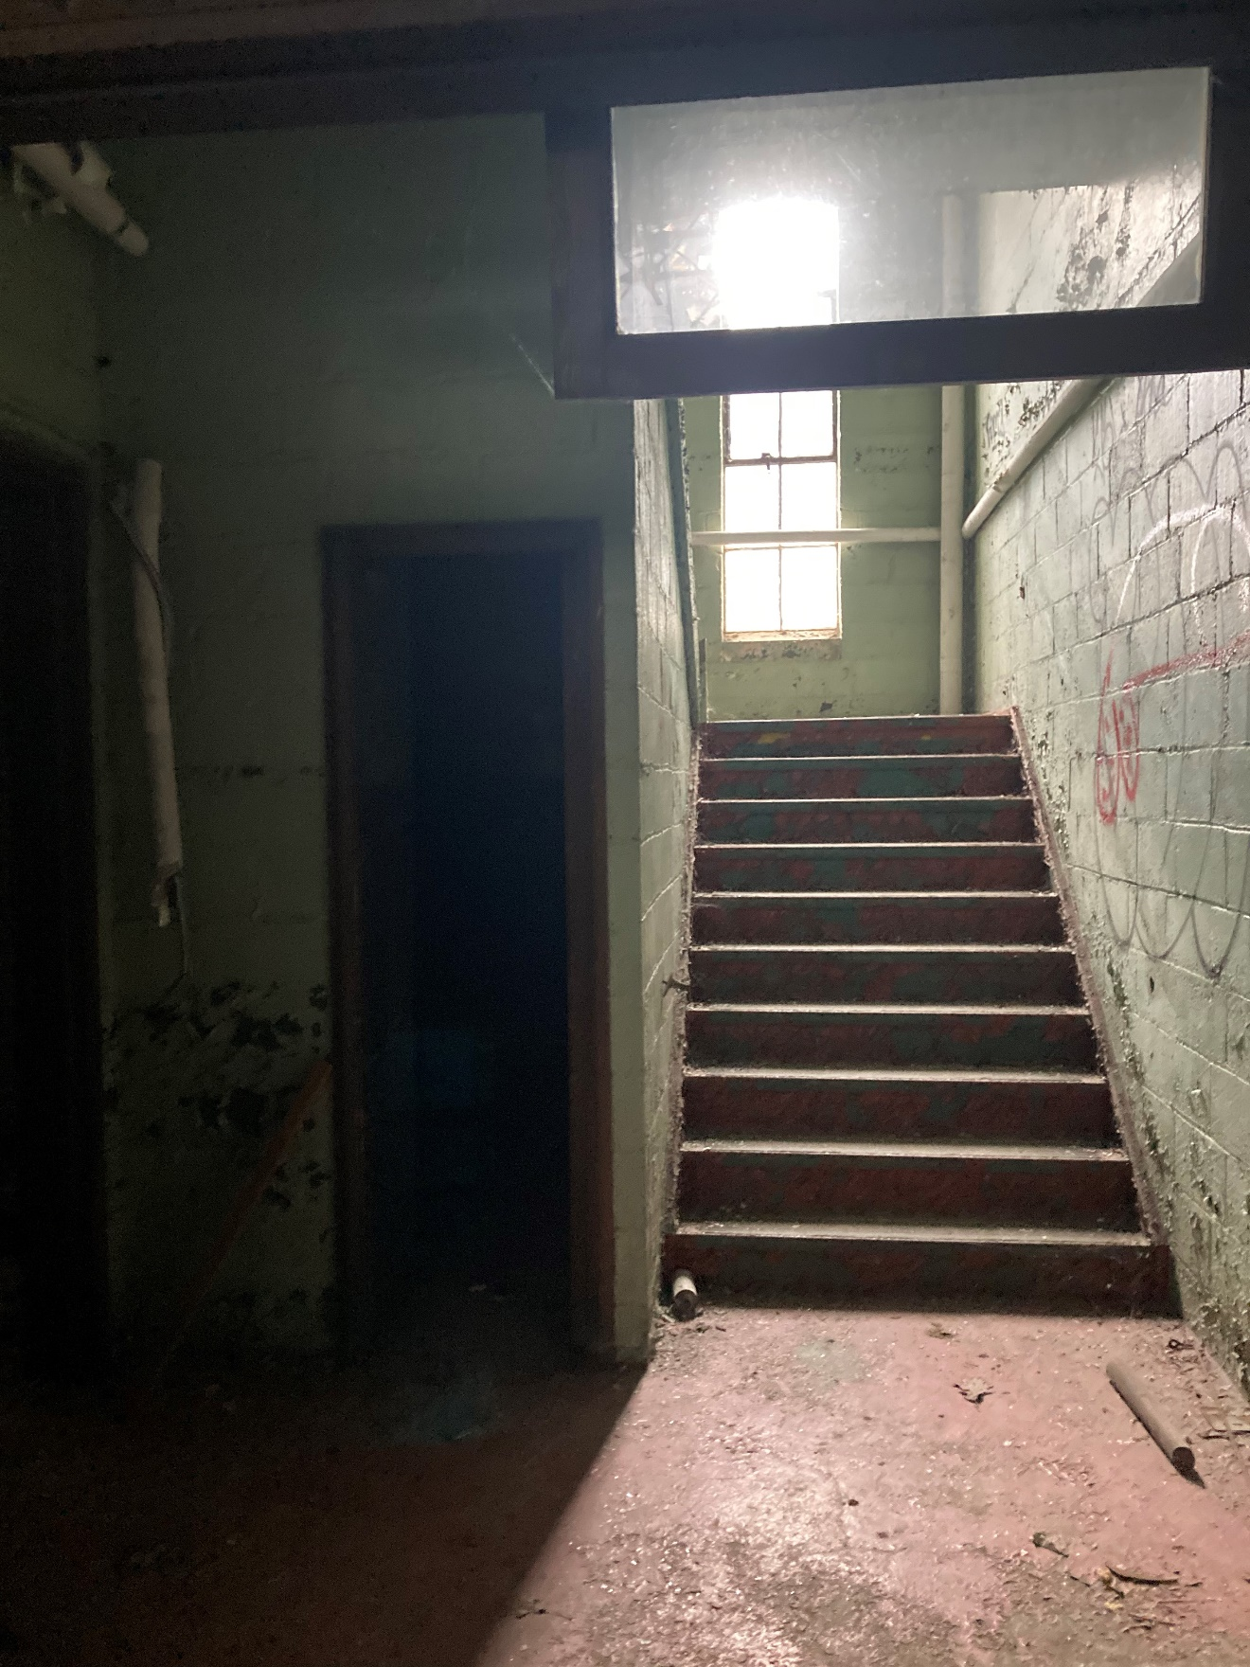
Figure #37: Interior, North Block, Stair. 2022

Slide 2
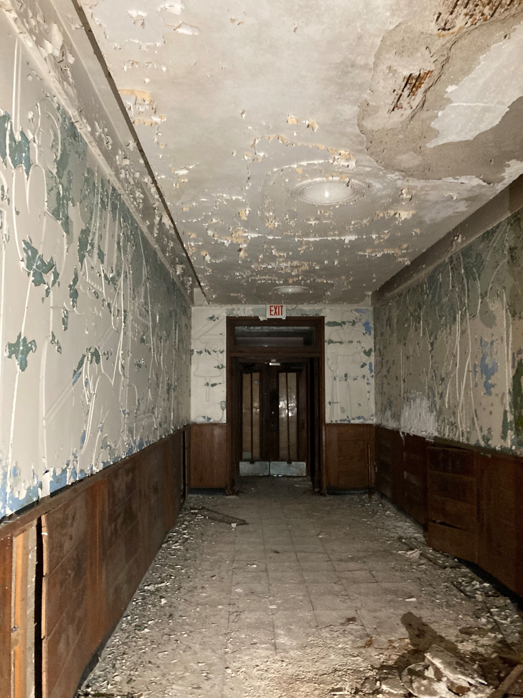
Figure #38: Interior, South Block, Hildebrand Murals. 2022

Slide 3
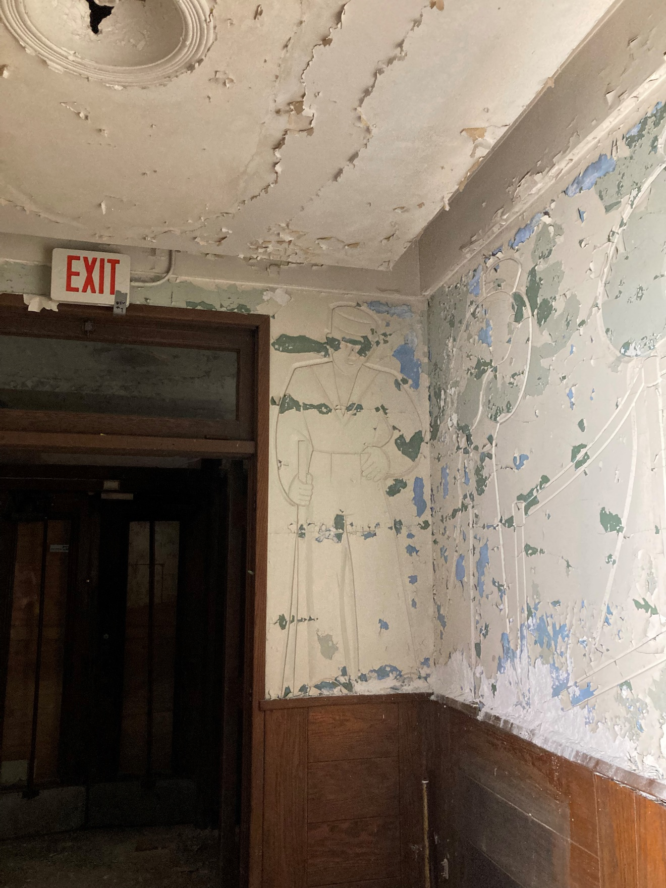
Figure #39: Interior, South Block, Hildebrand Murals. 2022

Slide 4
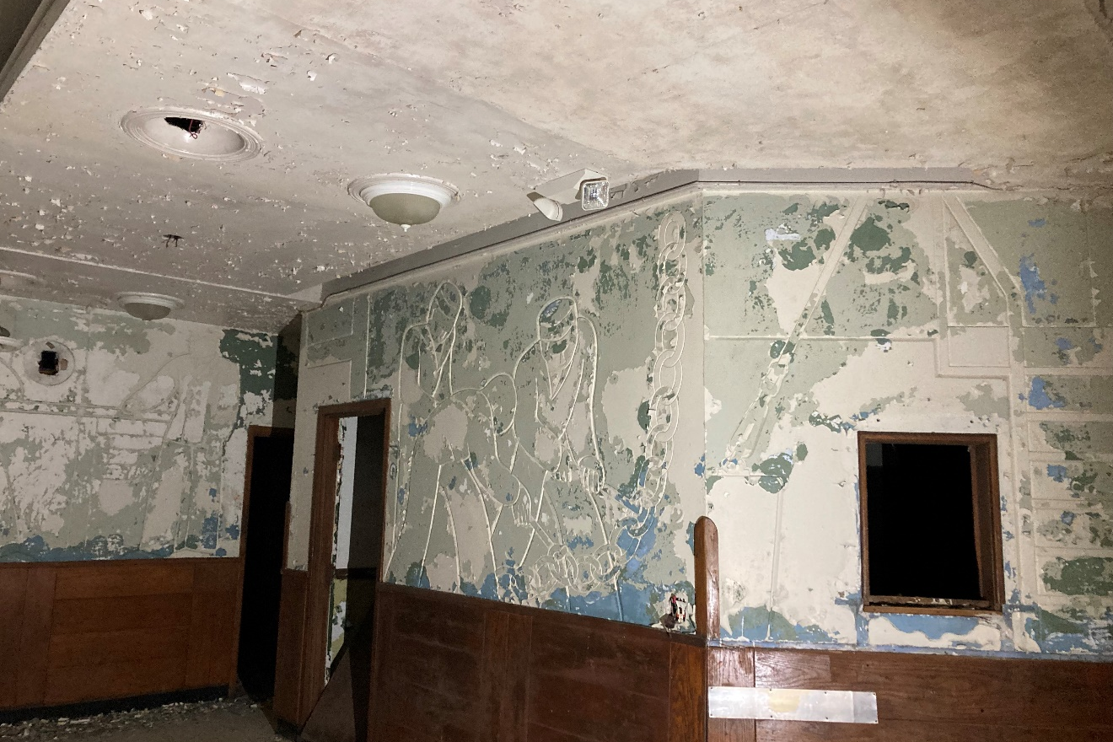
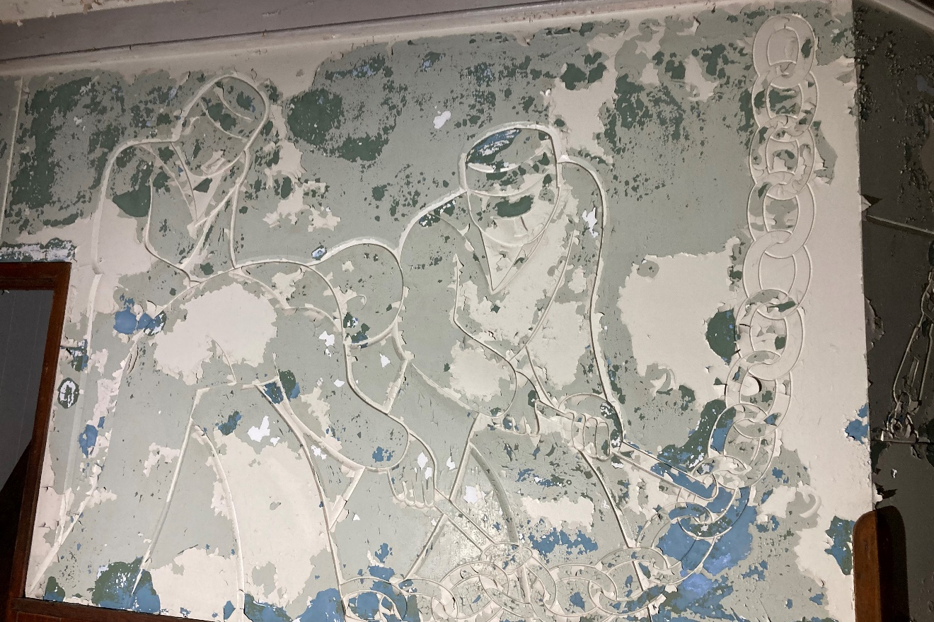
Figure #40: Interior, South Block, Hildebrand Murals. 2022.
Figure #41: Interior, South Block, Hildebrand Murals. 2022

Slide 5
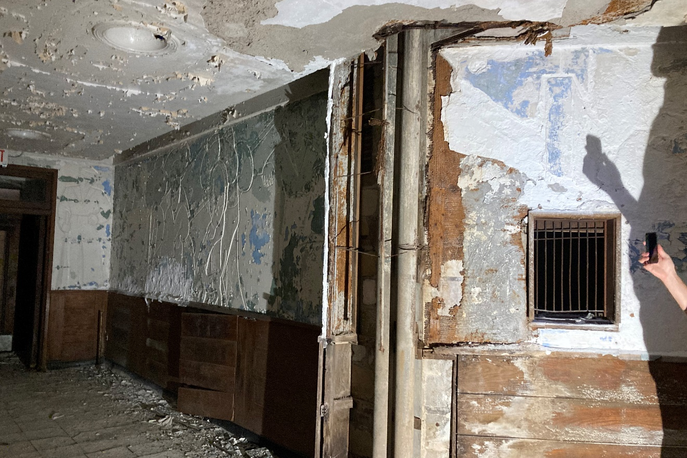
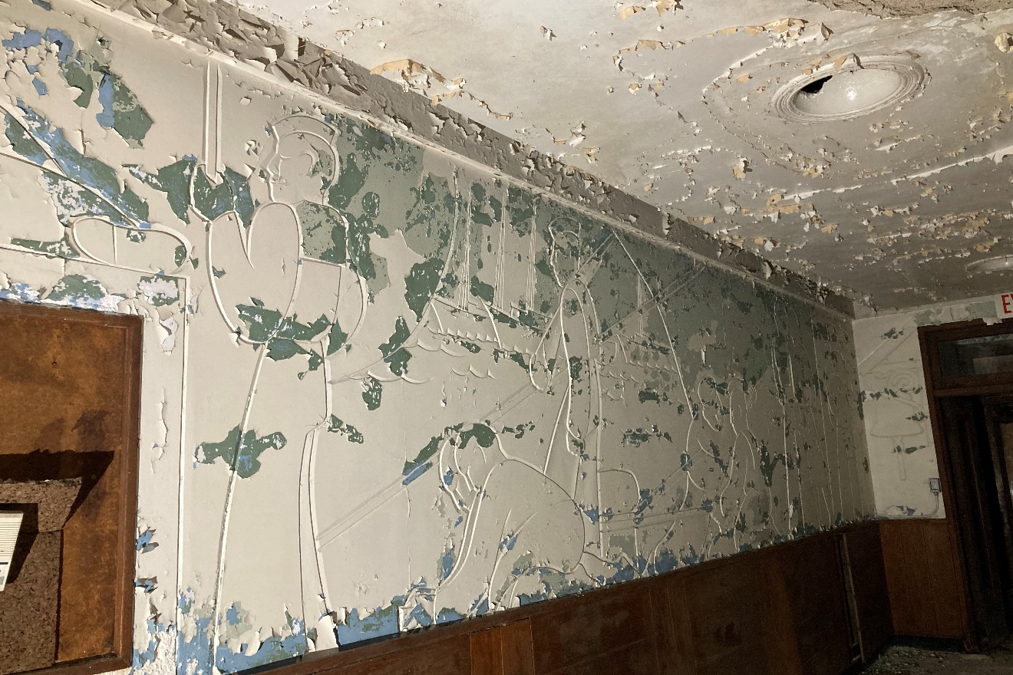
Figure #42: Interior, South Block, Hildebrand Murals. 2022
Figure #43: Interior, South Block, Hildebrand Murals. 2022

Slide 6
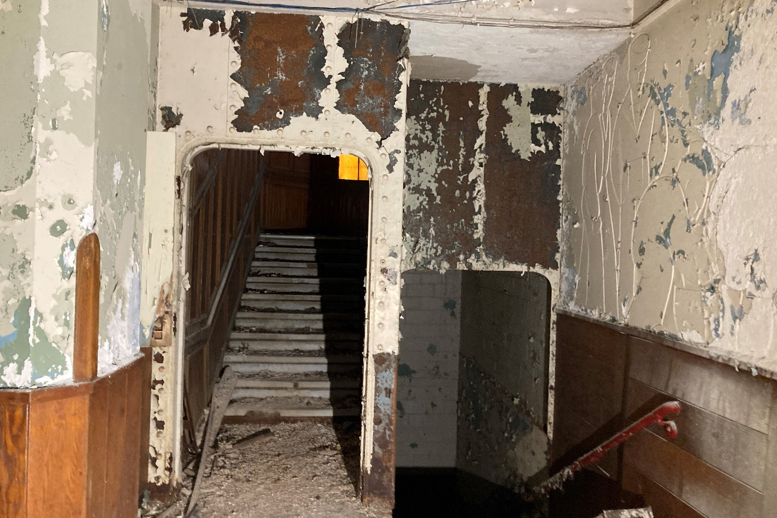
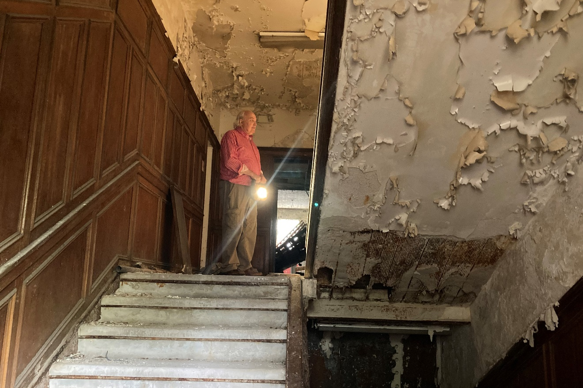
Figure #44: Interior, South Block, Bulkhead and staircase. 2022
Figure #45: Interior, South Block, Staircase. 2022

Slide 7
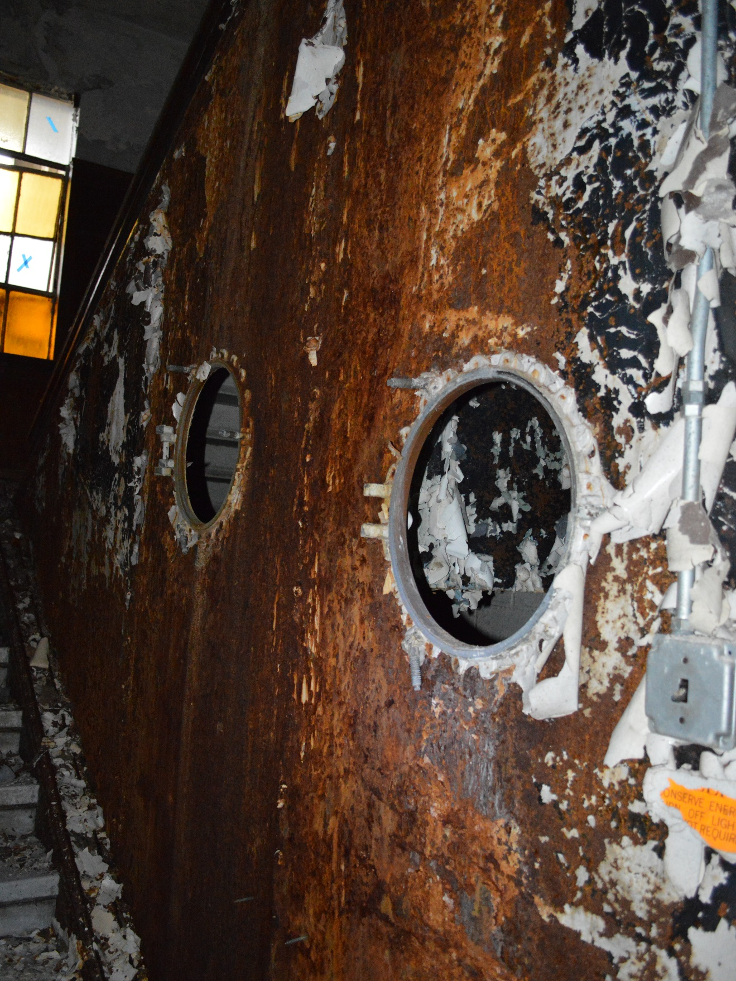
Figure #46: Interior, South Block, Bulkhead Wall. 2022

Slide 8
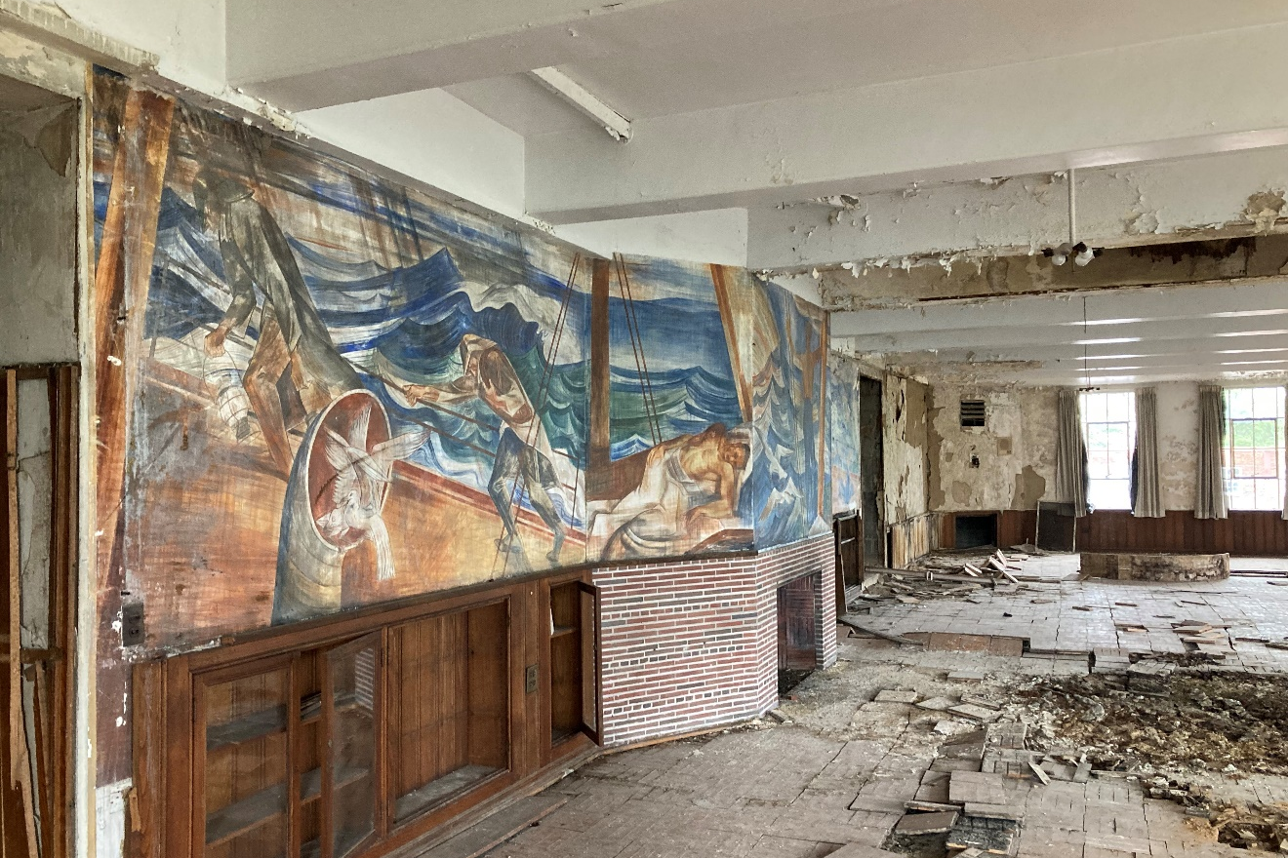
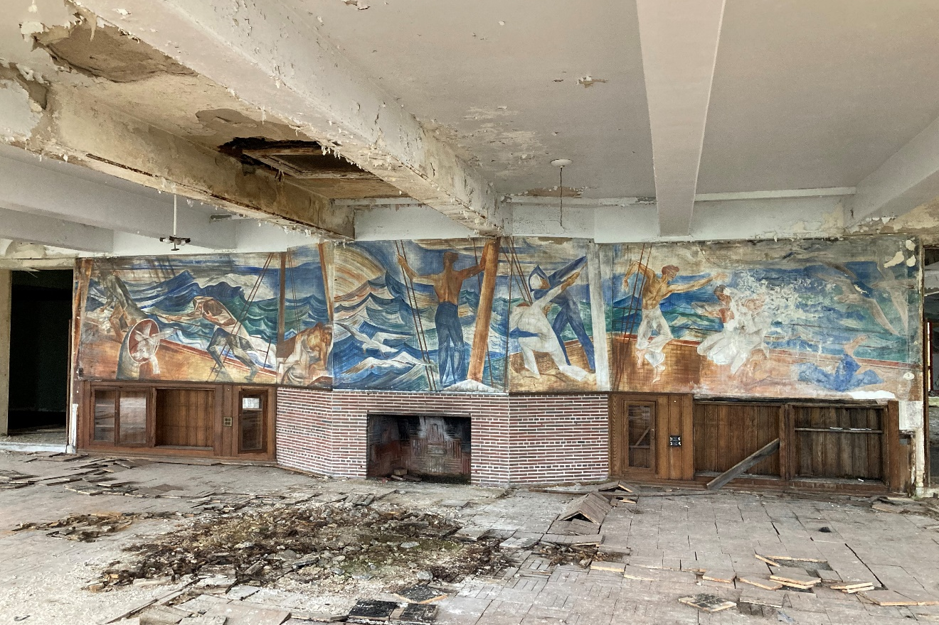
Figure #47: Interior, South Block, Wardroom, Fredenthal Mural. 2022
Figure #48: Interior, South Block, Wardroom, Fredenthal Mural. 2022

Slide 9
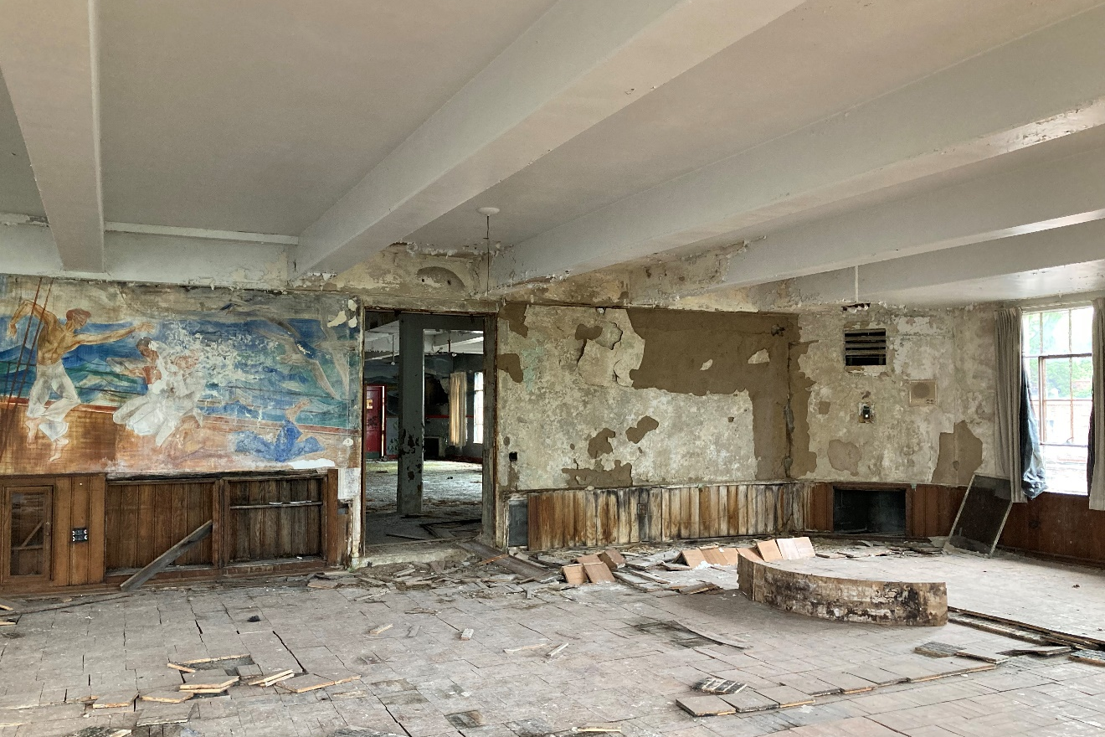
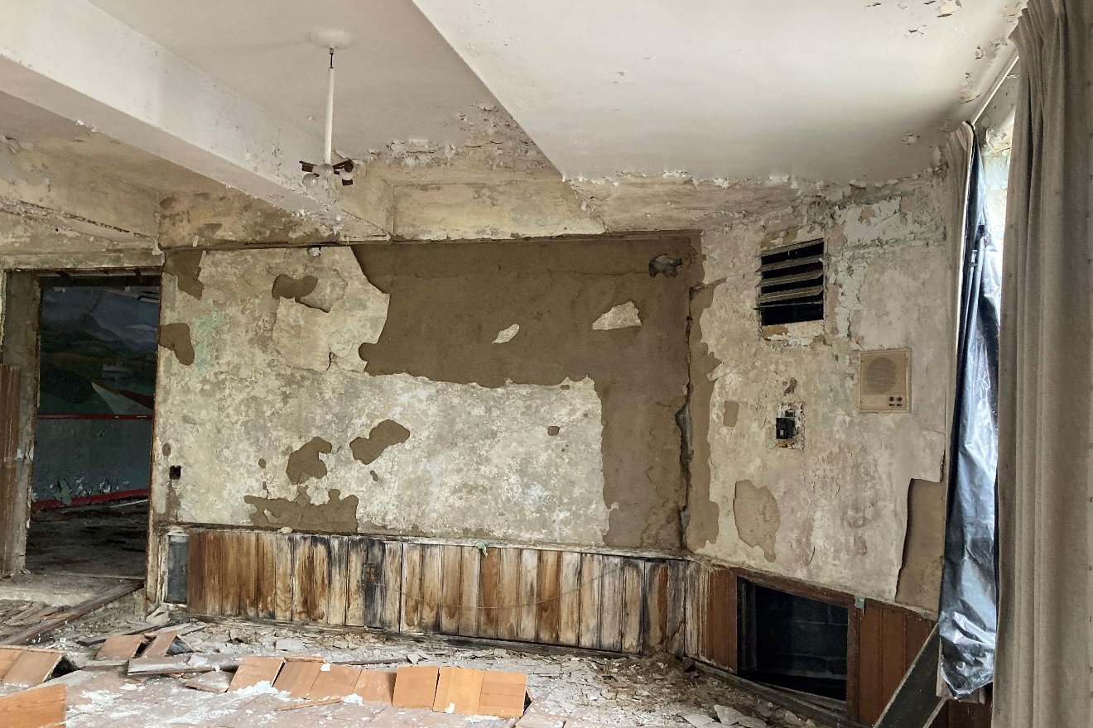
Figure #48: Interior, South Block, Wardroom, Fredenthal Mural. 2022
Figure #49: Interior, South Block, Wardroom, Fredenthal Mural. 2022

Slide 10
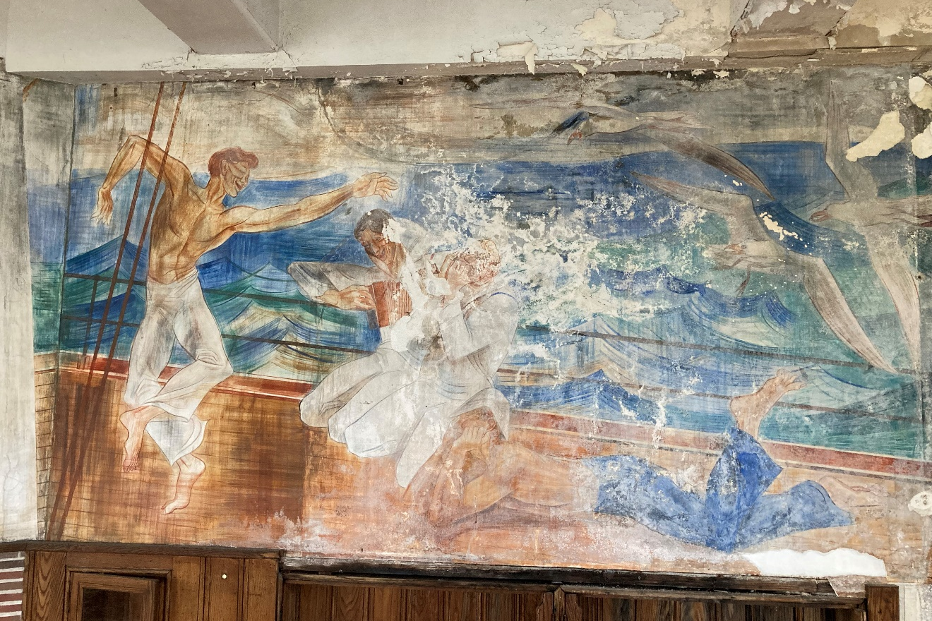
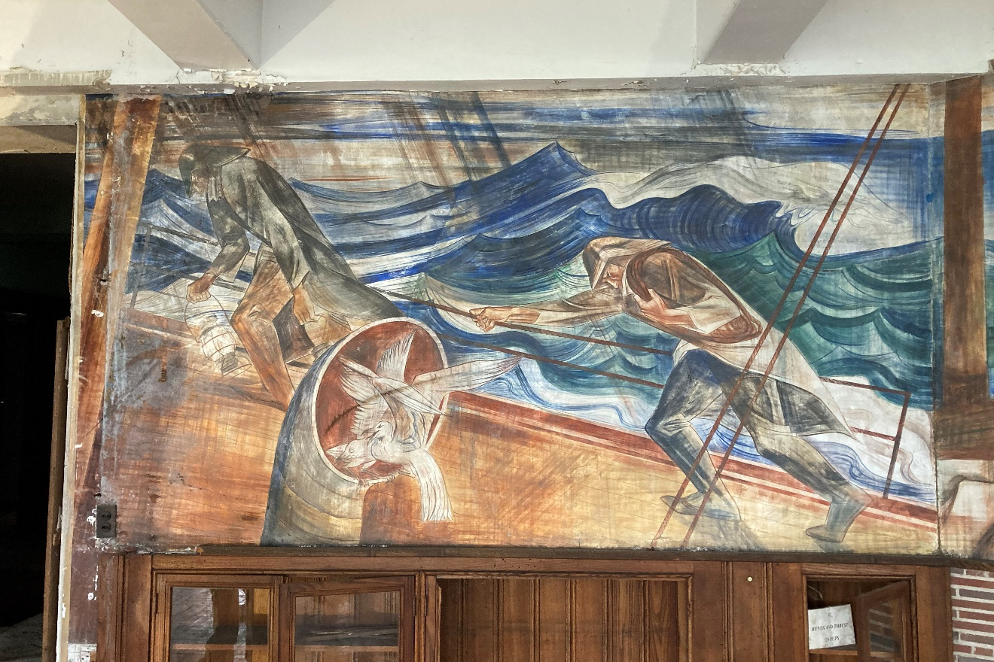
Figure #50: Interior, South Block, Wardroom, Fredenthal Mural. 2022
Figure #51: Interior, South Block, Wardroom, Fredenthal Mural. 2022

Slide 11
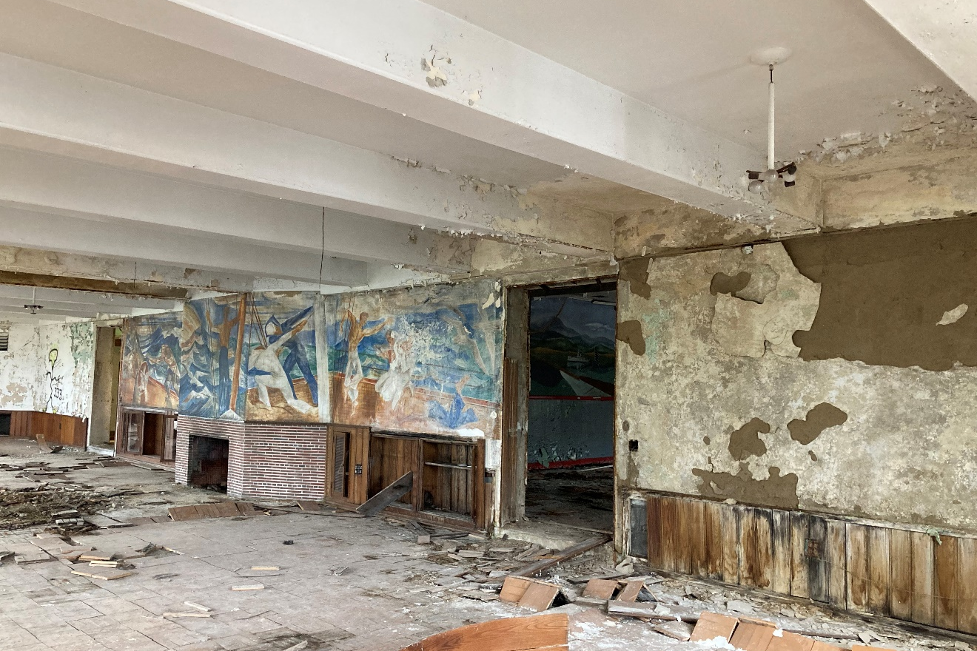
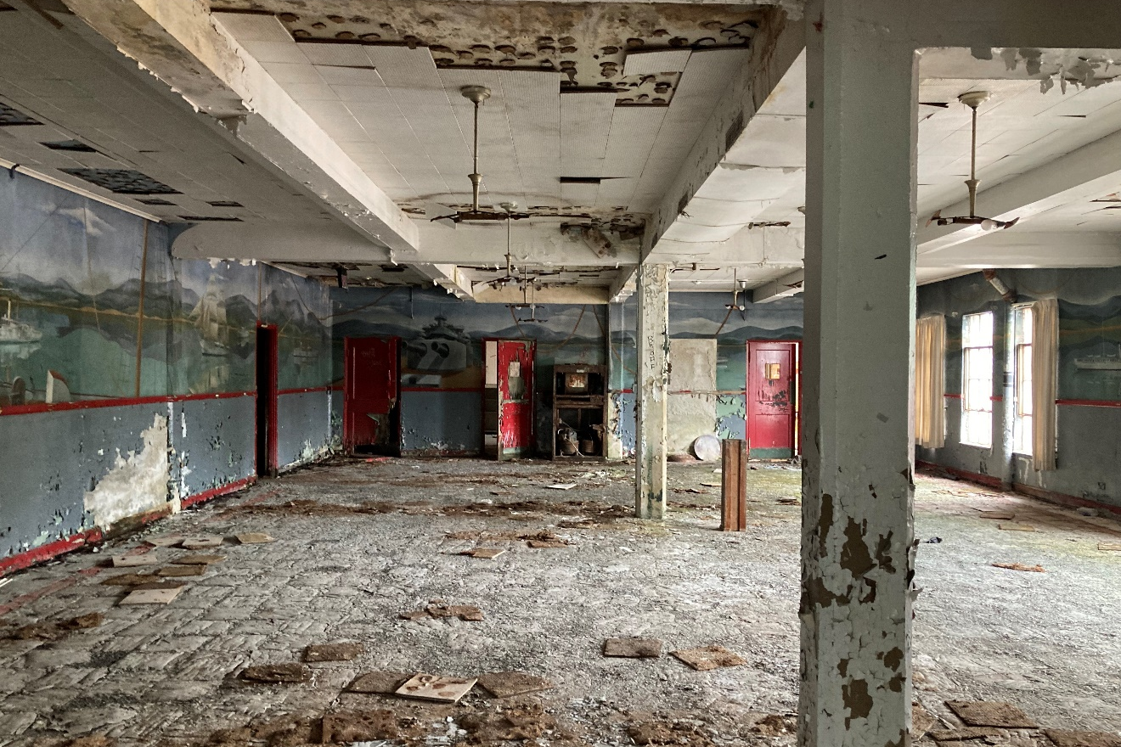
Figure #52: Interior, South Block, Wardroom, Fredenthal Mural. 2022
Figure #53: Interior, South Block, Dining Room, Yaeger Mural. 2022

Slide 12
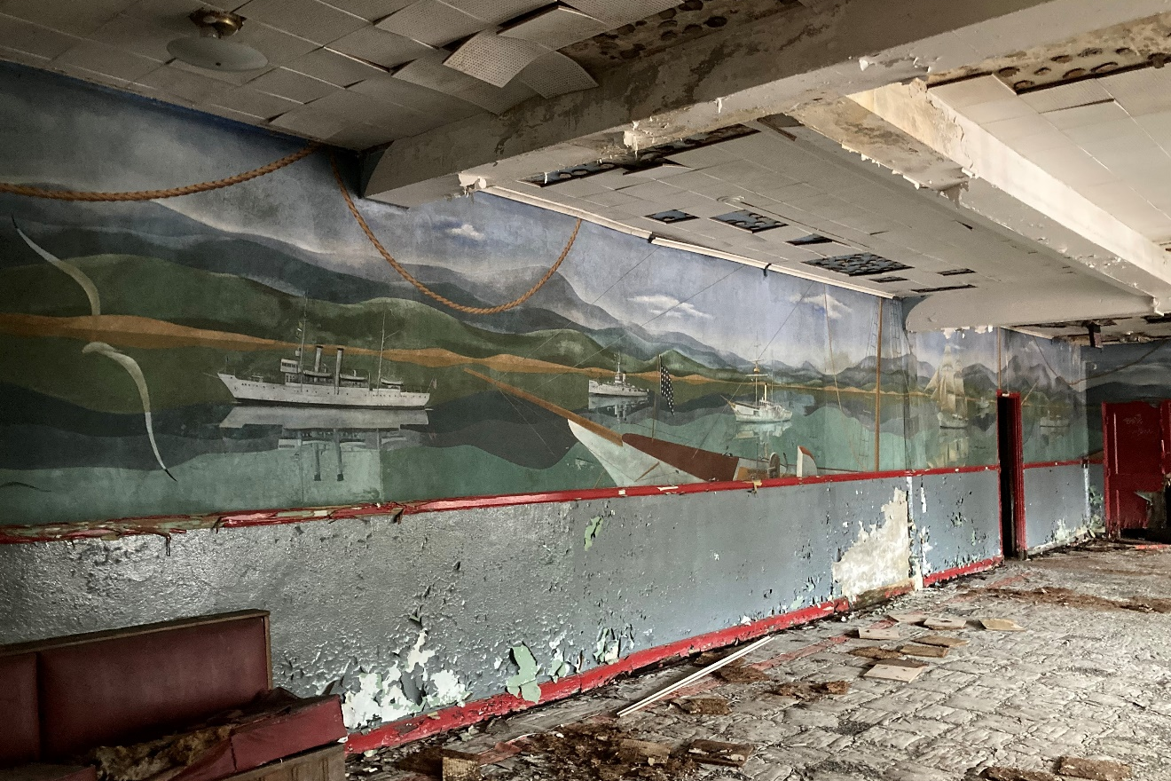
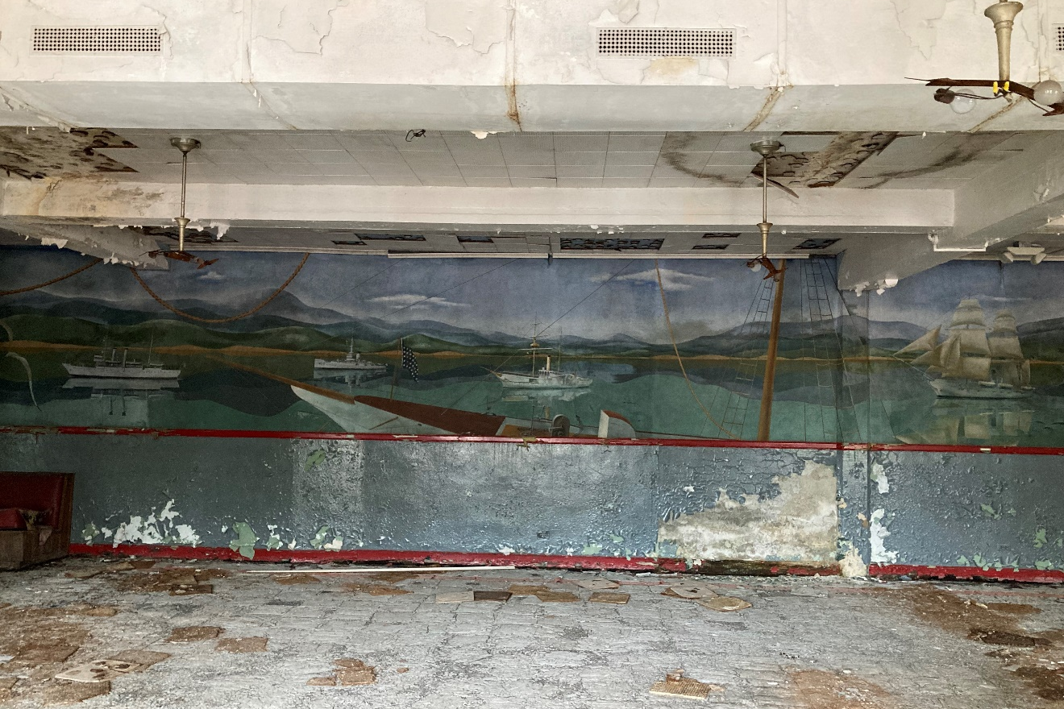
Figure #54: Interior, South Block, Dining Room, Yaeger Mural. 2022
Figure #55: Interior, South Block, Dining Room, Yaeger Mural. 2022

Slide 13
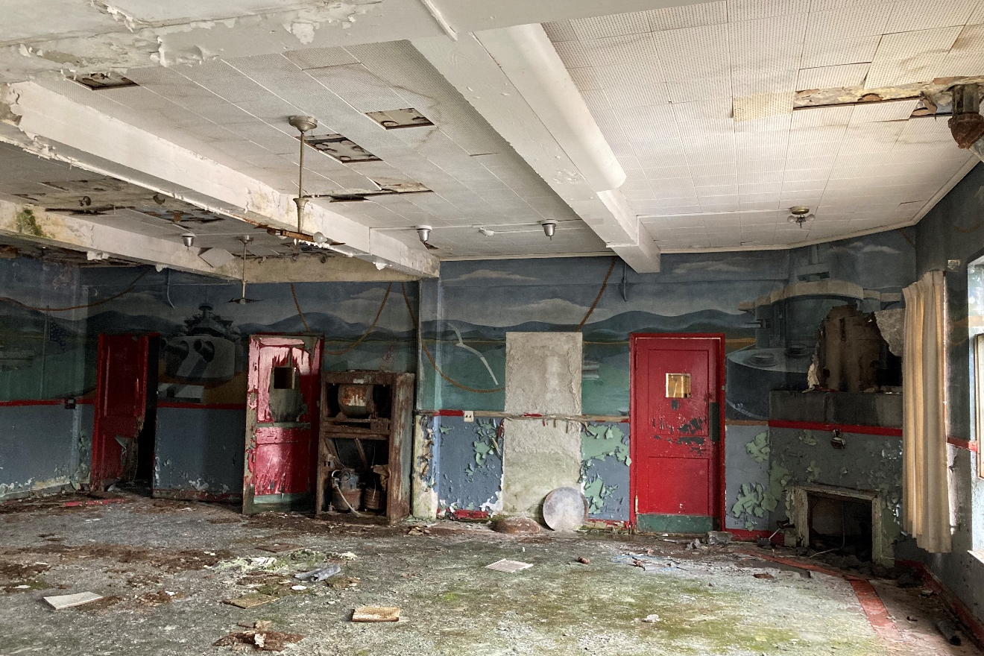
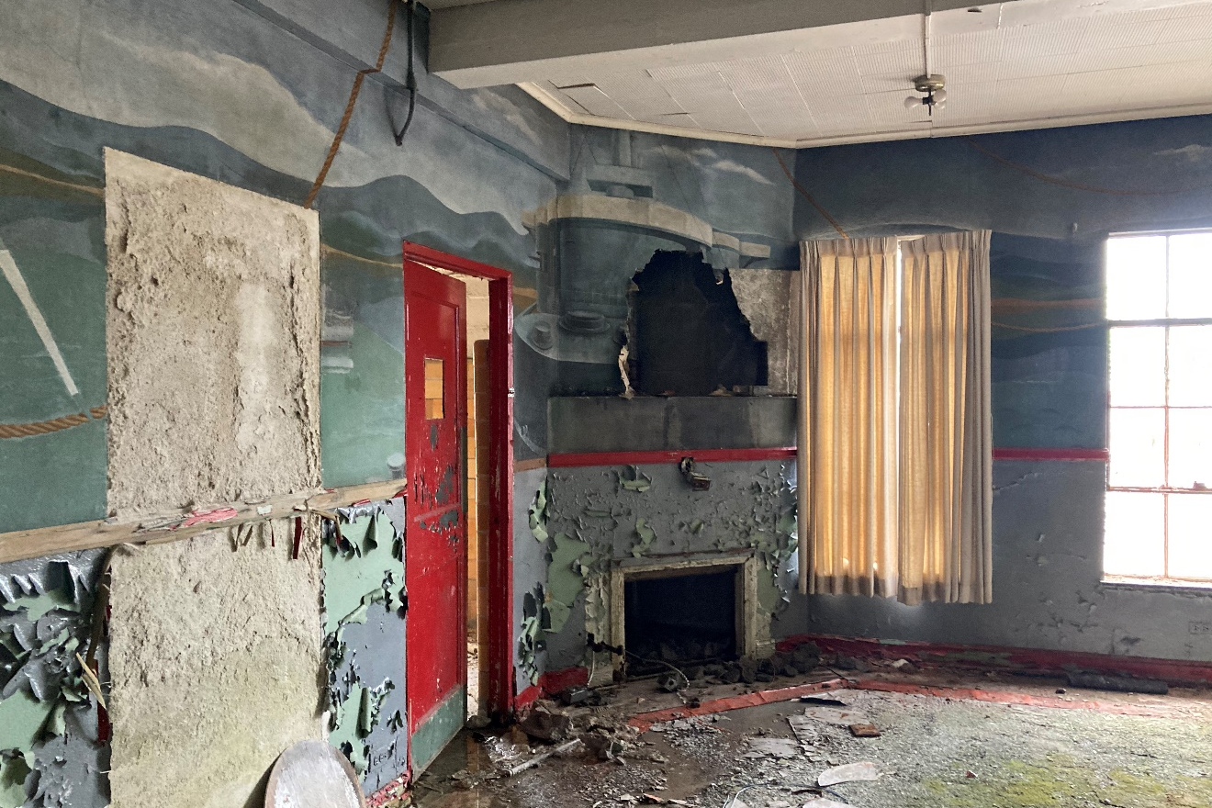
Figure #56: Interior, South Block, Dining Room, Yaeger Mural. 2022
Figure #57: Interior, South Block, Dining Room, Yaeger Mural. 2022

Slide 14
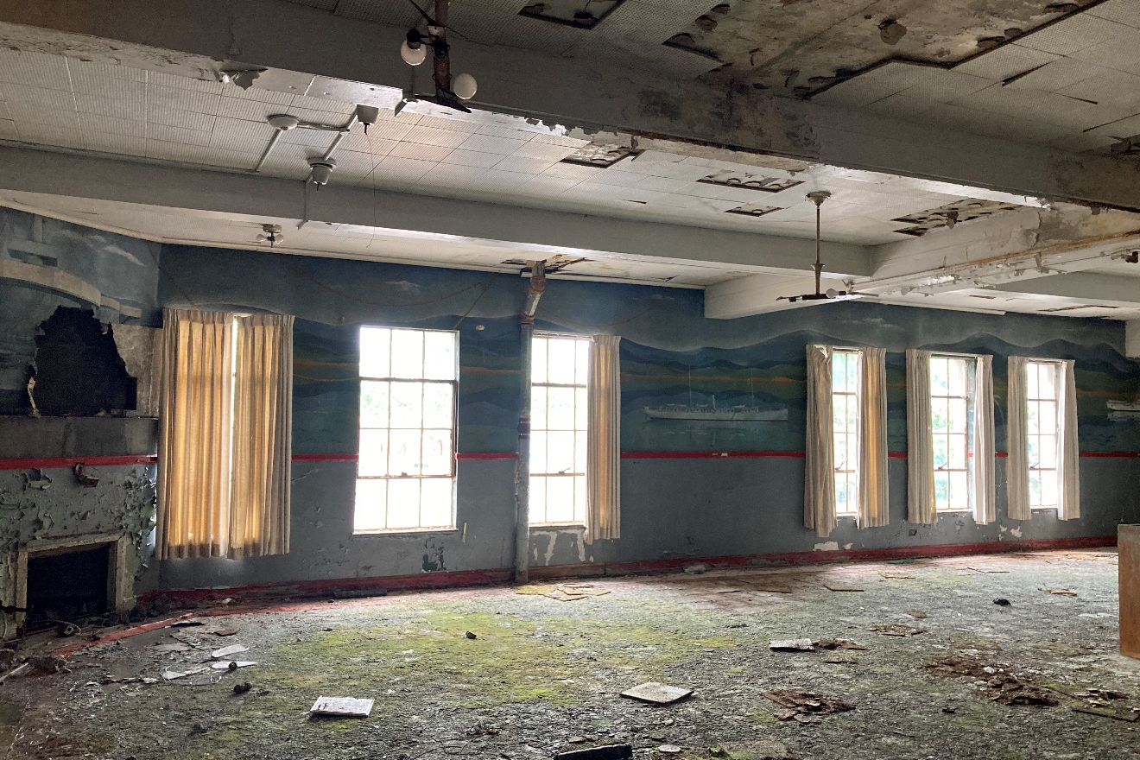
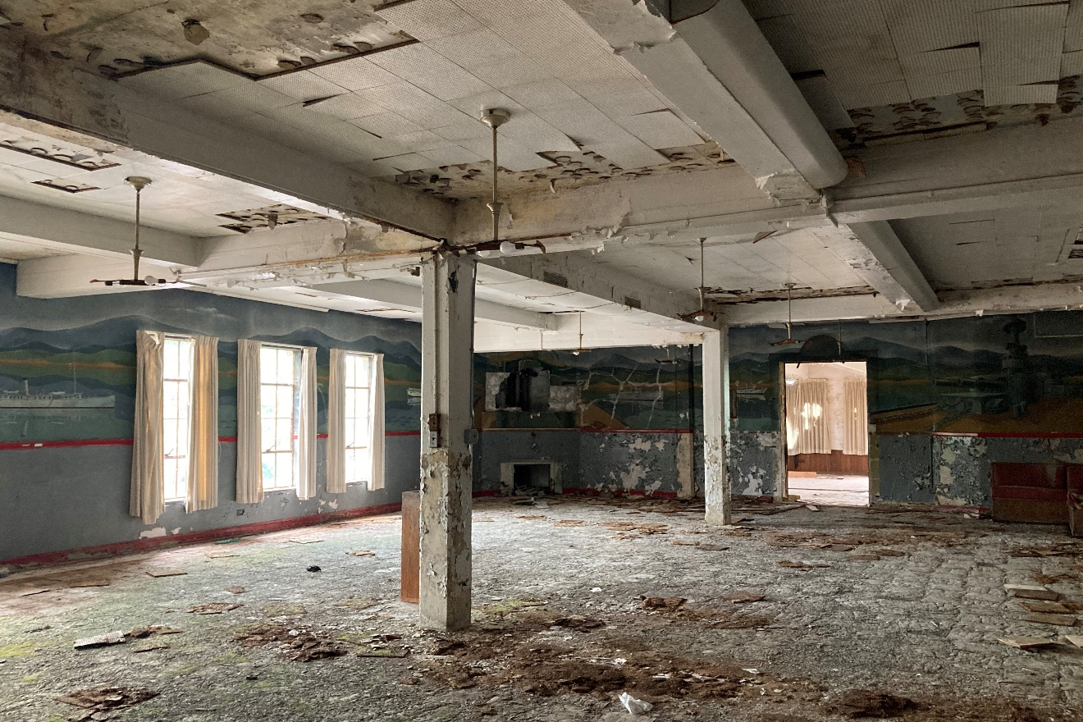
Figure #58: Interior, South Block, Dining Room, Yaeger Mural. 2022
Figure #59: Interior, South Block, Dining Room, Yaeger Mural. 2022

Slide 15
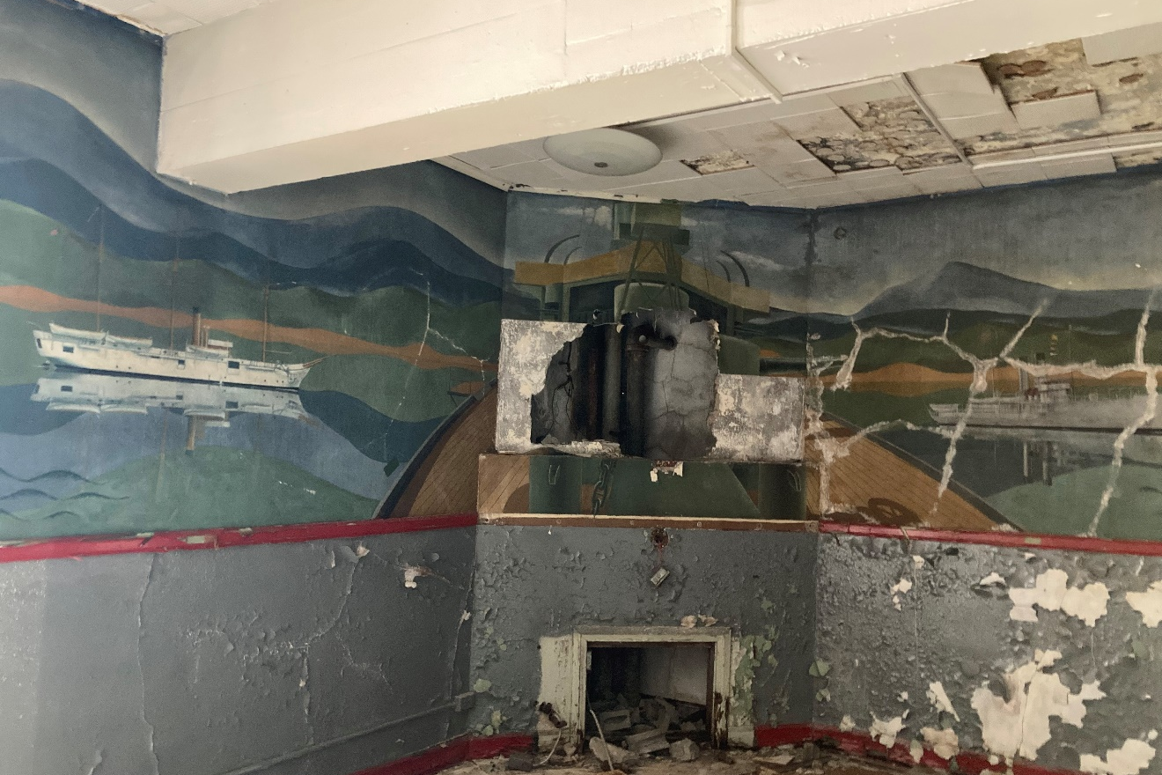
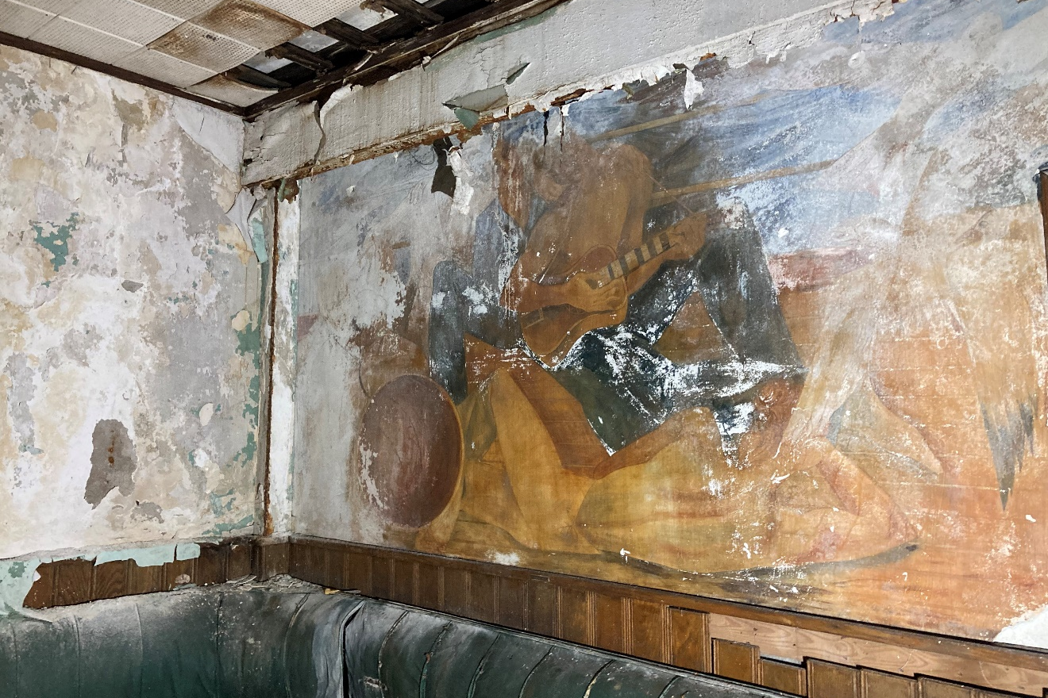
Figure #60: Interior, South Block, Dining Room, Yaeger Mural. 2022
Figure #61: Interior, South Block, Bar, Fredenthal Mural. 2022

Slide 16
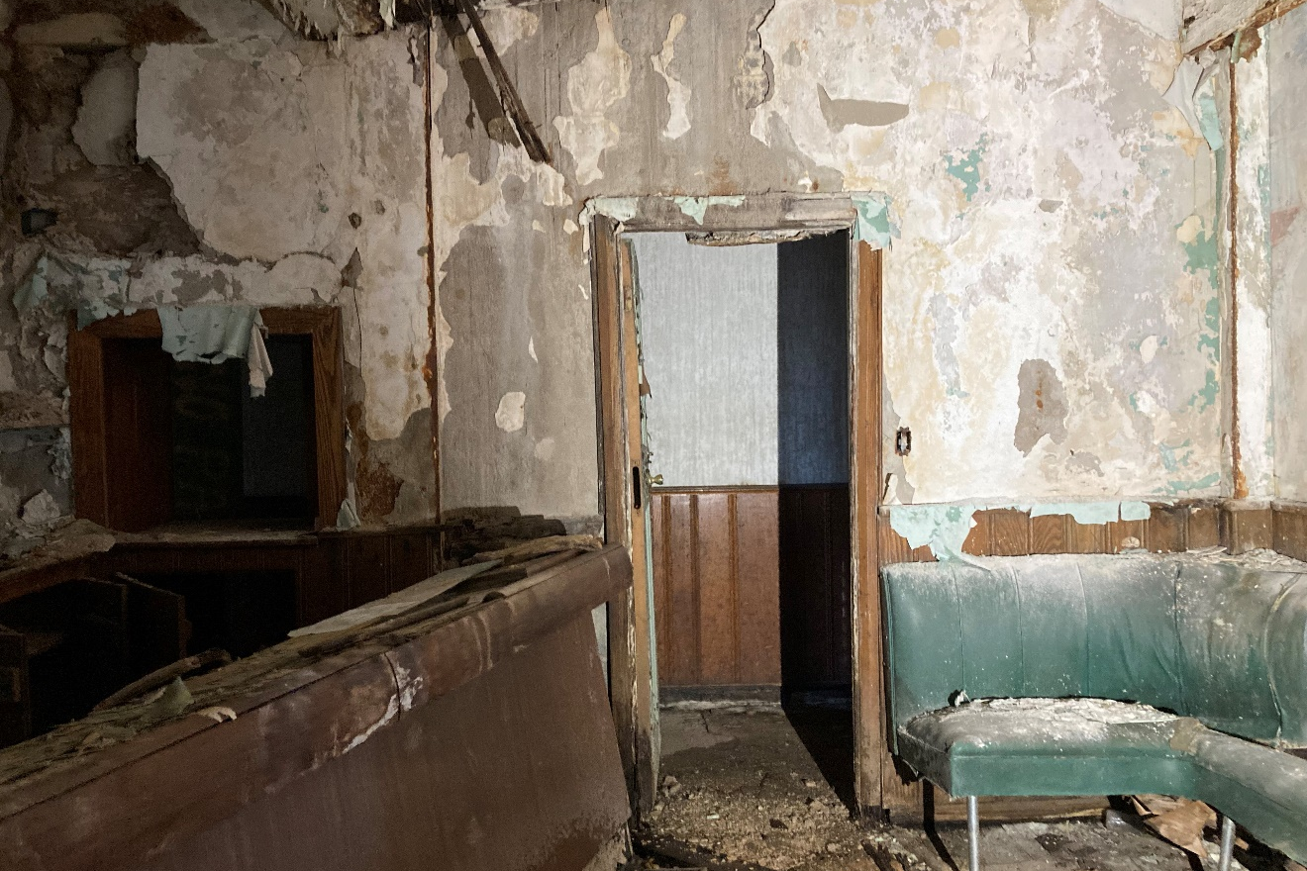
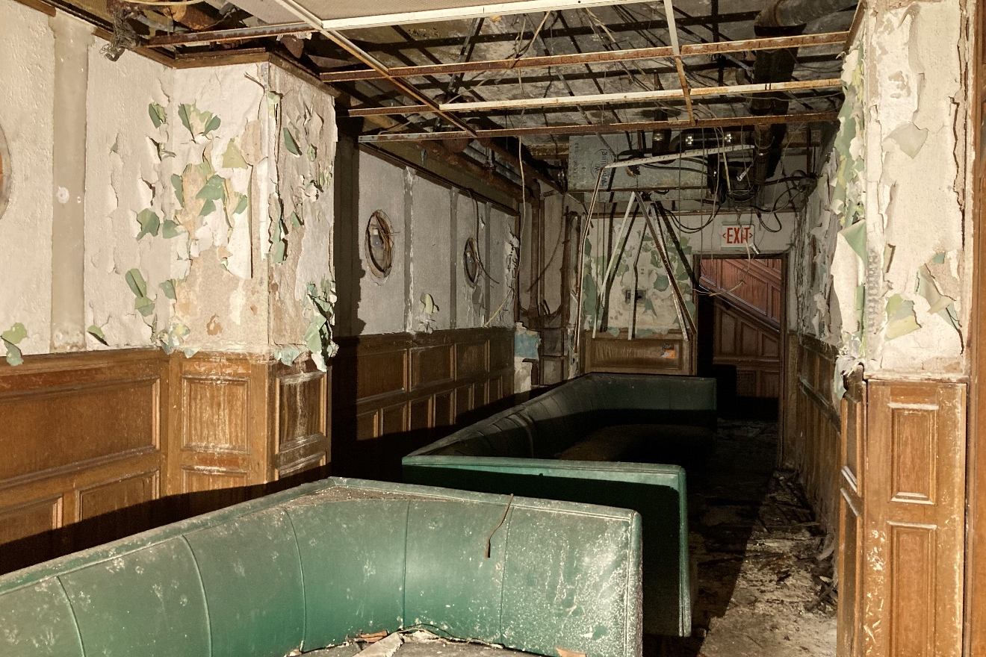
Figure #62: Interior, South Block, Bar, Looking North. 2022
Figure #63: Interior, South Block, Bar, Looking South. 2022

Slide 17
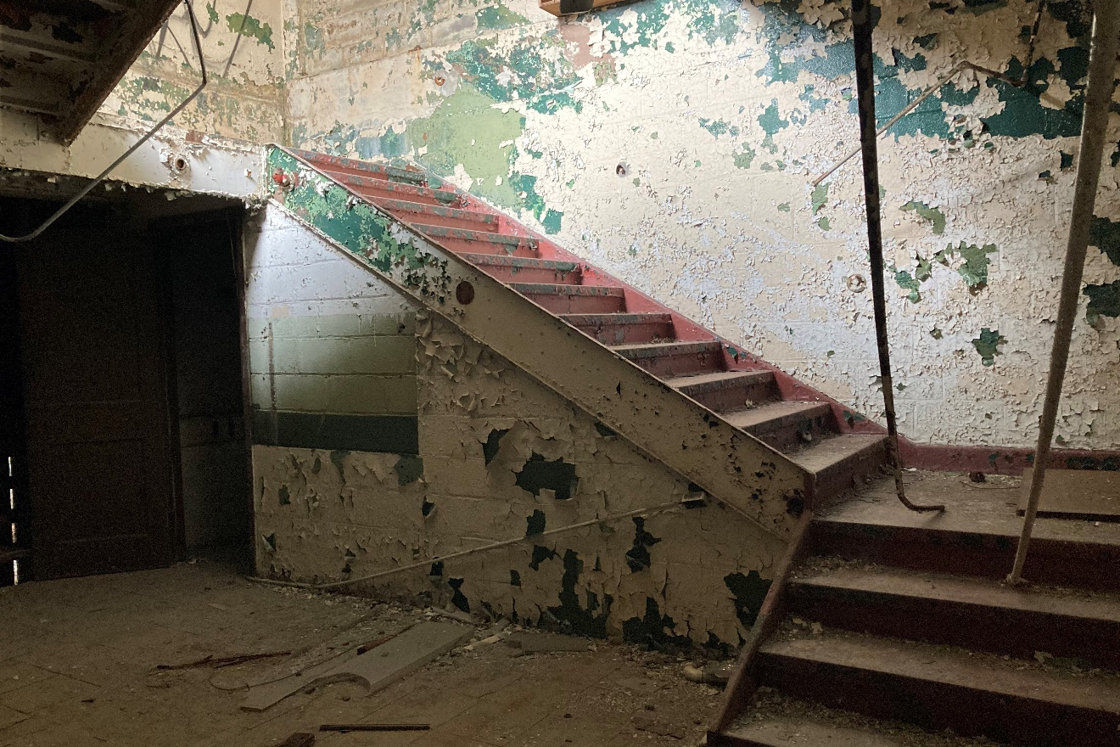
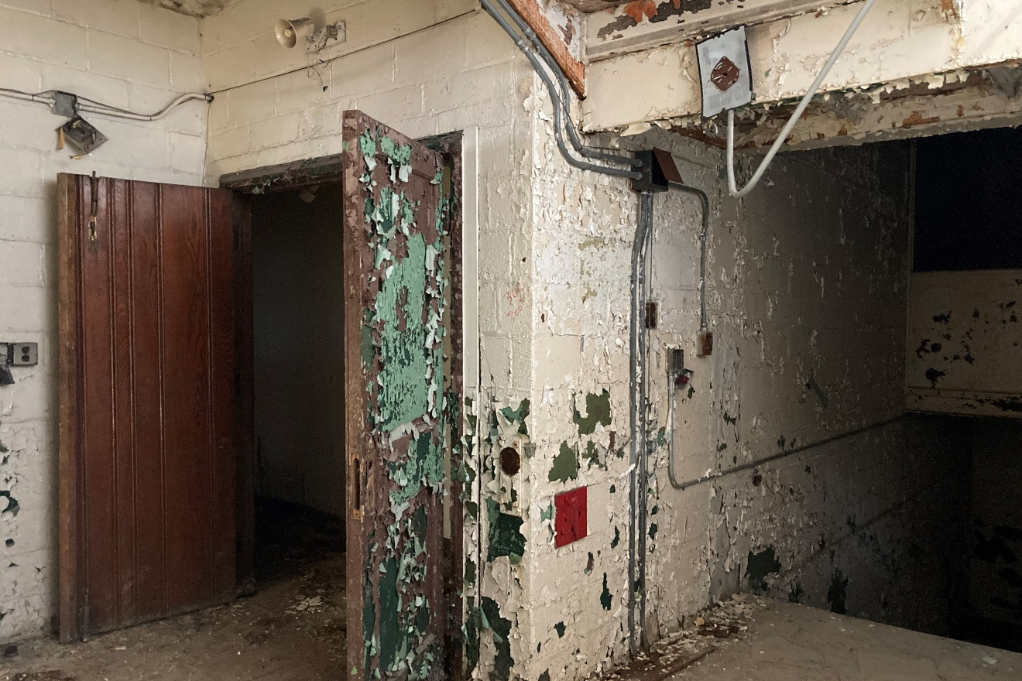
Figure #64: Interior, South Block, Stair. 2022
Figure #65: Interior, South Block, Corridor. 2022

Slide 18
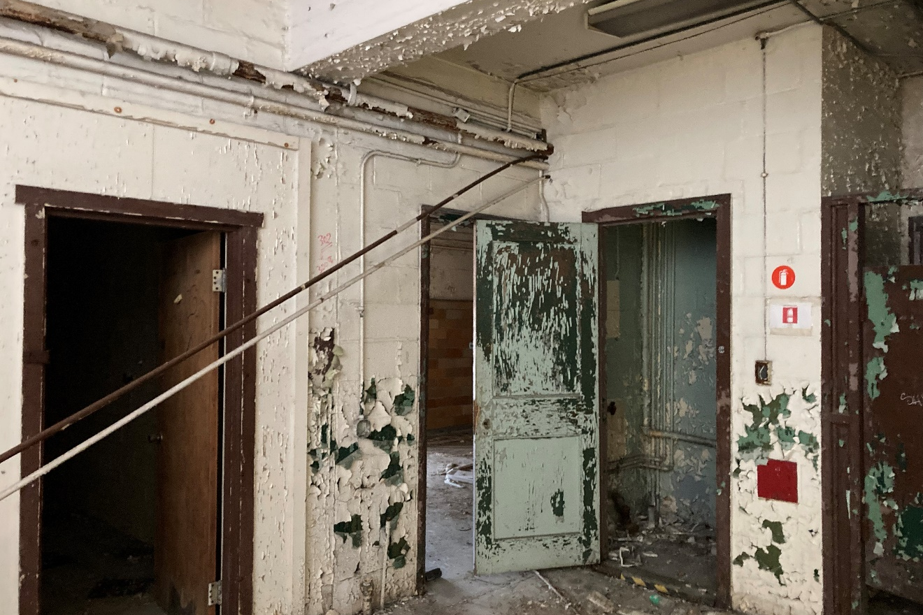
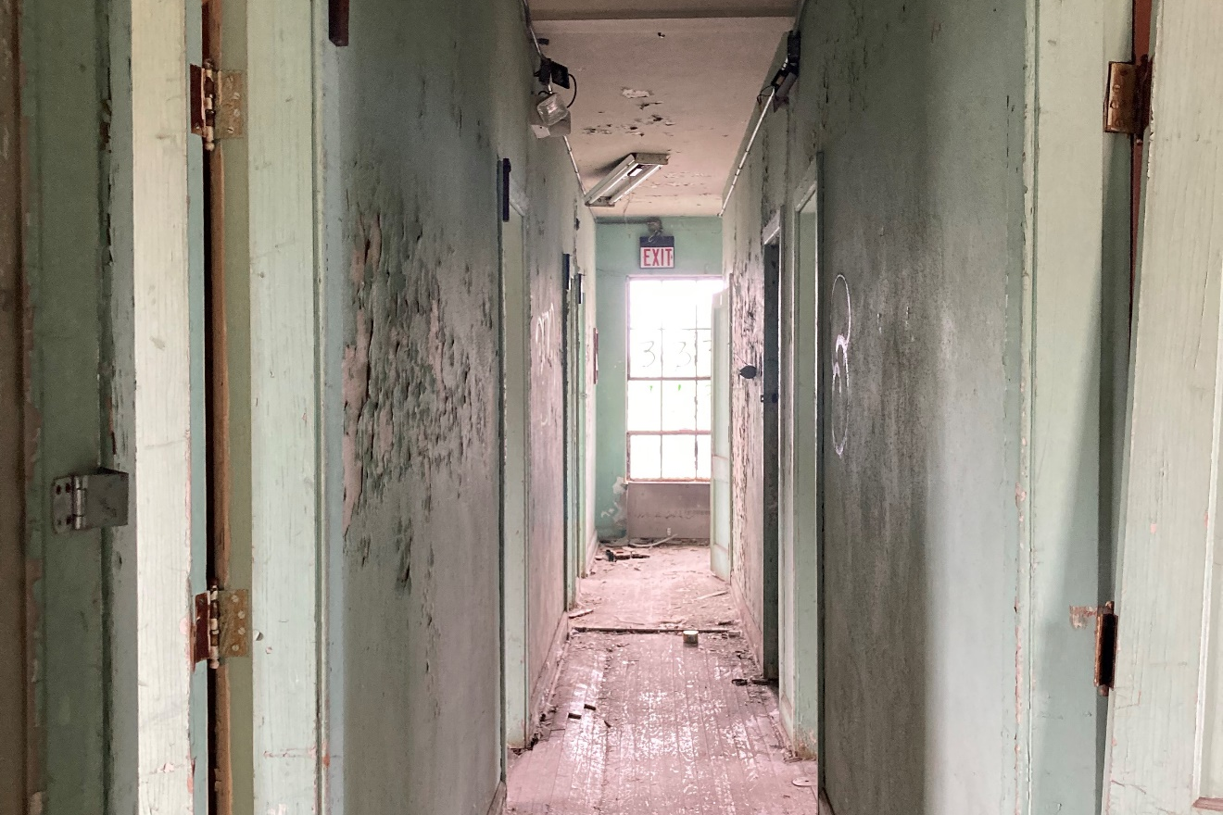
Figure #66: Interior, South Block, Corridor. 2022
Figure #67: Interior, South Block, Corridor. 2022

Slide 19
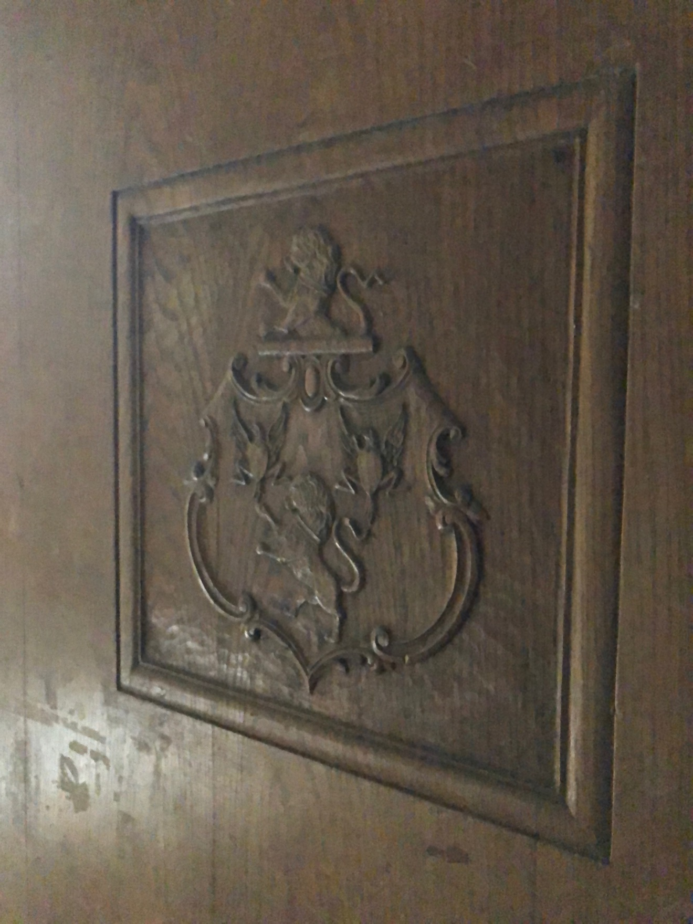
Figure #68: One of the remaining carved doors. 2020

Slide 20
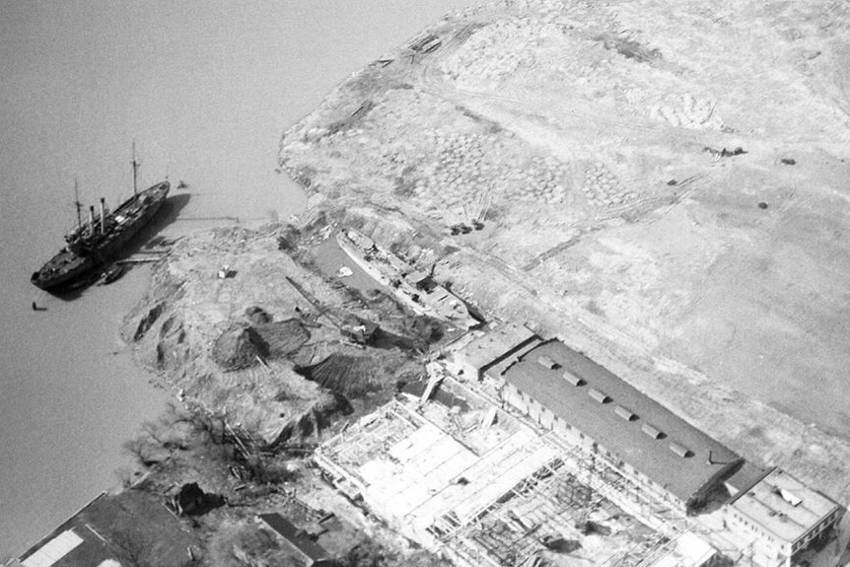
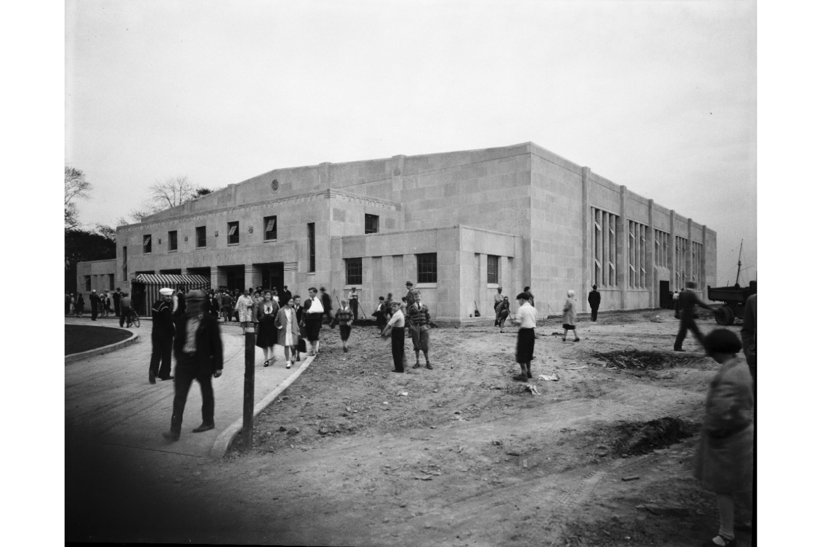
Figure #69: Historic Photo with Brodhead Armory being constructed circa 1929-1930
Figure #70: Brodhead Armory, undated, Wayne State University Archives.

Slide 21
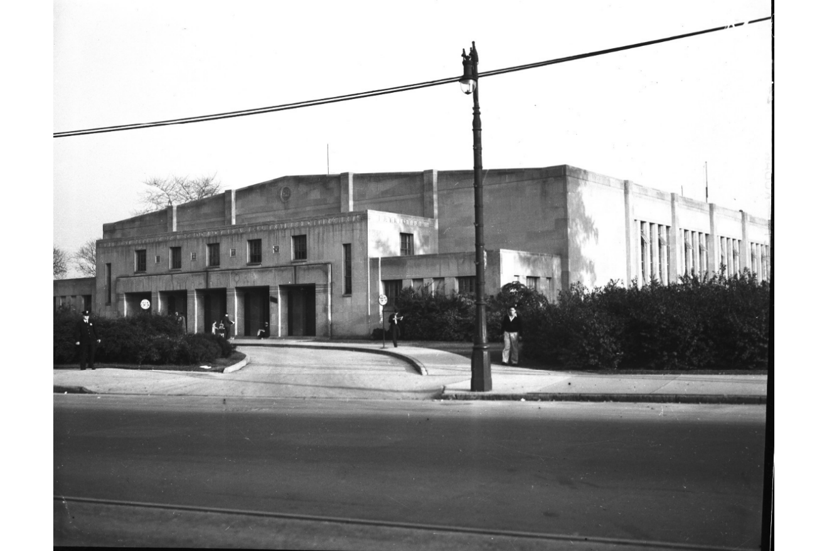
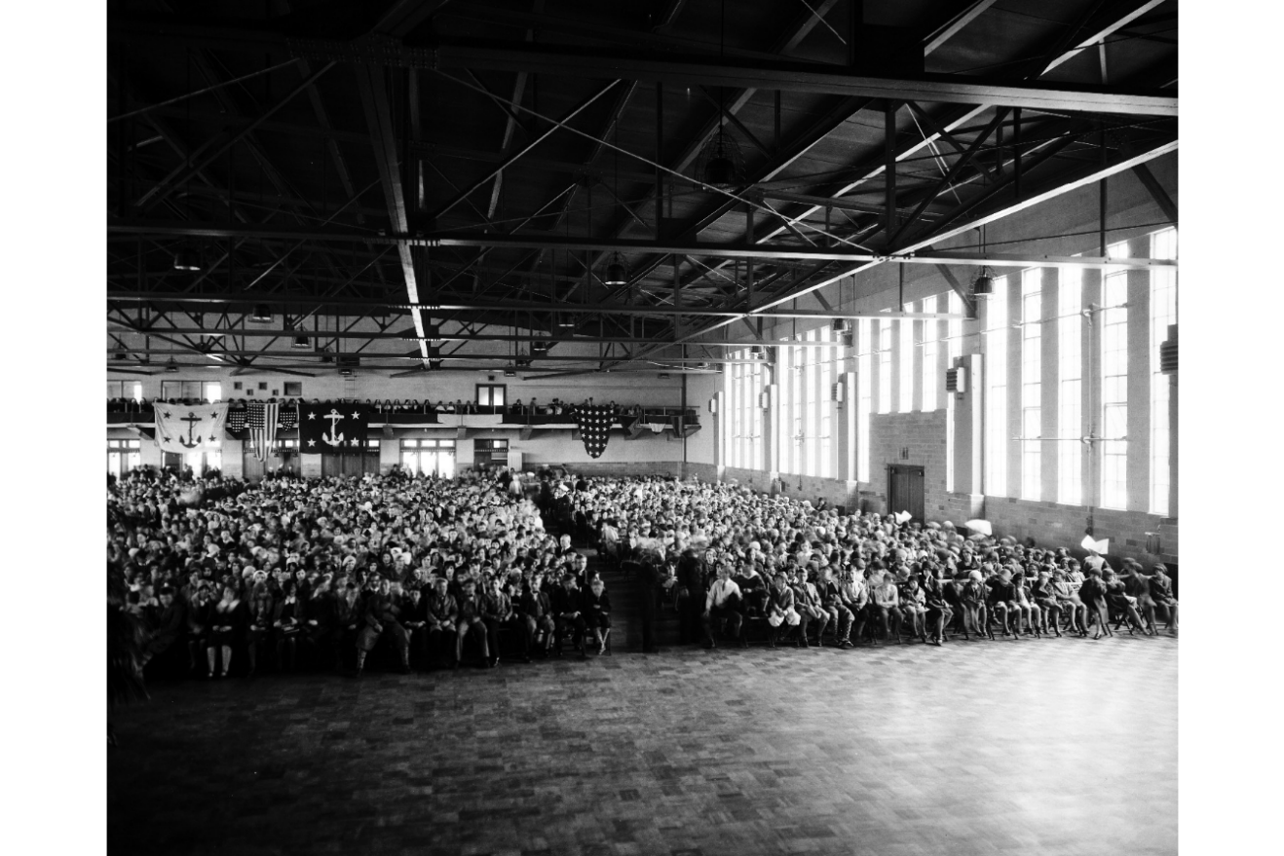
Figure #71: Historic Photo, 1930, Wayne State University Archives.
Figure #72: Historic Photo, Interior of Drill Hall, 1930, Wayne State University Archives

Slide 22
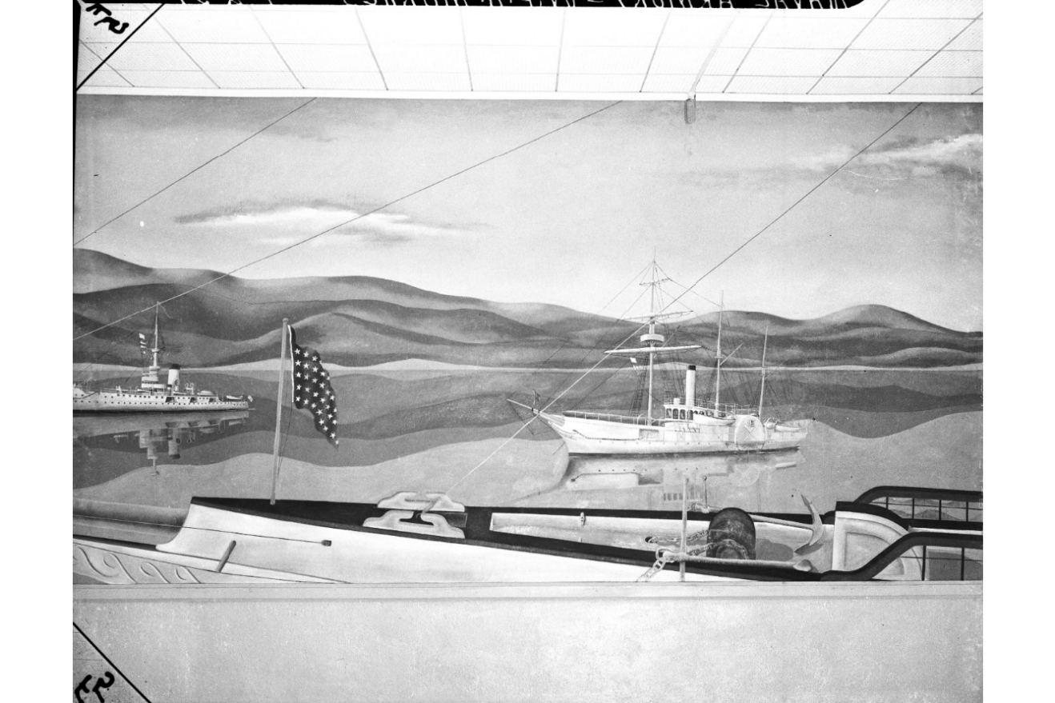
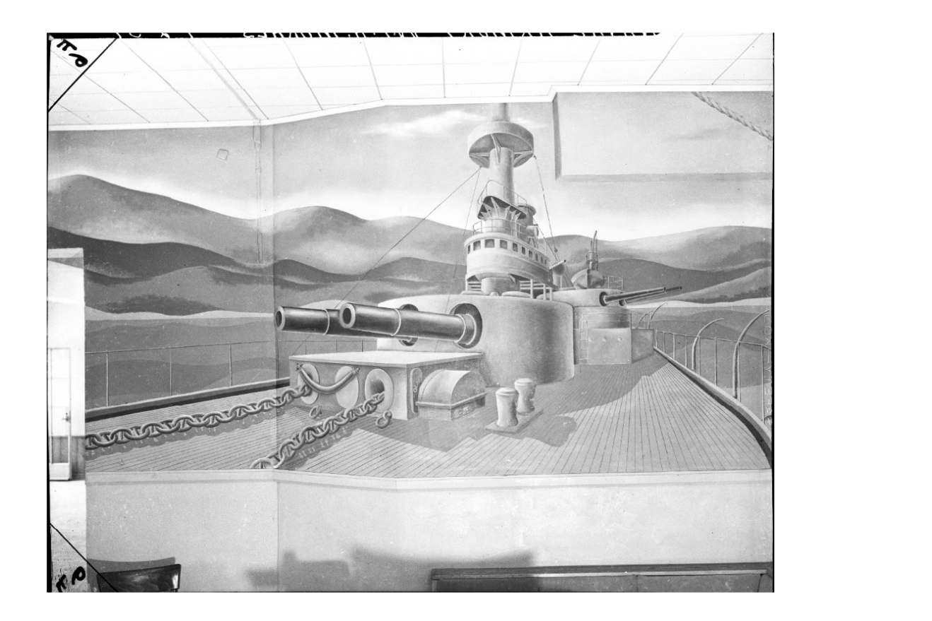
Figure #73: Historic Photo, undated, Wayne State University Archives.
Figure #74: Historic Photo, undated, Wayne State University Archives.

Slide 23
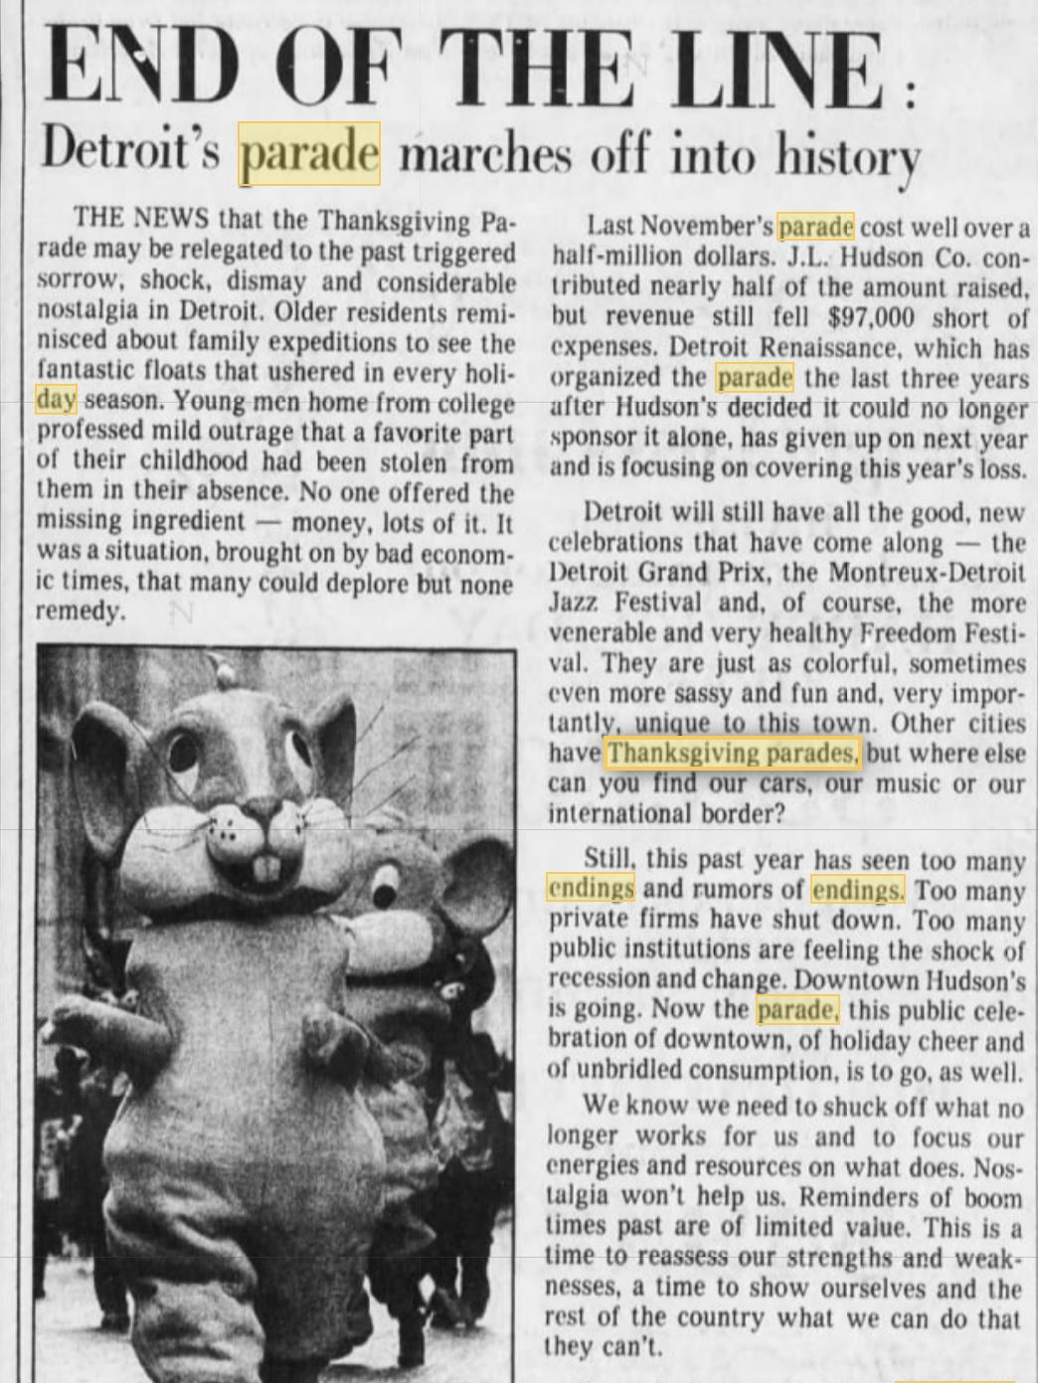
Figure #75: Detroit Free Press article about the ending of the Parade. 12/31/1982

Slide 24
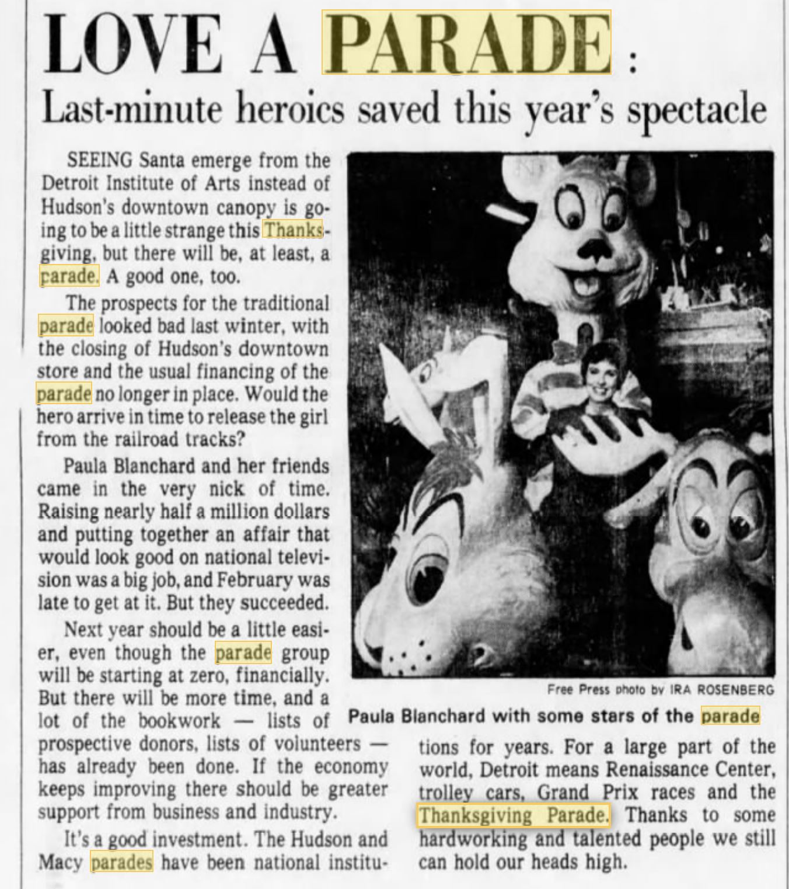
Figure #76: Detroit Free Press article on the 1983 Thanksgiving Day Parade. 11/21/1983

