Slide 1
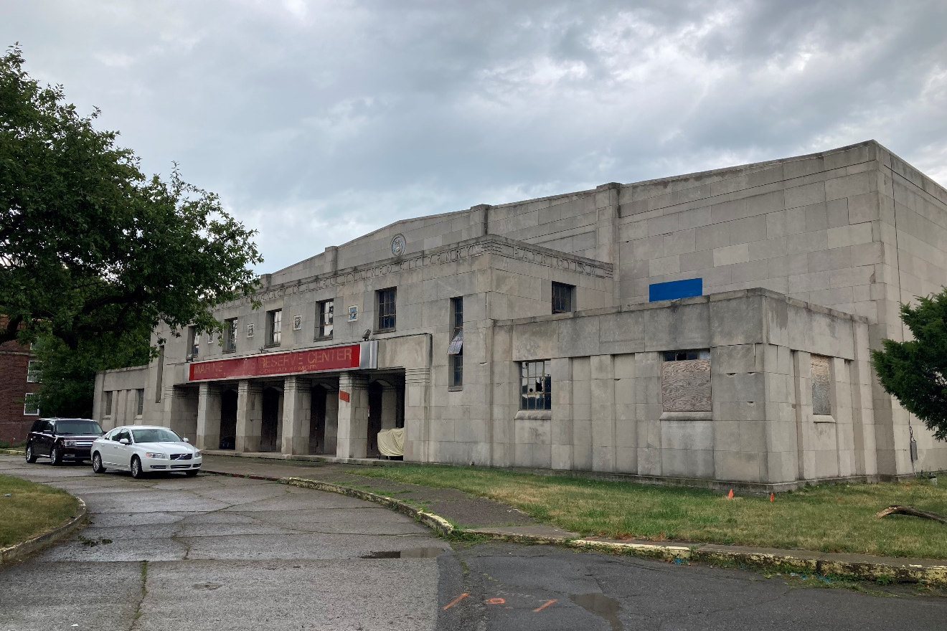
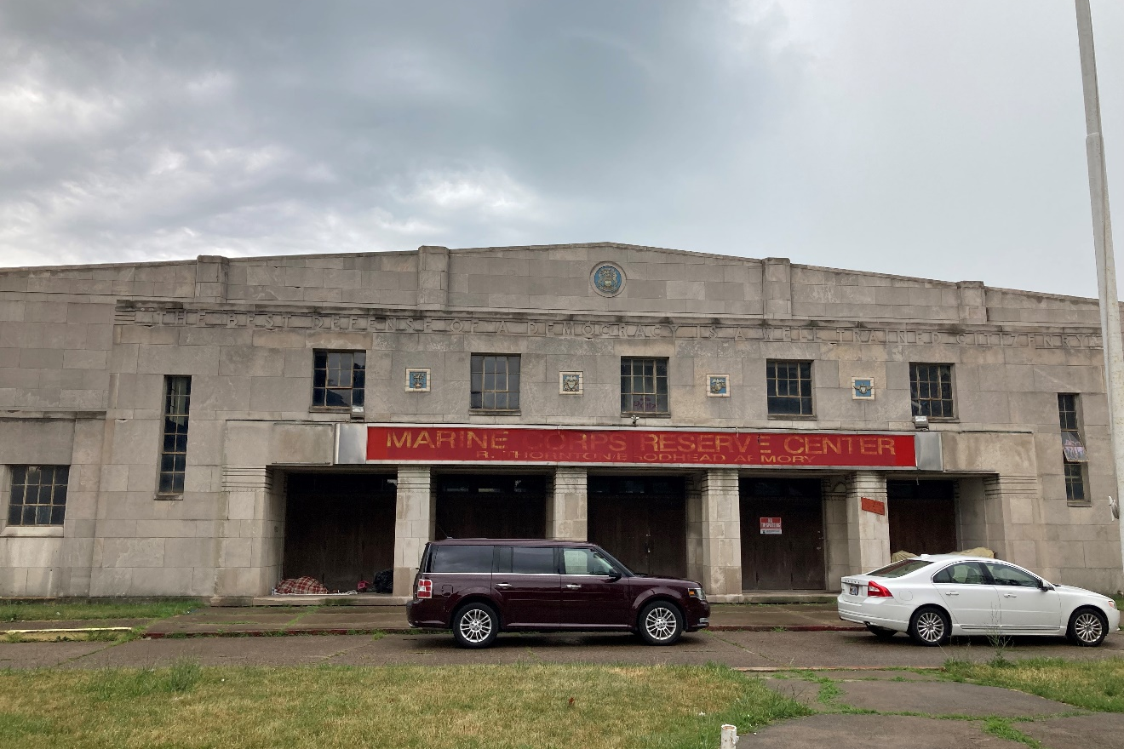
Figure #1: Exterior, Looking Southeast. 2022
Figure #2: Exterior, Looking South. 2022

Slide 2
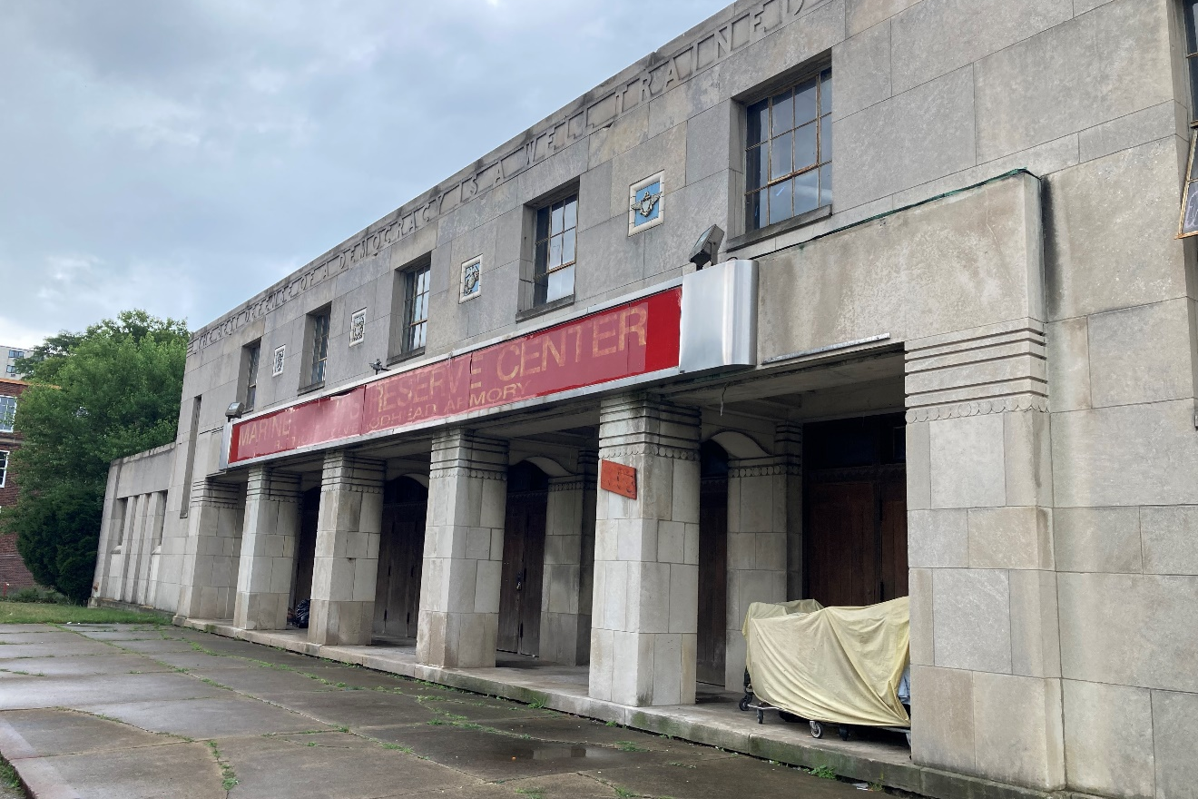
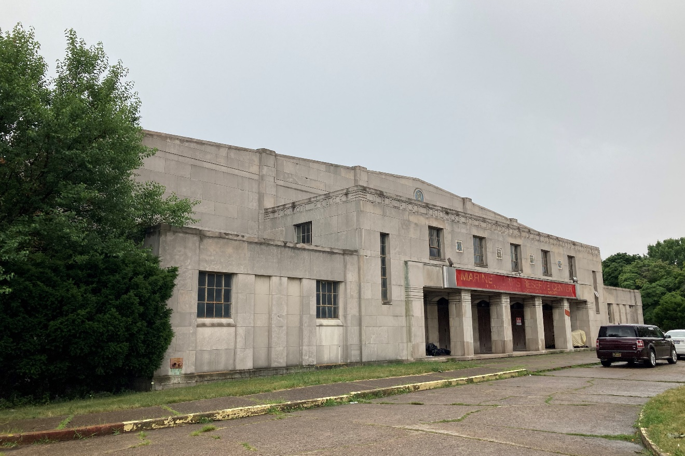
Figure #3: Exterior, Looking Southeast. 2022
Figure #4: Exterior, Looking Southwest. 2022

Slide 3
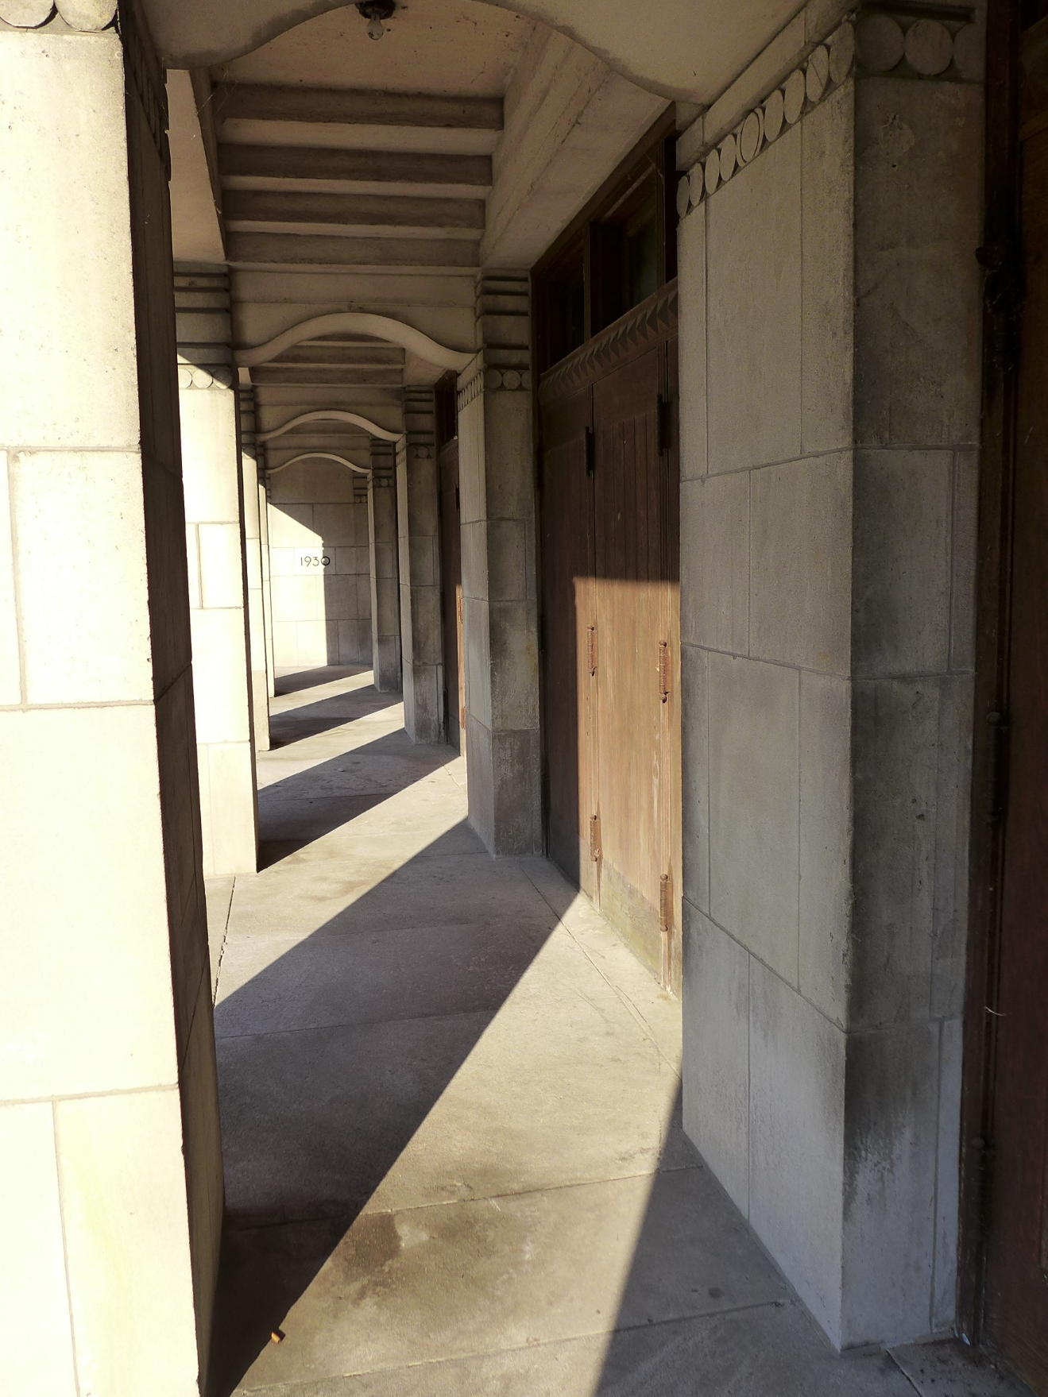
Figure #5: Exterior, Entry Arcade, Looking East. 8-22-2020

Slide 4
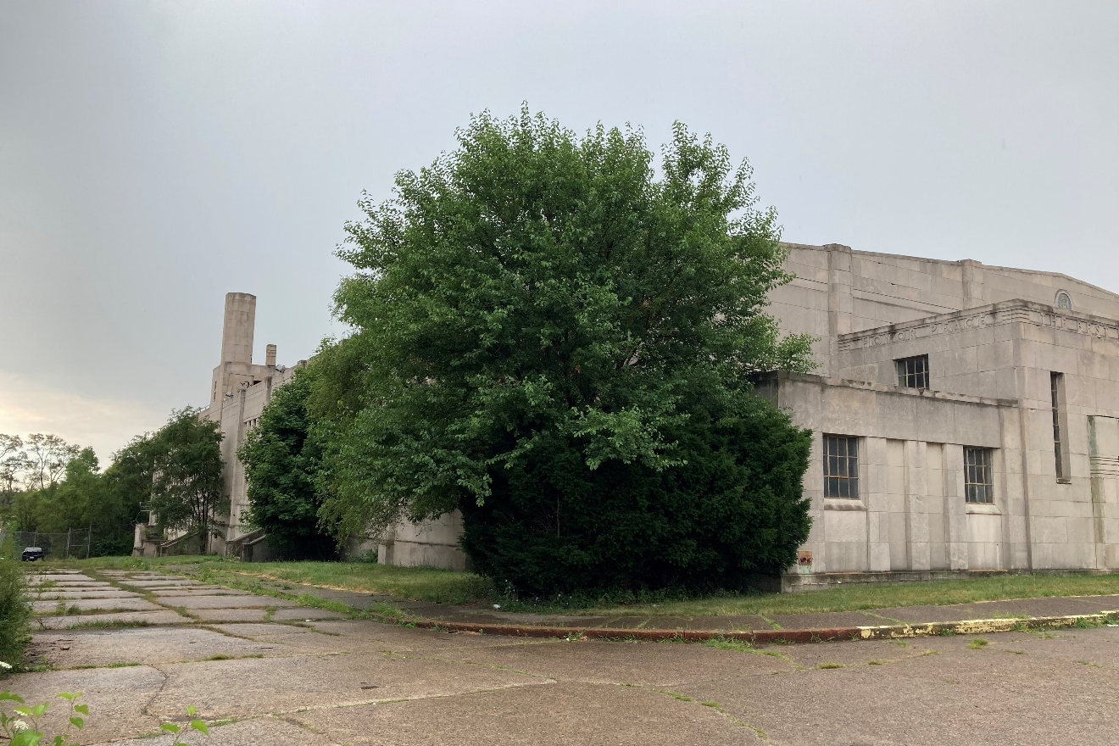
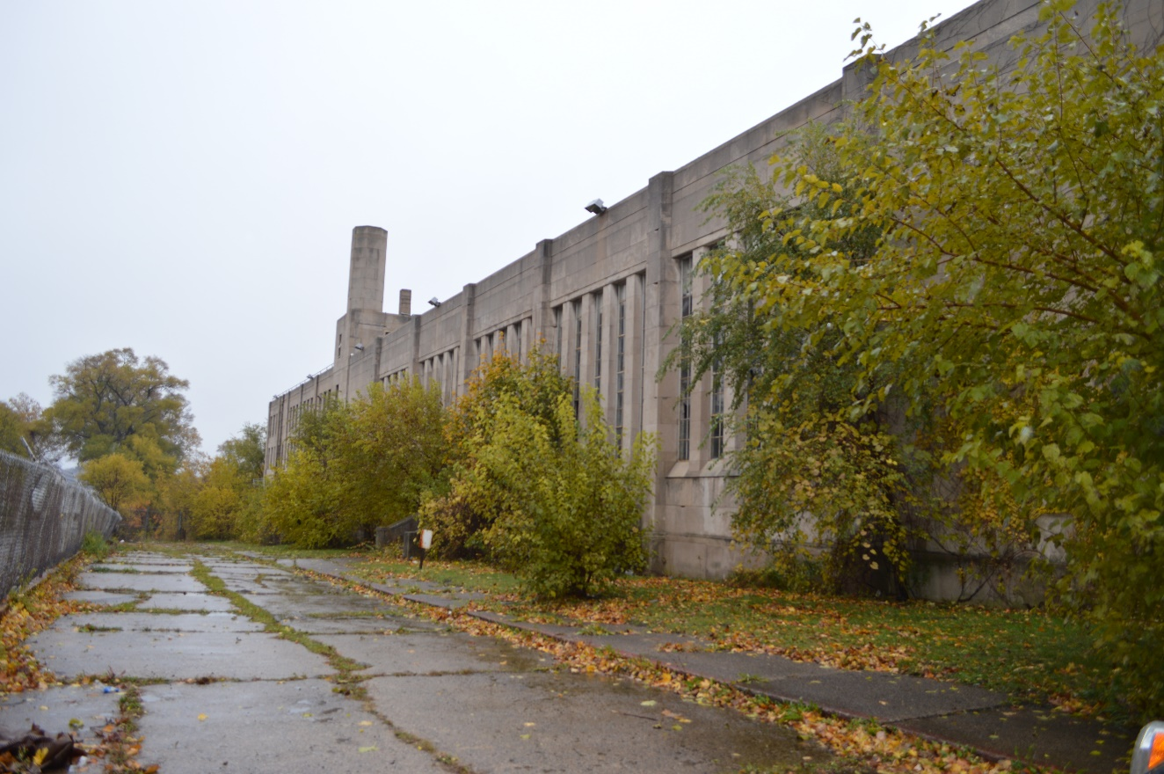
Figure #6: Exterior, East Façade, Looking Southwest. 2022
Figure #7: Exterior, East Façade, Looking Southwest. 2018

Slide 5
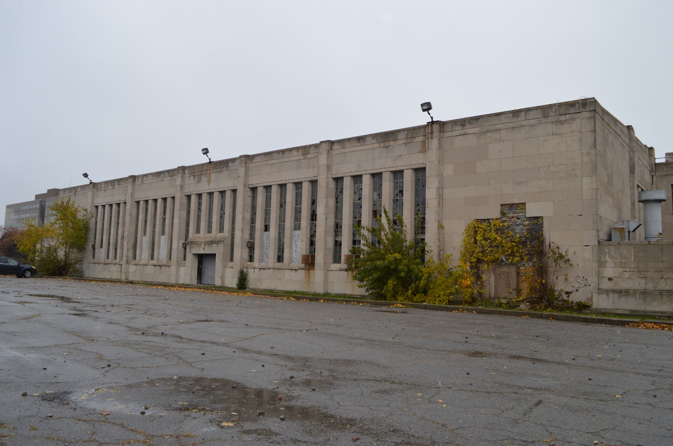
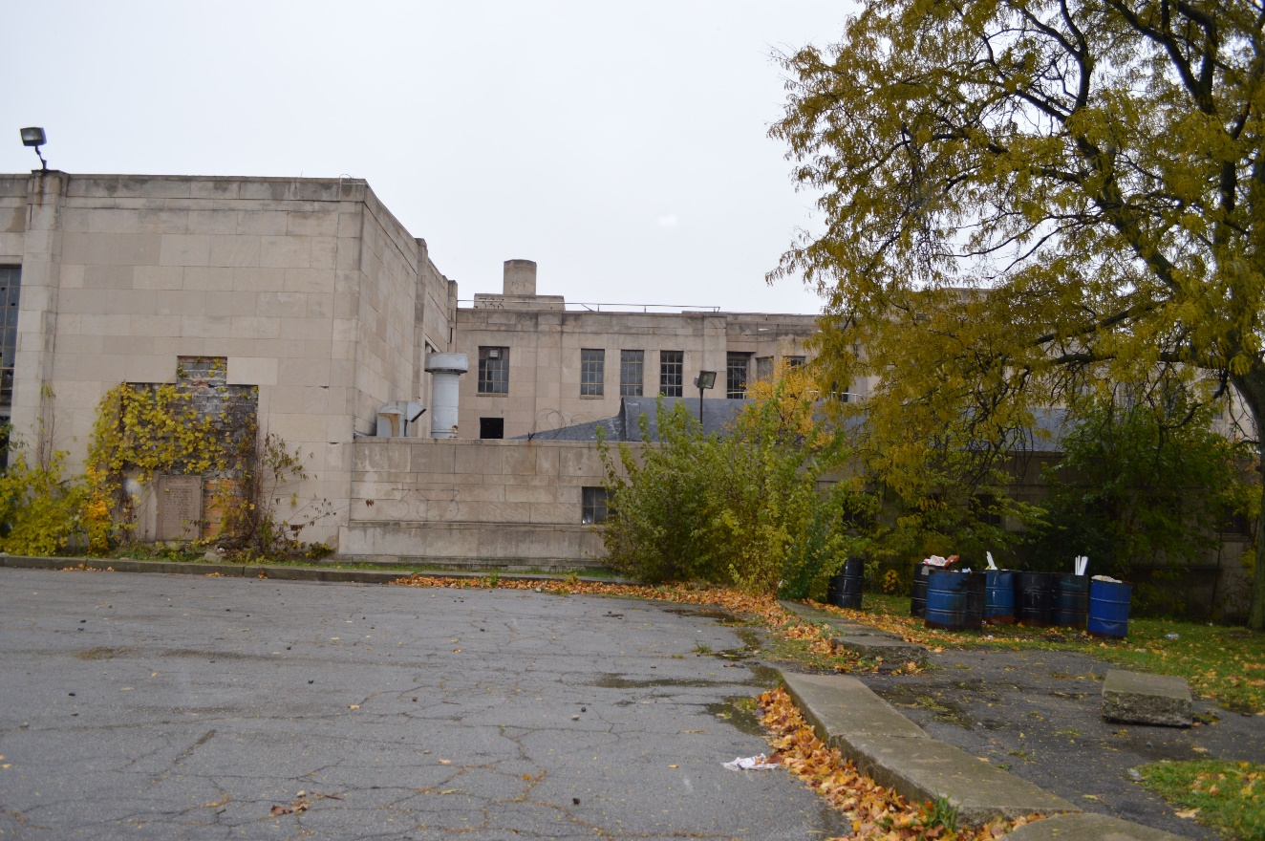
Figure #8: Exterior, West Façade, Looking East. 2018
Figure #9: Exterior, West Façade, Looking East. 2018

Slide 6
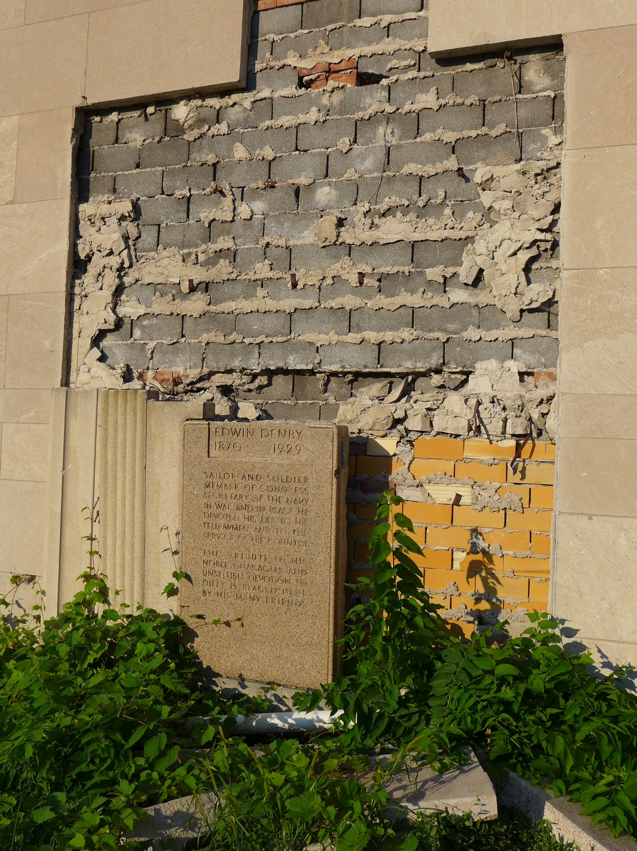
Figure #10: West Façade, Denby Memorial, Looking East. 2020

Slide 7
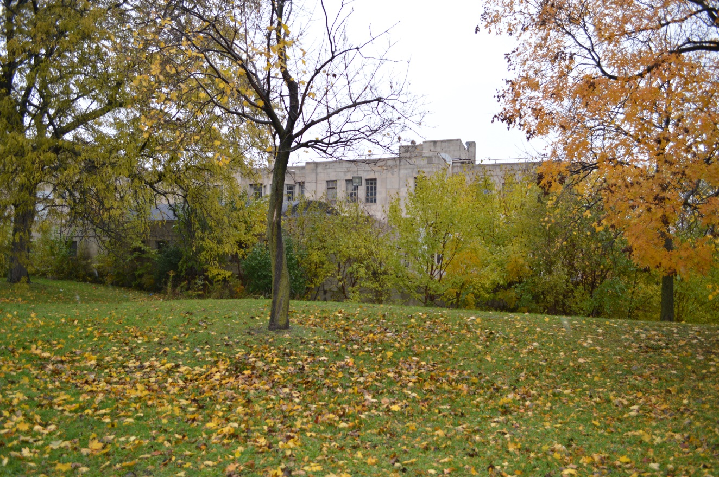
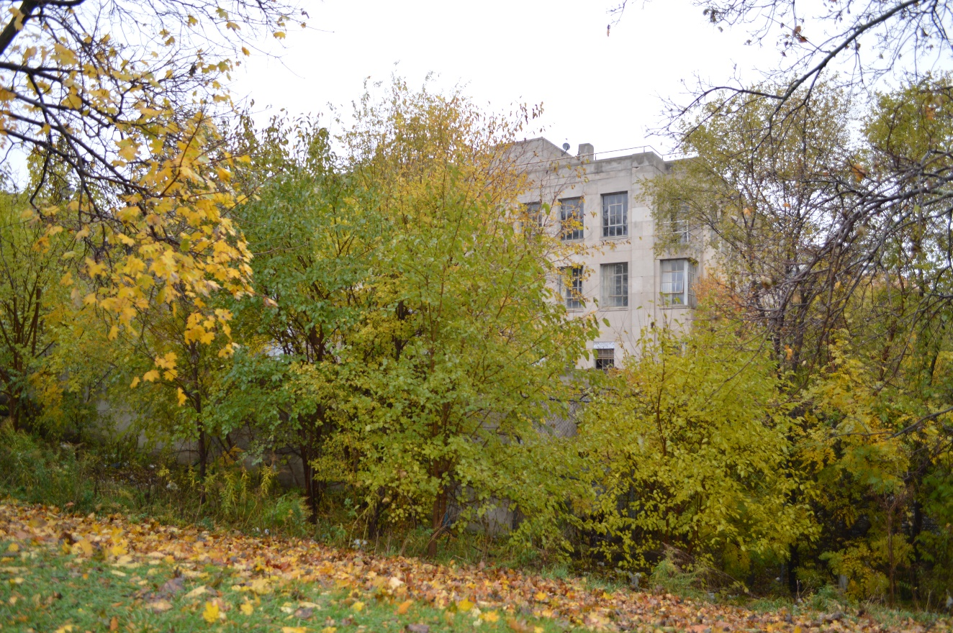
Figure #11: Exterior, West Façade, Looking East. 2018
Figure #12: Exterior, West Façade, Looking East. 2018

Slide 8
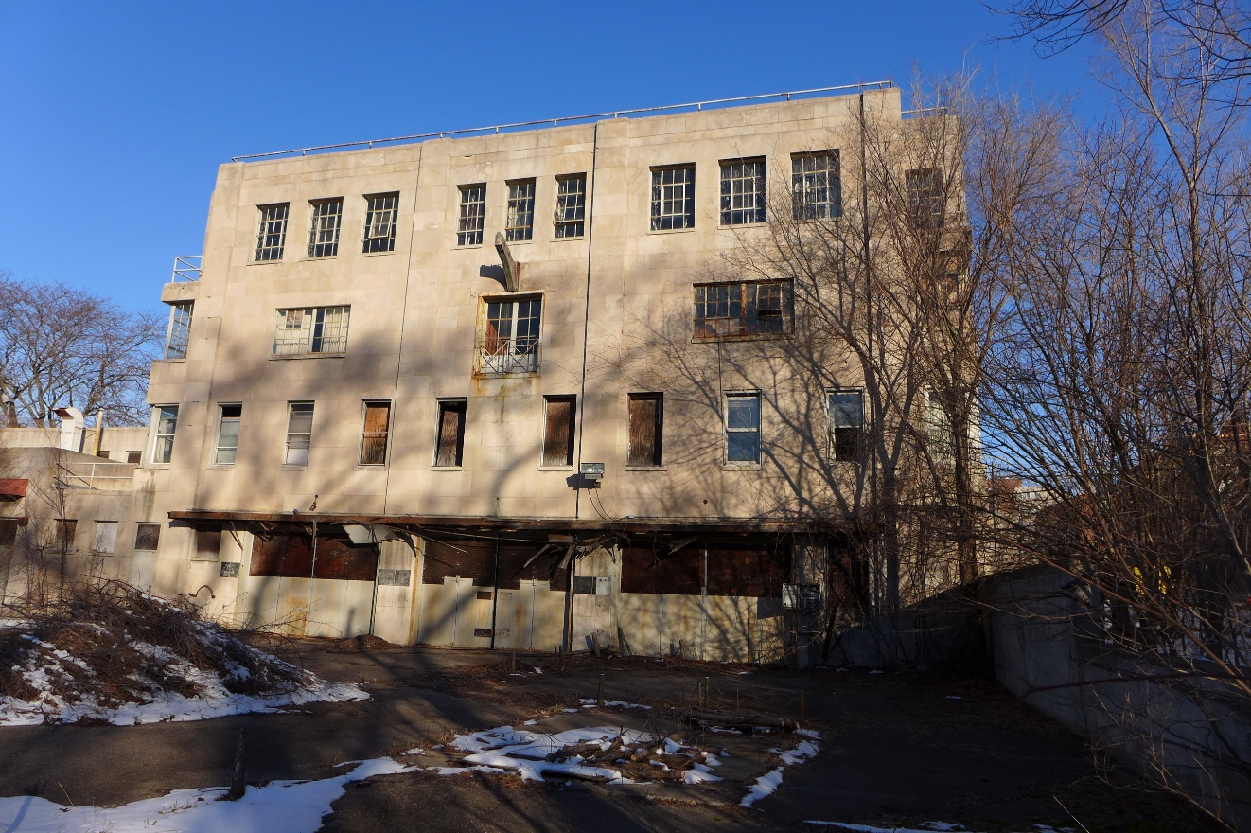
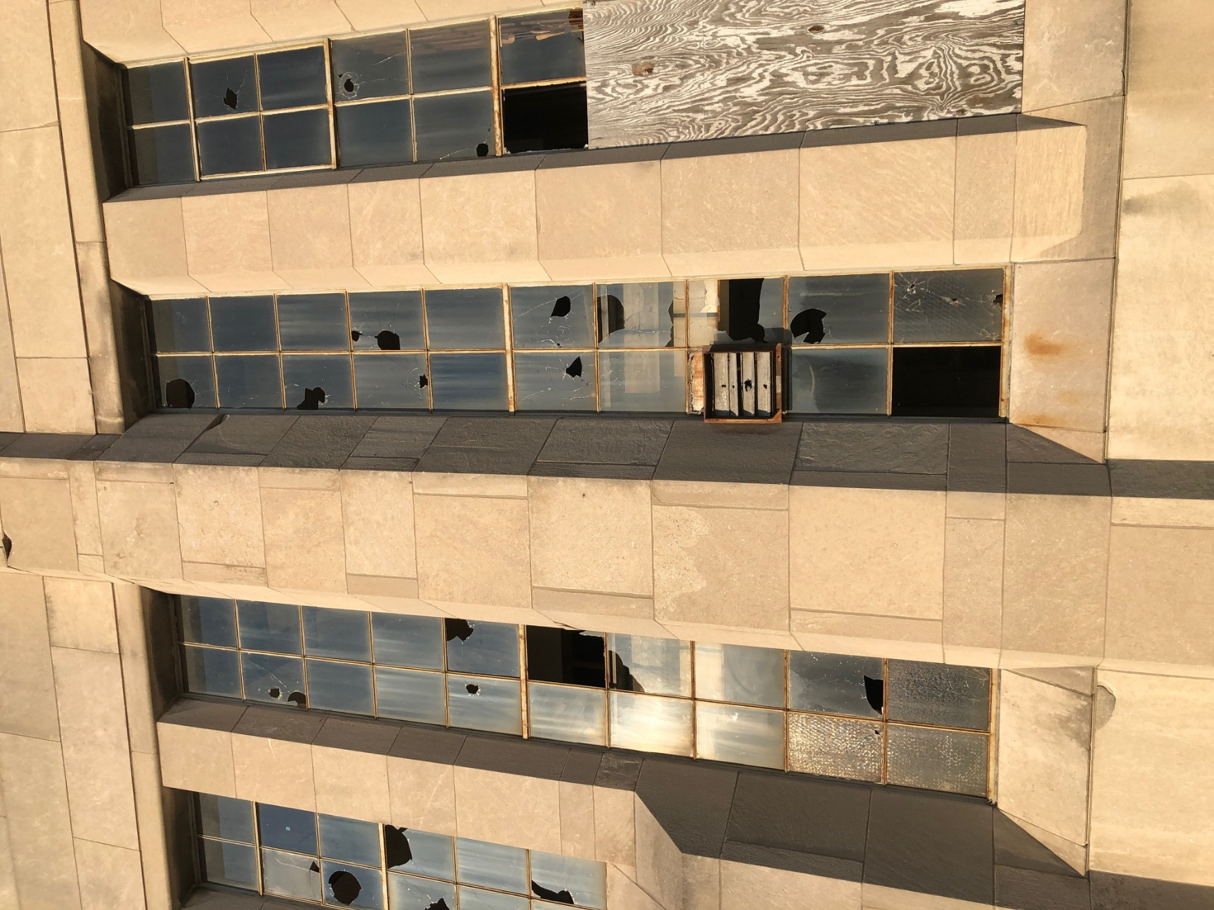
Figure #13: Exterior, South Block, Looking North. 2020
Figure #14: Exterior, North Block, Windows. 2020

Slide 9
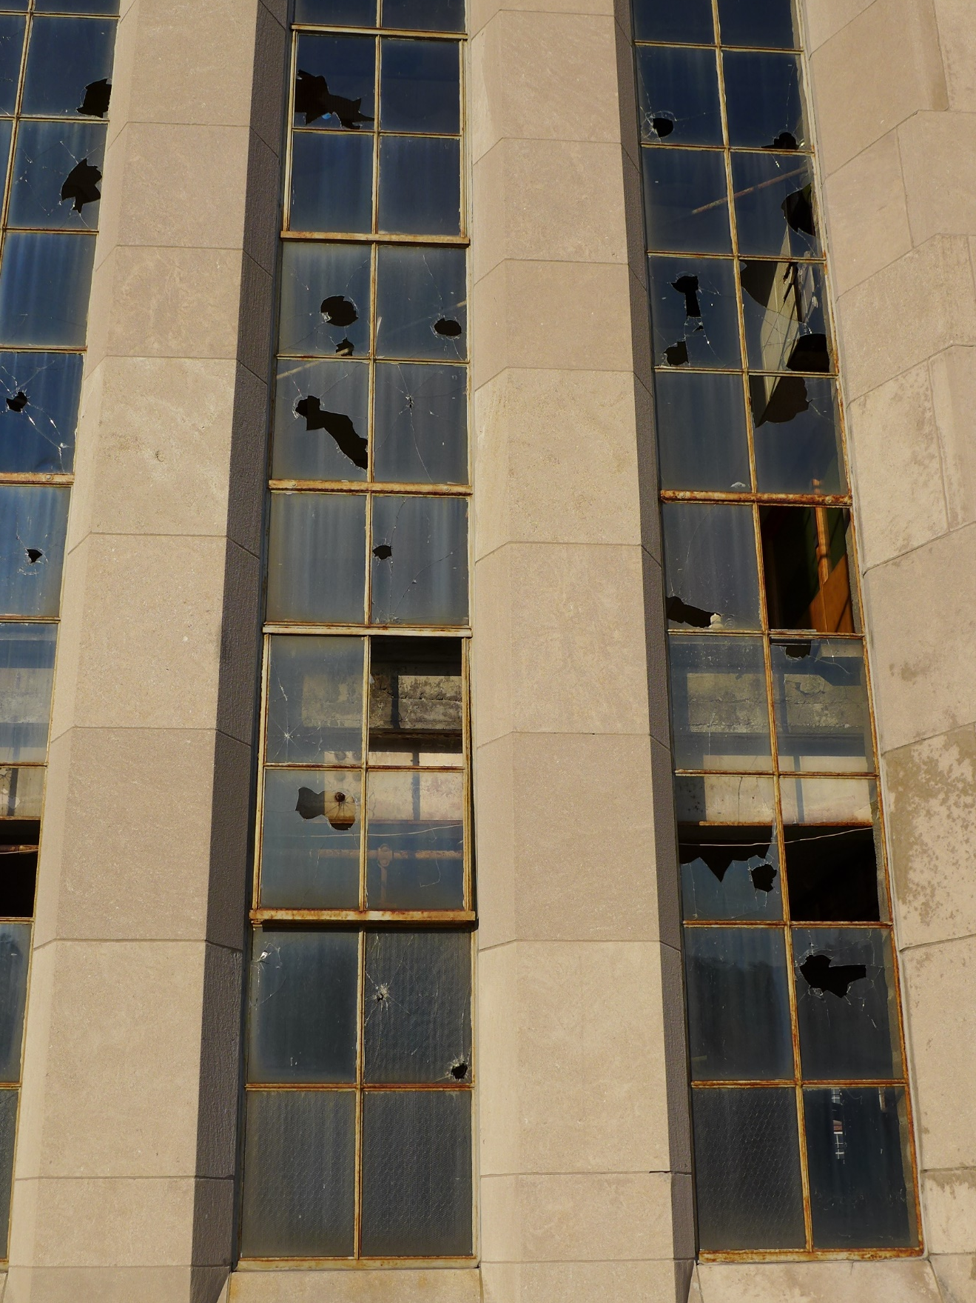
Figure #15: Exterior, North Block, Windows. 2020

Slide 10
Figure #16: Exterior, North Block, Windows. 2020

Slide 11
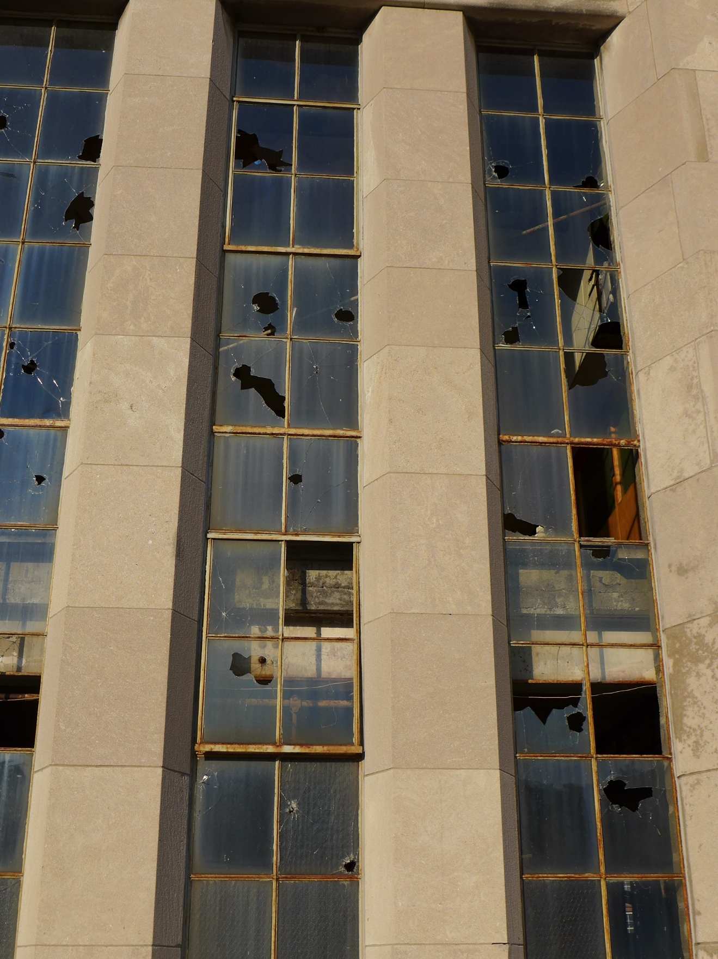
Figure #17: Exterior, North Block, Windows. 2020

Slide 12
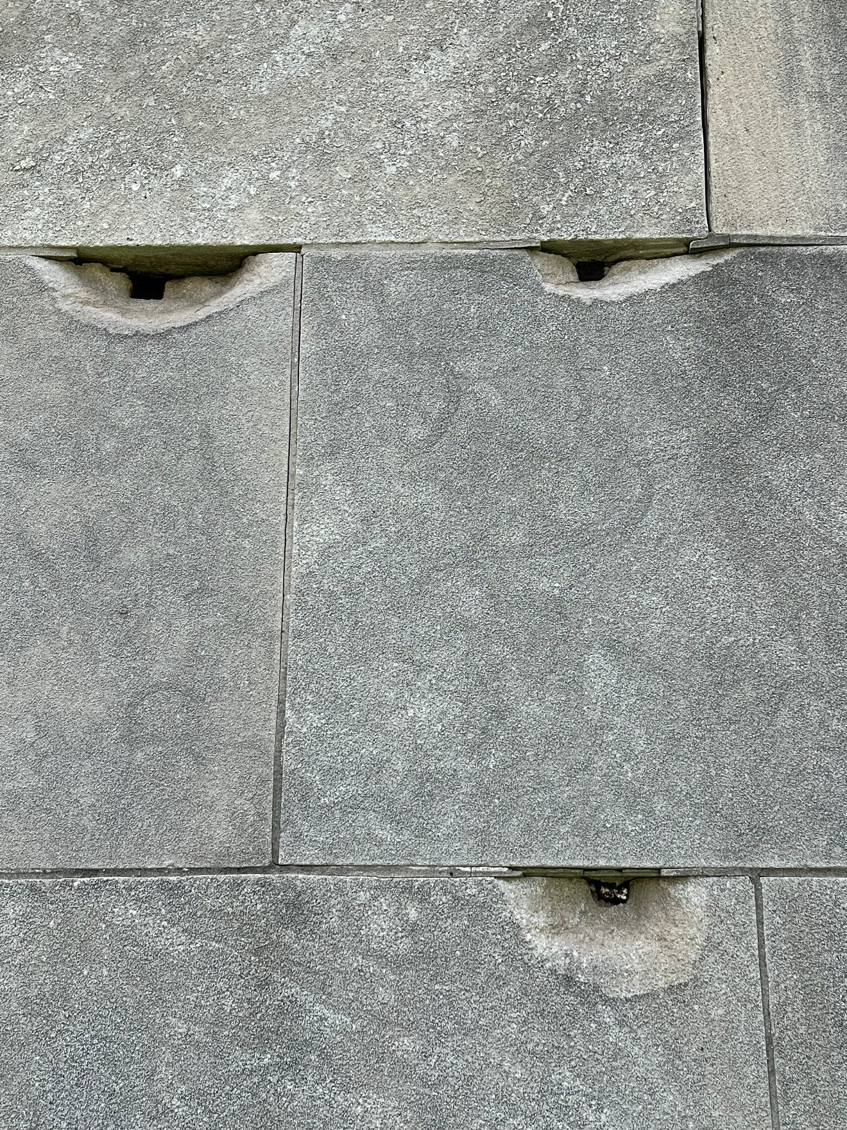
Figure #18: Exterior, North Block, Masonry. 2022

Slide 13
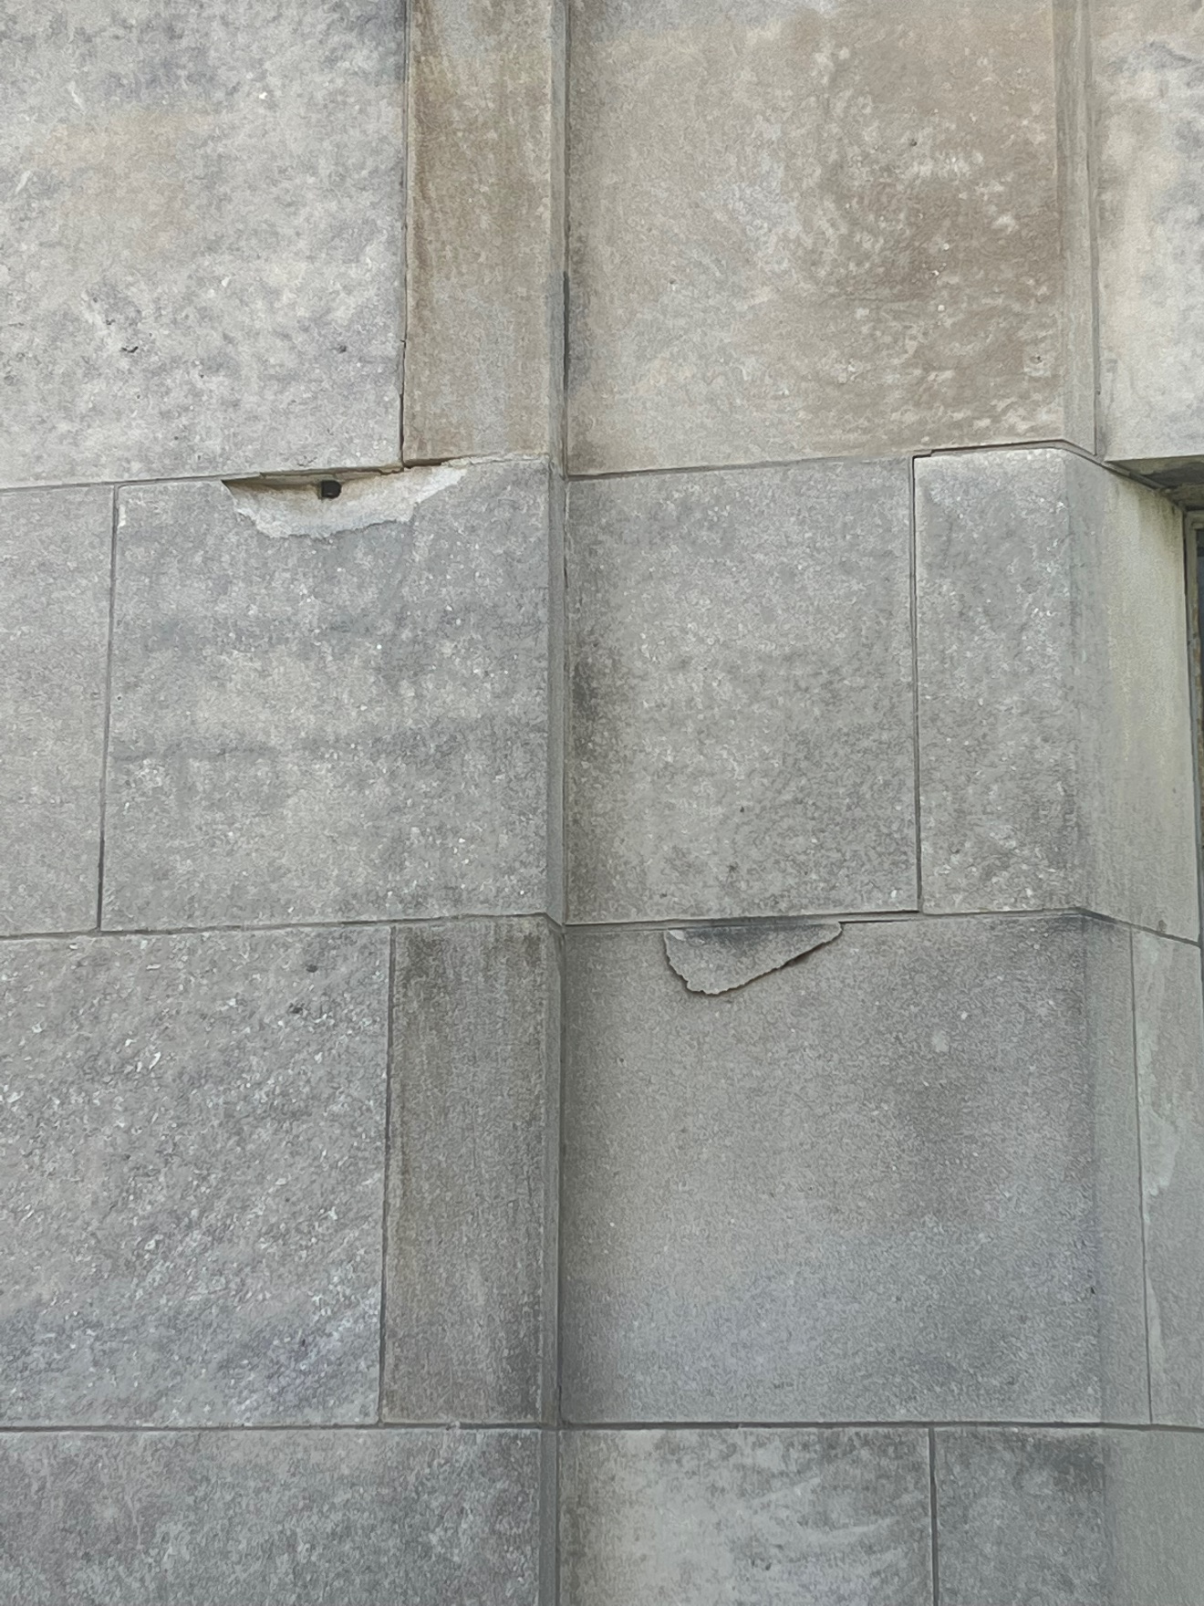
Figure #19: Exterior, North Block, Masonry. 2022

Slide 14
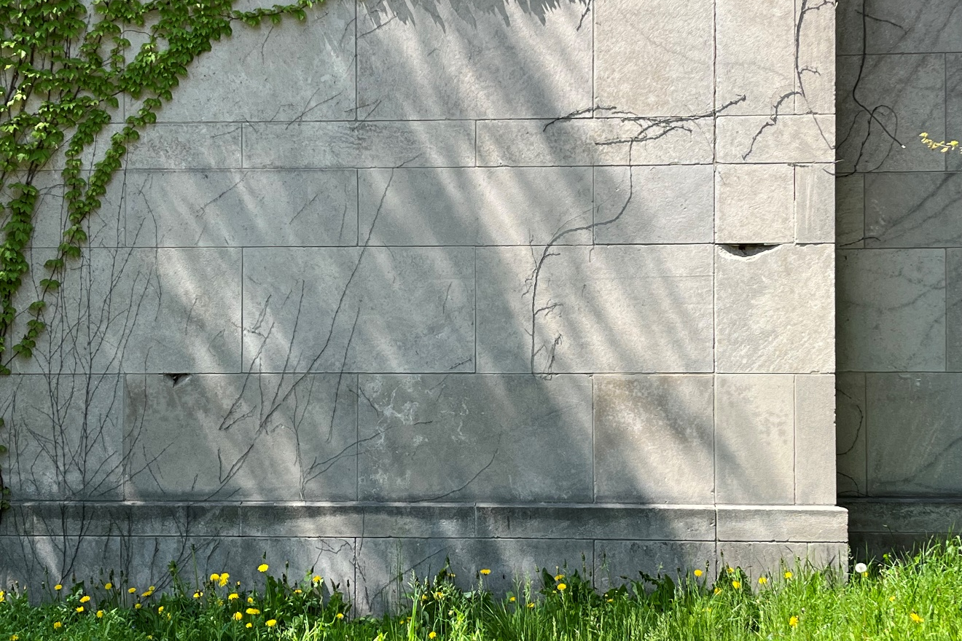
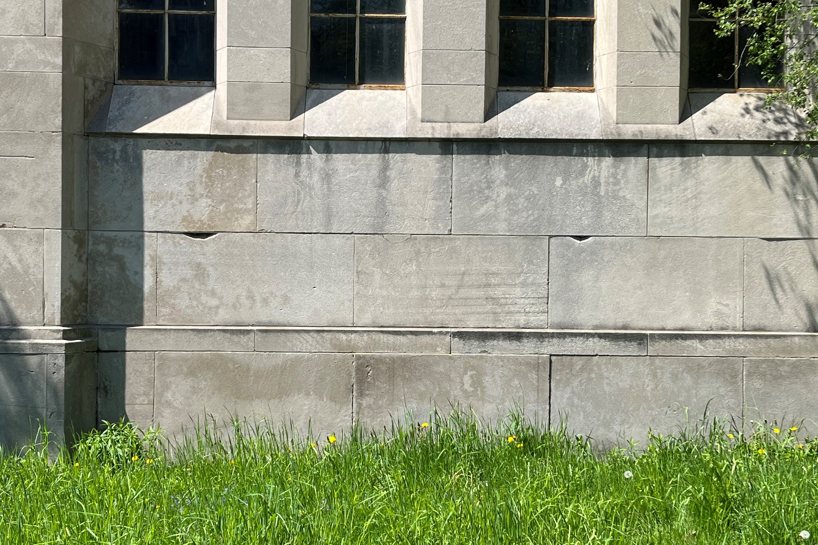
Figure #20: Exterior, North Block, Masonry. 2022
Figure #21: Exterior, North Block, Masonry. 2022

Slide 15
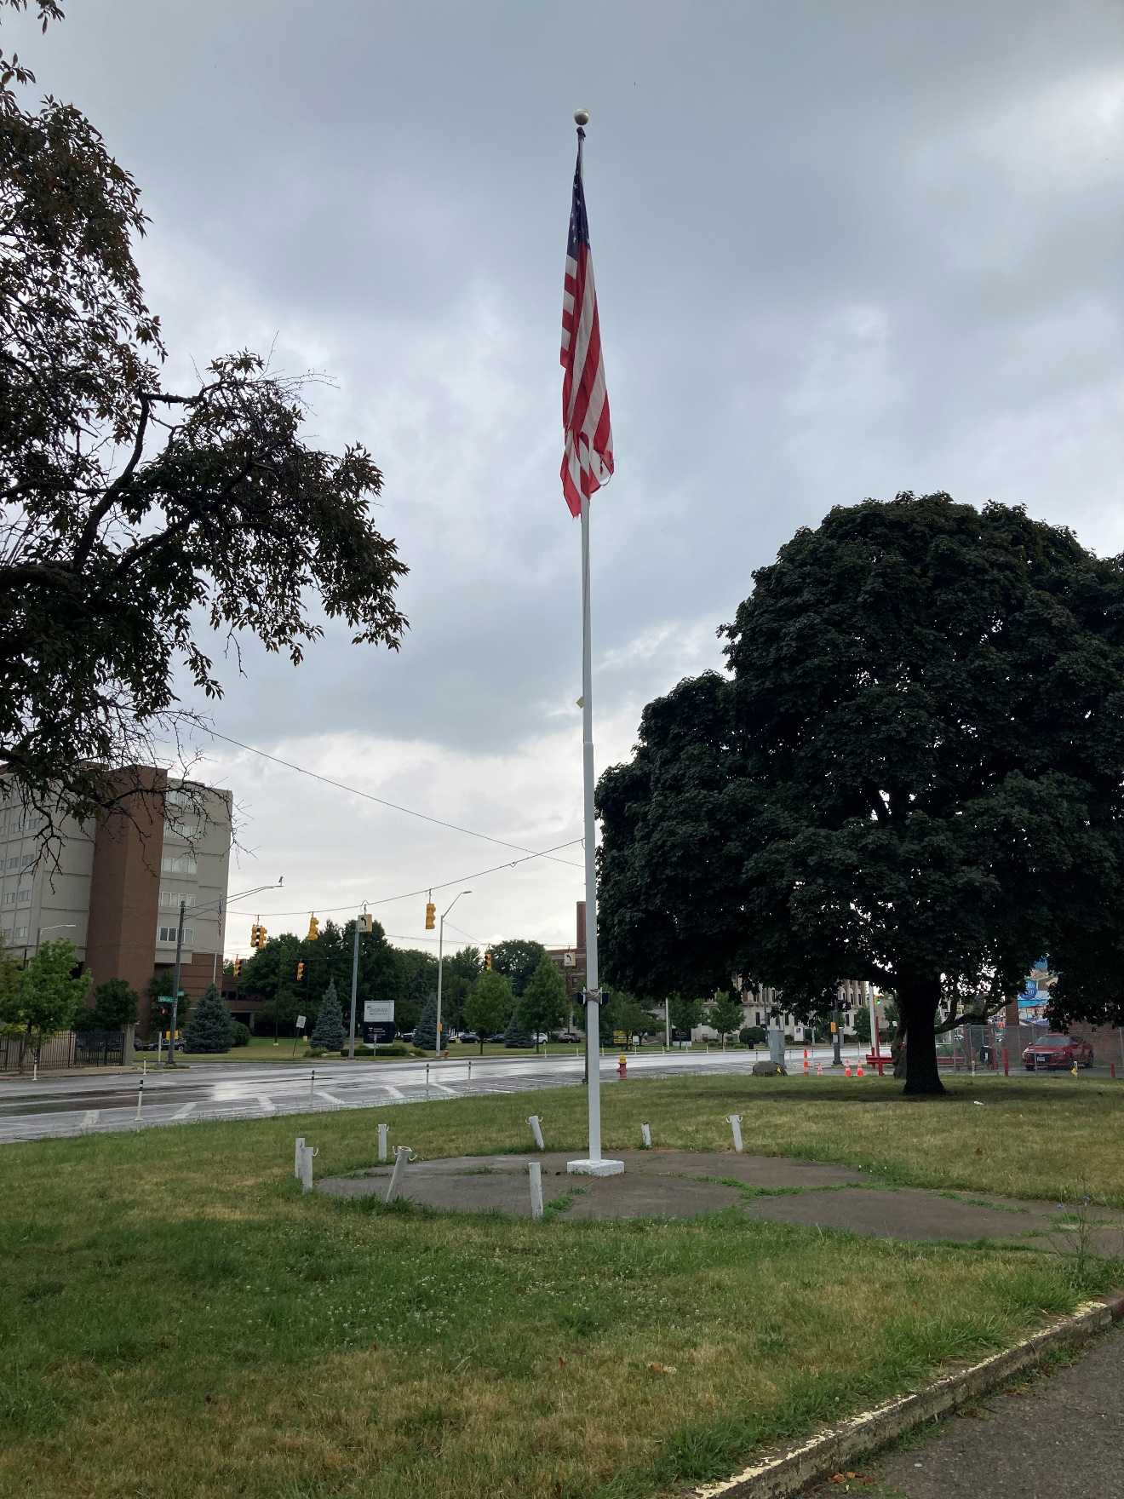
Figure #22: Exterior, flagpole and surround, looking northeast. 2022

Slide 16
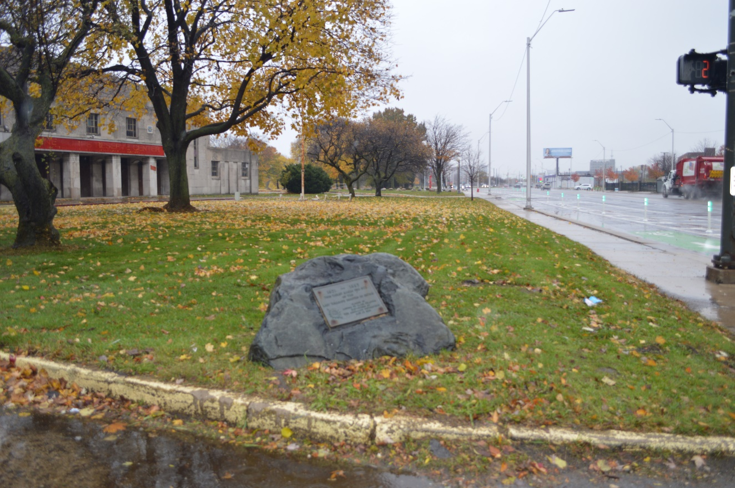
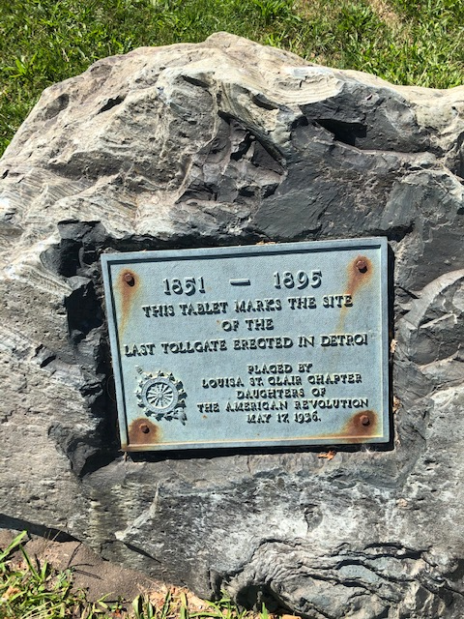
Figure #23: Exterior, Rock with Plaque. 2018
Figure #24: Exterior, Rock with Plaque. 2018

Slide 17
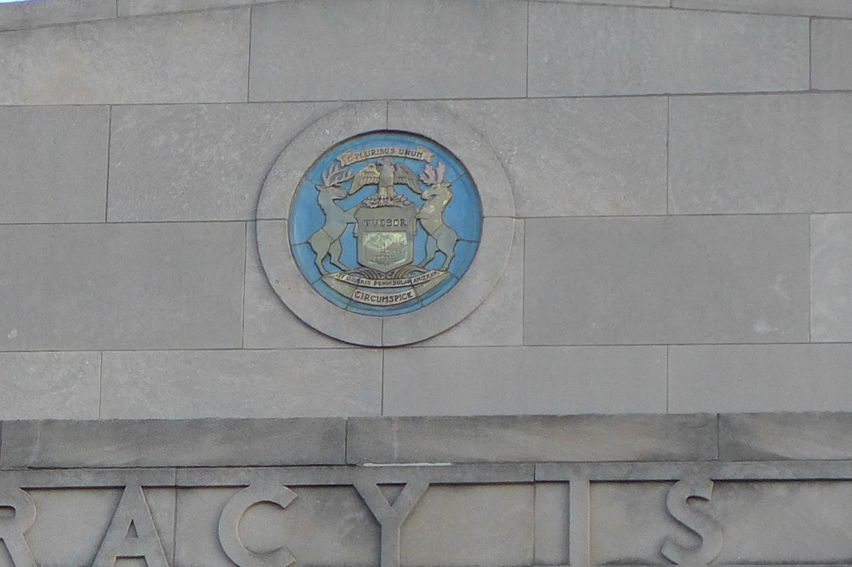
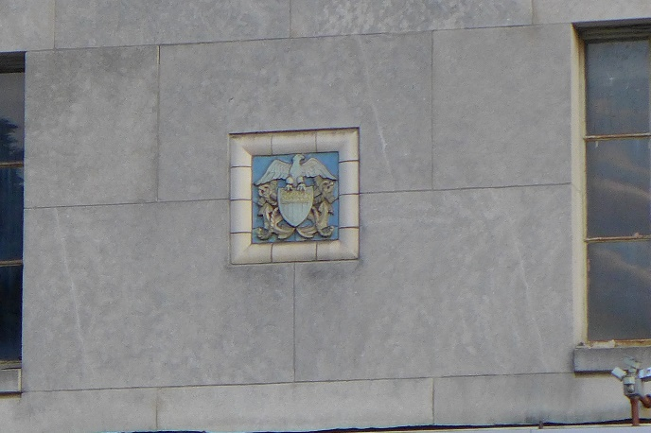
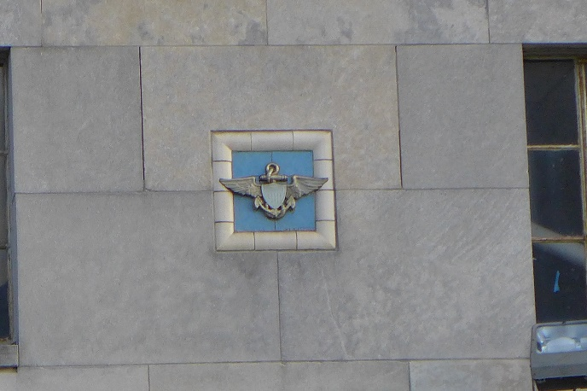
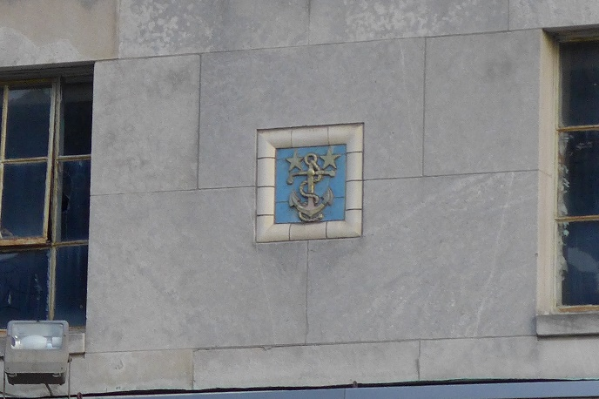
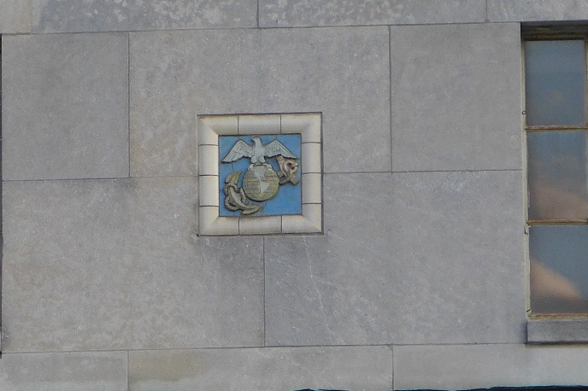
Figure #25: Exterior, Plaque on primary facade. 2020
Figure #26: Exterior, Nautical Pewabic Tiles. 2022

Slide 18
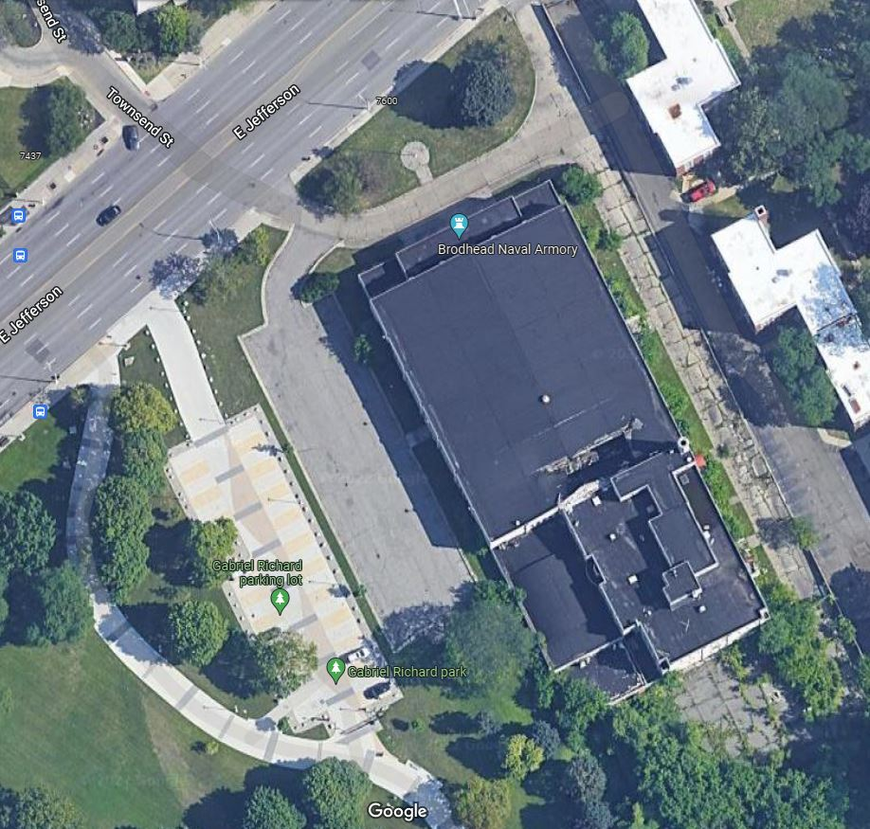
Figure #27: Exterior, Google Earth View.

Slide 19
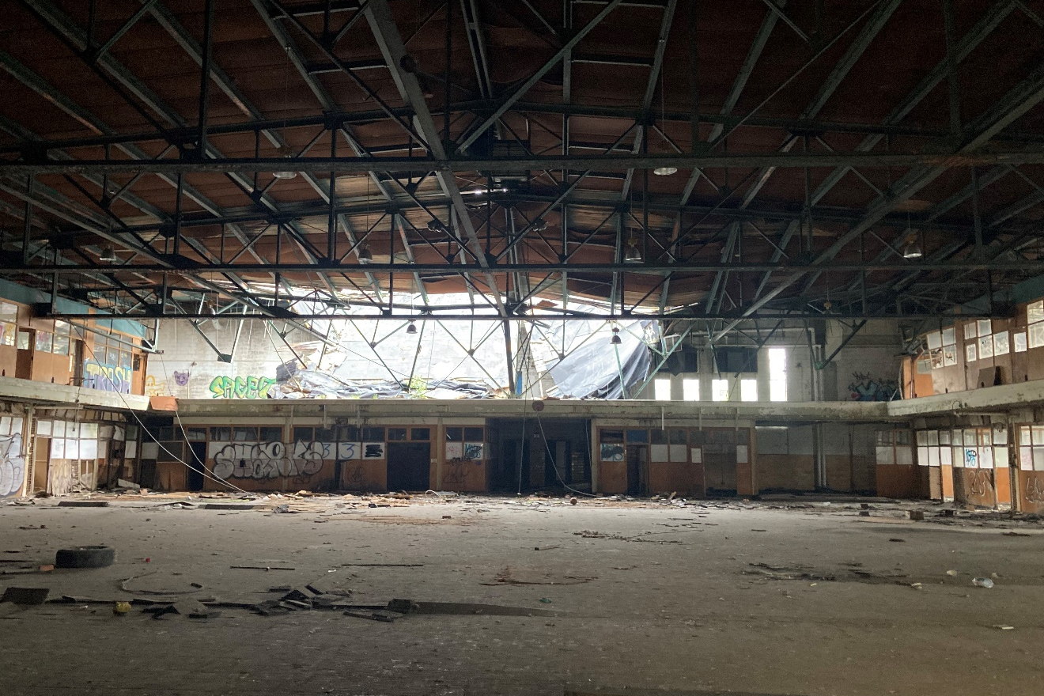
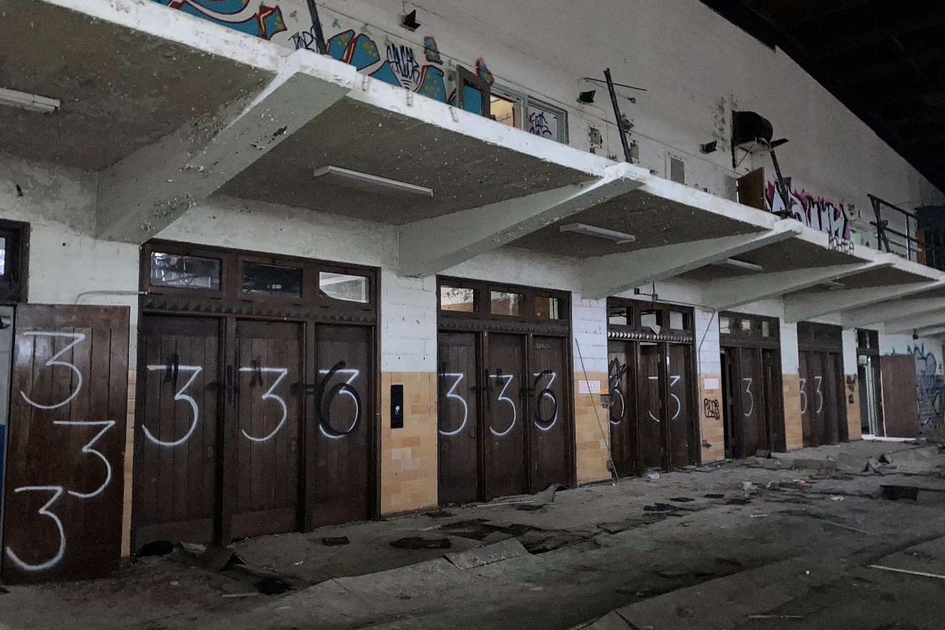
Figure #28: Interior, North Block, Drill Hall, Looking South. 2022
Figure #29: Interior, North Block, Drill Hall, Looking Northeast. 2022

Slide 20
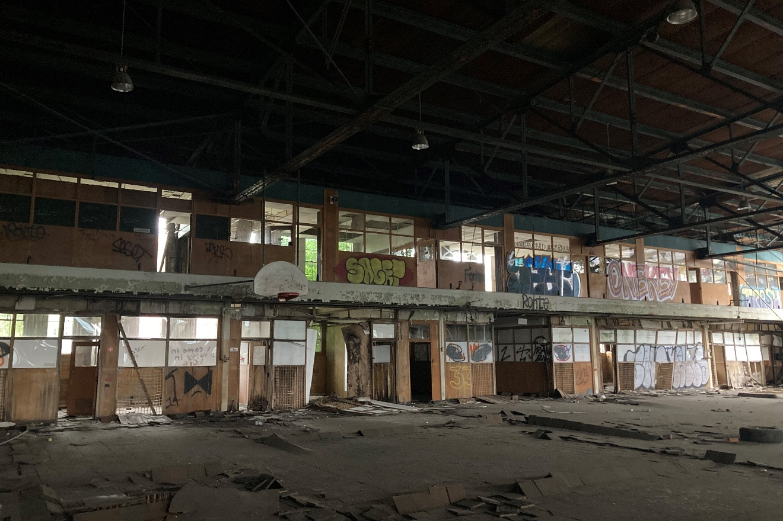
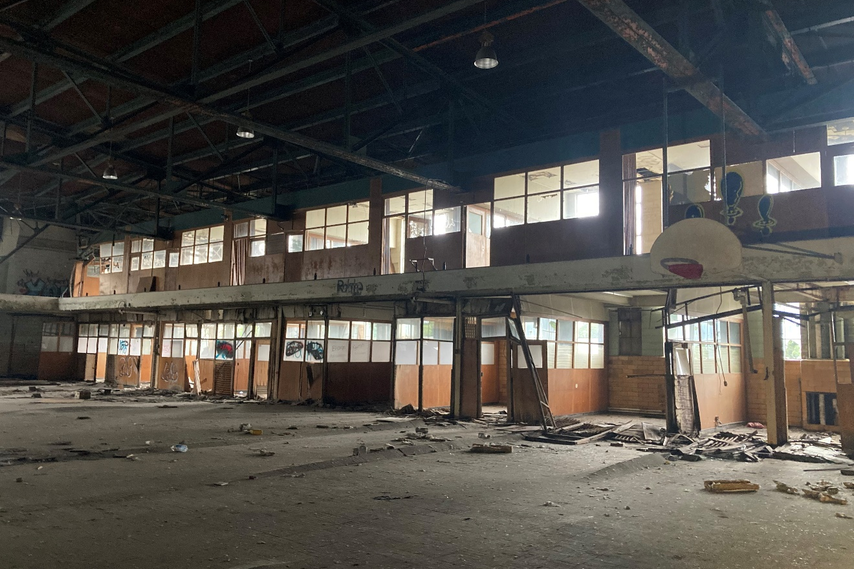
Figure #30: Interior, North Block, Drill Hall with mezzanine, looking East. 2022
Figure #31: Interior, North Block, Drill Hall with mezzanine, looking west. 2022

Slide 21
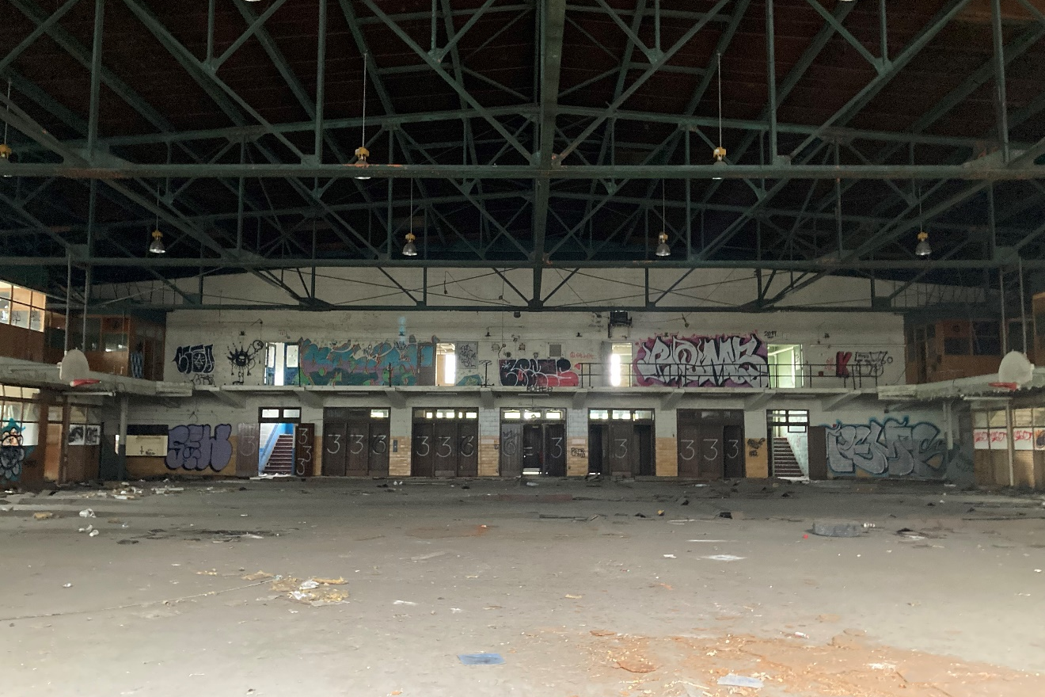
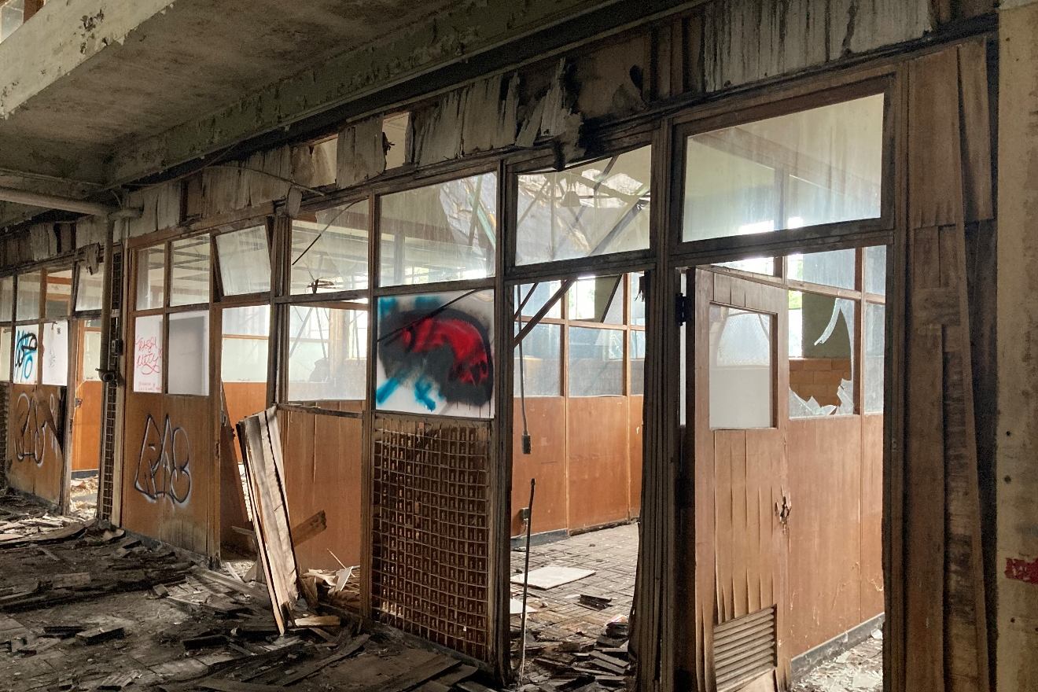
Figure #32: Interior, North Block, Drill Hall, Looking North. 2022
Figure #33: Interior, North Block, partitions under mezzanine. 2022

Slide 22
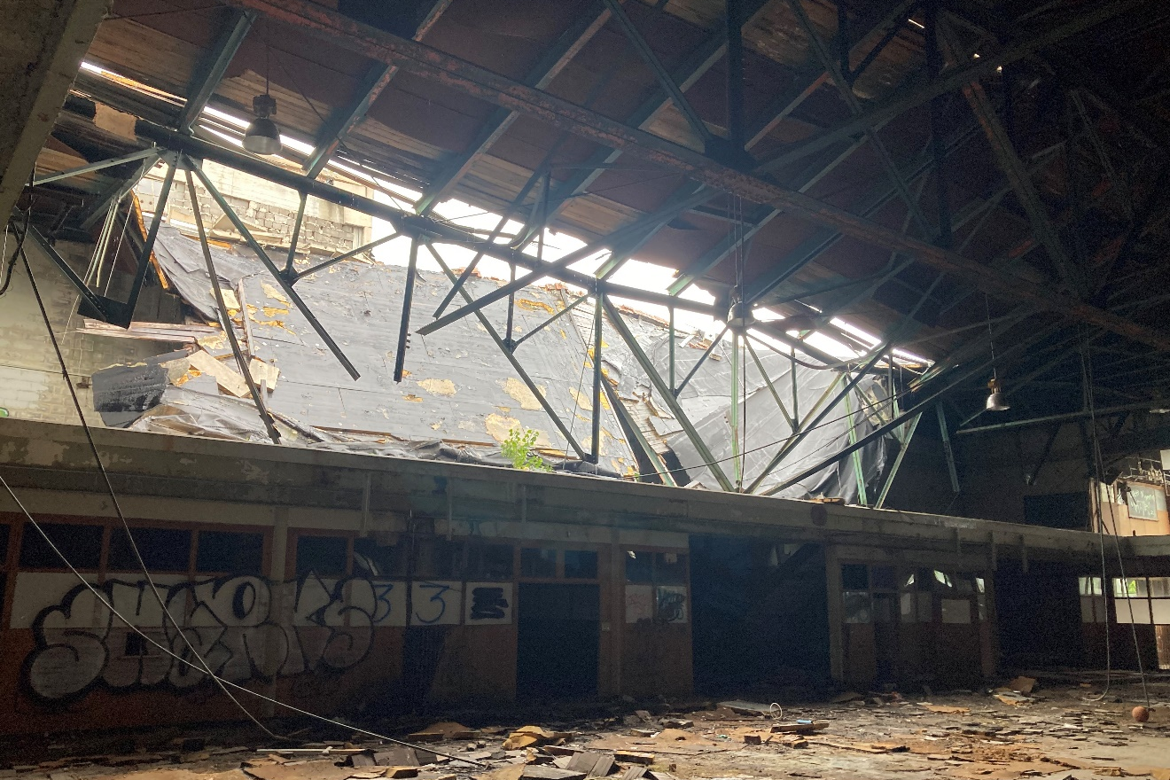
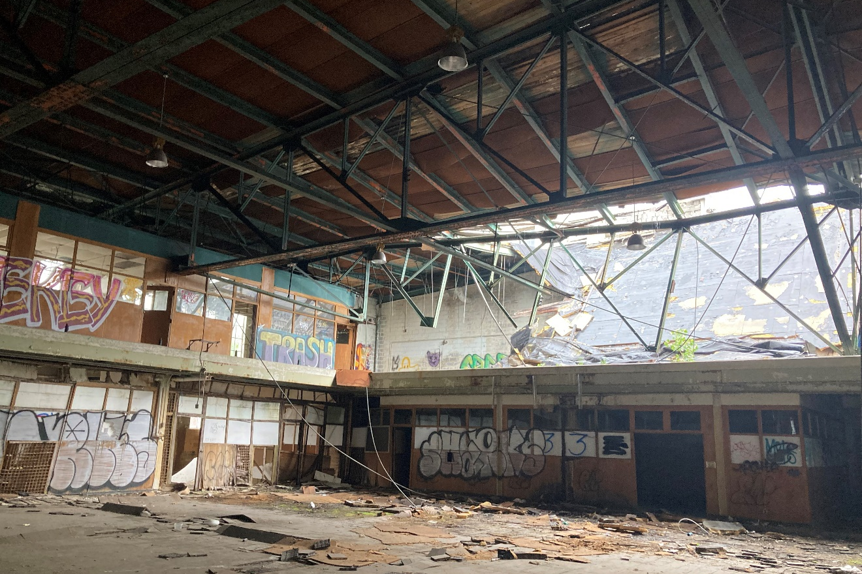
Figure #34: Interior, North Block, Roof Collapse at south end of North Block. 2022
Figure #35: Interior, North Block, Roof Collapse at south end of North Block. 2022

Slide 23
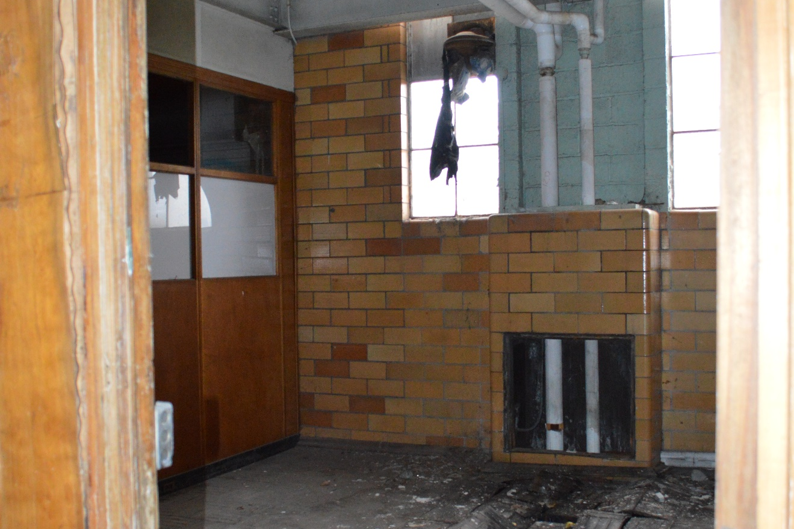
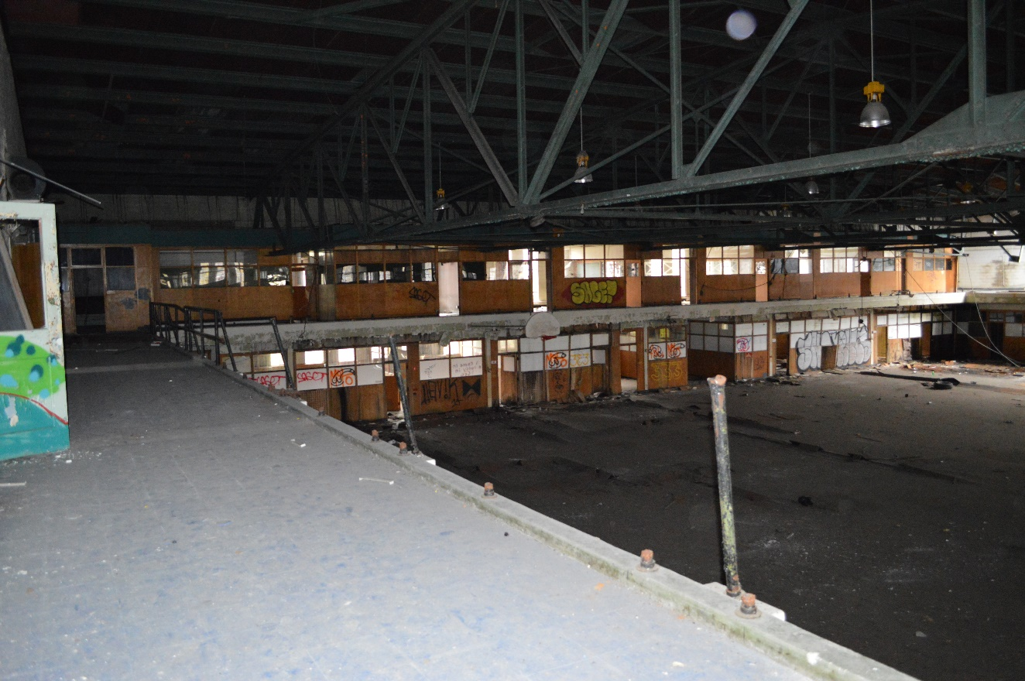
Figure #35A: Interior, 1st Floor, Glazed Brick in Office, 2018.
Figure #35B: Interior, 1st Floor, Mezzanine, Looking East.. 2018

Slide 24
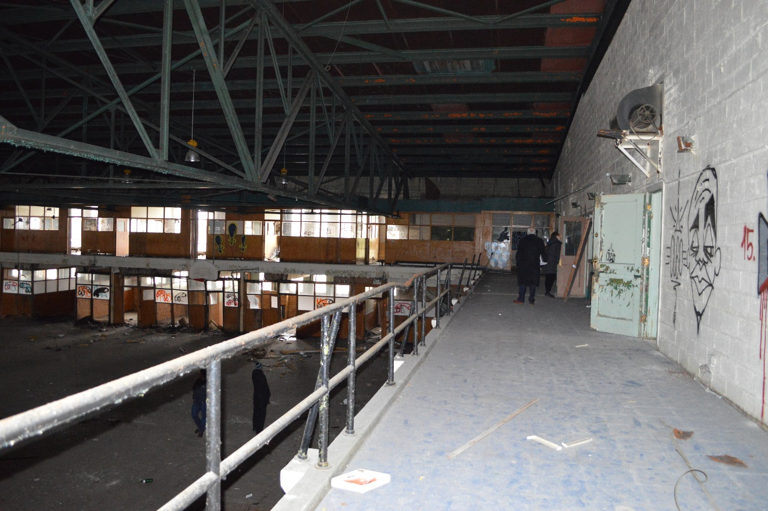
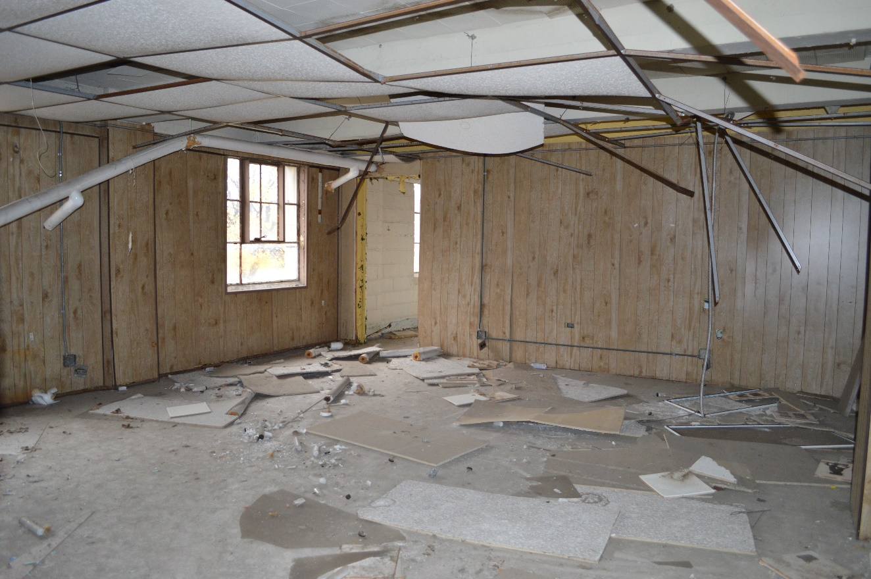
Figure #35C: Interior, Mezzanine, Looking West. 2018
Figure #35D: Interior, Mezzanine Office, Looking South. 2018

Slide 25
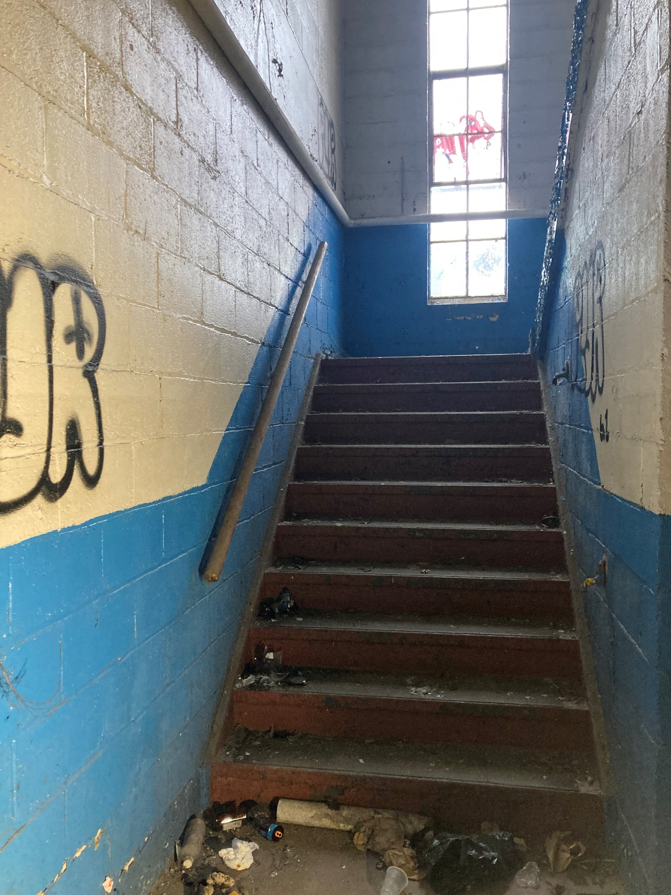
Figure #36: Interior, North Block, Stair. 2022

