Slide 1
867 Edison St
Detroit, MI 48202
16x20 Garage Proposal

Slide 2
Proposal
Construct new 16’x20’x11’ detached garage on already approved concrete pad (Reference App# 20-6713)
Material to be 2x4 construction with 3/8 Smart Side Exterior Vertical Groove Siding (See Specs Attached)
Install 8x7 white raised panel garage door
Install 3/0 x 6/8 Steel Entry Door

Slide 3
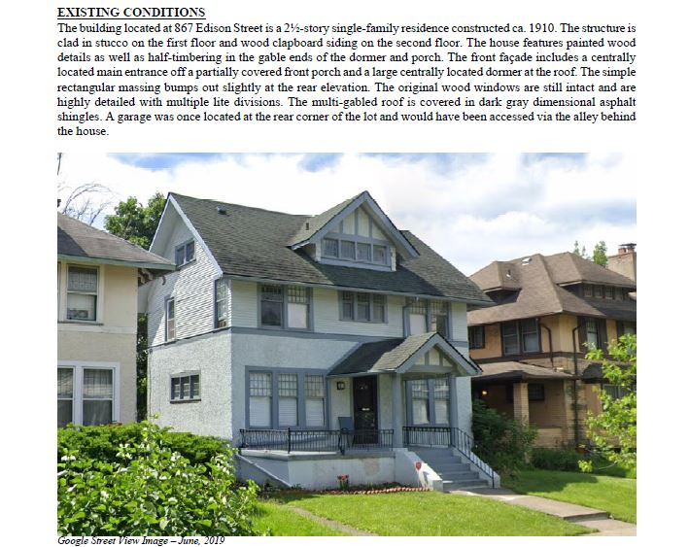

Slide 4
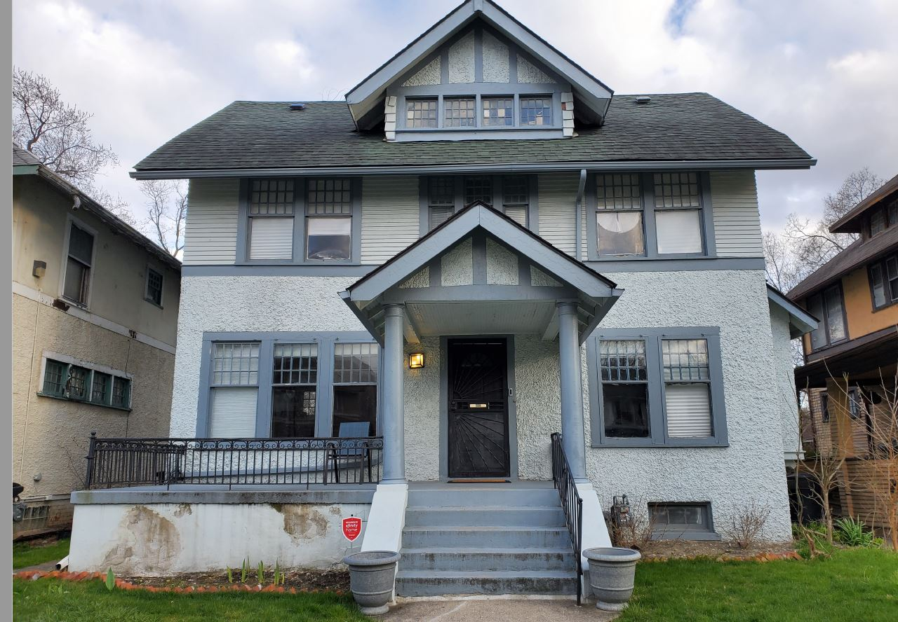

Slide 5
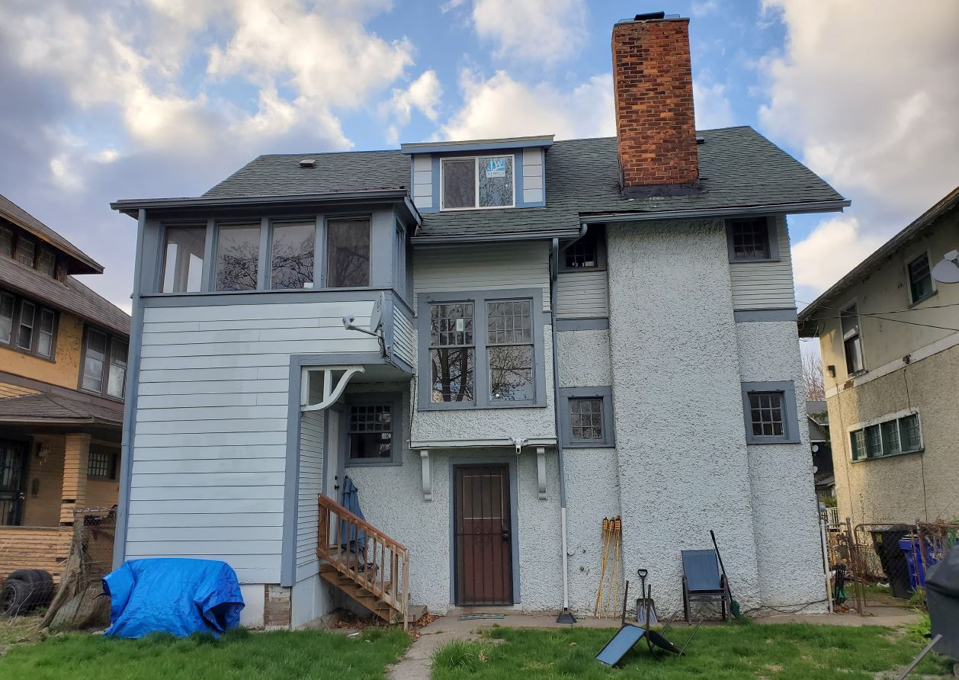

Slide 6
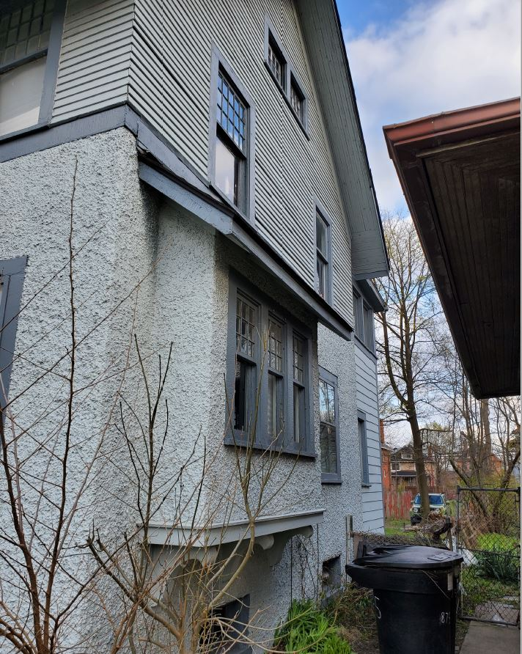
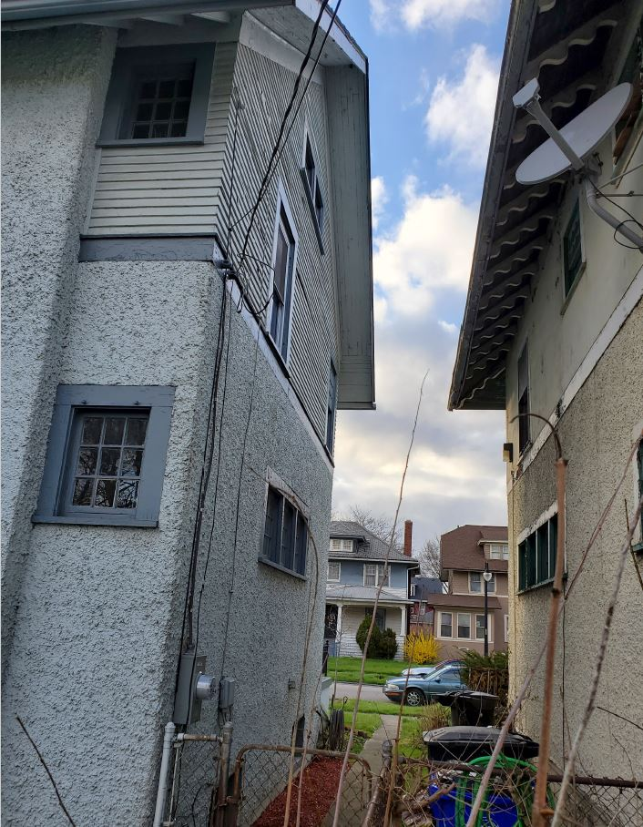

Slide 7
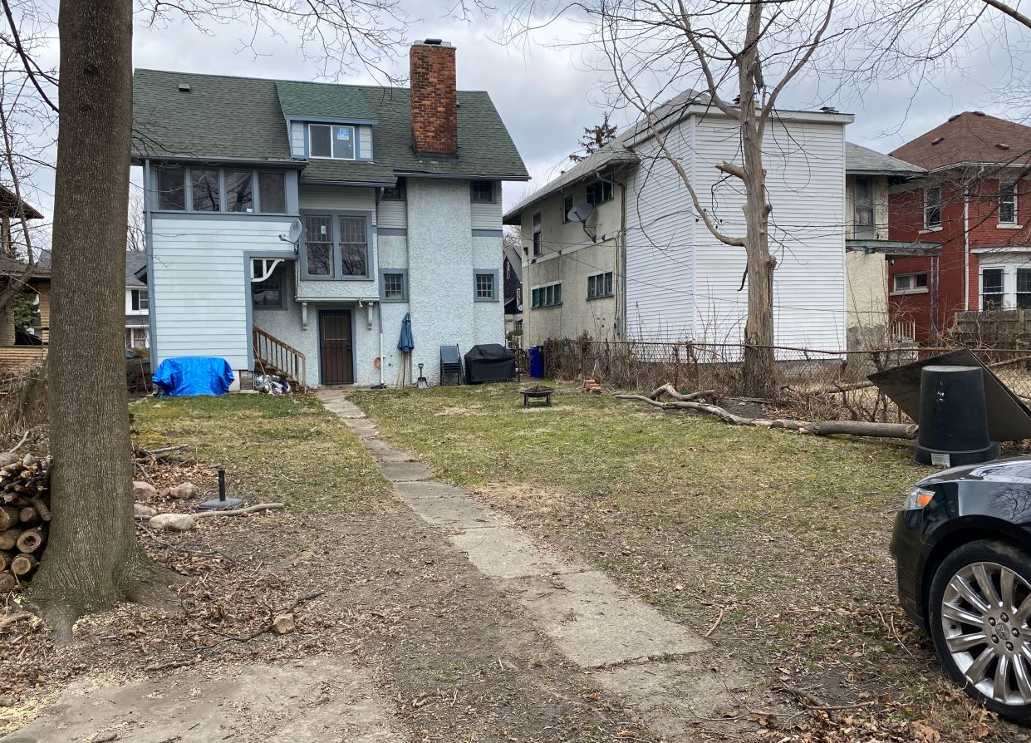
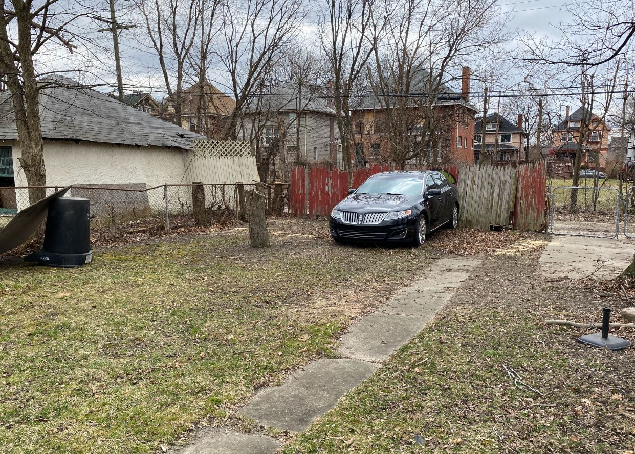

Slide 9
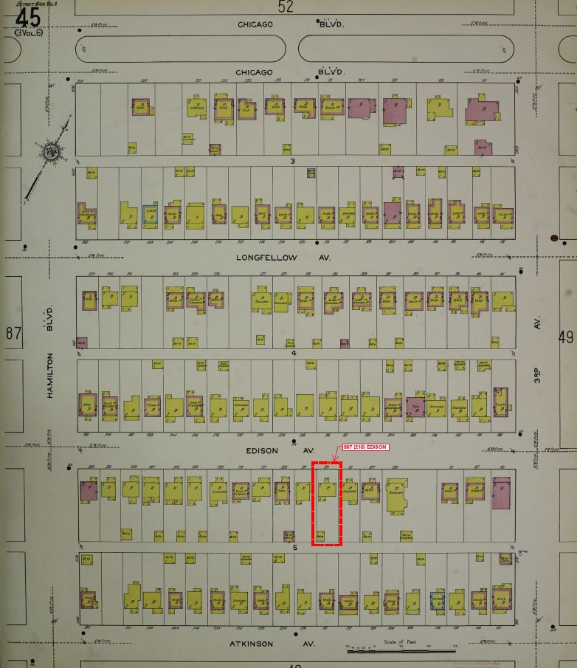
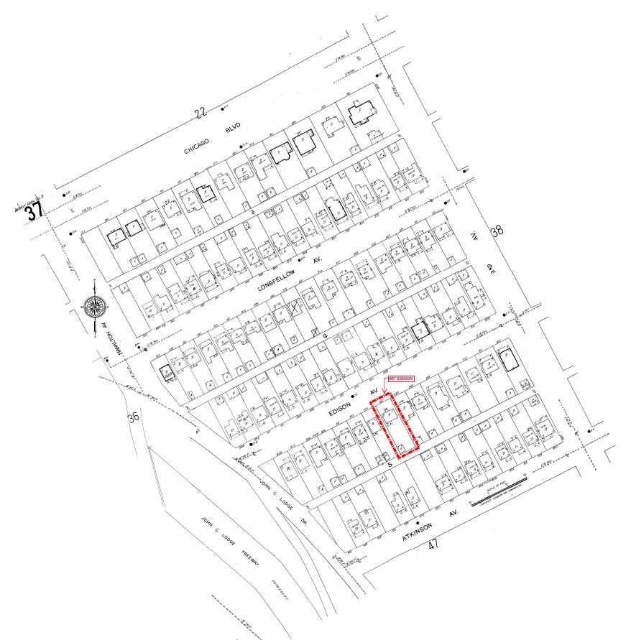

Slide 11
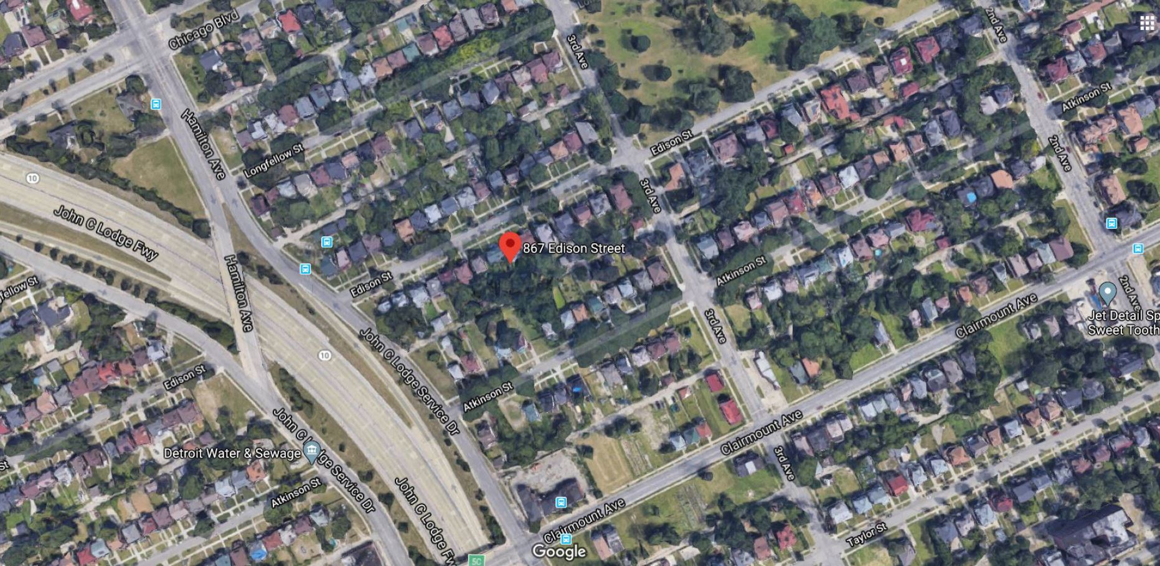

Slide 12
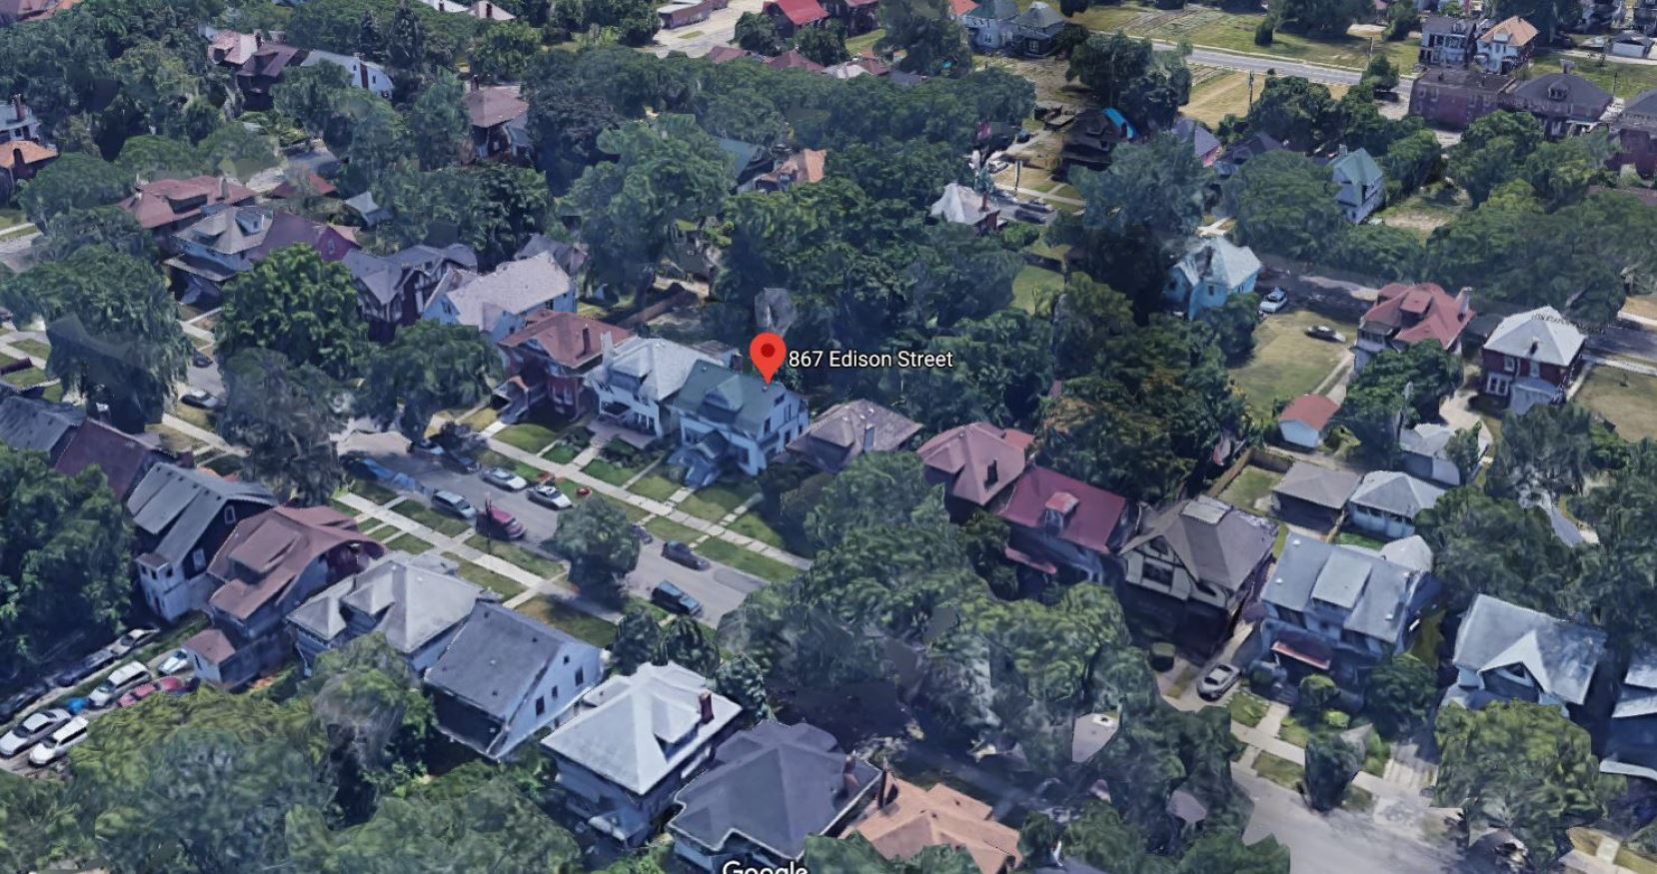

Slide 13
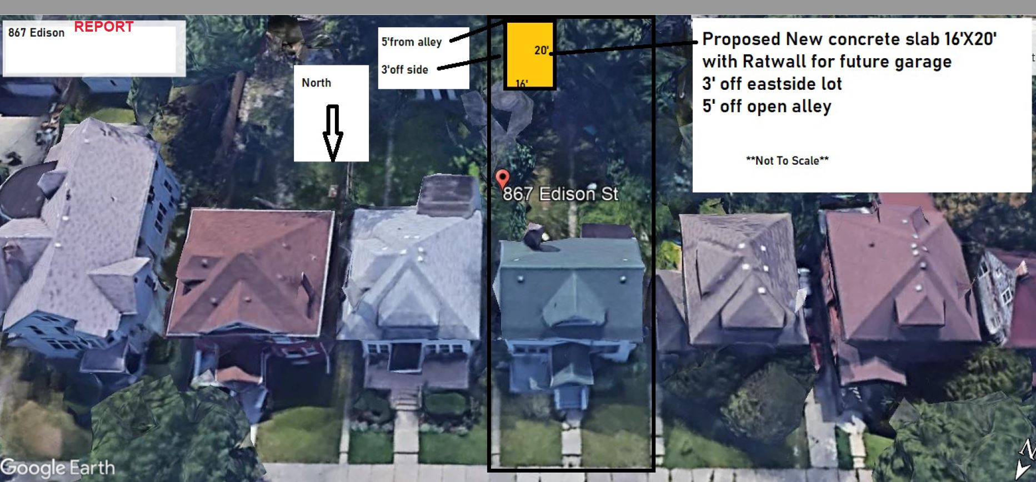

Slide 14
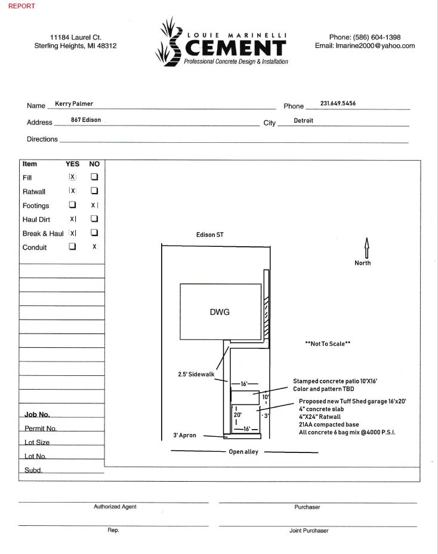

Slide 15
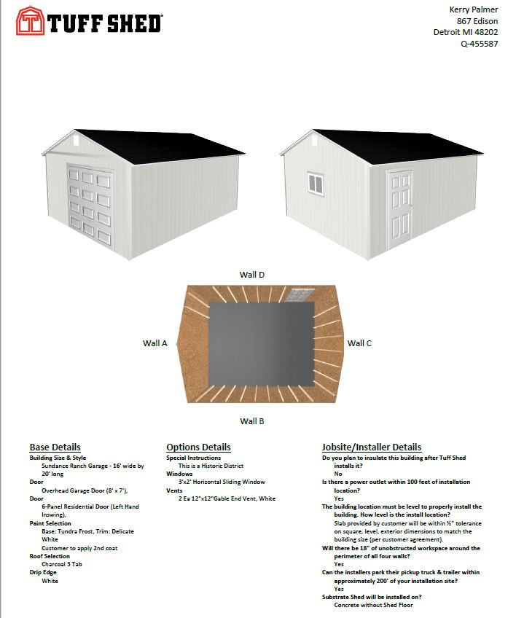

Slide 16
