Slide 1
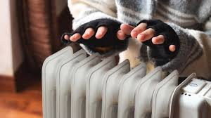
DFD Safety Series: Home Heating and CO Safety
Welcome & Thank You for Joining us for the DFD Safety Series!
Dennis Hunter, Chief of Fire Prevention
General Info: 313-596-2900/2959
Emergencies: 9-1-1
https://detroitmi.gov/departments/detroit-fire-department
2025

Slide 2
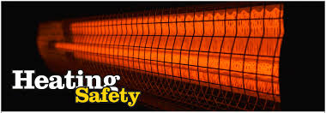
DFD Safety Series: Home Heating and CO Safety
During the winter months everyone wants to stay warm and comfortable in their homes.
Today, we’ll discuss the types of heating appliances we recommend and how to stay safe while using them, as well as how to prevent carbon monoxide poisoning, which can be deadly.

Slide 3
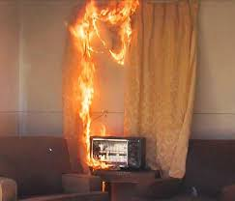
DFD Safety Series: Home Heating and CO Safety
In 2024 in the City of Detroit, we responded to 73 structure fires caused by alternative heating methods such as warming fires and the improper use of heating appliances.
One fire resulted in a civilian fatality and 5 resulted in injuries to civilians and or firefighters.
According to FEMA, house Fires occur in winter months more that any other time of the year and one in every seven house fires involves improper use of heating equipment.

Slide 4
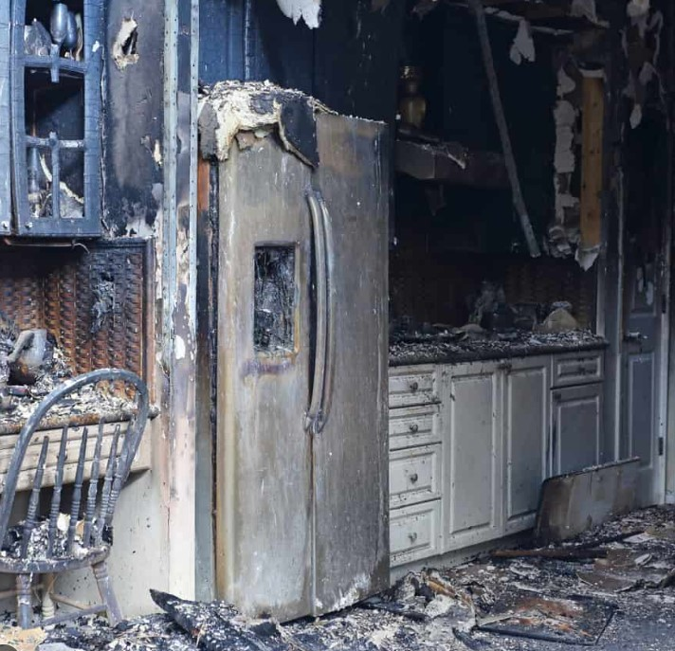
DFD Safety Series: Home Heating and CO Safety
A Red Cross survey showed that more than half of the population uses space heaters – which are involved in most deadly fires related to home heating.
The US Department of Energy records about 25,000 house fires every year that are linked to a space heater fires. Many result in trips to the emergency room, with more than 300 fatalities across the country each year.
Property damage from these fires can also be devastating, requiring extensive professional fire damage restoration.

Slide 5
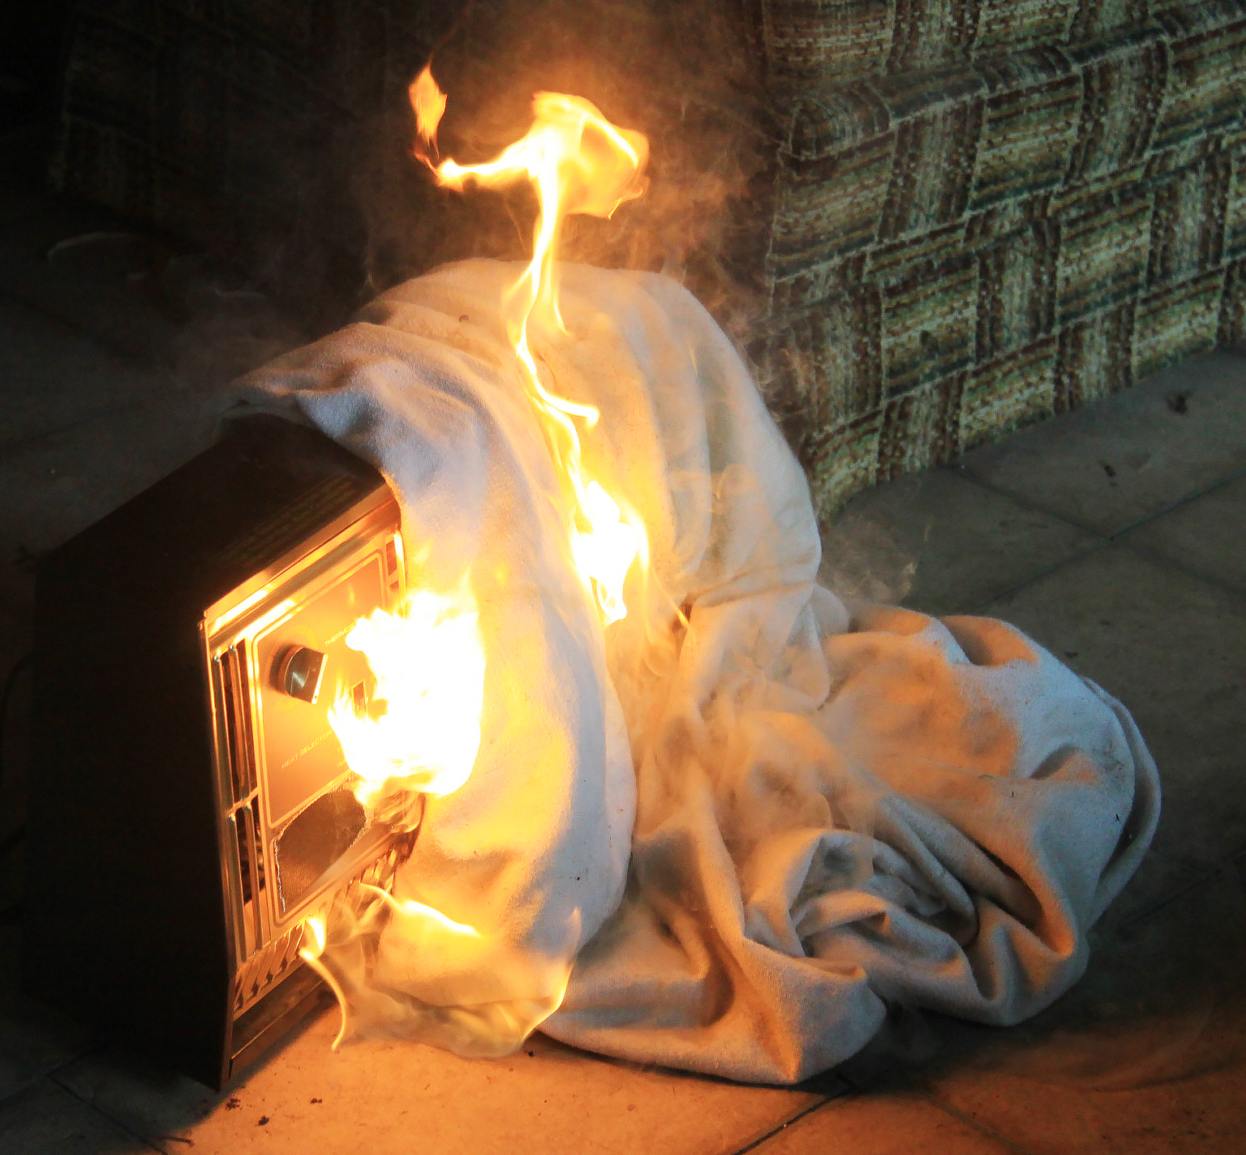
DFD Safety Series: Home Heating and CO Safety
Home Heating Safety Tips:
If you use a space heater, maintain a 3-foot safety zone away from flammable items, such as drapes, clothes and bedding.
Always place space heaters on a flat surface.
Ensure portable heaters have an automatic shut-off feature and are UL listed.
Turn off heaters when you go to bed.

Slide 6
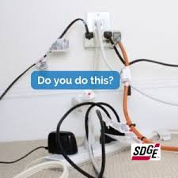
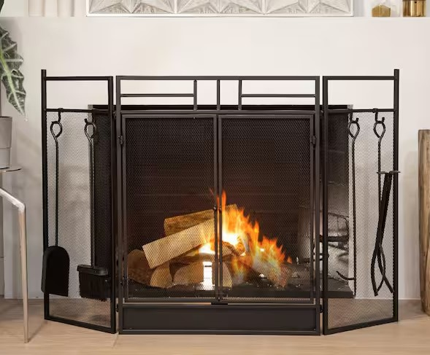
DFD Safety Series: Home Heating and CO Safety
Home Heating Safety Tips:
Check for damaged or frayed cords on all heating appliances.
Never overload outlets with multiple heating appliances.
Each heating appliance should be plugged into its own outlet.
Keep a glass or metal screen in front of your fireplace to prevent embers or sparks jumping out.

Slide 7
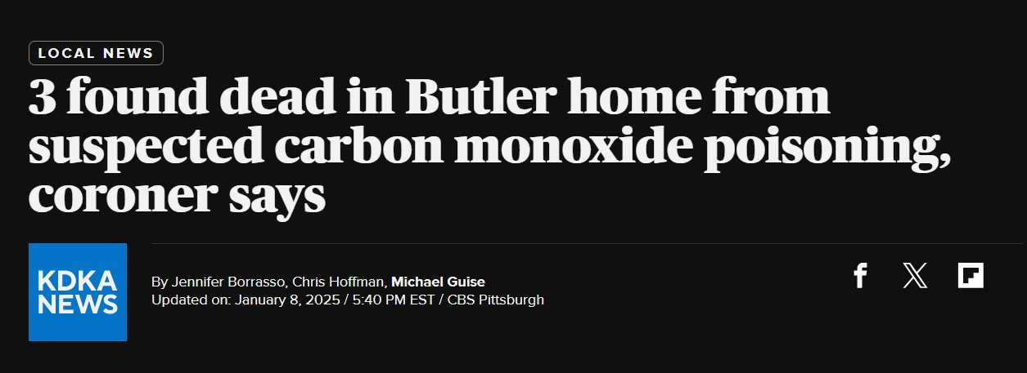
DFD Safety Series: Home Heating and CO Safety
What Not to Do When Heating Your Home – CO Poisoning can be deadly
Never use outdoor heaters inside your home such as propane patio heaters.
Kerosene heaters should only be used indoors for short periods.
During and after a snowstorm, make sure vents for the dryer, furnace, stove, and fireplace are clear of snow build-up.

Slide 8
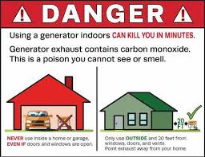
DFD Safety Series: Home Heating and CO Safety
What Not to Do When Heating Your Home – CO Poisoning can be deadly
Never use a generator inside your home or attached porch or garage!
When using a generator outside make sure the exhaust is pointing away from your windows and doors.
Never use your stove as a primary heat source for your home; it is extremely dangerous and can lead to carbon monoxide poisoning and fires. Stoves are designed for cooking, not heating a room - overheating can occur.

Slide 9
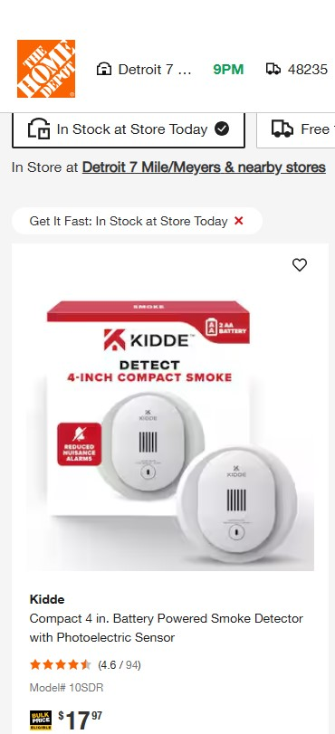
DFD Safety Series: Home Heating and CO Safety
Early Detection saves lives!
Carbon Monoxide is odorless and tasteless.
Make sure you have working smoke & carbon monoxide detectors, test them annually and change batteries when needed.
Practice a fire escape plan with your family!
Have your furnace inspected each year and keep a 3-foot clearance around furnace.

Slide 10
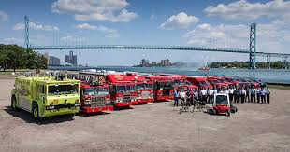
DFD Safety Series: Home Heating and CO Safety
When to call 911:
If you see smoke or flames in your home, get out and call 911. Fire can spread fast – property can be replaced, but people can’t!
CO enters the body through breathing. CO poisoning can be confused with flu symptoms, food poisoning and other illnesses. Some symptoms include shortness of breath, nausea, dizziness, light headedness or headaches. High levels of CO can be fatal, causing death within minutes.
If you experience these symptoms, get outside and call 911!
DFD is here for you – our response times are some of the best in the country. We’ll be there when you need us!

Slide 11
Does DFD offer free smoke alarms and CO Detectors?
Through the Detroit Smoke Alarm Program, the Detroit Fire Department plans to install a total of 5000 smoke alarms in homes citywide by Fall of this year. Applications were open from October through December of 2024, and we had 1600 households apply!
We are in the process of prioritizing and installing these smoke alarms now. As a result of this ongoing program, DFD currently has no smoke alarms available for distribution to the public.
UL Certified smoke alarms and CO detectors are available for purchase at your local hardware store and on Amazon for a relatively low cost. Smoke alarms should be installed in a gathering space in your home, the hallway to your bedroom and just inside each sleeping area. CO Detectors are an easy plug-in device and should be installed on every level of your home and near heating devices such as furnaces.

Slide 12
DFD Safety Series: Home Heating and CO Safety
Thank you for joining us today for the DFD Safety Series.
Please reach out if you have any questions!
Dennis Hunter, Chief of Fire Prevention
Contact Information:
Hunterd5395@detroitmi.gov
(313) 596-2929

