Slide 1
Detroit MODES - Mobility Optimization through data for Equity and Safety

Slide 2
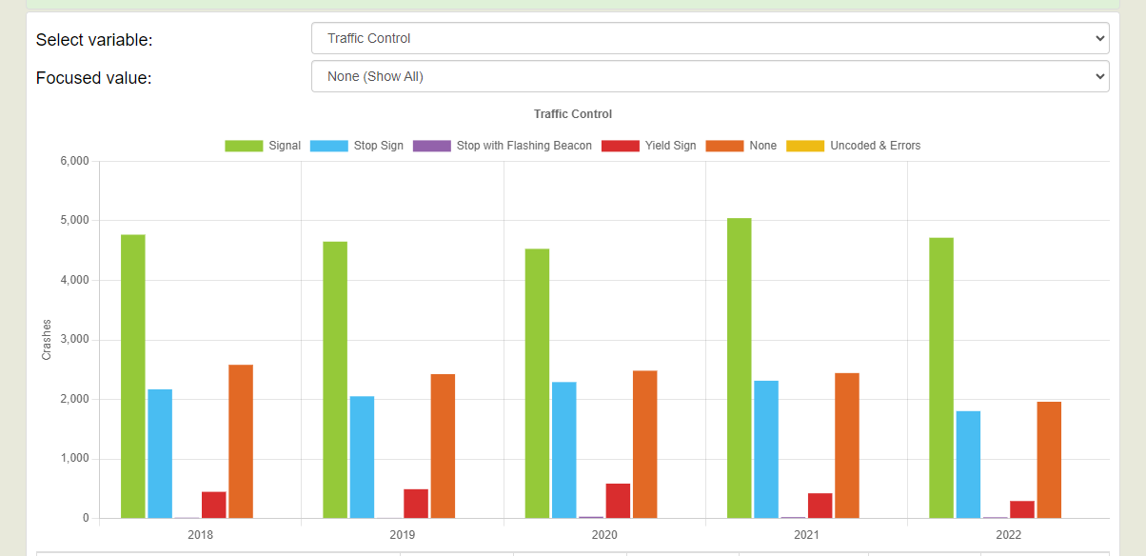
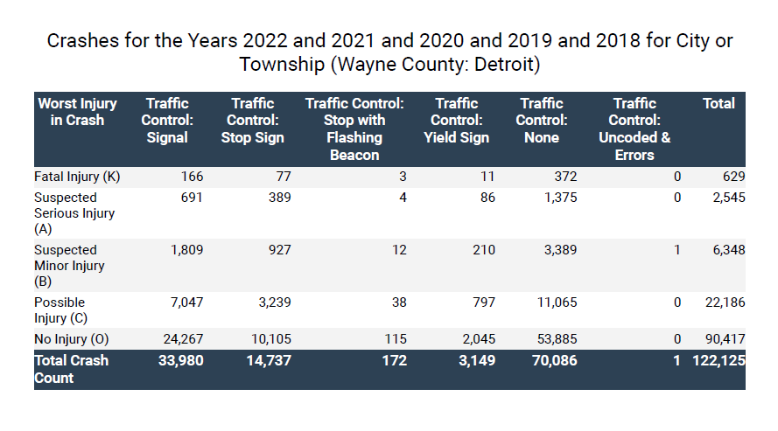
Why Is This Project Important?
Auto accident fatality rate per capita: (for 2020)
#2 among America’s largest cities - (28.71 for every 100,000 people)
#3 among pedestrian death rate
Notes:
We have way too many lives being lost on our roads every year. this is only one additional tool to help us improve safety.
There are different types of intersection control. Signalized intersections are the biggest issues. And we have the most control over that.
Most crashes happening at intersections, happen at signalized intersections.
Working towards no incidents any where in Detroit.
This kind of technology can get us to that point … this is where we can bring the biggest value to you.
---------------
Over a Quarter of all Fatal and Serious Injury Crashes occur at Signalized Intersections.
That is closely followed by Stop and No Controlled Intersections. All aspects of the problem are important, but as a starting point:
Signalized Intersections are the part of the roadway where we have the most information of what's happening and we can have the most impact

Slide 3
Project Overview
01
Engage with City and Public Stakeholder
02
Smart intersection technologies
Identify vehicle crash causes
03
04
Public Information Shared with the Community
05
Analyze and deploy roadway safety interventions
To gather feedback and input into the dashboard data. Focus groups will help shape the public-facing platform. Following CIOGS process and City ordinances and requirements.
Utilizing existing traffic network in communities that need it the most by leveraging smart intersection technologies to collect data.
With various factors in driving, it’s important to identify the reason(s) for each crash and evaluate the impact of safety measures
Relevant findings will be shared with the Community
The effects a stop sign makes to traffic will be able to be tracked with before and after data analysis; shows the specific impact a safety intervention can hold

Slide 4
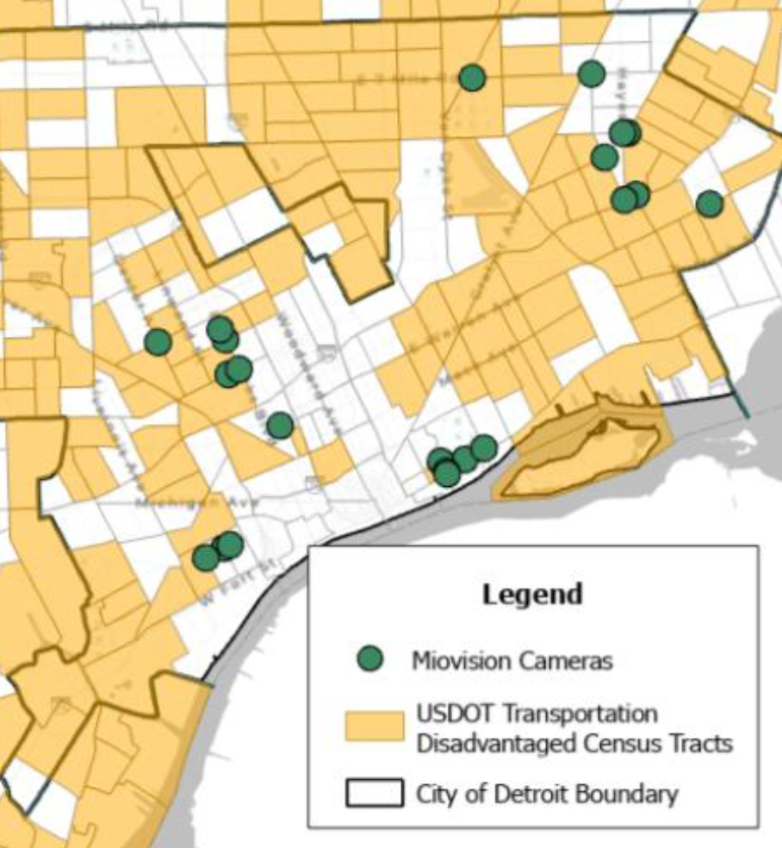
Project Goals
SAVE LIVES
22 locations with Smart Technology
Use findings to find the problem and help figure out the solution.
Find out how useful a solution was
Reduce time spent on crash analysis, intervention, and impact.
Figure 1. proposed 22 locations

Slide 5
Project Standings
Stakeholder Engagement
Design & Implementation
conducted several stake holder meetings to enforce project timeline/quality
start creating the system, analytics, and information reporting
Data Discovery, Analysis
Data Implementation & Integration
Project Partners:
Derq - Advanced traffic safety solutions using existing video streams ​
Miovision - Traffic safety signal management and analytics No new hardware installation required
Notes:
Following CIOGS process and City ordinances and requirements.

Slide 6
Thank you.

