Slide 1


Detroit MODES: Mobility Optimization through Data for Equity and Safety

Slide 2

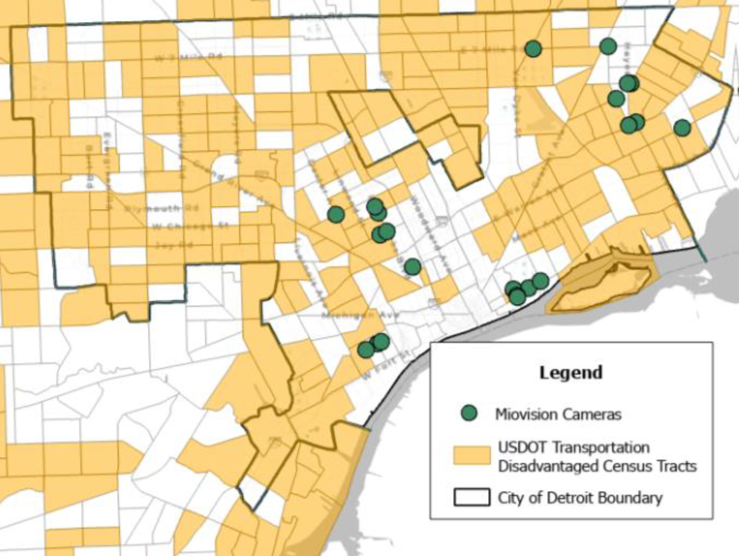
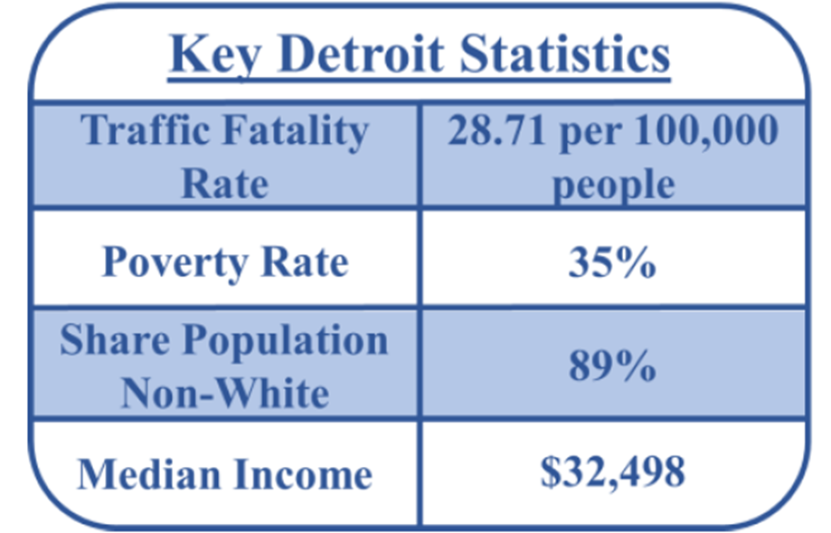
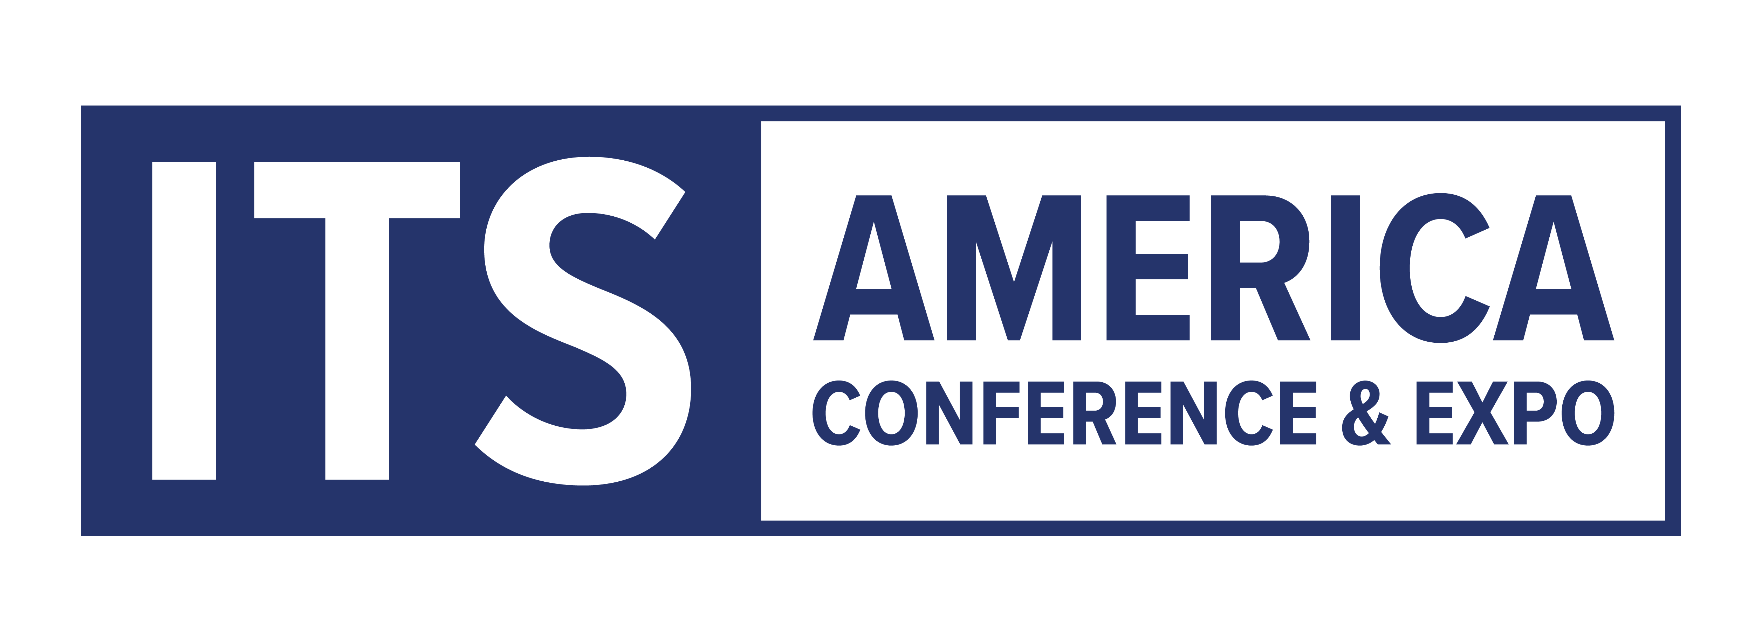
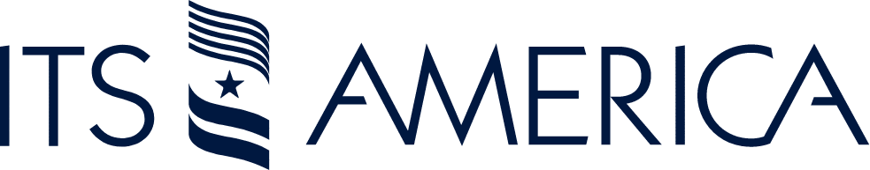
Project Overview and Status
The Detroit MODES project is an innovative initiative to improve transportation safety and equity in the city. By deploying smart intersection technologies, the project aims to collect real-time data, identify crash causes, and assess the effectiveness of safety interventions.
In Partnership With:
Built By:

Slide 3
Project Overview and Status
Why Detroit MODES? Detroit MODES addresses traffic fatalities and mobility challenges, particularly in Historically Disadvantaged Communities (HDCs)
Project Aim - Detroit MODES will deploy smart intersection technology in 22 locations, it utilizes Derq software and Miovision for real-time data collection.
Next Steps - The team will continue to engage stakeholders, finalize data integration, install communications solution with a dedicated server and apply for additional funding to scale the system to reach over 100 traffic signals through Detroit.

Slide 4

Challenges and Goals
Persistent Traffic Fatalities - Detroit faces a high traffic fatality rate, necessitating innovative solutions to enhance roadway safety.
Limited Economic Mobility - The project aims to improve transportation equity, particularly in Historically Disadvantaged Communities.
Data-driven Interventions - The project will leverage smart intersection technologies to collect data, identify crash causes, and evaluate the impact of safety measures.
In Partnership With:
Built By:

Slide 5
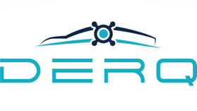
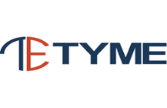

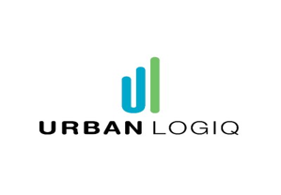
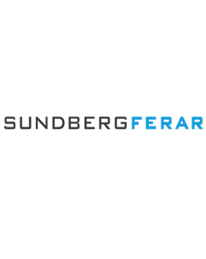
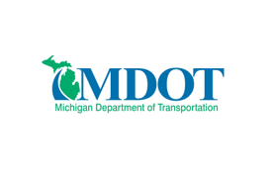
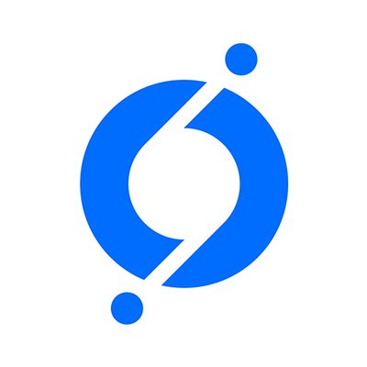
Project Partners
In Partnership With:
Built By:

Slide 6
Current Status
Data Discovery and Intergration - We are currently working with Urban Logiq to obtain and process Big Data Sets, Third-Party Data, and Regional Data which includes O/D, Harsh Braking, Near-Misses, and more.
Stakeholder Engagement - Our Partner Sundberg-Ferar has conducted serval stakeholder meetings with regional and government departments to help guide Urban Logiq and the design team to create a highly functional platform.
Partner Integration - Miovision and Derq have completed the integration of software and hardware which is a crucial function of this project.
Preliminary Design - Tyme Engineering has begun their preliminary design of the system with direct input from the City of Detroit and the partners involve.
In Partnership With:
Built By:

Slide 7
What We’ve Learned
Contracts and Procurement - The procurement process can be much longer than expected due to many factors including: working with grant funds, initiating first-time contracts, working through time-zone differences, proper paperwork filing, and more.
Partner Meetings - Frequent partnership gatherings are needed for comprehension of technologies and personality styles.
Elevator Pitch - Have a one-pager explaining project ready to go in tandem with an elevator pitch. New ideas or technology must be explained to many different groups.
Be Patient – These types of projects will indeed meet unexpected roadblocks and will require innovation for problem solving.
In Partnership With:
Built By:

