Slide 1
2024
ANNUAL ACTION PLAN
WELCOME

Slide 2
2024
ANNUAL ACTION PLAN
City-Wide
Public Hearing Virtual Meetings
Tuesday, June 25 and Wednesday, June 26, 2024
6:00 - 7:00 pm

Slide 3
Agenda
Introductions and Citizen Participation– Marlene Robinson
Overview of the Consolidated/Annual Action Plan incl. Funding Allocations and the 2024-25 Proposed Budgeted Projects & Activities – Warren Duncan
Neighborhood Beautification Grant Program – Sam Coons
Community Resources – Jennifer Mahone, Chelsea Neblett and Brenna Welch

Slide 4
2024 Annual Action Plan – Citizen Participation
Citizen Comments
Citizens will have an opportunity to comment at the end of the presentation. Please write questions and comments in the “Chat” or “raise your hand” during Q & A.
Citizen comments are received by the following methods:
Two Virtual Public Hearings
- June 25 and 26, 2024
In Writing at: Housing &
Revitalization Department, Grants
Management section, 2 Woodward
Ave, Ste. 908, Detroit MI, 48226
3. Via Email at:
ConPlancomments@detroitmi.gov
4. Via Telephone: 1-313-224-6380, Hours:
Monday to Friday from 8:30am-4:30pm
5. Department of Neighborhood District
Manager or City Council person
HRD website
www.detroitmi.gov/hrd
-Copy of draft – 2024 Action Plan
-Copy of presentation

Slide 5
2024 Annual Action Plan – Citizen Participation
Citizen Comments
The public comment period is June 5, 2024 – July 6, 2024. All comments and responses will be reported in our final Action Plan report.
This public hearings will be recorded and available on HRD's Facebook page. The presentation slides will be available on HRD website www.detroitmi.gov/hrd.
To provide an equal opportunity to participate in today’s public meeting, HRD has provided American Sign Language (ASL) interpreters for individuals.
HRD Citizen Participation Plan: https://detroitmi.gov/document/citizens-participation-plan-revised-10-17-22
The public hearings will focus on the Action Plan and is not to discuss funding for organizations or other non-related matters.

Slide 6
HRD – Community Engagement
The Housing & Revitalization Department (HRD) provides community outreach services in the community by disseminating resources to low-moderate income persons about HUD funded programs that are administered by HRD and other related resources.
Community Events: Non-profit organizations, schools, block clubs, churches, sororities, fraternities, back-to-school, resource fairs, and related community events.
Email request to: hrd@detroitmi.gov
Subject Line: HRD Community Engagement request
Include: contact information, name of organization, location, date, time, description of event.
Thank you for your support!

Slide 7
Consolidated Plan & Annual Action Plan
Consolidated Plan – FY 2020-2024
Annual Action Plan FY 2024-25
City of Detroit receives annual U.S. HUD grants:
Community Development Block Grant (CDBG),
HOME Investment Partnership (HOME) Program
Emergency Solutions Grant (ESG),
Housing Opportunities for Persons with AIDS (HOPWA)
HUD requires us to identify and prioritize the City’s housing & community development needs and set five-year goals for use of grants in the plan
Input from diverse stakeholders such as residents, community leaders, non-profits, and private sector to create the plan
City’s application to HUD to receive annual allocation of HUD Grant funds
Identifies strategic projects and programs to be done using the annual HUD funding
Supports the strategies, goals, & objectives of the Consolidated Plan
Leverages private sector, state, and local general funds investment
FY 2024-25 Annual Action Plan is the 5th year of 5-yr Consolidated Plan

Slide 8
Consolidated Plan Strategy & Annual Action Plan
Five Year Plan
2020-2024
(Contains Strategies, broad goals, and objectives)
Plan was submitted in Jan 30, 2021
Now Due 2024
Action Plan
Year 1: 2020
(Contains specific implementing actions to carry out five year strategies, goals and objectives)
Action Plan
Year 2: 2021
(Contains specific implementing actions to carry out five year strategies, goals and objectives)
Action Plan
Year 3: 2022
(Contains specific implementing actions to carry out five year strategies, goals and objectives)
Action Plan
Year 4: 2023
(Contains specific implementing actions to carry out five year strategies, goals and objectives)
Action Plan
Year 5: 2024
(Contains specific implementing actions to carry out five year strategies, goals and objectives)
Goals
Primarily focused on low-to moderate-income households and communities
Development of decent and affordable housing
Create suitable living environments and promote quality of life
Expand economic opportunities

Slide 9
FY 2024-25 HUD FORMULA ALLOCATIONS
COMMUNITY DEVELOPMENT BLOCK GRANT (CDBG)………......…$32,759,210
HOME INVESTMENT PARTNERSHIP (HOME)…...............................$ 5,928,131
EMERGENCY SOLUTIONS GRANT (ESG)…………………...……….. $ 2,990,945
HOUSING OPPORTUNITIES FOR PERSONS W/AIDS (HOPWA)…...$ 3,593,290

Slide 10
City of Detroit Funding Allocations 2005 – 2024

Slide 11
Identify & Prioritize Housing & Community Dev Needs
The City’s housing and community development needs were identified and prioritized below using a combination of online community needs surveys and analysis of demographic, housing, and economic data:
Housing
Economic Development
Public Infrastructure and Neighborhood Services
Community and Public Facilities
Public Services
Homeless Prevention

Slide 12
COMMUNITY DEVELOPMENT BLOCK GRANT (CDBG)
2024-25 Project/Activity Expenditure Budget
Admin/Planning | $6,551,842
Demolition | $0
Economic Development (Summer Job Program & Training) | $1,500,000
Home Rehabilitation (incl Lead and service delivery costs) | $11,829,303
Housing Development- Pre-development Afford Hsg (incl staff) | $1,743,795.5
Public Facility Rehabilitation | $0
Public Service | $2,456,940.75
Homeless Public Service | $2,456,940.75
Choice Neighborhood Initiative | $2,000,000
Section 108 Loan Repayments | $4,220,388

Slide 13
2024-25 ACTIVITY EXPENDITURE BUDGET (CDBG)
Admin/Planning | 6,551,842
Demolition | 0
Economic Development | 1,500,000
Home Rehabilitation (incl Lead) | 11,829303
Housing dvlpt -/Pre-dvpt Affr Hsg | 1,743,795.5
Public Facility Rehabilitation | 0
Public Service | 4,913,881.5
Choice Neighborhood Initiative | 2,000,000
Section 108 Loan Repayments | 4,220,388

Slide 14
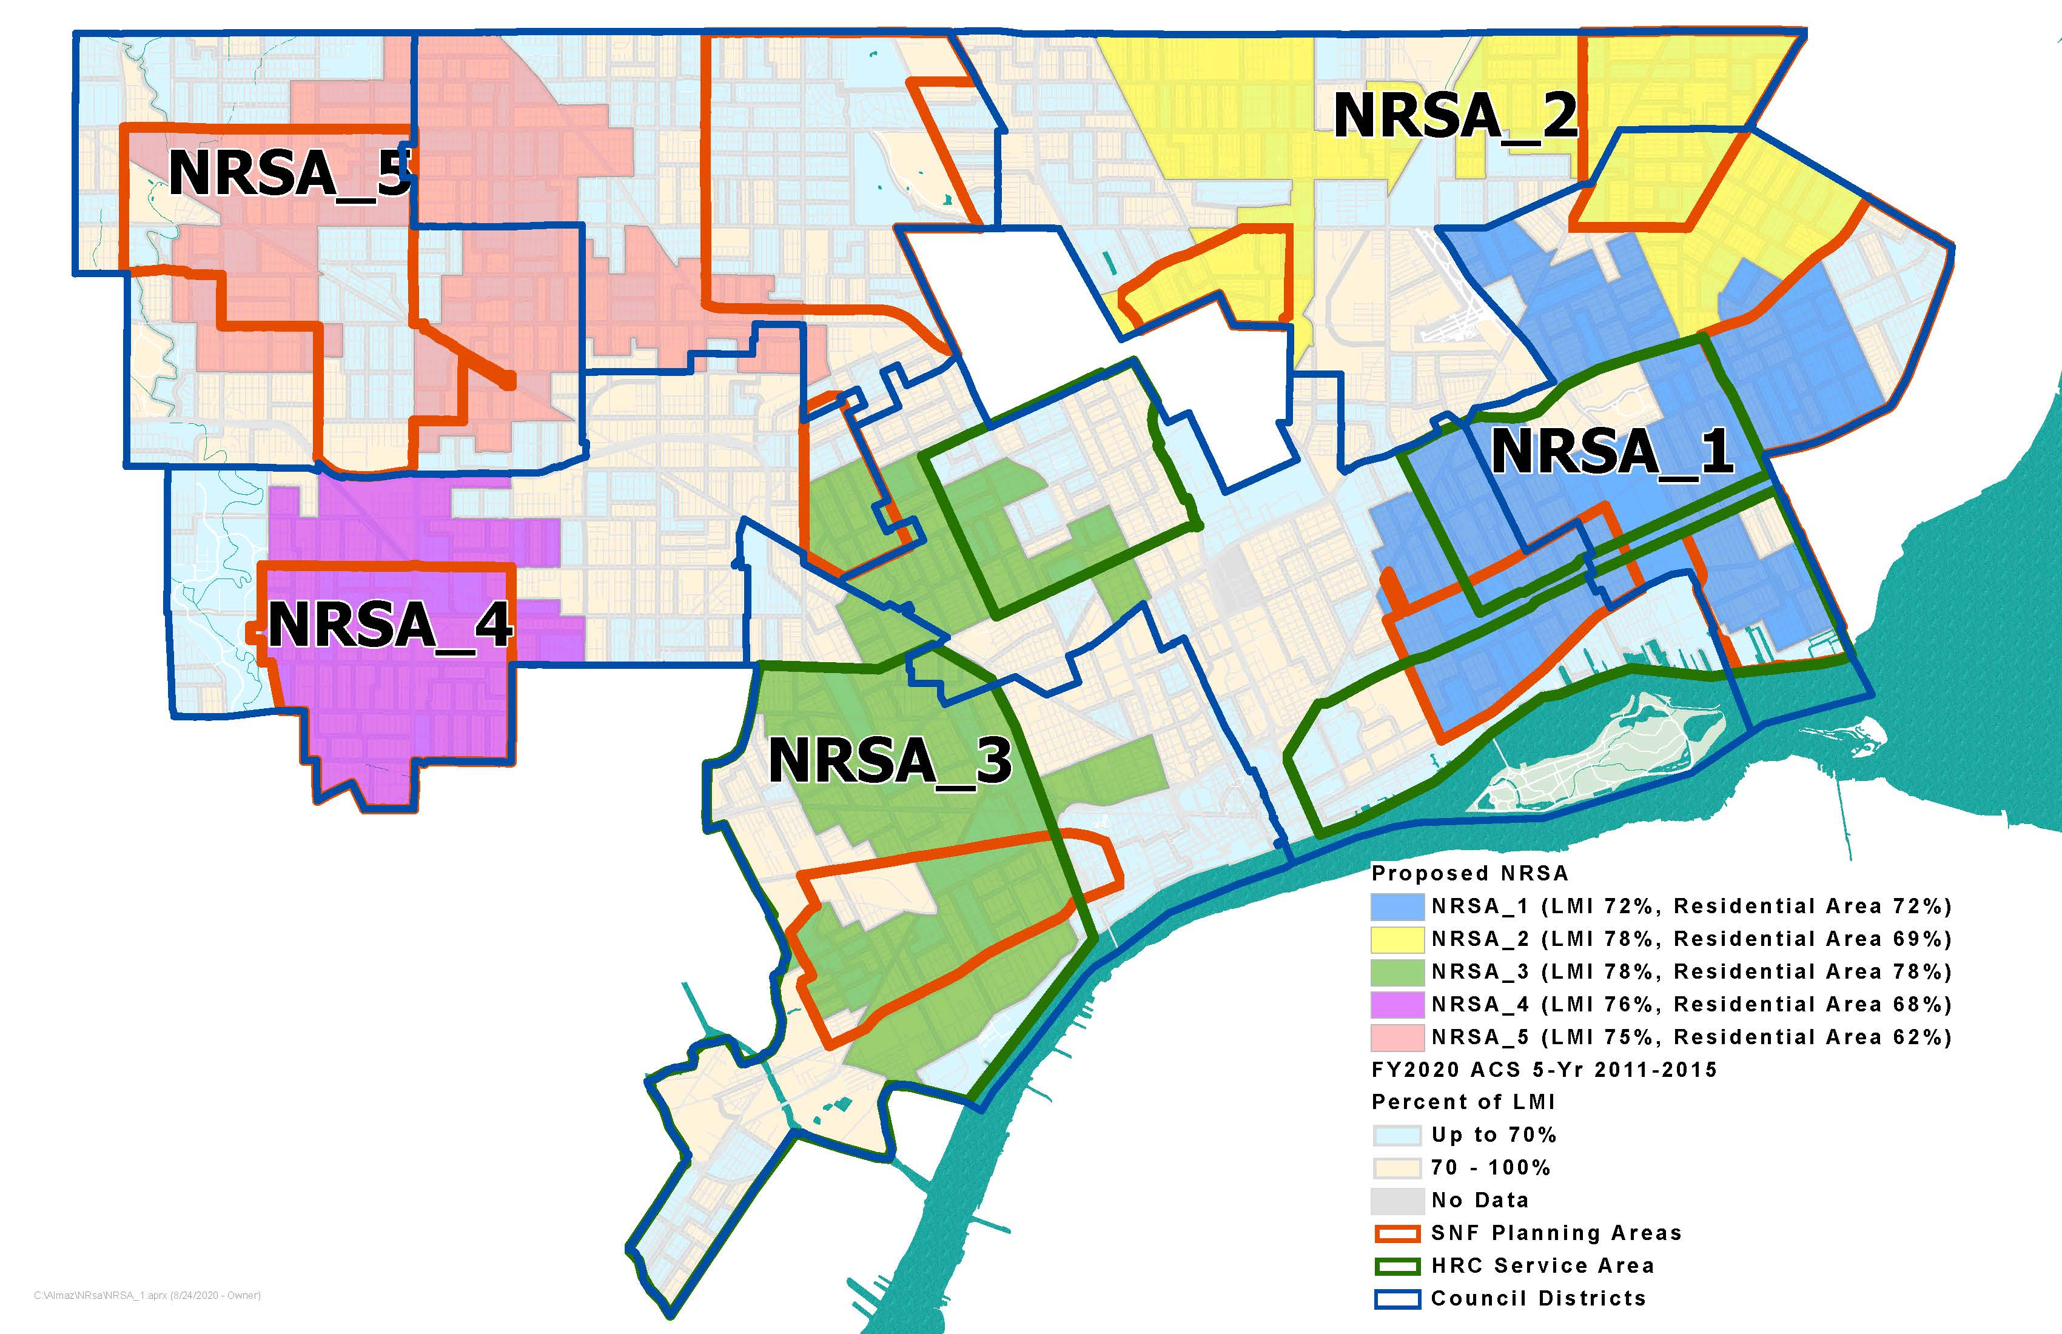
2020-2024 NRSAs

Slide 15
New 5-Year HUD Consolidated Plan 2025-2029
The next 5-year Consolidated Plan is due before August 15, 2025.
Citizen Participation: Looking for interested organizations who would like to host a community meeting between January 2025 thru May 2025 where HRD staff will present the following:
Topics
  Education about the HUD Consolidated Plan Process
  Community needs survey
  Neighborhood Revitalization Strategy Area (NRSA)
Email request to: ConPlanComments@detroitmi.gov
Subject Line: HRD Consolidated Plan - Community Engagement request
Include: contact information, name of organization, purpose of organization, location of community meeting, date, time

Slide 16
COMMUNITY RESOURCES
COMMUNITY RESOURCES

Slide 17
COMMUNITY RESOURCES

Slide 18
COMMUNITY RESOURCES

Slide 19

Detroit Housing Resource HelpLine​
866-313-2520 Monday-Friday 8am-6pm, Saturday 9am-12pm

Slide 20
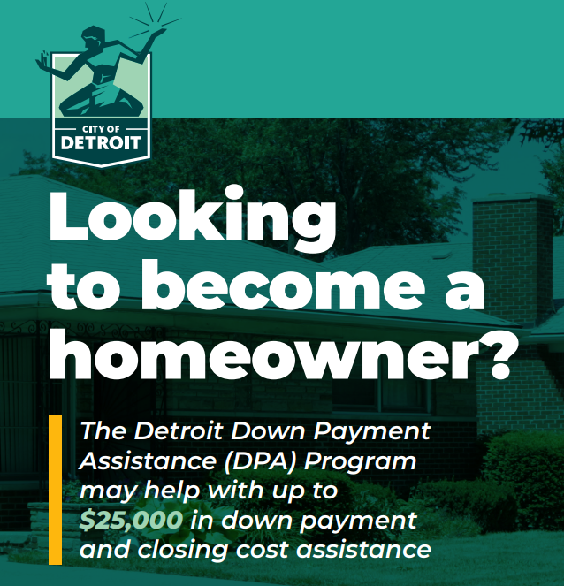
Detroit Down Payment Assistance
GET READY! New applications will be accepted soon!
Visit www.detroitDPA.org to sign up for the DPA Interest List.
You will be notified when the program reopens for new applications and other resources.​
The Detroit DPA Program assists with up to $25,000 for the following:​
Down payment​
Prepaids​
Closing costs​
Principal reduction​
Interest rate buy-down​

Slide 21
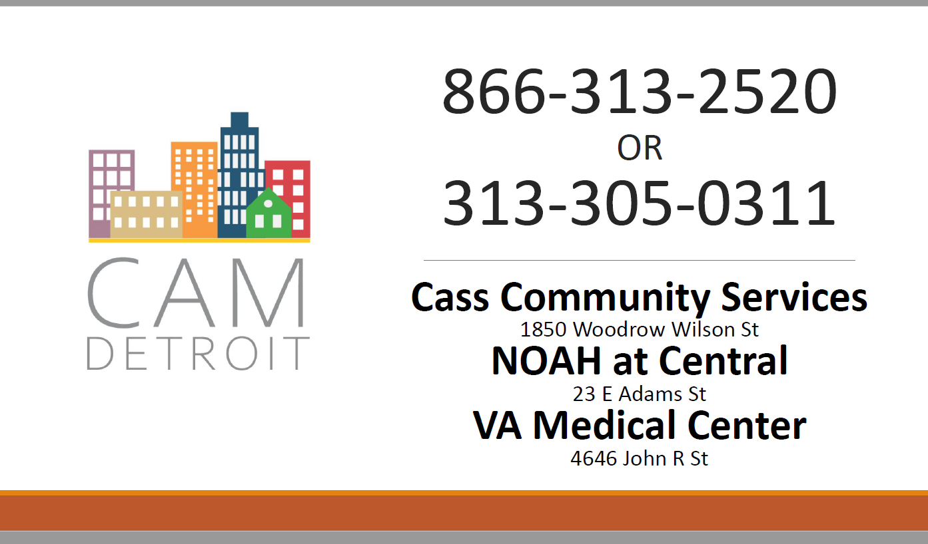
COMMUNITY RESOURCES

Slide 22
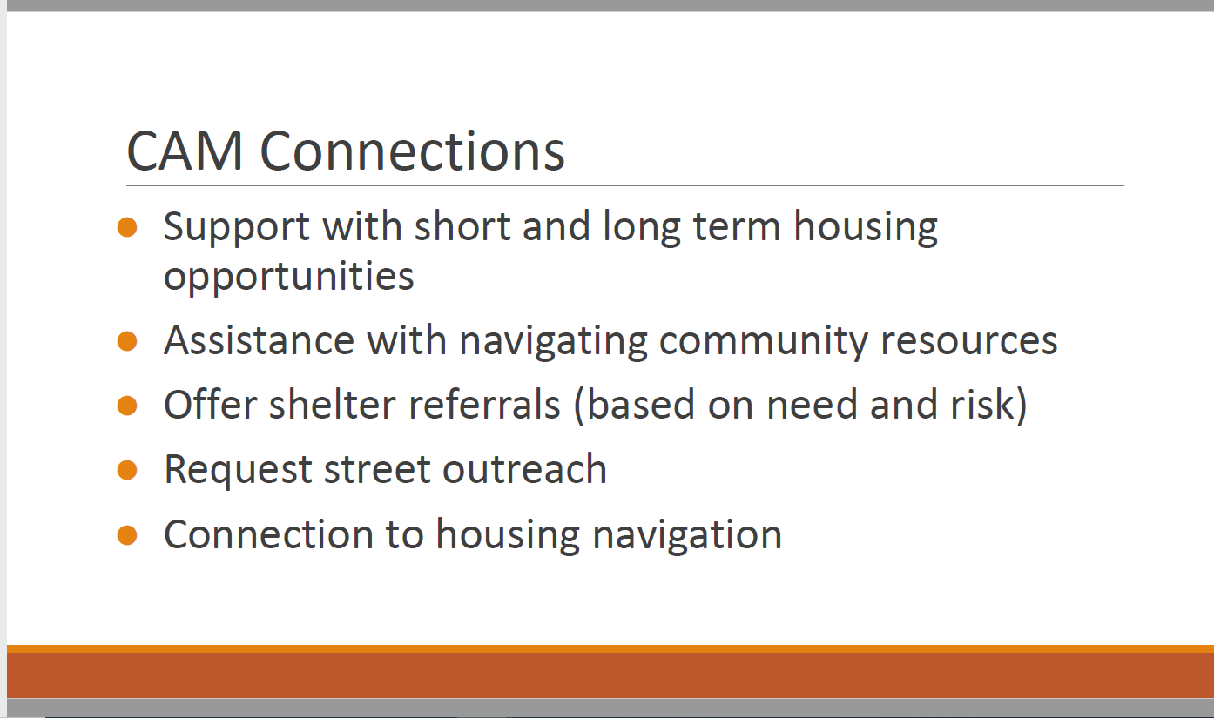
COMMUNITY RESOURCES

Slide 23
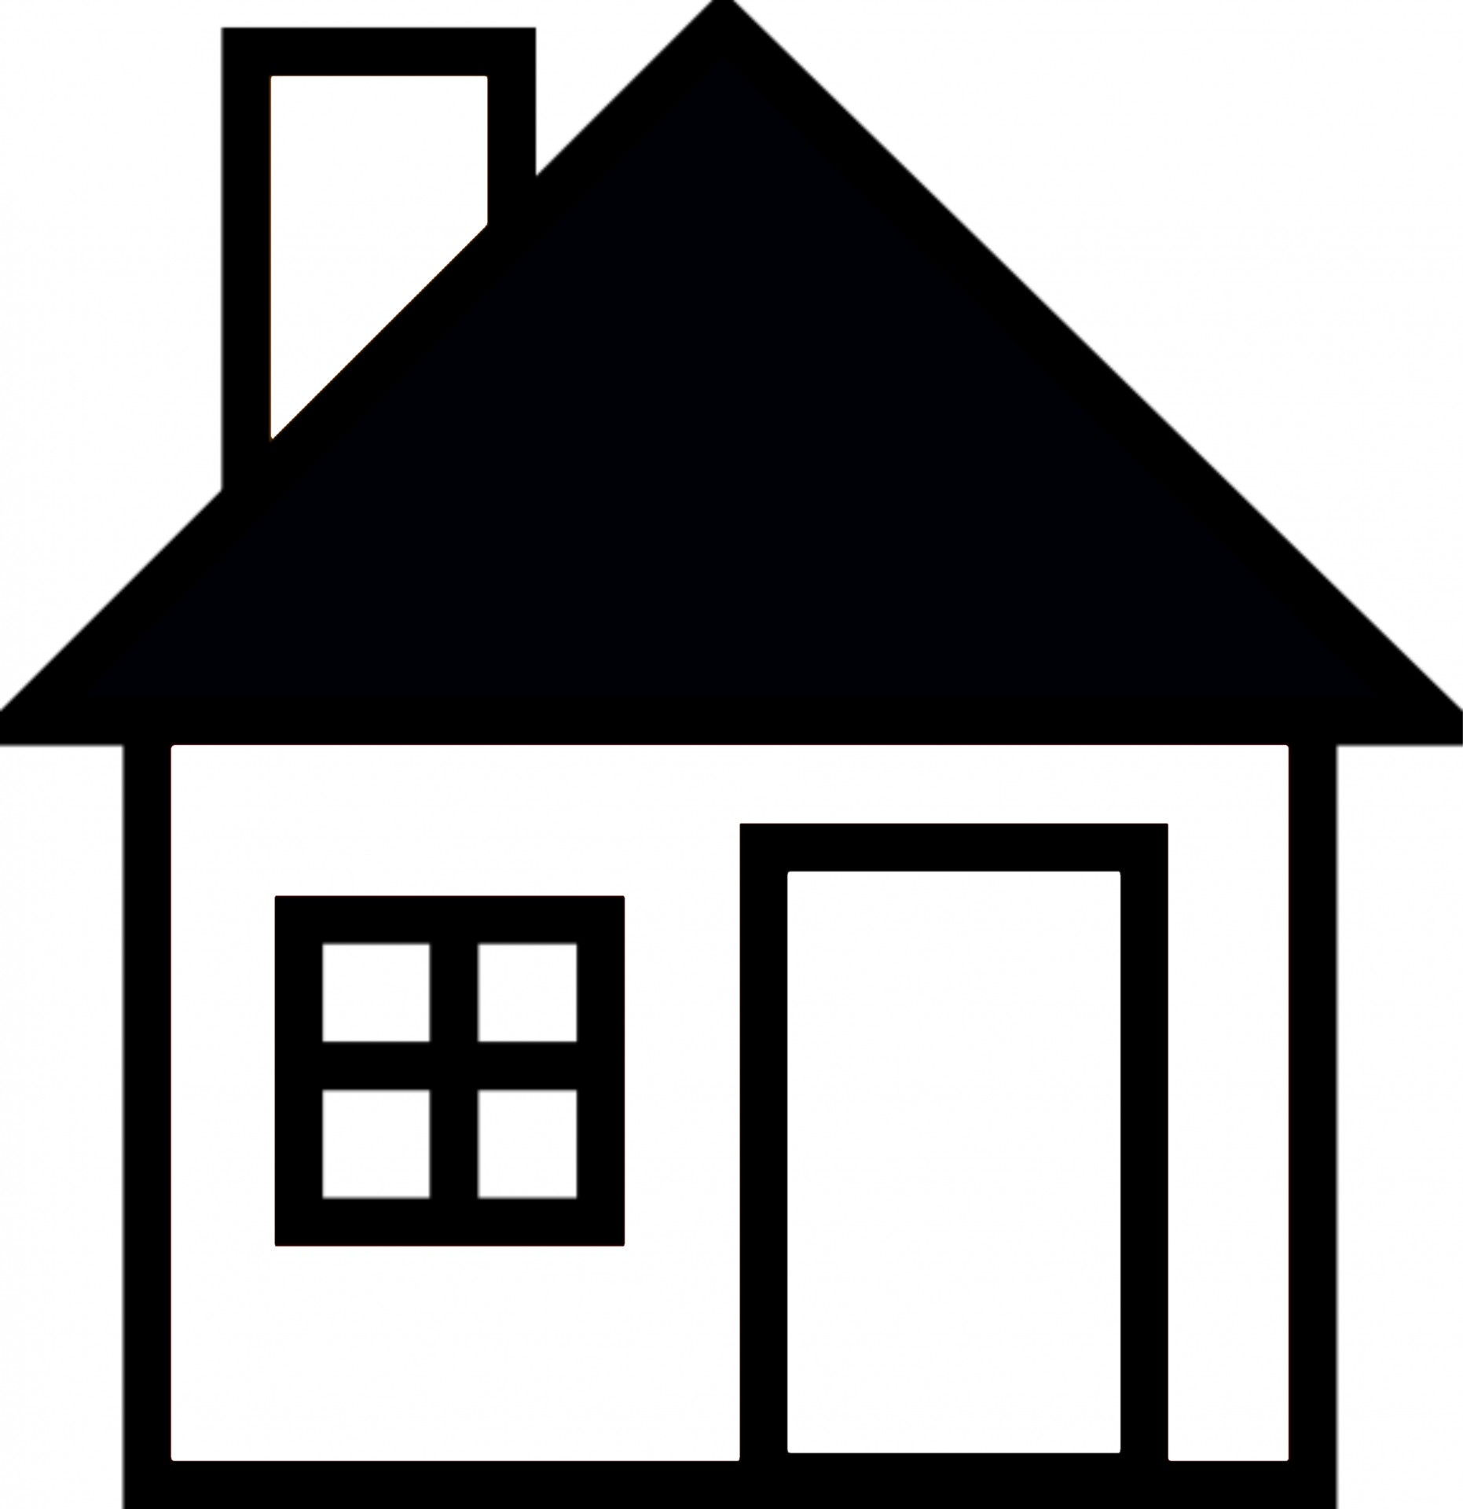
COMMUNITY RESOURCES
Coordinated Assessment Model (CAM) – 313-305-0311
website: camdetroit.org
Detroit Housing Resource Help Line – 866-313-2520
CDBG Home Repair related question contact: Anna Pinter email: pintera@detroimi.gov

Slide 24
CITY WEBSITE REFERENCES
www.detroitmi.gov/hrd

Slide 25
Public Participation
Question and Answer
Comments (Conplancomments@detroitmi.gov)

Slide 26
HOUSING & REVITALIZATION
My email:
wduncan@detroitmi.gov

