Slide 1

Annual Public Budget Meeting
September 25, 2023
Office of the Chief Financial Officer
Office of Budget
Notes:
All font should be Montserrat
Text within content blocks should be 12pt font
To edit Department in the lower right corner, click Slide, Edit Master. In top “Master” slide edit Department name in footer

Slide 2
Agenda
Welcome and Introductions
City of Detroit Office of Budget
Department Presentations
  Public Lighting Department (PLD)
  Public Lighting Authority (PLA)
  Detroit Fire Department
  Detroit Health Department
  Detroit Police Department
Public Comment

Slide 3
How is the budget built?
Sept
Budget Kickoff
Sept
Sept. Revenue Estimating Conference
The City’s fiscal year (FY) runs from July 1 to June 30
    FY 2024:
    July 1, 2023 to June 30, 2024
    FY 2025:
    July 1, 2024 to June 30, 2025
Sept – Oct
Annual Public Budget Meetings
Oct
District Priorities Forums
Nov – Feb
Budget Preparation
Feb
Feb. Revenue Estimating Conference
Mar
Mayor Proposes Budget
Mar – Apr
City Council Budget Hearings
Apr
City Council Adopts Budget
Jul 1
Fiscal Year Begins
= opportunities for public input

Slide 4
Where does the budget money come from?
Detroit’s FY24 city budget totals $2.6 billion
Revenue sources that support the General Fund include: Wagering Tax, Property Tax, Income Tax, Utility Users Tax, and State Revenue Sharing
The “Other” category includes: court fines & fees, parking fines & fees, licenses, permits, inspections, and emergency medical services fees​

Slide 5
Where does the budget money go?
The City’s expenditures exactly equal its revenues to maintain a balanced budget
The FY24 budget supports approximately 10,800 full-time equivalent (FTE) positions
The FY24 budget supports an increase of 288.5 FTE positions, supporting departments like health, general services, and water and sewer
Notes:
Largest category:​
Water & sewer, DPW, GSD, Construction & Demo​
Department breakouts can be found in our Budget in Brief handout​
Enterprise agencies include:​
DDOT​
Airport​

Slide 6
What portion of the budget can we influence?
FY24 Adopted Budget – General Fund ($1.3 billion)
FY24 Adopted Budget – All Funds ($2.6 billion)

Slide 7
Ways to #TakePart in Your Budget
Email us any time at
Attend the Annual Public Budget Meetings – tune in on September 18th & September 25th @5pm
  Learn more about the budget cycle and hear from several city service, health, and safety departments
Attend your District Priority Forum – tune into your regular DON meeting from mid-to-late October (see next slide for schedule)
  Share what you would prioritize within the budget
Look for more information at
YourBudget@detroitmi.gov
Detroitmi.gov/Budget

Slide 8
District Priorities Forums
Call-In Number:
(312) 626-6799
DISTRICT | DETAILS | Joining Info
1 | October 26th @5:30pm | Crowell Recreation Center / hybrid https://cityofdetroit.zoom.us/j/92945572636 Meeting ID: 929 4557 2636
2 | October 10th @6pm | Northwest Activities Center / hybrid https://cityofdetroit.zoom.us/j/85890565831 Meeting ID: 858 9056 5831 Passcode: 222222
3 | October 24th @6pm | https://cityofdetroit.zoom.us/j/93947894155 Meeting ID: 939 478 94155
4 | October 24th @5pm | https://cityofdetroit.zoom.us/j/89532011115 Meeting ID: 895 3201 1115
5 | October 18th @6pm | https://cityofdetroit.zoom.us/j/88093600136 Meeting ID: 880 936 00136
6 | October 19th @5pm | https://cityofdetroit.zoom.us/j/3631409738 Meeting ID: 363 140 9738
7 | October 25th @5pm | https://cityofdetroit.zoom.us/j/89283928278 Meeting ID: 892 839 28278

Slide 9
Public Lighting Department (PLD)

Slide 10
Public Lighting Department
Mission
Mission of the Public Lighting Department
The mission of the Public Lighting Department (PLD) is to support the Public Lighting Authority (PLA) as it maintains the upgraded street light system. PLD leases conduit space and pole attachments to various fiber optic companies and makes conduit available for Public Safety communication equipment. PLD is actively salvaging unused cable and wire throughout the City to sell as scrap to help defray the cost of decommissioning unusable electric utility assets as well as increasing public safety and abating blight by removing unsightly unused overhead lines and poles.

Slide 11
Public Lighting Department
Services & Activities
Services | Activities
Administration/Overhead | Project Coordination with the following: MDOT / (67 Individual Bridge Projects) The Gordie Howe International Bridge/Gateway Project Downtown construction projects
PLD Reserve | Maintain integrity of legacy conduit grids and make available to City of Detroit Department of Information Technology for fiber optic communication cables and also lease excess capacity to private fiber optic companies. Salvage saleable materials from unneeded infrastructure. Increase public safety and reduce blight by removing unused unsightly overhead lines and old, unused poles.
Streetlights | Assists PLA in maintaining street lights throughout the City of Detroit.

Slide 12
Public Lighting Department
Budget by Service
Services | FY 2024 Adopted | FY 2024 Adopted FTE
Administration/Overhead | $83,355 | 1.0
PLD Reserve | $245,000 | -
Streetlights | $18,512,554 | -
Total: | $18,840,909 | 1.0

Slide 13
Public Lighting Department
How We Measure Success
Metrics | Data
Removal and salvage of unused underground cable (in feet) | 5,000 feet per 40-hour week
Removal and salvage of unused overhead wire (in feet) | 25,000 feet per 40-hour week

Slide 14
Public Lighting Department
Contact Information
Public Lighting Department Contact Information
Phone Number: (313) 267-5130

Slide 15
Public Lighting Authority of Detroit (PLA)

Slide 16
Public Lighting Authority
Mission
Mission of the Public Lighting Authority
To operate and maintain city of Detroit streetlights, responding to residents’ needs and ensuring that the system continues to shine for years to come.
PLA is an independent special purpose Authority
governed by a 5-member Board of Directors appointed by the Mayor and City Council
and funded by the City of Detroit Utility Users Tax.

Slide 17
Public Lighting Authority
Services & Activities
Services | Activities
Operations & Maintenance of Streetlights | Respond to light outages and pole knockdowns; diagnose, repair and replace assets; construct and deploy electric connections
Engineering & Design of Public Lighting | Consult on City park and streetscape designs; provide photometric analysis of lighting output
Telecommunications Infrastructure Coordination | Approve permits for 5G providers on light poles; coordinate attachments on streetlights
Administration | Coordinate with City of Detroit initiatives; debt service on 2014 Construction bonds

Slide 18
Public Lighting Authority
Budget by Service
Services | FY 2024 Adopted | FY 2024 Adopted FTE
Operations & Maintenance of Streetlights | $8.4M $5.3M (capital budget) | 12.5 FTE, 14 crews (contractual)
Engineering & Design of Public Lighting | $250k | 1 FTE, 2 p.t. contracts
Telecommunications Infrastructure Coordination | $80k | 1 FTE
Administration | $1.6M $12M (debt service budget) | 3.5 FTE, 2 p.t. contract
Total: | $27.7M | 18 FTE

Slide 19
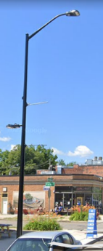
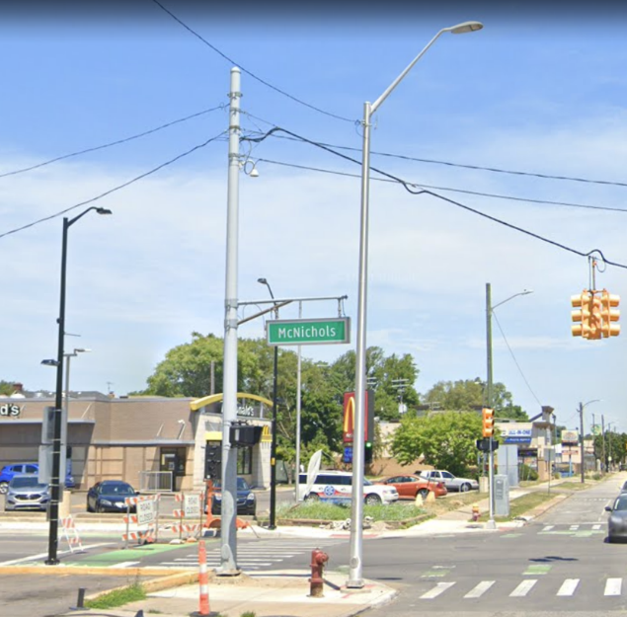
Public Lighting Authority
Capital Projects & New Initiatives
PLANT program
  A training program to get Detroiters into high paying skilled trades
Residential Wood Pole Replacement
  Installing new poles and fixtures in neighborhoods; 10% of City complete
Lumenaire swapouts
  Replacing 8000 fixtures reaching the end of their useful lives
Collector Corridor Standardization
  Improving light output and old, obsolete infrastructure on traffic corridors; 5 miles of 40 are completed
  Supporting city of Detroit streetscape and site improvements
Downtown Pole Refresh
  Repairing aged streetlights
  Painting and/or refurbishing historic poles on Woodward and Washington
Left: Streetscape pole on Kercheval;
Right: Disparity of poles on collector street

Slide 20
Public Lighting Authority
How We Measure Success
Metrics | Data
Maintenance Work orders | 378 per month (calendar 2023)
Telecommunications attachment jobs | 541 site improvements (calendar 2023)
PLANT participation | 10 placements (calendar 2023)

Slide 21
Public Lighting Authority
Contact Information
Name and phone number of contact person
  Dre Brooks
  Director of Government and Community Relations
  313-324-8289
Department website
www.Pladetroit.org

Slide 22
Detroit Fire Department

Slide 23
Fire Department
Mission
Mission of DFD
Provide a safe environment for our citizens and visitors through public education, enforcement of fire codes, and deployment of efficient emergency response resources.
Vision of DFD
The DFD will continuously strive to provide exemplary emergency services to our citizens in a professional and courteous manner. Establish a strong community engagement and training program and be the model of a world class fire department.

Slide 24
Fire Department
Services & Activities
Services | Activities
Administration | Fire Administration, Legal & Labor, Apparatus and Facilities Management.
Fire and EMS Dispatch | Dispatches over 170,000 fire and medical emergencies annually.
Fire Investigation | Investigates the cause and origin of fires and work with the Detroit Police Department to prosecute criminal cases.
Fire Marshal | Inspects and enforce all laws governing fire prevention and fire alarm systems.
Emergency Medical Services (EMS) | EMS Administration and Staffing of Advance and Basic Life support transport ambulances.
Fire Suppression and Hazardous Response | Fire Fighting Administration and all response personnel for fire, medical and any type of hazardous response.
Training | Trains new hires and current employees. Offers CPR classes to the general public.
Community Education | Educates and engages with the community i.e. Smoke/CO detectors installations, 8th Grade hands only CPR training, and fire safety education.

Slide 25
Fire Department
Budget by Service
Services | FY 2024 Adopted | FY 2024 Adopted FTE
Fire and EMS Dispatch | $4,251,750 | 31.0
Administration | $12,775,066 | 41.0
Fire Investigation | $2,345,666 | 14.0
Emergency Medical Services (EMS) | $24,884,233 | 209.0
Fire Marshal | $4,688,153 | 32.0
Community Education | $577,125 | 4.0
Fire Suppression and Hazardous Response | $99,038,549 | 884.0
Training | $1,973,296 | 17.0
Total: | $150,533,838 | 1,232.0

Slide 26


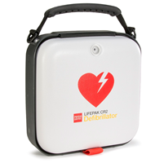
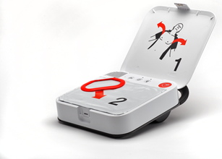
Fire Department
Capital Project & New Initiatives
Save-A-Life Initiative
  Smoke and CO detectors
  8th CPR (Hands Only)
  Fire Safety Classes
HeartSafe Community
  Community AEDs (General & Grant Funding)
Ladder 30 and Ambulance Station Annex
  L30 - 17475 Mount Elliott St (ARPA Funding)
  E60 - 19701 Hoover St
  E55 - 18140 Joy Rd
  E57 - 13960 Burt Rd
Portable Radios/ Accountability System
  Handheld radios for all Fire and EMS Personnel
  First in the country to have a State Radio integrated accountability system
  Provides next level of accountability and safety for personnel
CPR Training
https://calendly.com/dfdacademy

Slide 27
Fire Department
How We Measure Success
Metrics | Data
EMS Response Time | 8 minutes, 5 seconds - Code 1 average response
Fire Response Time | 5 minutes, 45 seconds - Structure Fire average response
Community Engagement and Training | 31,000+ Detroit residents trained in fire safety, 1500+ smoke detectors installed
Fire Inspections | 100% annual inspections for schools, high rises, gas stations, 302 sites and senior multi family units.

Slide 28
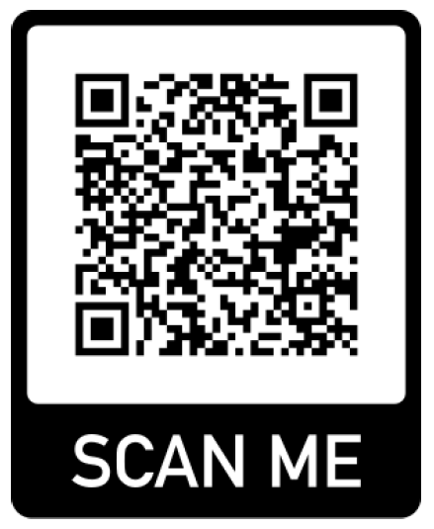
Fire Department
Contact Information
Residents contact the Fire Department
Community Relations Division
https://detroitmi.gov/departments/detroit-fire-department
313-596-2900
If interested in becoming a Detroit Firefighter
Please scan this QR code

Slide 29
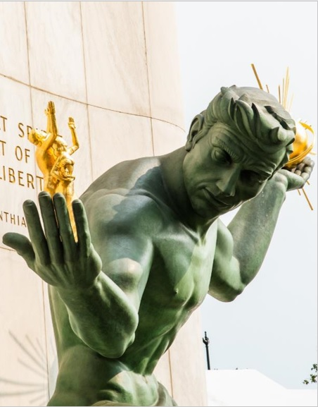

Annual Public
Budget Meeting
Detroit
Health Department
OCFO - Office of Budget
Notes:
Welcome, introduction
The Detroit Health Department is pleased to present its Annual FY 24 Budget for your review
This overview will highlight the various services offered by the Department, its current budget, and what we were able to accomplish with our funding during FY23.

Slide 30
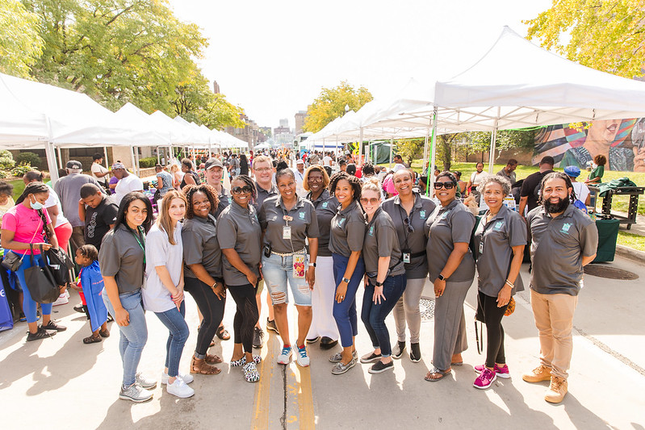
Mission
Address public and population health priorities of Detroiters
Vision
We envision healthy communities where everyone has the opportunity to thrive
Values
Service, Transparency,
Respect, Accountability
Notes:
The Health Department envisions healthy communities where everyone has an opportunity to thrive by addressing public and population health priorities of Detroiters. We provide these services with respect and transparency, while holding ourselves accountable to meet the needs of Detroiters.

Slide 31
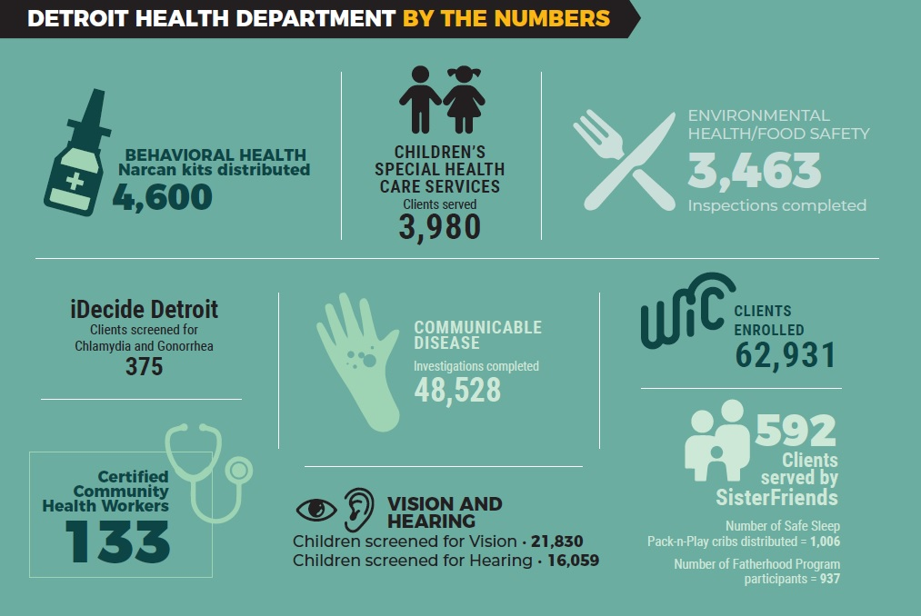
Community Impact
Notes:
I'd like to highlight what the Department had accomplished over the past year, as we seek to expound upon the collective impact of our services

Slide 32
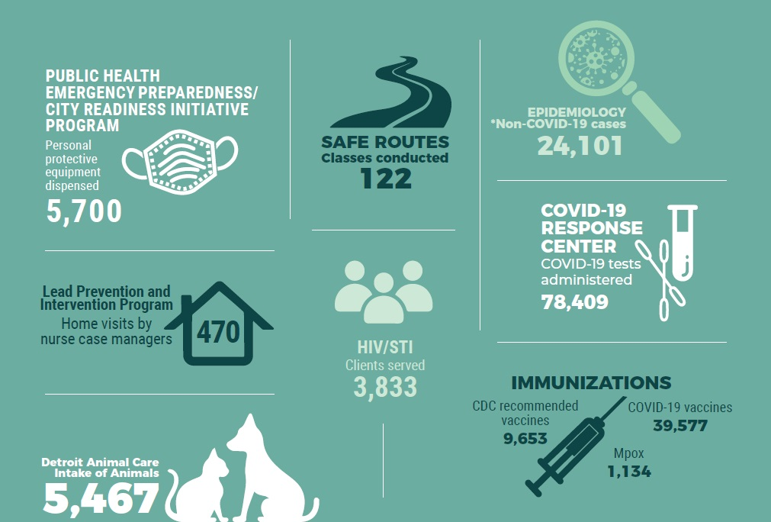
Community Impact (cont'd)

Slide 33
Detroit Health Department
Services & Activities
Services | Activities
Administration/Overhead | Fiscal stewardship and oversight for all programs
Behavioral Health Services | Behavioral and Mental health wellness, prevention education
Children's Special Health Care Services | Assist chronically ill children and adults with special health needs
Communicable Disease | Control and slow the spread of infectious diseases
Community Health Services | Case management and community outreach
Community Violence Intervention | CeaseFire crime violence intervention and youth services
Emergency Preparedness | Prevention, protection, mitigation response and recovery of security planning
Environmental Health | Pool inspections, day care inspections, and planning review
Essential Local Public Health Services | Total population and community health initiatives
Notes:
The Health Department's funding allows for a broad range of service provision in order to the meet the needs of Detroiters.
Notable services for FY 24 are:
Behavioral Health which includes opioid response activitites
Crime Violence Intervention
Essential Local Public Health Services

Slide 34
Detroit Health Department
Services & Activities (cont.)
Services | Activities
Family Planning | Reproductive health care
Food Sanitation Safety Regulations | Fixed food, temporary, and mobile truck food inspections
HIV-STI | Testing, education, assistance and prevention programs
Housing Opportunities for People with AIDS (HOPWA) | Rental and housing assistance
Immunizations | Vaccination and education against communicable diseases
Lead Prevention | Education, prevention and treatment against lead poisoning
Maternal and Child Health | Intervention and family well-being services
Safe Routes | Bicycle and pedestrian law education
WIC Mother & Infant Wellness | Nutrition education and fresh food options for Mothers and infants
Notes:
Along with its existing services, the Health Department seeks to implement new initiatives such as:
Enhance food safety regulations through increased community outreach
Increase lead prevention activities in partnership with BSEED, HRD, and the Mayor's office
Launch a new pilot program focused on ensuring pregnant people in Detroit have access to care

Slide 35
Detroit Health Department
Budget by Service
Services | FY 2024 Adopted | FY 2024 Adopted FTE
Administration/Overhead | $5,229,881 | 41.25
Behavioral Health Services | $371,695 | 5.0
Children's Special Health Care Services | $633,044 | 5.0
Communicable Disease | $416,400 | 4.0
Community Health Services | $1,011,225 | 9.0
Community Violence Intervention | $775,000 | -
Emergency Preparedness | $479,379 | 4.0
Environmental Health | $729,908 | 9.25
Essential Local Public Health Services | $1,527,608 | 4.0
Notes:
The Health Department made extensive revisions to its staffing structure which included:
The transition of contractual staff from SEMHA to the City of Detroit
Addition of 5 FTE's to Behavioral Health in support of the ongoing opioid response
The transition of CeaseFire from the Police Department to the Health Department

Slide 36
Detroit Health Department
Budget by Service (cont.)
Services | FY 2024 Adopted | FY 2024 Adopted FTE
Family Planning | $520,000 | -
Food Sanitation Safety Regulations | $1,952,027 | 24.0
HIV-STI | $12,229,206 | 23.0
Housing Opportunities for People with AIDS | $3,448,666 | 13.0
Immunizations | $1,380,714 | 14.0
Lead Prevention | $447,524 | 2.0
Maternal and Child Health | $2,235,478 | 16.0
Safe Routes | $1,421,883 | 3.0
WIC Mother & Infant Wellness | $8,268,050 | 46.0
Total: | $43,077,888 | 222.5
Notes:
Therefore, in total, the Health Department's budget for FY 24 is slightly over $43 mil dollars and now entails 222.5 FTE's overall.

Slide 37
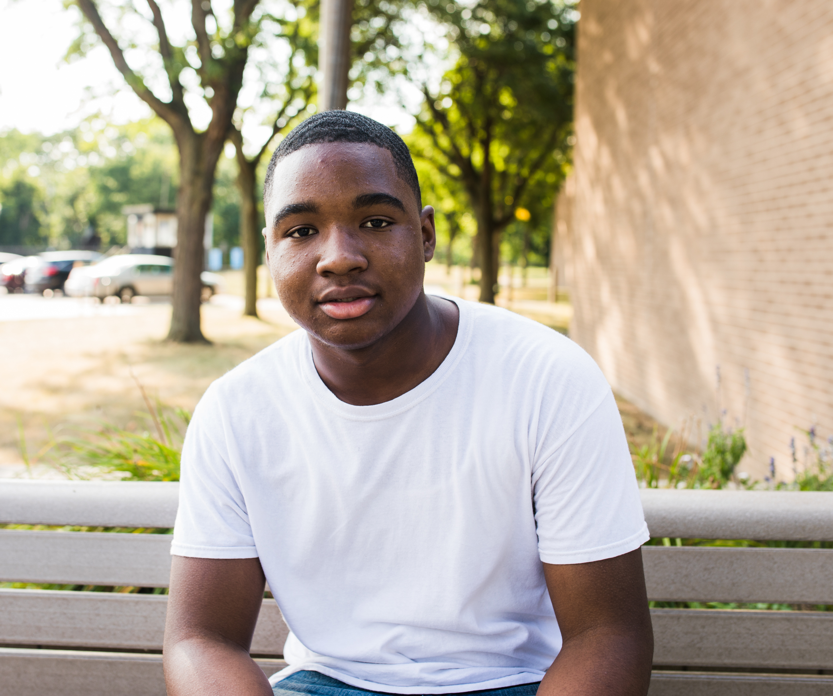
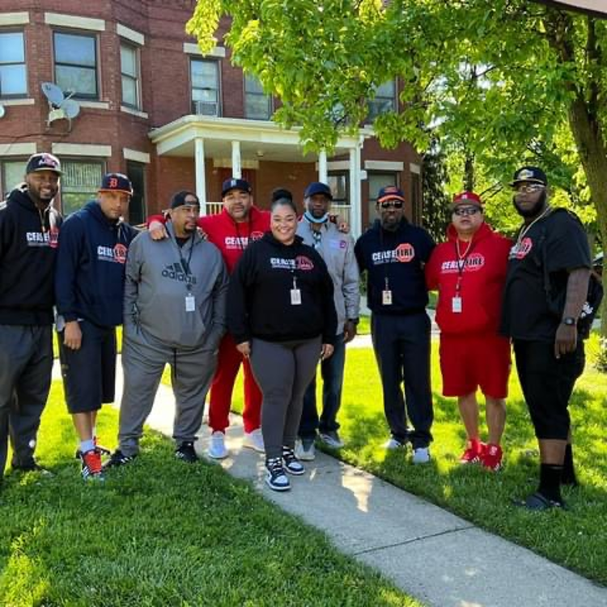
Detroit Health Department
FY 2024 New Initiatives
Behavioral Health
  Initiative focused on expanding opioid outreach, distribution of harm reduction materials, education and training. With the aim of addressing the ongoing opioid crisis, this initiative is dedicated to raising awareness, providing support, and promoting education to combat the devastating effects of opioid misuse and addiction.
CeaseFire
  A community violence intervention that utilizes a focused deterrence model to address and reduce violence within the city with the program being structured around three essential pillars: Mentoring, Community Intervention, and Legal Aid Support.
Notes:
There are three new initiatives within the FY 24 budget:
Behavioral Health and the opioid response
CeaseFire, a community based violence intervention program
Rides to Care, a maternal child health pilot program to ensure equitable access for pregnant people of Detroit

Slide 38

Detroit Health Department
Contact Information
Notes:
We thank you for your time and look forward to our continued partnerships within the community and the City of Detroit.

Slide 39
Detroit Police Department

Slide 40
Police Department
Mission
Mission of the Police Department
To encourage thoughtful decision-making and a strong sense of community responsibility through education, equity, empathy, professionalism, transparency, and policing standards properly informed by community input and civic leadership.

Slide 41
Police Department
Services & Activities (part 1)
Services | Activities
Citizens Patrol | Citizens patrol specific areas and report crime or other community concerns
Communications Operations | 911 Call Taking System, Police/Fire Dispatch, Telephone Crime Reporting
Community Engagement | Police Explorers, Jr. Police Cadets, Police Reserves, Neighborhood Police Officers, Chief Neighborhood Liaison
Criminal Investigations | Precinct Detective Units, NIBIN, Evidence and Property Control
Crossing Guards | Traffic Safety, Coordination of Crossing Guard positions and staffing citywide
Detroit Detention Center | Processing and holding facility for arrests made by the Department
Downtown Services | Facilitate the flow of vehicular and pedestrian traffic downtown and during special events
Eastern Operations (3rd, 5th, 7th, 9th, 11th Pcts) | Responding to calls for service and community concerns on the east side of the City of Detroit
Executive Protection Unit | Security and risk mitigation measures taken to ensure the safety of individuals who way may exposed to elevated person risk due to their status
Fiscal Operations | Manages the accounts for the collection and expenditure of funds

Slide 42
Police Department
Services & Activities (part 2)
Services | Activities
Gaming Unit | Patrol units that respond to calls-for-service in the areas surrounds the casinos
Major Case Investigation | The investigation of Homicide, Special Victims (Domestic Violence, Child Abuse, Sex Crimes) and Missing Persons
Management Services | Oversight and management for Abandoned Vehicles, Towing Operations, Facilities, and Resource Management in the Department
Narcotics Forfeiture Activity | Manages and accounts for vehicle and property forfeitures
Office of Internal Affairs | The investigation of crimes of sworn and civilian city employees
Office of the Assistant Chief | Management and oversight for patrol, investigation and support functions of the Police Department
Office of the Chief | Oversees the day-to-day operations of the Chief’s Office. Provides leadership and overall direction of the Police Department
Police Fleet Management | Assigning, managing, and deploying all Department vehicles, motor equipment, bicycles, and other supplies
Police Grants | Applies, manages, and ensures compliance with all local, state, federal, and private grant funding
Police Human Resources | Responsible for maintaining complete and adequate personnel records on all members; processing all personnel matters; recruiting new members, and administering and securing promotional examinations.

Slide 43
Police Department
Services & Activities (part 3)
Services | Activities
Police Medical | Ensuring that proper care is provided for sick and injured members, and maintaining medical records for all members of the Department
Police Recruitment | Responsible for the recruitment, processing and investigation of new members
Police Services Infrastructure | Providing cleaning and preventive maintenance for all Department buildings and property and also restoring and renovating Department buildings
Police Towing Operations | The impoundment and removal of vehicles
Resource Management | Acquiring uniforms, other related equipment, and leather goods for issuance to designated Department members
Tactical Services & Operations | Critical incident special operations response and management
Technology | Assistance with computer hardware, software, and other electronic or mechanical devices
Training | Provides training for Department members, it serves as the Department's training liaison with other criminal justice agencies
Victims Assistance Services | Support families of victims with court processes and counseling
Western Operations (2nd, 4th, 6th, 8th, 10th, 12th Pcts) | Responding to calls for service and community concerns on the west side of the City of Detroit

Slide 44
Police Department
Budget by Service
Services | FY 2024 Adopted | FY 2024 Adopted FTE
Citizens Patrol | $194,127 | 1.0
Communications Operations | $26,637,026 | 335.0
Community Engagement | $4,264,019 | 39.0
Criminal Investigations | $42,667,328 | 446.0
Crossing Guards | $565,500 | -
Detroit Detention Center | $14,974,122 | 68.0
Downtown Services | $10,262,528 | 111.0
Eastern Operations (3rd, 5th, 7th, 9th, 11th Pcts) | $69,915,629 | 674.0
Executive Protection Unit | $2,483,231 | 22.0
Fiscal Operations | $2,592,083 | 29.0
Gaming Unit | $2,583,004 | 23.0
Major Case Investigation | $30,595,086 | 182.0
Management Services | $7,732,359 | 83.0
Narcotics Forfeiture Activity | $581,584 | 7.0
Office of Internal Affairs | $4,762,311 | 39.0

Slide 45
Police Department
Budget by Service (cont.)
Services | FY 2024 Adopted | FY 2024 Adopted FTE
Office of the Assistant Chief | $2,297,723 | 15.0
Office of the Chief | $2,936,164 | 25.0
Police Fleet Management | $3,228,512 | 16.0
Police Grants | $6,721,515 | 47.0
Police Human Resources | $16,464,440 | 67.0
Police Medical | $1,325,216 | 10.0
Police Recruitment | $878,500 | -
Police Services Infrastructure | $4,646,090 | -
Police Towing Operations | $2,090,423 | 45.0
Resource Management | $7,095,360 | 44.0
Tactical Services & Operations | $16,310,762 | 126.0
Technology | $5,225,749 | 69.0
Training | $5,874,150 | 48.0
Victims Assistance Services | $715,375 | 10.0
Western Operations (2nd, 4th, 6th, 8th, 10th, 12th Pcts) | $92,211,262 | 880.0
Total: | $388,831,178 | 3,440.0

Slide 46
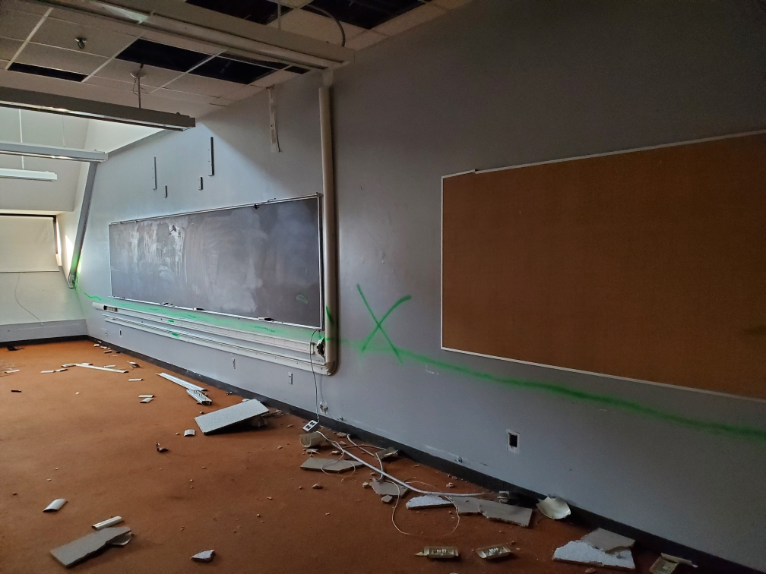
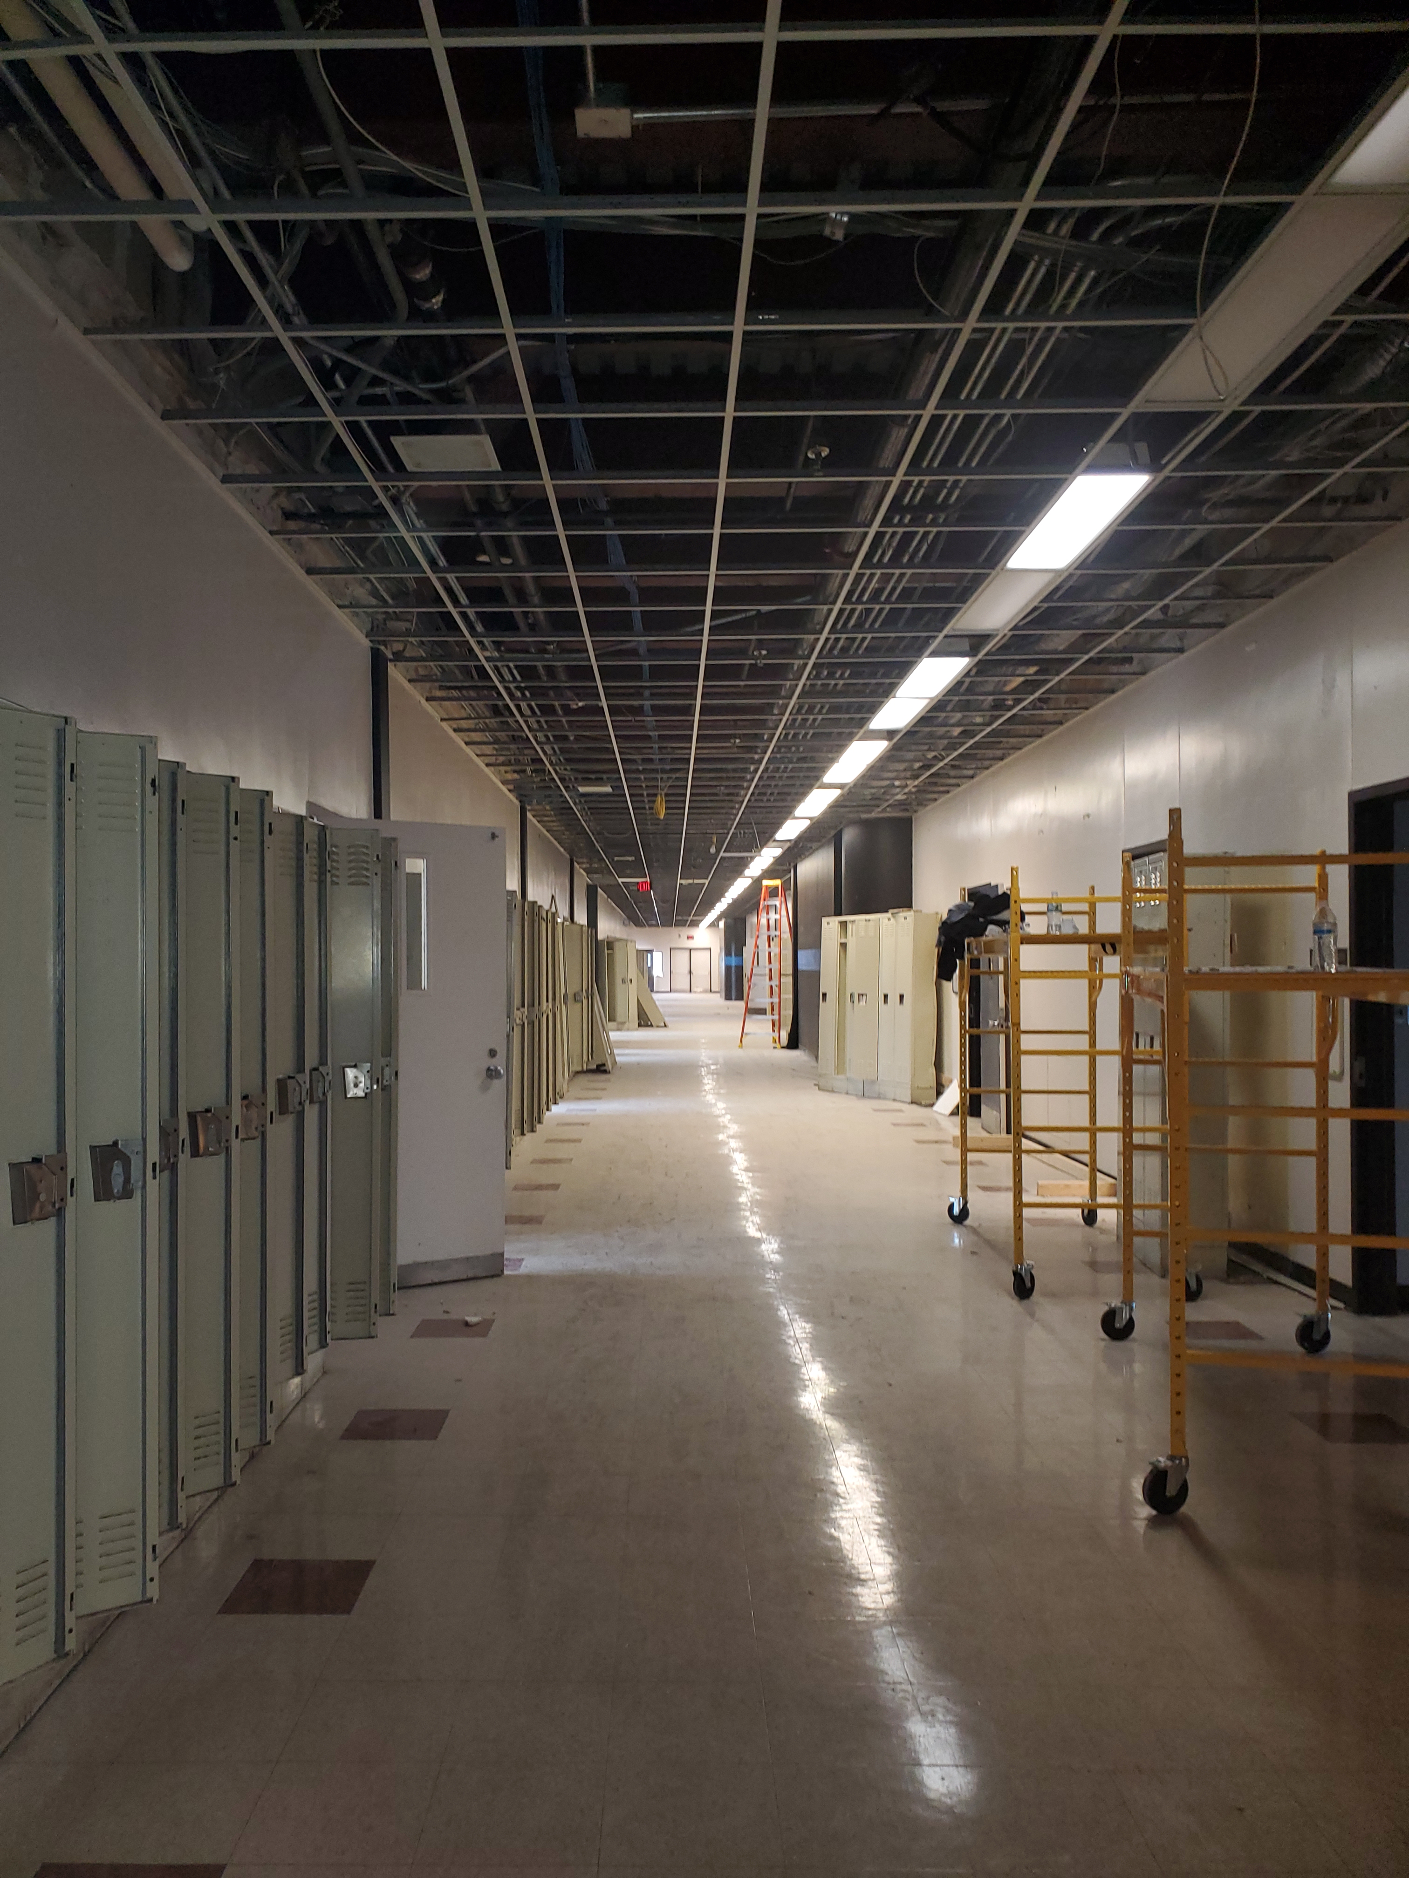
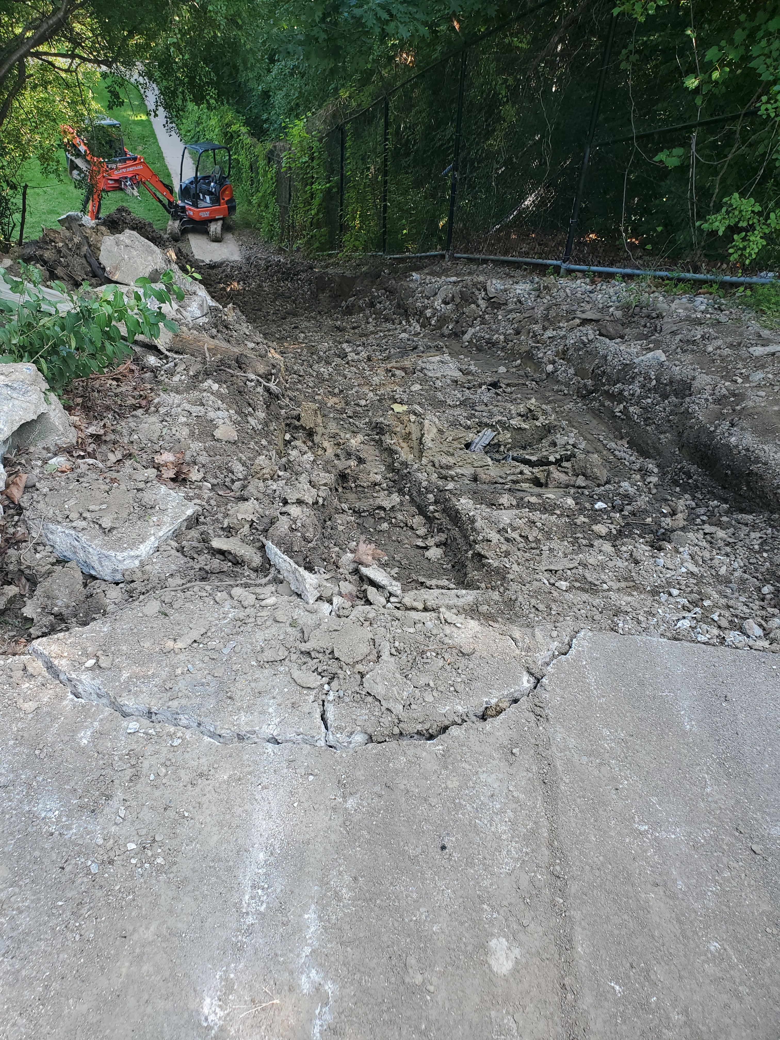
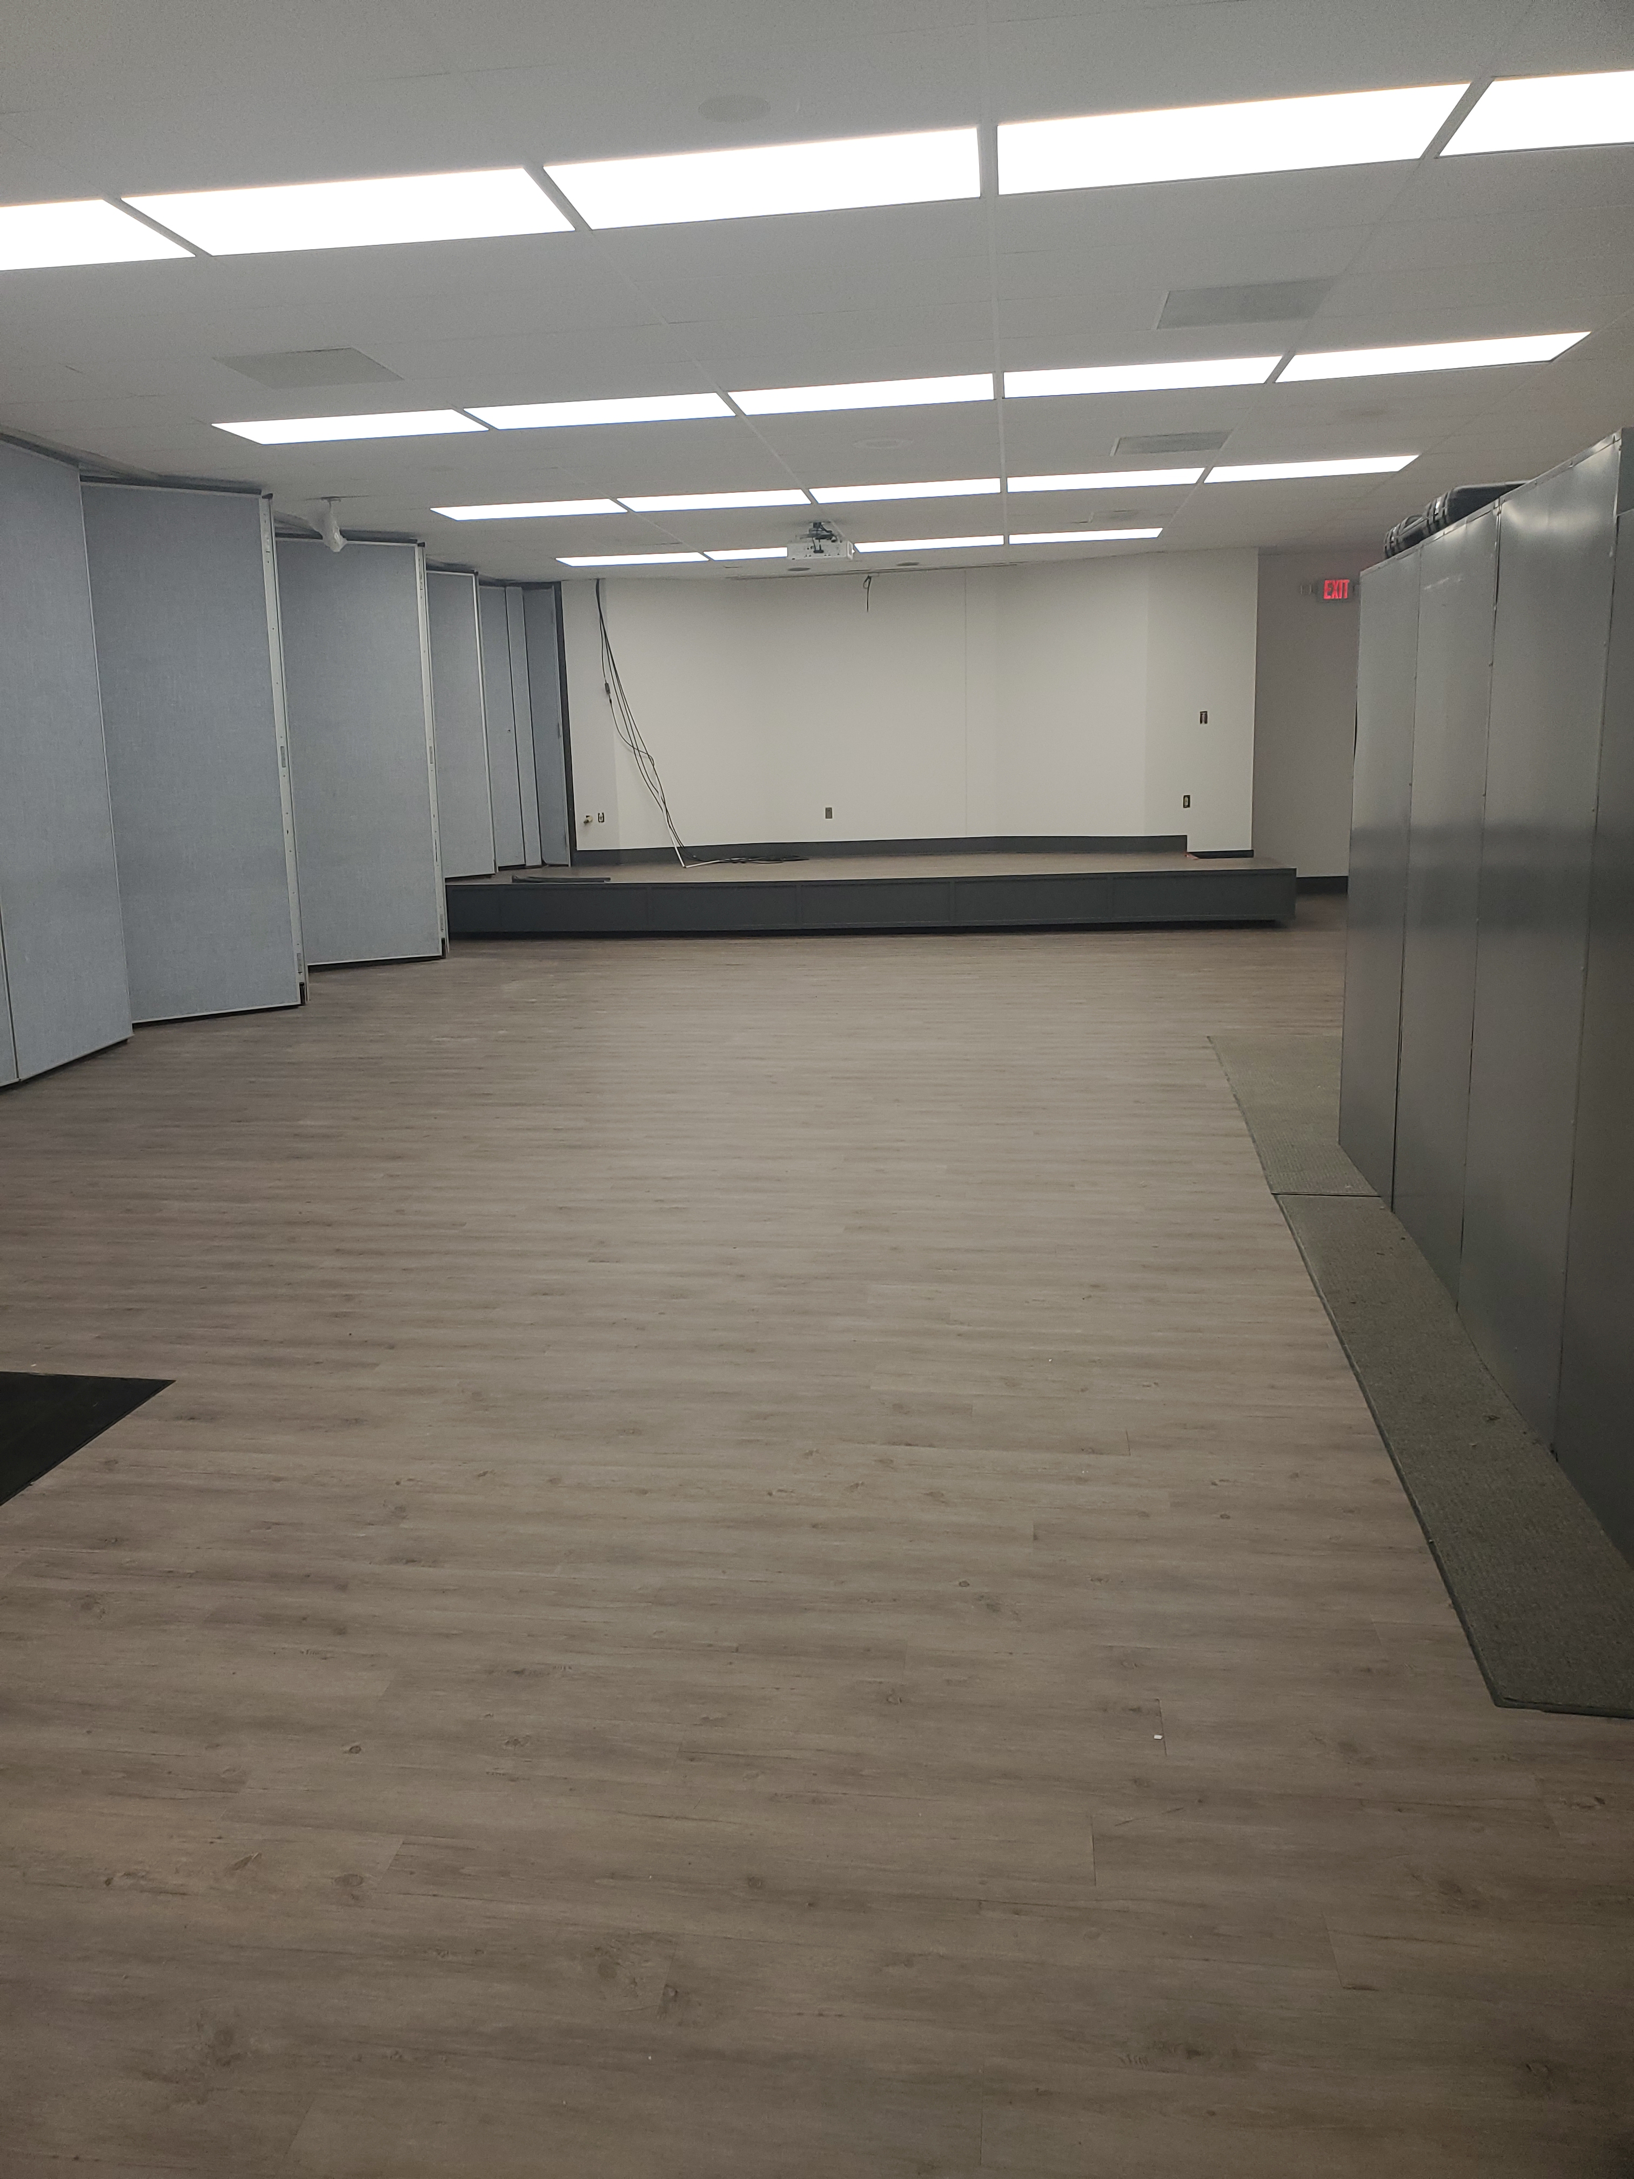
Police Department
Capital Project & New Initiatives
Training Center Renovation
  Demolition and remodeling to update the flooring, classrooms, HVAC, and overall state of good repair.
Rouge Range Renovation
  Update the facilitie’s classrooms, restrooms, and kitchen area. Demolition and installation of new steps to the range.
7th Precinct Renovation
  Floor plans are being finalized for the project to go out for bid.
Civilianization Initiative
  Evaluating positions throughout the Department to return sworn members to patrol.

Slide 47
Police Department
How We Measure Success
Metrics | Data
DPD Calls For Service | 295,654 calls received by DPD 231,790 were handled by DPD 63,894 were canceled, duplicate calls or handled by other agencies
Major Case Investigation- Yearly Homicide Closure | 46%
Part 1 Crime Data (as of 9/18/2023): | Decreases in Criminal Homicide -9%, Sex Assault -8.6%, Carjacking -31% / Increases in Aggravated Assault 0.5% and Robbery 6 %
Other Services (Mental Health Calls/ Homeless Engagement) | 11,687 Mental Health calls received by DPD 10,320 Mental Health calls were handled by DPD 1,367 Mental Health calls were canceled Homeless Engagement 469 people T=YTD
Recruitment | Goal is to hire 40 employees a month

Slide 48
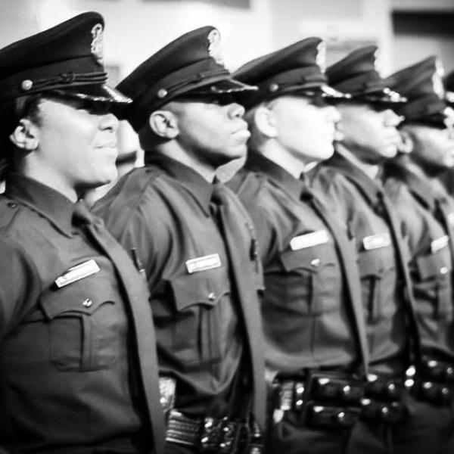
Police Department
Contact Information
How residents can contact your department
Chief Neighborhood Liaison: 313.596.2520
Detroit Public Safety Headquarters
1301 3rd Street
Detroit, MI 48223
Department website: https://detroitmi.gov/departments/police-department
Facebook: https://www.facebook.com/detroitpolice
Instagram: detroit police

Slide 49
Questions?
Moderated Public Comment:
“Raise Hand” function in Zoom
Share more by emailing:
YourBudget@detroitmi.gov

