Slide 1
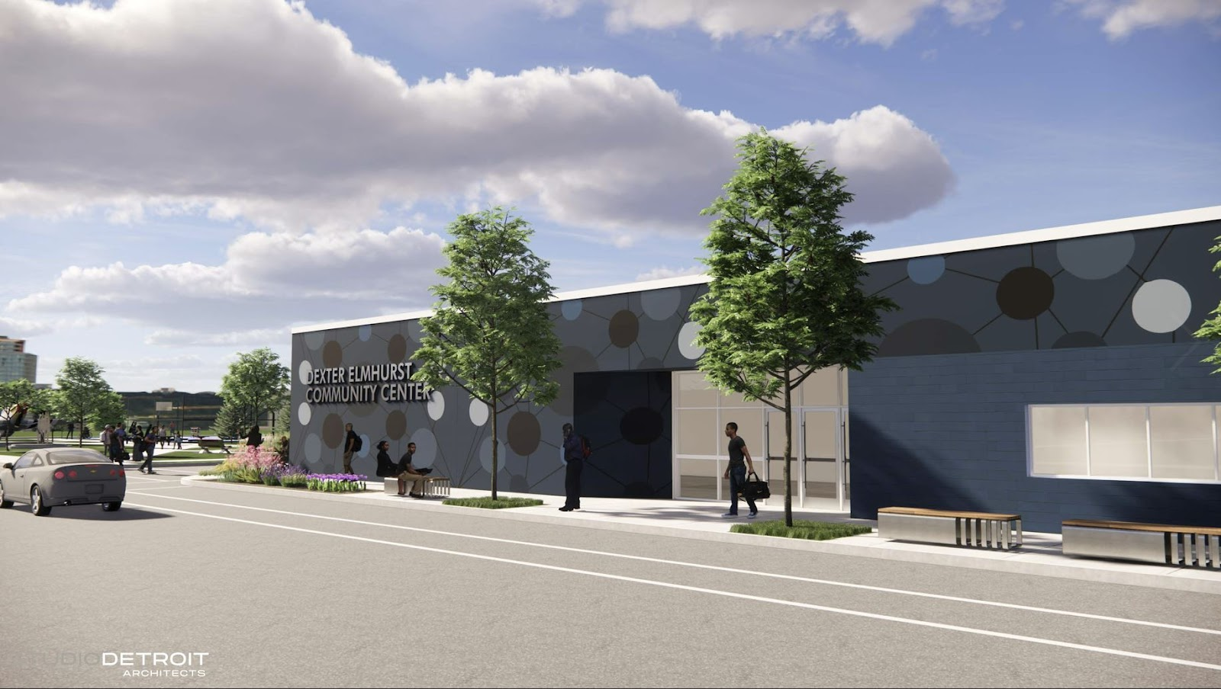
Dexter - Elmhurst
Parks and Recreation
December 6, 2022
For more information go to: Detroitmi.gov/DexterElmhurst
Notes:
BRAD / RHEA

Slide 2
Welcome!
Today's Agenda:
  Introductions & Acknowledgements
  Presentation / Overview
  Facilitated table discussions
  Report out
  Closing
  6:00 pm
  6:10 pm
  6:20 pm
  7:00 pm
  7:20 pm
Notes:
BRAD / RHEA

Slide 3
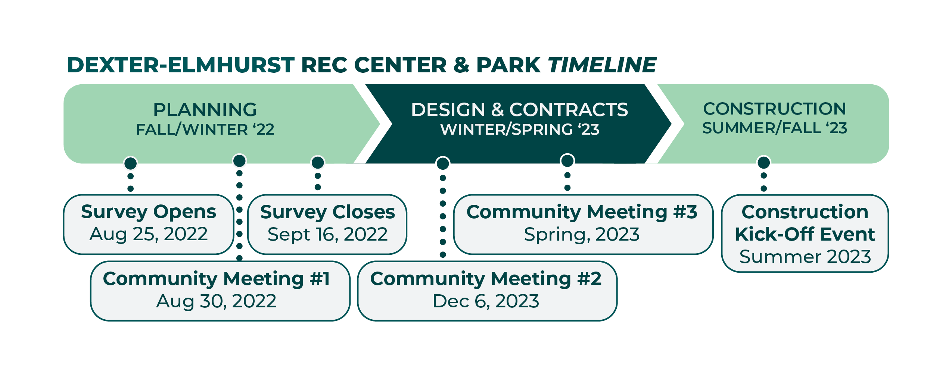
Timeline
Notes:
JULIANA

Slide 4
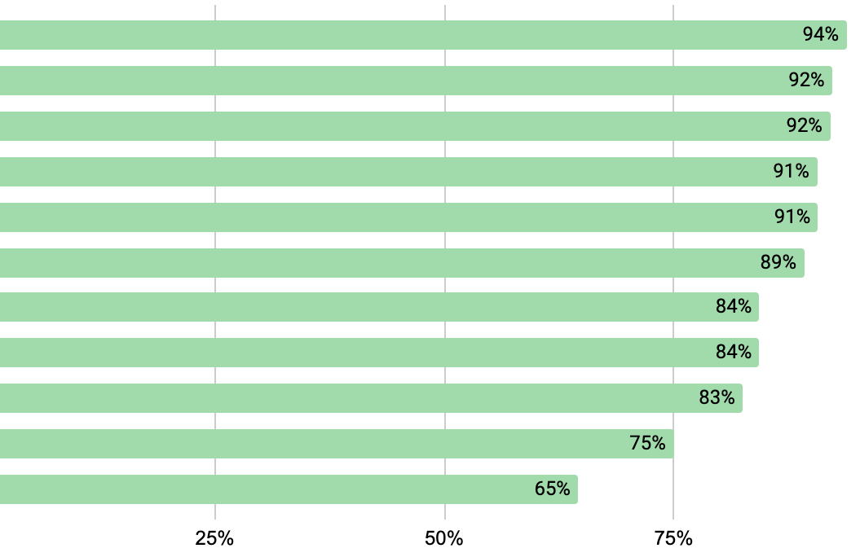
What we've heard:
Rec Center Survey Results
Wanted Activities / Spaces (percentage of respondents who reported wanting the amenity)
Gymnasium
Fitness
Arts & Crafts
Community Meetings
Computer Lab
Cultural Activities
Dance & Aerobics
Reading Room
Cooking & Health Classes
STEM Classes
Special Events
Notes:
Walking / running – 71%
Group fitness classes (yoga, zumba, etc.) – 68%
Art / educational programs – 66%
Small special events (birthday parties, etc.) – 62%
Work out equipment / weight room – 61%
Community meetings –60%
Field sports (football, soccer, lacrosse) – 47%
Basketball – 45%
Large special events (graduations, concerts, etc.) – 41%

Slide 5
What we've heard:
Rec Center Survey Results
Highest Priority Activities / Spaces (percent of respondents choosing the amenity in their top 3)
Fitness Activities – 59%
Community Meetings – 51%
Gymnasium – 40%
Computer Lab / Internet Access – 35%
Dance & Aerobics – 29%
Cultural Activities – 23%
STEM Classroom – 20%
Cooking & Health Classes – 17%
Reading Room – 14%
Special Events – 10%
Common write-ins: Senior/youth spaces, Local Business/Non-profit Spaces, Swimming, Gymnastics

Slide 6
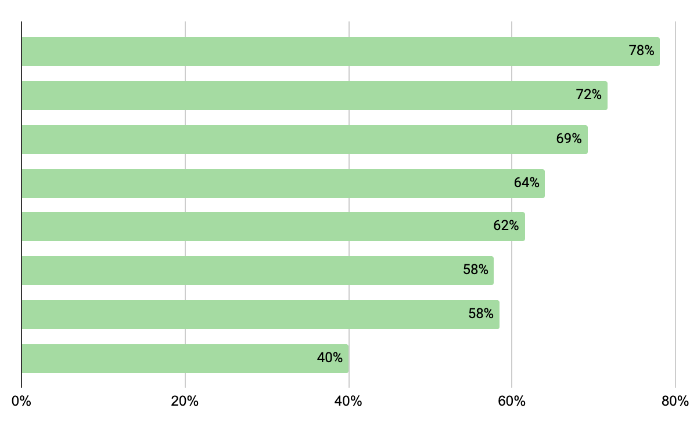
What we've heard:
Park Survey Results
Wanted Activities (percentage of respondents who reported wanting the amenity)
Traditional Playground
Nature Exploration Area
Picnic Tables
Outdoor Fitness Equipment
Basketball Court
Outdoor Challenge Course
Open Lawn
Dog Park
Notes:
Walking / running – 71%
Group fitness classes (yoga, zumba, etc.) – 68%
Art / educational programs – 66%
Small special events (birthday parties, etc.) – 62%
Work out equipment / weight room – 61%
Community meetings –60%
Field sports (football, soccer, lacrosse) – 47%
Basketball – 45%
Large special events (graduations, concerts, etc.) – 41%

Slide 7
What we've heard:
Park Survey Results
Highest Priority Activities (percent of respondents choosing the amenity in their top 3)
Playtime for kids – 55%
Group fitness classes – 48%
Outdoor fitness equipment – 39%
Picnic / BBQ – 37%
Passive activities – 34%
Open lawn – 29%
Dog Park – 26%
Basketball – 25%
Special Events – 17%
Common write-ins: Various types of gardens / planted areas

Slide 8
What we've been working on
Conceptual layout to fit the wanted amenities, looking for feedback on the park amenities and on the rec centers rooms and layout.
FOOD FOR THOUGHT:
- Combining some compatible uses into multipurpose spaces (ie meeting and classroom(s))
- Providing flexible space to adapt to future uses/wants
- Improving access, parking
POOL: there were many write-ins and comments about building a new pool for year-round swimming, and unfortunately it is beyond the budget of this project and the available space.
VACANT / BLIGHT: we are looking at expanding the parking lot and park to accommodate more parking. We are also looking into expanding the park in the future on vacant lots, but that would be a future phase. For blighted properties, please reach out to Mona Ali, D7 DON.

Slide 9
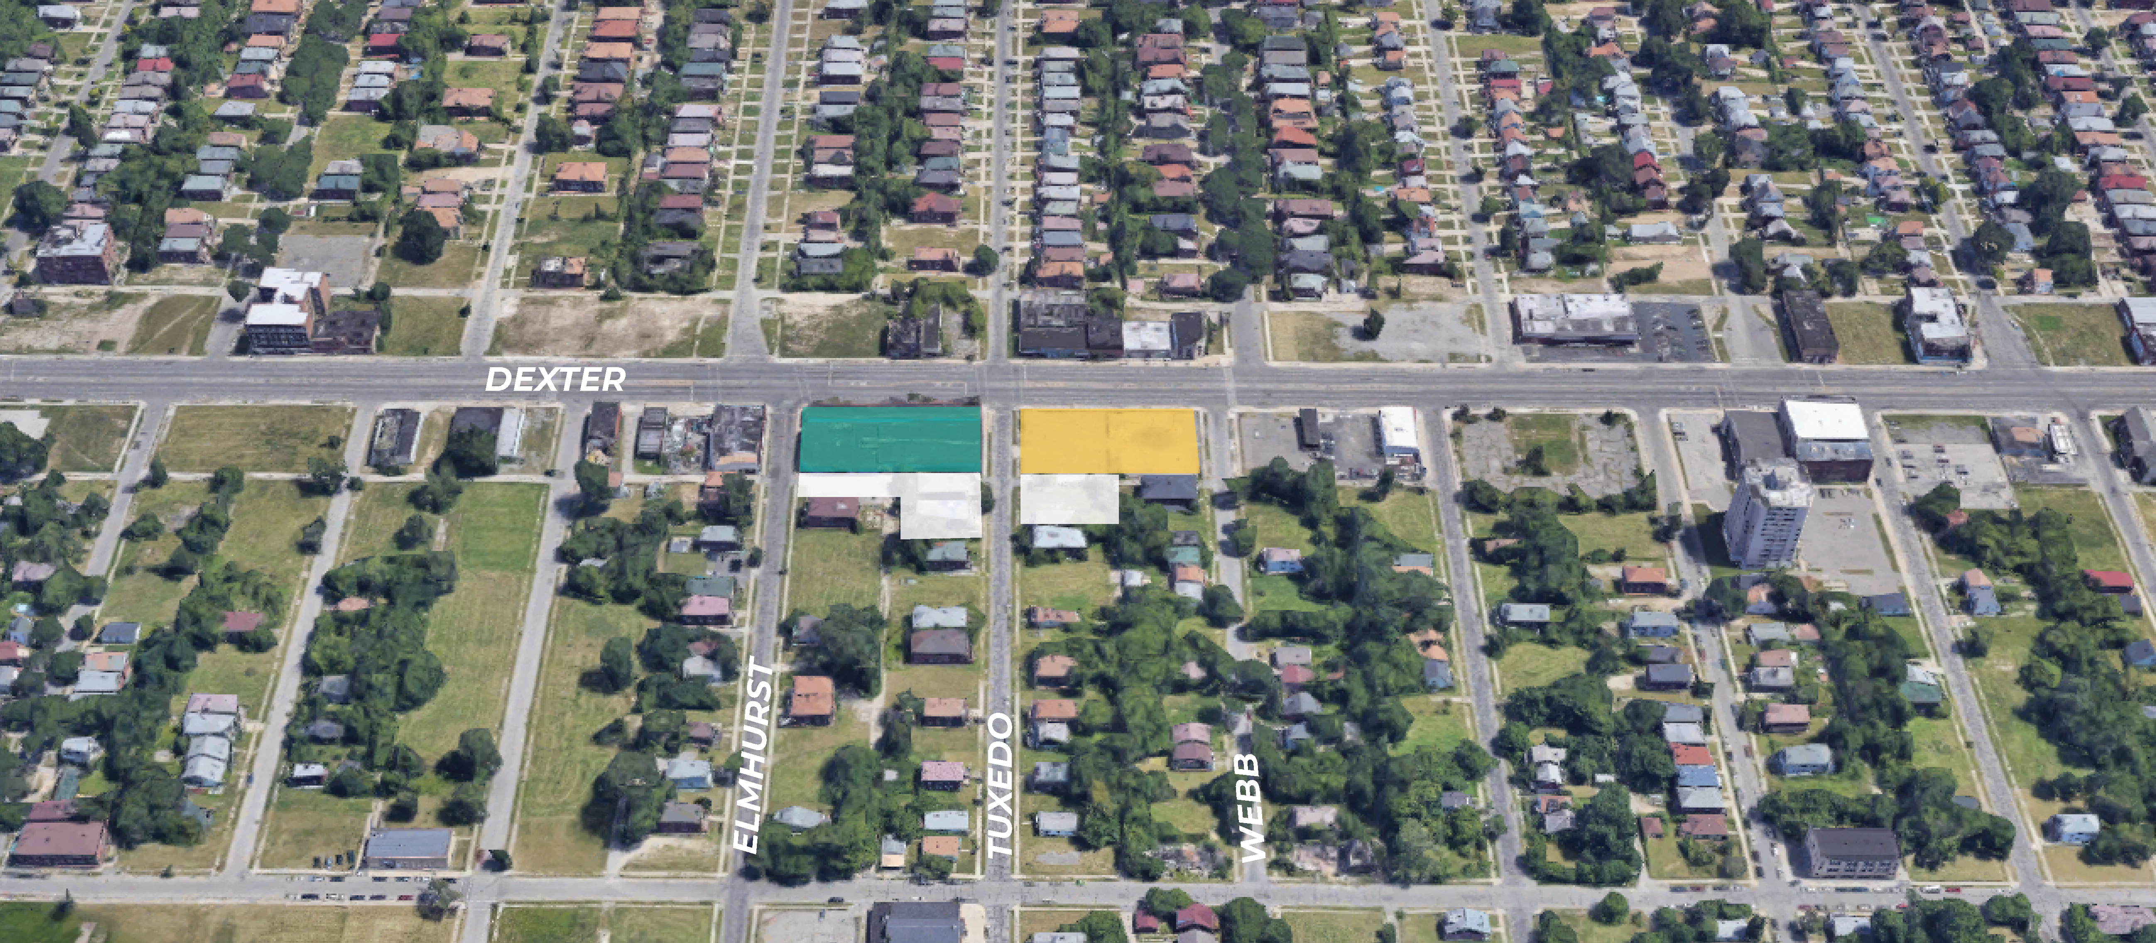

Future Rec Center & Park
REC CENTER
PARK
Notes:
JULIANA
Looking into potential expansion with vacant land around the center/park - this would be a future phase and not yet funded.
Park – 0.6 acres

Slide 10

Site Plan – Existing
Dexter-Elmhurst Recreation Center
Conceptual Image of Future Center
Notes:
RHEA / DEBBIE
-note that nothing is finalized

Slide 11
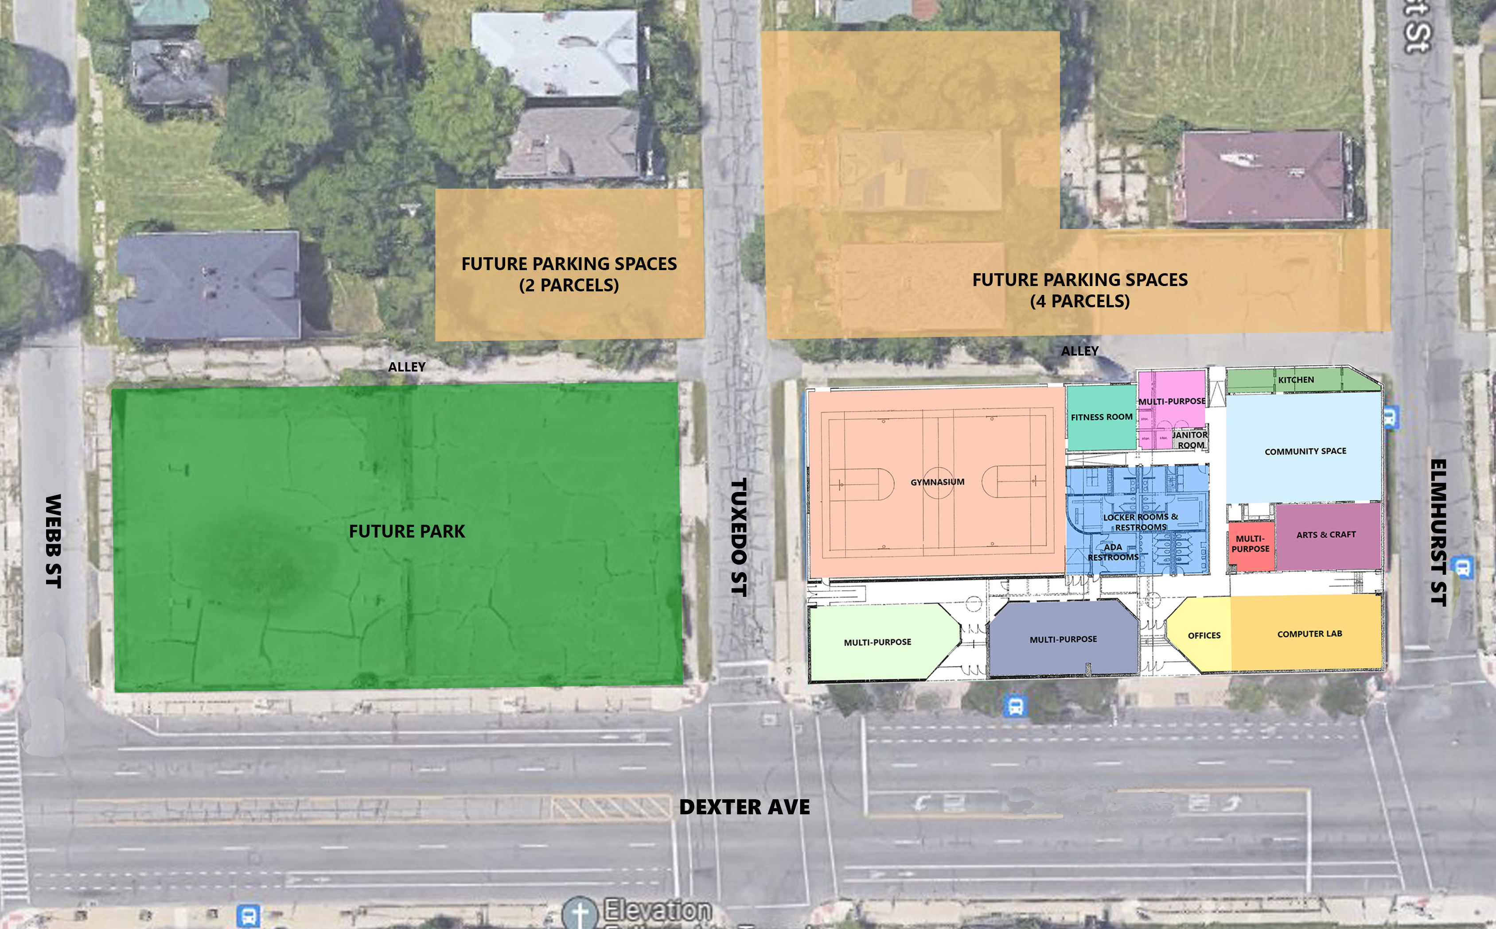
Site Plan – Existing
Recreation Center - Concept Design
NORTH
Notes:
RHEA / DEBBIE
25,000 SF

Slide 12
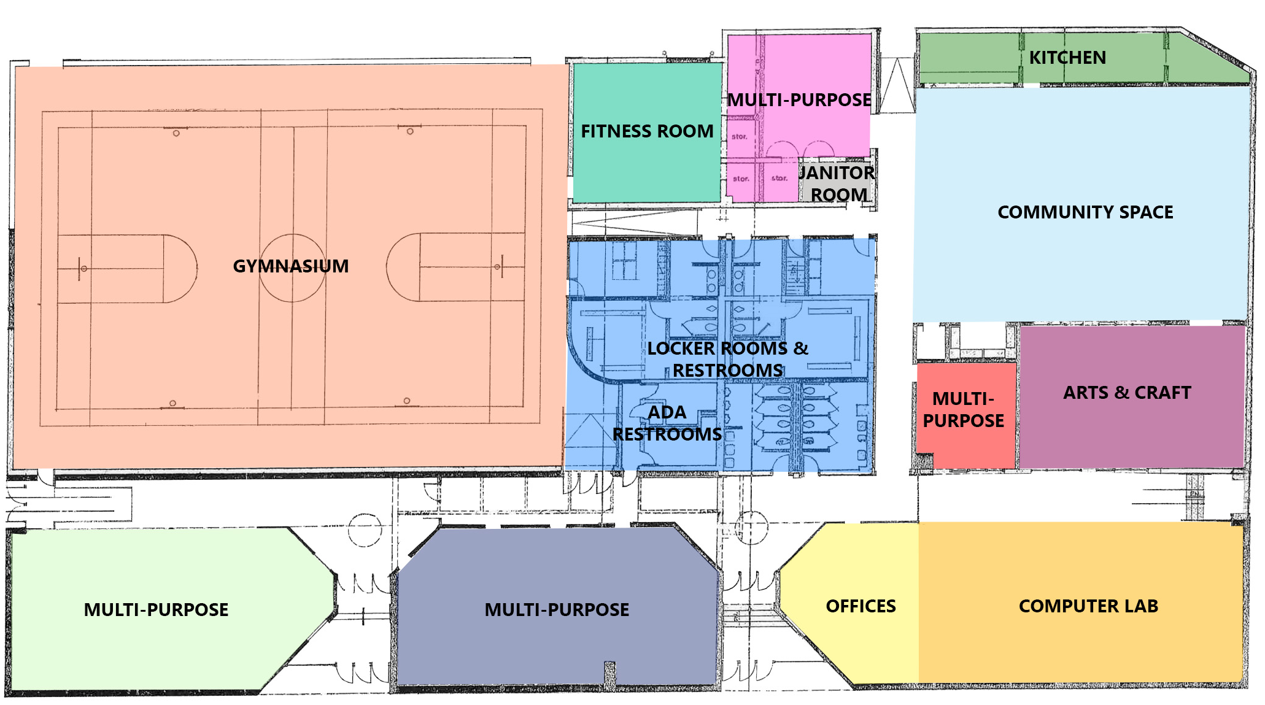
Site Plan – Existing
Recreation Center - Concept Design
NORTH
Notes:
RHEA / DEBBIE
25,000 SF

Slide 13
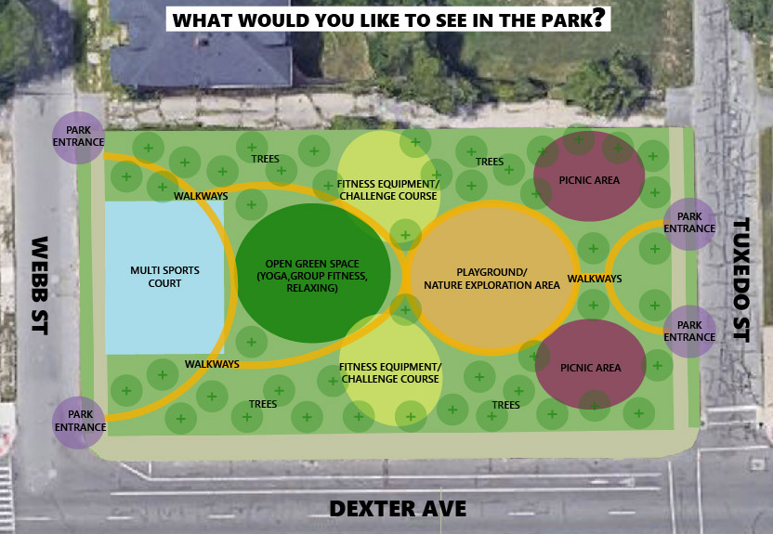
Park - Concept Design Option #1
NORTH
Notes:
JULIANA
Looking into potential expansion with vacant land around the center/park - this would be a future phase and not yet funded.
Park – 0.6 acres

Slide 14
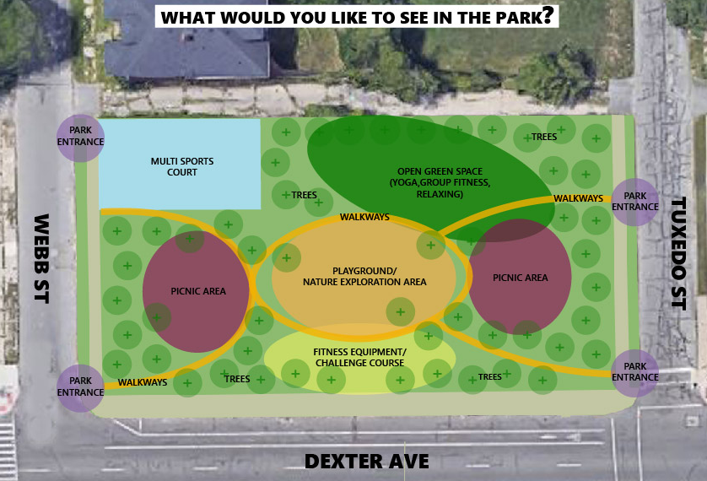
Park - Concept Design Option #2
NORTH
Notes:
JULIANA
Looking into potential expansion with vacant land around the center/park - this would be a future phase and not yet funded.
Park – 0.6 acres

Slide 15
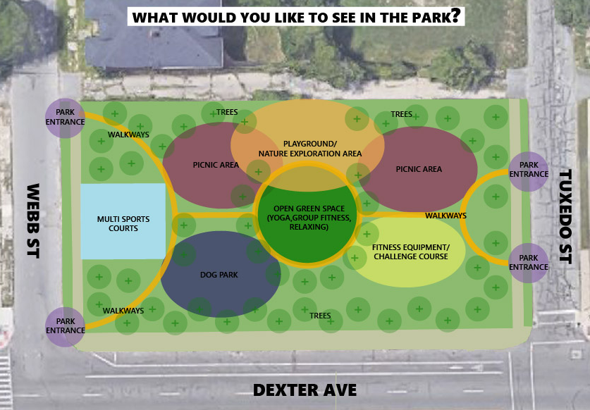
Park - Concept Design Option #3
NORTH
Notes:
JULIANA
Looking into potential expansion with vacant land around the center/park - this would be a future phase and not yet funded.
Park – 0.6 acres

Slide 16
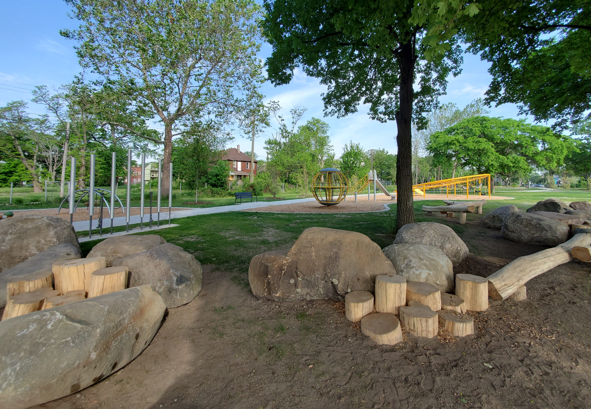
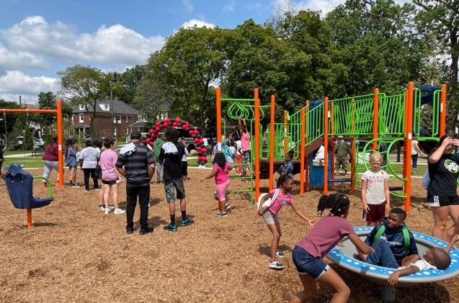
Playground - Precedent Images
Notes:
JULIANA
Looking into potential expansion with vacant land around the center/park - this would be a future phase and not yet funded.
Park – 0.6 acres

Slide 17
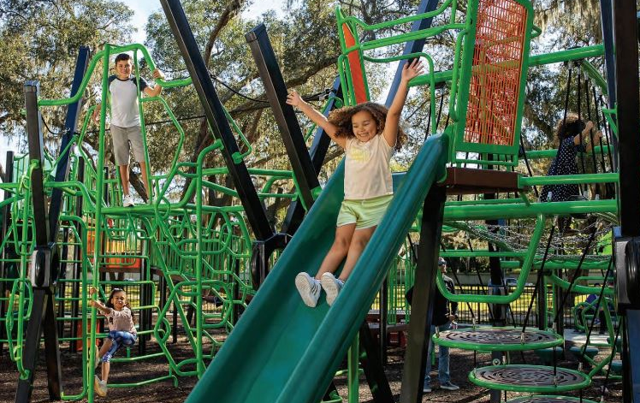
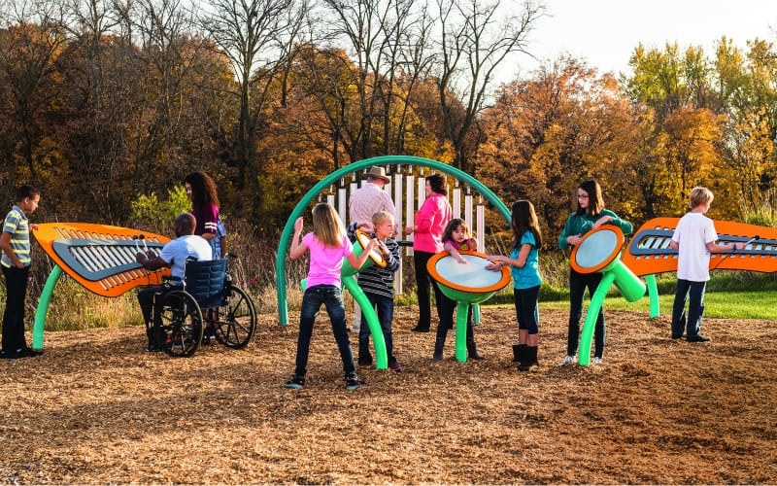
Playground - Precedent Images
Notes:
JULIANA
Looking into potential expansion with vacant land around the center/park - this would be a future phase and not yet funded.
Park – 0.6 acres

Slide 18
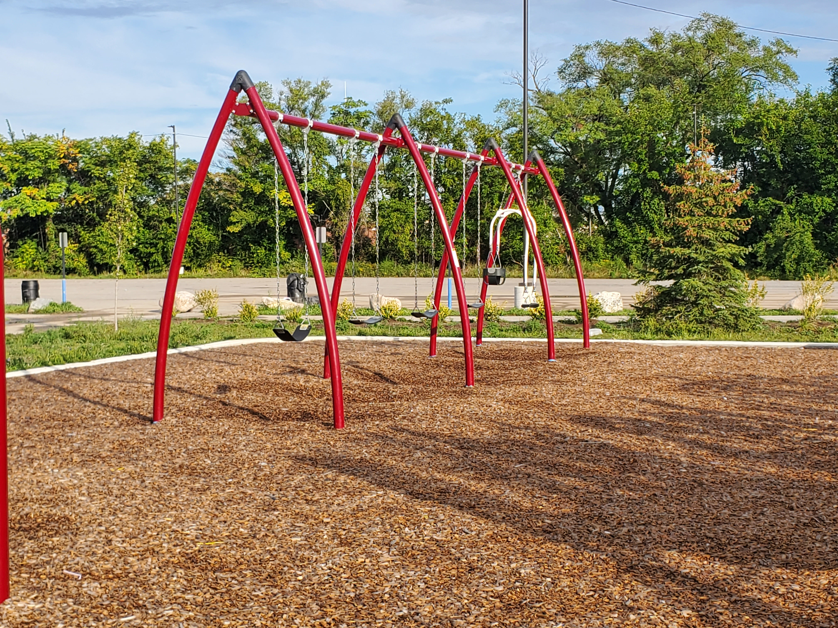
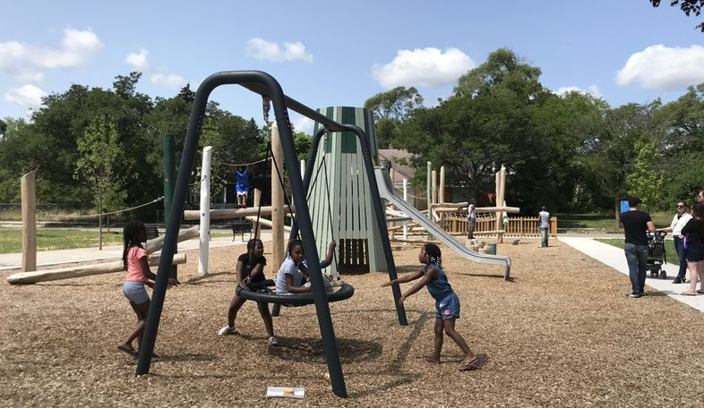
Playground - Precedent Images
Notes:
JULIANA
Looking into potential expansion with vacant land around the center/park - this would be a future phase and not yet funded.
Park – 0.6 acres

Slide 19
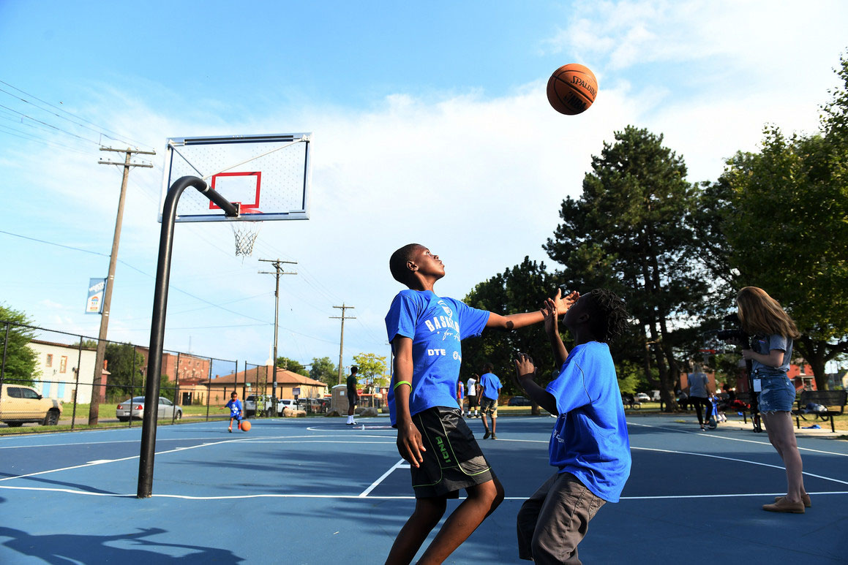
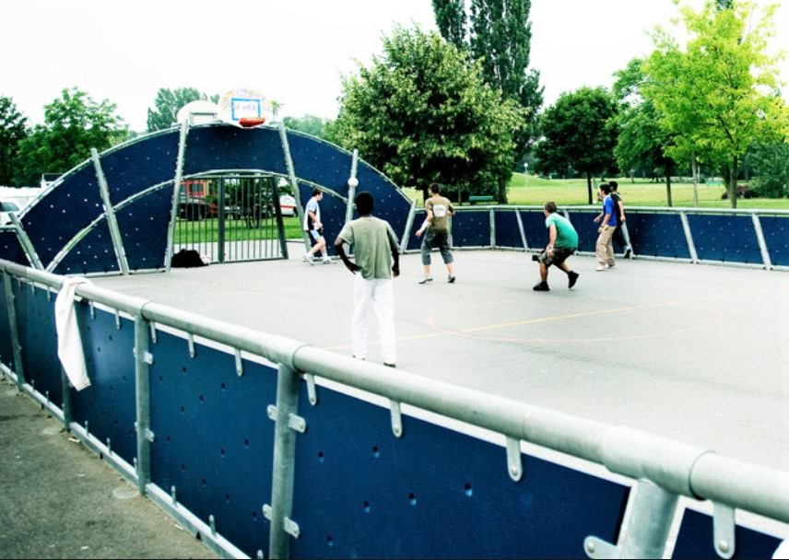
Sports Court - Precedent Images
Notes:
JULIANA
Looking into potential expansion with vacant land around the center/park - this would be a future phase and not yet funded.
Park – 0.6 acres

Slide 20
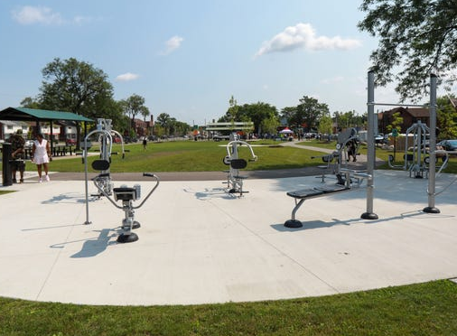
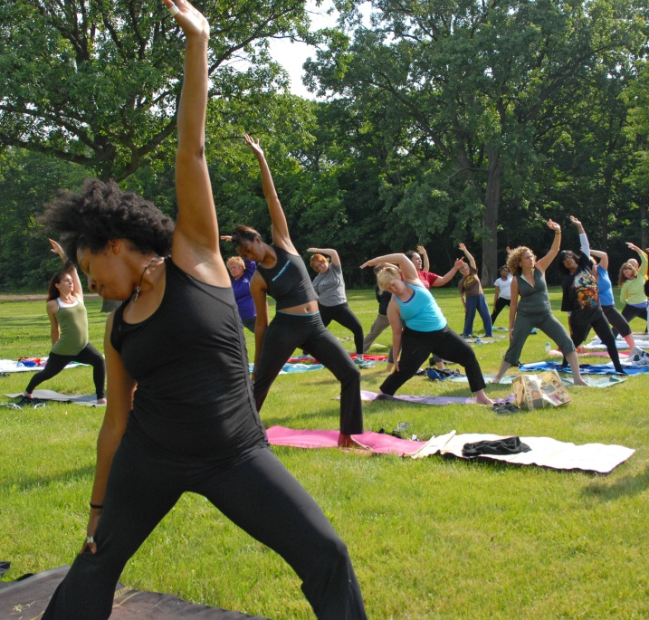
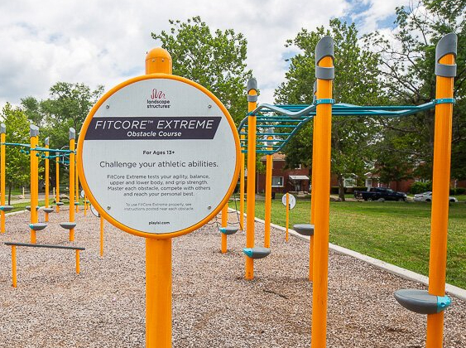
Fitness - Precedent Images
Notes:
JULIANA
Looking into potential expansion with vacant land around the center/park - this would be a future phase and not yet funded.
Park – 0.6 acres

Slide 21
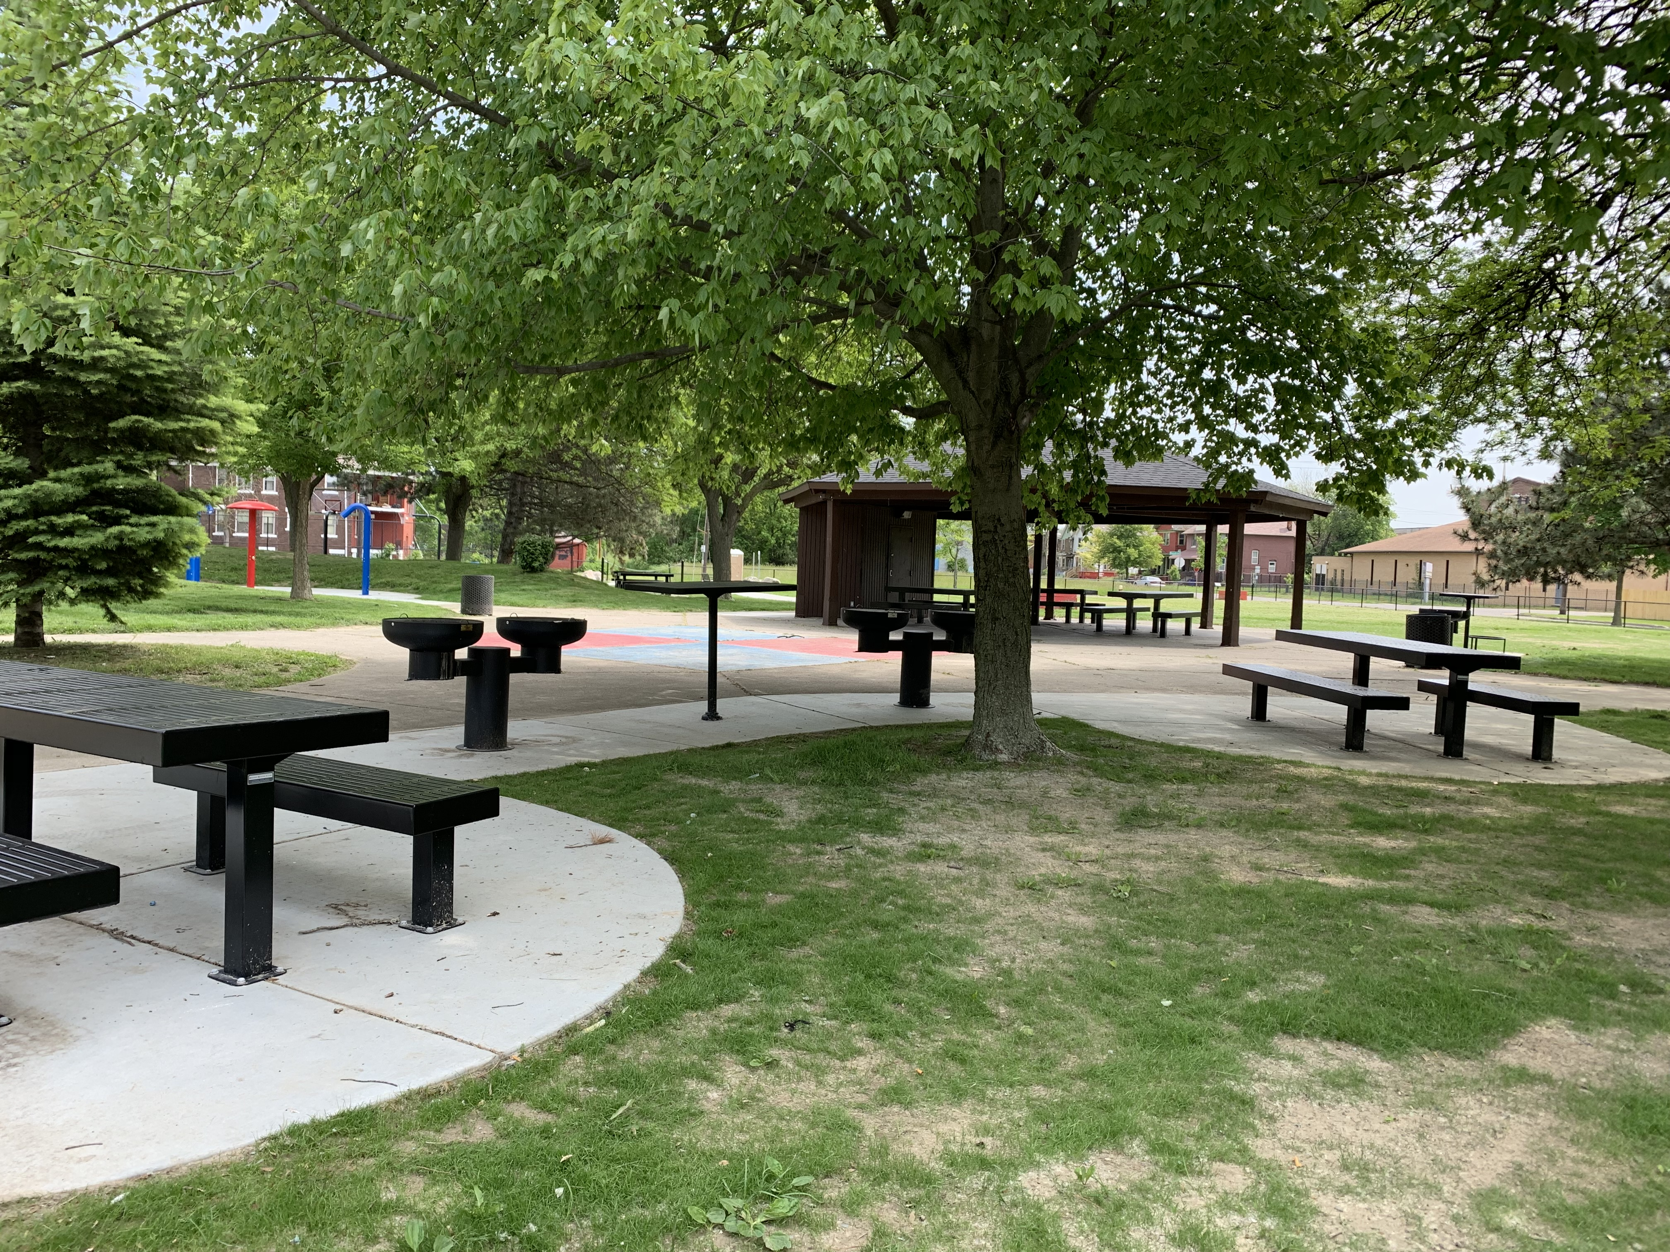
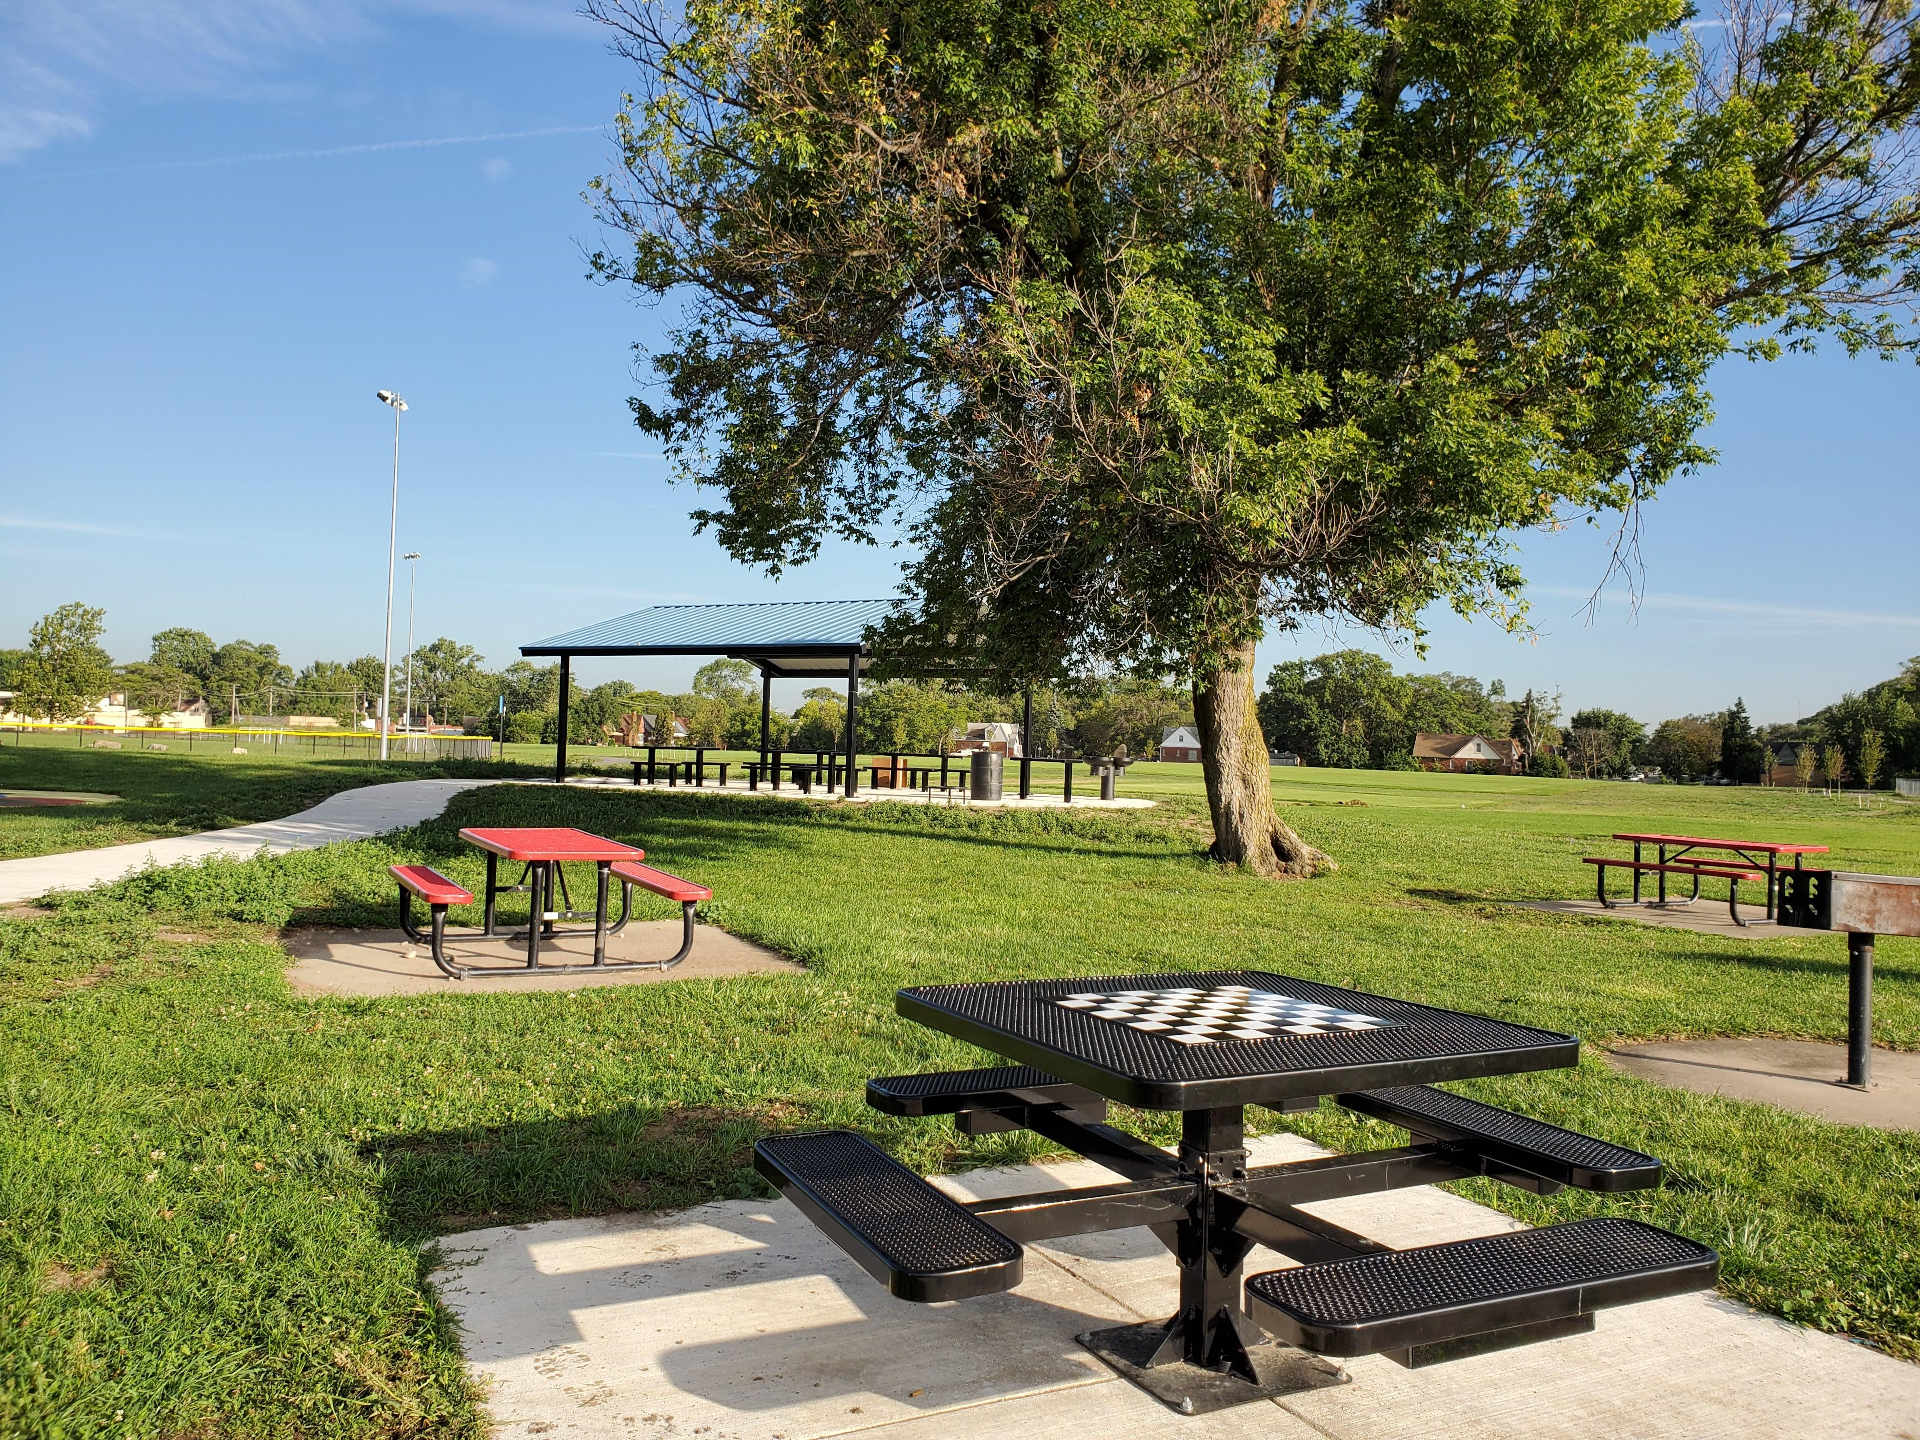
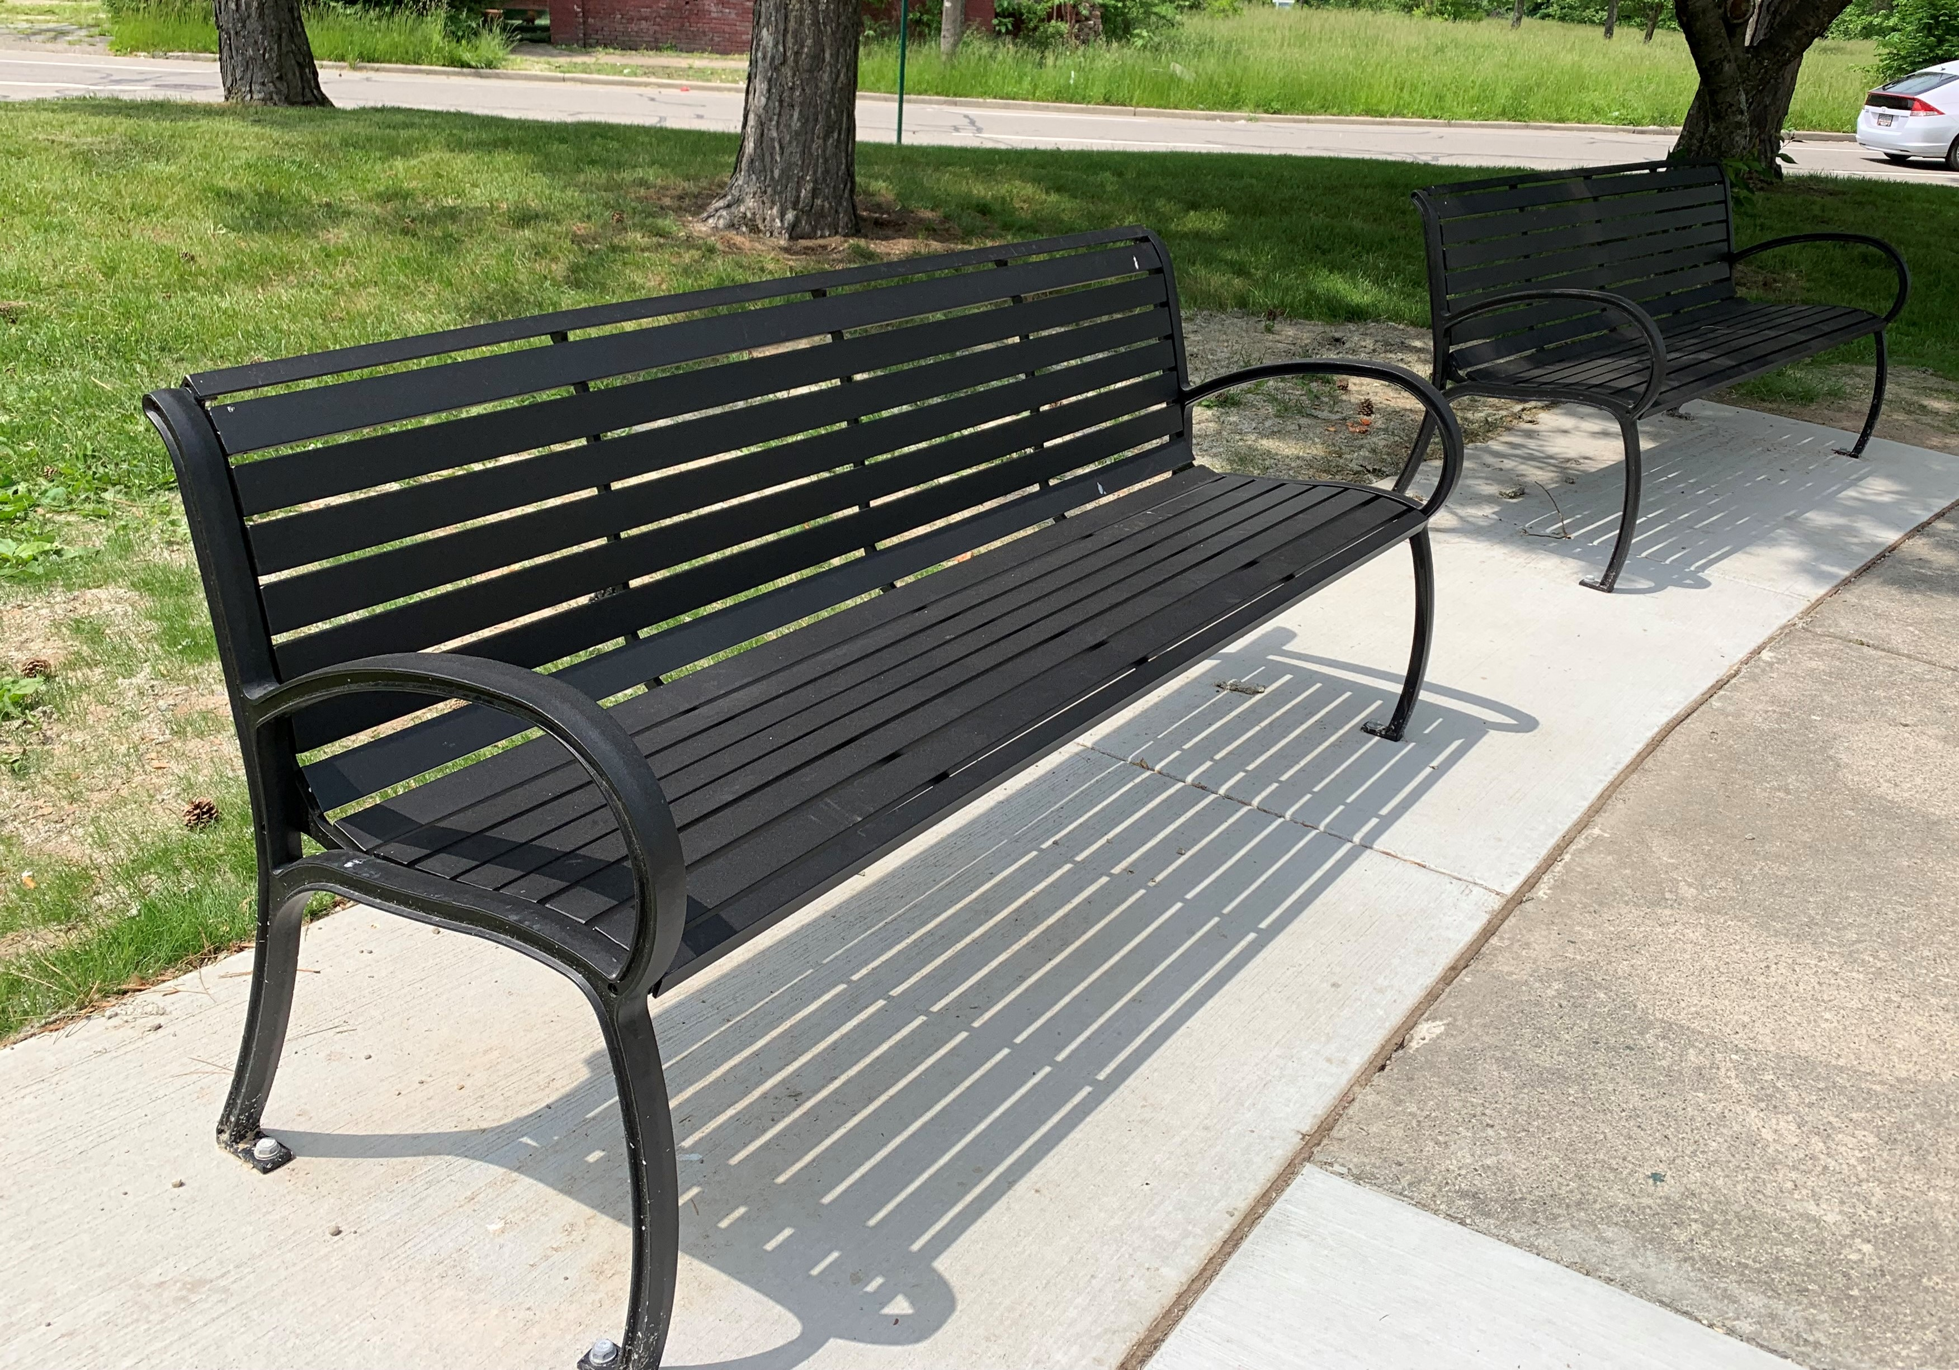
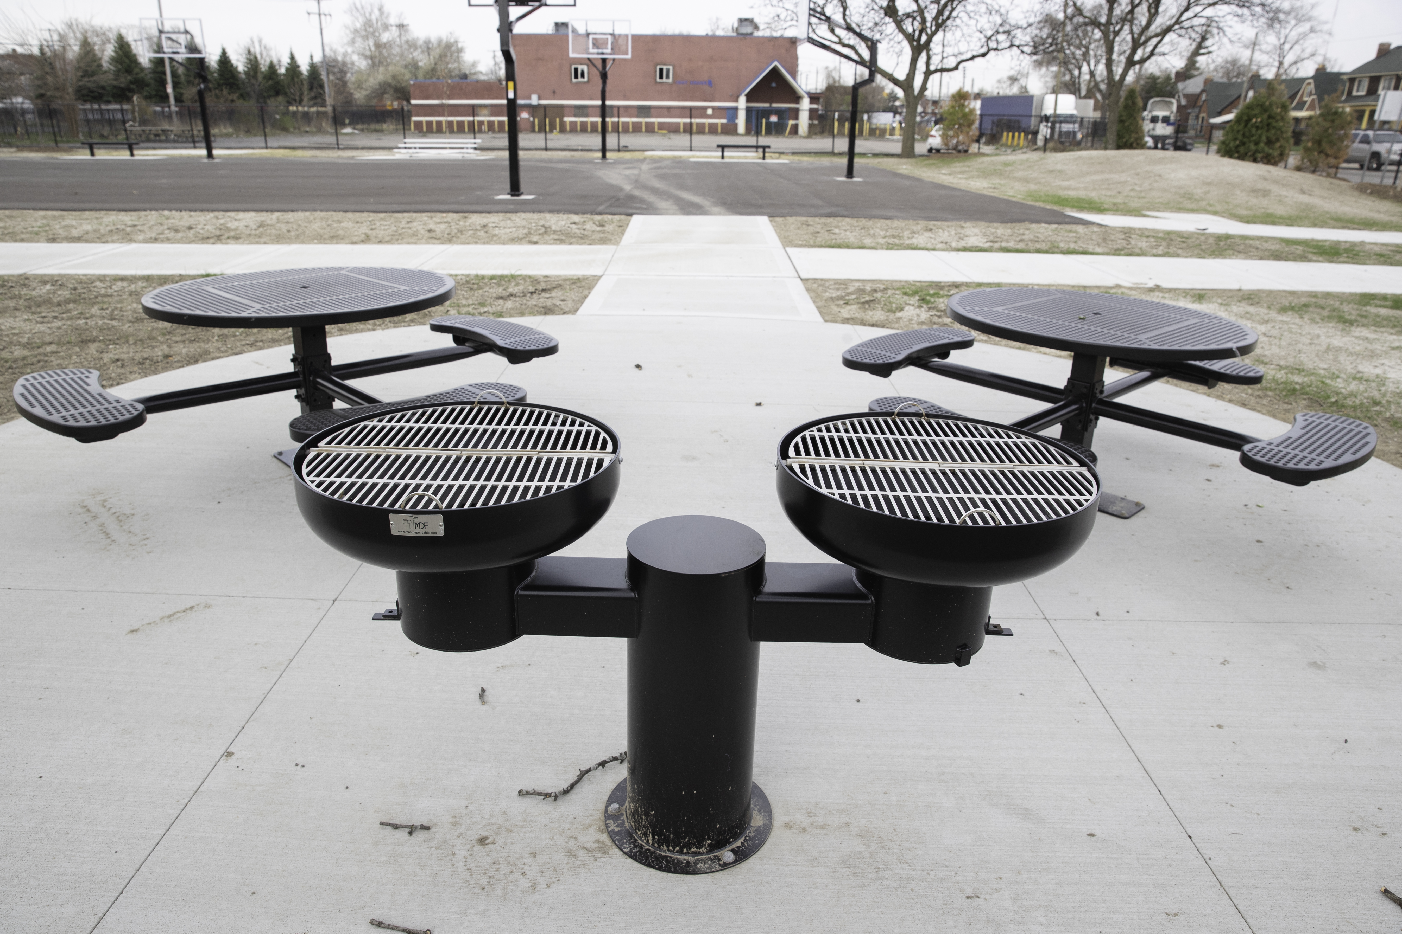
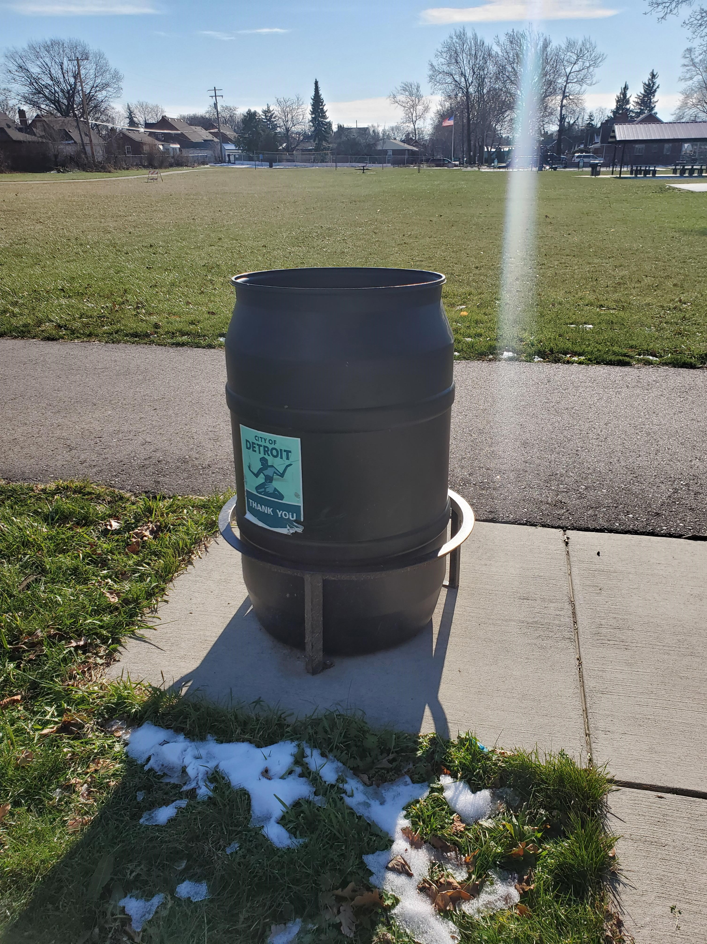
Site Amenities - Precedent Images
Notes:
JULIANA
Looking into potential expansion with vacant land around the center/park - this would be a future phase and not yet funded.
Park – 0.6 acres

Slide 22
Discussion – Report back in ~40 minutes
Thank you!
Stay up to date on the project: Detroitmi.gov/DexterElmhurst
Contact us:
Juliana Fulton - Deputy Chief Parks Planner fultonj@detroitmi.gov
Debbie Machnak - Project Manager Debbie.Machnak@detroitmi.gov

