Slide 1
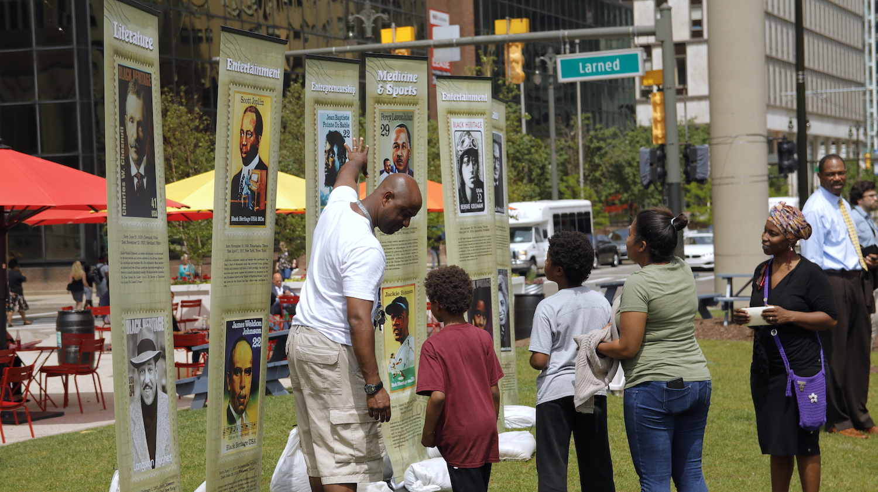

CIVIL RIGHTS, INCLUSION & OPPORTUNITY DEPARTMENT
DETROIT BUSINESS OPPORTUNITY PROGRAM

Slide 2

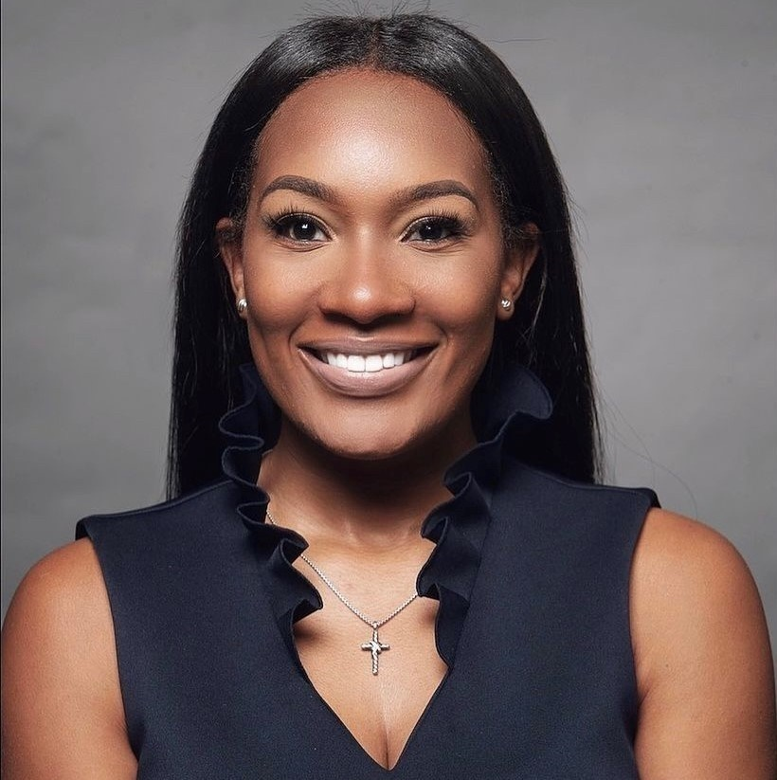
THE TEAM
PURPOSE
To encourage and increase the utilization of local businesses by giving certified businesses the competitive edge needed to procure with the city of Detroit.
Tenika Griggs, Esq.
Deputy Director
Civil Rights, Inclusion and Opportunity

Slide 3

THE DETROIT BUSINESS OPPORUNITY PROGRAM
The Detroit Business Opportunity Program (DBOP), through processing applications and maintaining an online register, CRIO certifies and annually recertifies:
Detroit Based Businesses (DBB),
Detroit Headquartered Businesses (DHB),
Detroit Resident Businesses (DRB),
Detroit Small Businesses (DSB),
Detroit Based Micro Businesses (DBMB),
Detroit Start-Ups (DSU),
Minority-Owned Business Enterprises (MBE),
and Woman-Owned Business Enterprises (WBE).

Slide 4


CERTIFICATION TYPES
DETROIT BASED BUSINESS (DBB)
A business that furnishes goods, perform services, or both,
from a location within the City limits,
that pays City of Detroit Income Tax & City of Detroit property tax at least 1 year immediately proceeding date of application.
DETROIT HEADQUARTED BUSINESS (DHB)
Meets the requirements for a Detroit Based Business
Has an office within the City that serves as the administrative center where the chief executive officer and highest-level management staff perform at least 51% of their management functions
DETROIT RESIDENT BUSINESS (DRB)
Any business which employs a minimum of four employees
At least 51% of which are City residents
DETROIT SMALL BUSINESS (DSB)
Meets the requirements of a Detroit Based Business
Has been in operation for at least 1 year and does not meet the requirement for Micro Based
There is also an annual gross receipts cap depending on the type of business.
Cannot be a subsidiary of an entity

Slide 5
CERTIFICATION TYPES CONTINUED…
DETROIT BASED MICRO BUSINESS (DBMB)
Meets the requirements of a Detroit Based Business
Has an average annual gross receipts of $1M or less
No more than 15 employees
Cannot be a subsidiary of an entity
MINORITY OWNED BUSINESS/ WOMAN OWNED BUSINESS
At least 51% minority or woman ownership
JOINT VENTURE / MENTOR VENTURE
A venture of separate firms, one of which is already certified as a DBB, DBSB, DRB or DBMB
Which has been created to perform a specific contract.
Written agree in which the already certified business performs
  at least 51% of total performance , management and responsibility (Joint Venture)
  At least 30% of total performance , management and responsibility (Mentor Venture)

Slide 6
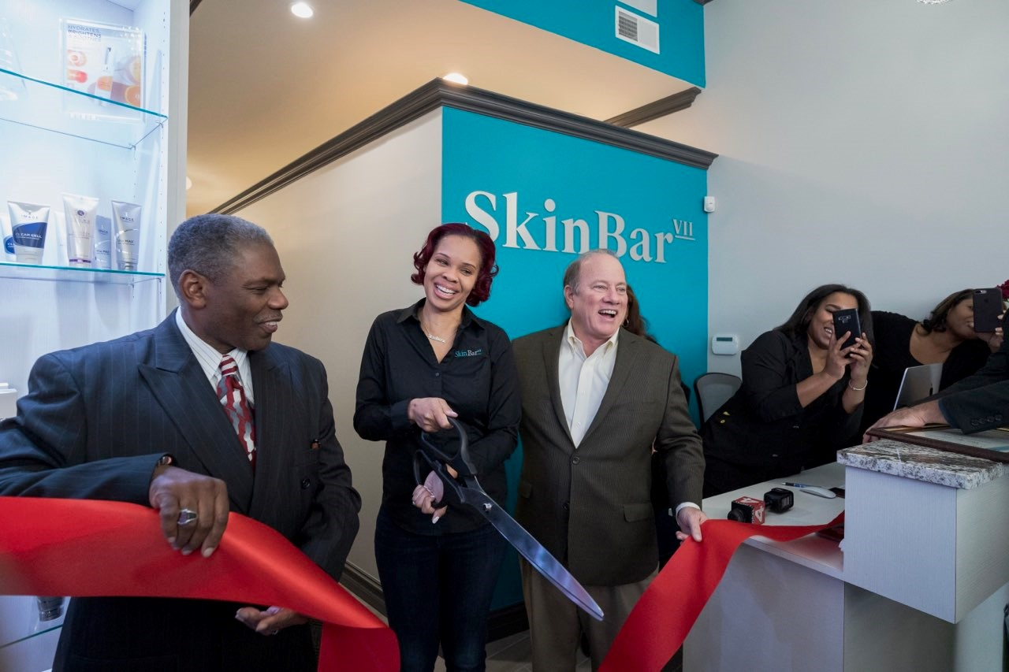
APPLICATION PROCESS
Apply online at:
Detroit Business Opportunity Program | City of Detroit (detroitmi.gov)
*Processing of applications may take up to 45 days
1.Processing | 2.Site Visit | 3. Certification Fee Payment | 4.Certification Letter
Gross Receipts From Previous Tax Year | Fee
≤ $250,000 | $250
< $ 1 million | $500
≥ $1million to $5 million | $1,500
> $5 million | $2,500

Slide 7

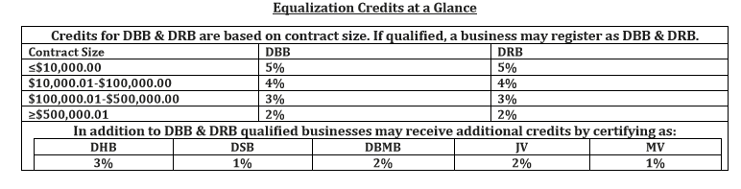
BENEFITS OF A DETROIT BASED CERTIFICATION
1. EQUALIZATION CREDITS

Slide 8
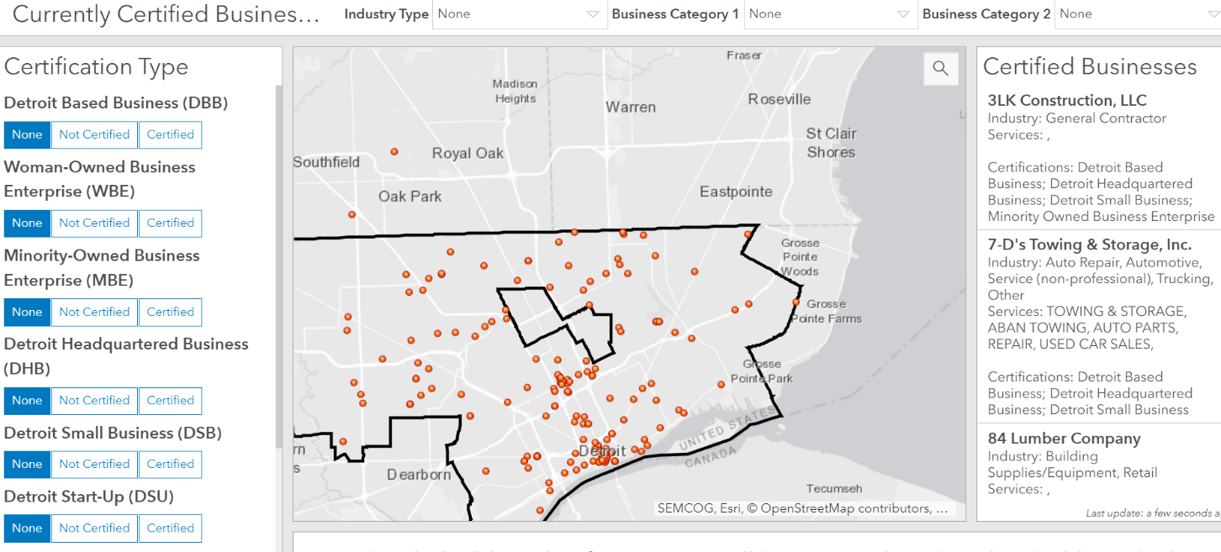
BENEFITS OF A DETROIT BUSINESS CERTFICATION
Appreciation events
Networking and business opportunities
Access to Capital
Possible Business Expansion
Visibility on the DBOP Register

Slide 9



THANK YOU!
Tenika Griggs, Esq.
Tenika.Griggs@detroitmi.gov
313-418-7280

