Slide 1
Supporting Small Businesses in Detroit
Helping Small Businesses in Detroit
Mike Kelly
April 6, 2023
Notes:
Hello there. Welcome to our virtual Government Contracting 101 training series. Today, we are going to look at the System for Award Management. This is available for businesses and is the government’s vendor database. If you want a government contract, you must become a registered vendor. This is done through SAM.

Slide 2
APEX Accelerator
Providing assistance to businesses pursuing federal, state and local government contracts.
Oakland
Livingston
Washtenaw
Wayne
The City of Detroit is served by the Wayne State University PTAC
The WSU APEX Accelerator services business within the city of Detroit.
Monroe
APEX Accelerator Introduction
Notes:
Just a note about PTAC. WSU PTAC serves businesses in the city of Detroit. Funding comes from the federal government, the state of Michigan and our host, Wayne State.
Relationship with PTACs of Michigan - Macomb County PTAC and the other offices around the state
Relationship with APTAC – offices across the country. If your business is located outside of Detroit city limits, we can connect you to the appropriate office.
PTAC offers an extensive network of procurement specialists who work to help small businesses find and win government contracts.

Slide 3
Why Sell to the Federal Government?
Small Business
$145.8B
The Federal Government is the LARGEST PURCHASING ENTITY of goods & services in the world
$491.2B
Other Than Small Business
Fiscal Year 2021/2022
APEX Accelerator Introduction
Notes:
The federal government is the largest consumer in the world.
These figures are from 2020-21.
26.5% to small business ($132.9 billion)
10.29% to small disadvantaged business ($51.6 billion) 5.19% to WOSB ($26 billion)
4.39% to SDVOSB ($22 billion)
2.28% to HUBZone ($1.4 billion)

Slide 4
Why Sell to the Federal Government?
Small Business
$145.8B
$637 Billion
In contract awards
$491.2B
Other Than Small Business
Fiscal Year 2021/2022
APEX Accelerator Introduction
Notes:
Notice how much went to small businesses.
What if you could get just one tenth of one percent of this? Wow!

Slide 5
The Government Buys Almost Everything Imaginable
APEX Accelerator Introduction
Notes:
The government is massive and owns offices of course, but also vehicles, buildings, hospitals, prisons, and military installations.
The stuff they need to buy to run these institutions is staggering.
They could be buying from your business.

Slide 6
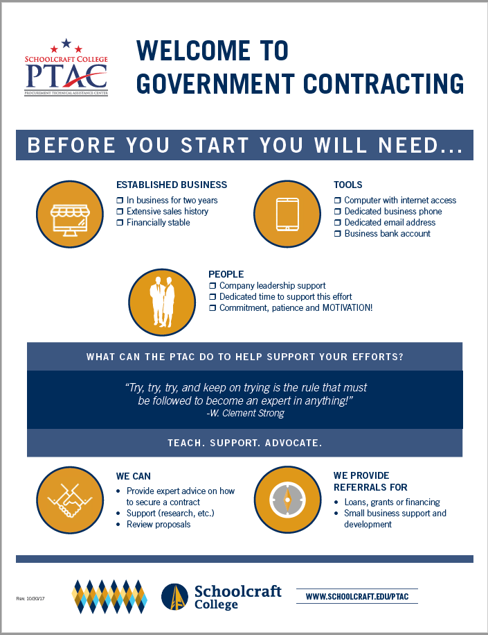
APEX Accelerator
Who Should Sell to the Government?
~ 2 years
Financial stability
Extensive sales
APEX Accelerator
APEX Accelerator Introduction
Notes:
Generally, to be eligible, you need to have been in business for 2-3 years with some past performance to report.
The government is looking for qualified, stable, credible businesses to reduce risk and liability in their procurement process.

Slide 7
Training Sessions
System for Award Management (SAM)
Small Business Programs
Finding Opportunities
Proposal Writing and Bidding
Marketing to the Government
APEX Accelerator Introduction
Notes:
This session is part of our introductory course. Here are the six modules in all. The other modules are scheduled for upcoming months.
They are listed in this order to build and deepen your understanding of the government marketplace.

Slide 8
Registrations and Certifications
Registrations System for Award Management (SAM) Vendor Self Service (VSS) SIGMA Oracle | Government Sector Certifications WOSB/EDWOSB 8(a) HUBZone SDVOSB DBE * commercial sector is out of scope
APEX Accelerator Introduction
Notes:
Some computer skills are required. So, if you aren’t comfortable on the computer, you need to become comfortable. Note that the URL is sam.gov. If it’s a .com or .org, then it’s not the actual government site. Be careful!

Slide 9
NAICS Code(s)
Classifies products and services
Required to register in SAM
Used to determine business size
APEX Accelerator Introduction
Notes:
How many know their NAICs Code? It’s a numbering system the government uses to sort vendors by industry. These codes are not unique to individual businesses, but rather, apply to any business that works in that sector. To find yours, google “NAICS” and your primary capability. You may have multiple (e.g. contracting, electrical, plumbing, etc.) but SAM will require you to identify your primary code. Use your main line of business or where you’ve had the most success/stake your business’ reputation on. Your code will also determine if you are considered a small business by the federal government.

Slide 10
Characteristics of Quality Bidders
Responsive
Responsible
Provides all information requested.
Responds to all sections requiring a response.
Submits samples if requested.
Acknowledges amendments.
Submits bids on time.
Demonstrates successful past performance.
Provides evidence for success.
Possesses acceptable financial stability.
APEX Accelerator Introduction
Notes:
The government is very particular about its vendors. In fact, it’s in the FAR as to what makes for a qualified vendor.
The business must be both responsive and responsible.
Responsive means to provide everything that is requested and nothing more and also adhering to all deadlines.
Responsible means having the capability to do the work, technically and financially.
How do you show you are responsive and responsible?
Responsive – with your bid package.
Responsible – with your past performance.

Slide 11
APEX Accelerator
Questions?
APEX Accelerator
APEX Accelerator Introduction
Notes:
Generally, to be eligible, you need to have been in business for 2-3 years with some past performance to report.
The government is looking for qualified, stable, credible businesses to reduce risk and liability in their procurement process.

Slide 12
Support the APEX Accelerator
We report contract award information to our funding agencies to demonstrate our effectiveness.
Please help by submitting your quarterly survey!
Contact Us
apex@wayne.edu
(313) 577-4665
APEX Accelerator Introduction
Notes:
Each quarter, we send an easy to complete electronic survey to our clients, asking for feedback. How is it going? What else can we be doing to help you? Have you secured any contracts? Please complete these surveys so we can continue to help you where you need it and to show our funders that we are adding value.

