Slide 1
2023
ANNUAL ACTION PLAN
WELCOME
City-Wide
Virtual Public Meeting
Wednesday, June 7, 2023
6:00 -7:00 pm

Slide 2
AGENDA
1. Introduction and Citizen Participation – Marlene Robinson
2. Overview of the Consolidated/Annual Action Plan with Funding Allocations and the
2023-24 Proposed Budgeted Projects & Activities – Warren Duncan
3. Neighborhood Beautification Grant Program and NOF ARPA – Tamra Hardy
4. Community Resources – Jennifer Mahone

Slide 3
2023 Annual Action Plan – Citizen Participation
Citizen Comments
Citizens will have an opportunity to comment at the end of the presentation. Please write questions and comments in the “Chat” or “raise your hand” during Q & A.
Citizen comments are received by the following methods:
Two Virtual Public Hearings
- June 1 and 7, 2023
In Writing at: Housing &
Revitalization Department, Grants
Management section, 2 Woodward
Ave, Ste. 908, Detroit MI, 48226
3. Via Email at:
ConPlancomments@detroitmi.gov
4. Via Telephone: 1-313-224-6380, Hours:
Monday to Friday from 8:30am-4:30pm
5. Department of Neighborhood District
Manager or City Council person

Slide 4
2023 Annual Action Plan – Citizen Participation
Citizen Comments
The public comment period is June 5, 2023 – July 6, 2023. All comments and responses will be reported in our final Action Plan report.
This public hearings will be recorded and available on HRD's Facebook page. The presentation slides will be available on HRD website www.detroitmi.gov/hrd.
To provide an equal opportunity to participate in today’s public meeting, HRD has provided American Sign Language (ASL) interpreters for individuals.
HRD Citizen Participation Plan: https://detroitmi.gov/document/citizens-participation-plan-revised-10-17-22
The public hearings will focus on the Action Plan and is not to discuss funding for organizations or other non-related matters.

Slide 5
HRD – Community Outreach
The Housing & Revitalization Department (HRD) wants to provide outreach in the community (community engagement) by disseminating resources to low-moderate income persons about HUD funded programs that are administered by the HRD and other related resources.
Community Events: HRD will provide: Resource Table/Vendor Table
Non-profit organizations, block clubs, churches, sororities, fraternities and related community events.
Please email your request to: hrd@detroitmi.gov
Subject Line: Community Engagement
Include: contact information, name of organization, location, date, time, description of event.
Thank you for your support!

Slide 6
2023 Annual Action Plan Overview
Consolidated Plan
and
Annual Action Plan

Slide 7
Consolidated Plan & Annual Action Plan
Consolidated Plan – FY 2020-2024
Annual Action Plan FY 2023-24
City of Detroit receives annual U.S. HUD grants:
Community Development Block Grant (CDBG),
HOME Investment Partnership (HOME) Program
Emergency Solutions Grant (ESG),
Housing Opportunities for Persons with AIDS (HOPWA)
HUD requires us to identify and prioritize the City’s housing & community development needs and set five-year goals for use of grants in the plan
Input from diverse stakeholders such as residents, community leaders, non-profits, and private sector to create the plan
City’s application to HUD to receive annual allocation of HUD Grant funds
Identifies strategic projects and programs to be done using the annual HUD funding
Supports the strategies, goals, & objectives of the Consolidated Plan
Leverages private sector, state, and local general funds investment
FY 2023-24 Annual Action Plan is the 4th year of 5-yr Consolidated Plan

Slide 8
Consolidated Plan Strategy & Annual Action Plan
Five Year Plan
2020-2024
(Contains Strategies, broad goals, and objectives)
Plan was submitted in Jan 30, 2021
Now Due 2023
Action Plan
Year 1: 2020
(Contains specific implementing actions to carry out five year strategies, goals and objectives)
Action Plan
Year 2: 2021
(Contains specific implementing actions to carry out five year strategies, goals and objectives)
Action Plan
Year 3: 2022
(Contains specific implementing actions to carry out five year strategies, goals and objectives)
Action Plan
Year 4: 2023
(Contains specific implementing actions to carry out five year strategies, goals and objectives)
Action Plan
Year 5: 2024
(Contains specific implementing actions to carry out five year strategies, goals and objectives)
Goals
Primarily focused on low-to moderate-income households and communities
Development of decent and affordable housing
Create suitable living environments and promote quality of life
Expand economic opportunities

Slide 9
FY 2023-24 HUD FORMULA ALLOCATIONS
COMMUNITY DEVELOPMENT BLOCK GRANT (CDBG)………......…$34,030,759
HOME INVESTMENT PARTNERSHIP (HOME)…...............................$ 8,003,366
EMERGENCY SOLUTIONS GRANT (ESG)…………………...……….. $ 3,034,444
HOUSING OPPORTUNITIES FOR PERSONS W/AIDS (HOPWA)…...$ 3,577,351

Slide 10
City of Detroit Funding Allocations 2005 – 2023

Slide 11
Identify & Prioritize Housing & Community Dev Needs
The City’s housing and community development needs were identified and prioritized below using a combination of online community needs surveys and analysis of demographic, housing, and economic data:
Housing
Economic Development
Public Infrastructure and Neighborhood Services
Community and Public Facilities
Public Services
Homeless Prevention

Slide 12
COMMUNITY DEVELOPMENT BLOCK GRANT (CDBG)
2023-24 Project/Activity Expenditure Budget
Admin/Planning | $6,806,152
Demolition | $0
Economic Development (Summer Job Program & Training) | $1,500,000
Home Rehabilitation (incl Lead and service delivery costs) | $7,108,756
Public Improvements/Pre-development Affordable Housing | $6,122,201
Public Facility Rehabilitation | $1,000,000
Public Service | $2,552,307
Homeless Public Service | $2,552,307
Down Payment Assistance Program | $0
Section 108 Loan Repayments | $5,211,847

Slide 13
2023-24 ACTIVITY EXPENDITURE BUDGET (CDBG)
Admin/Planning | 6,806,152
Demolition | 0
Economic Development | 1,500,000
Home Rehabilitation (incl Lead) | 7,108,756
Public Improvements/Pre-dvpt Affr Hsg | 6,122,201
Public Facility Rehabilitation | 1,000,000
Public Service | 5,104,614
Section 108 Loan Repayments | 5,211,847

Slide 14
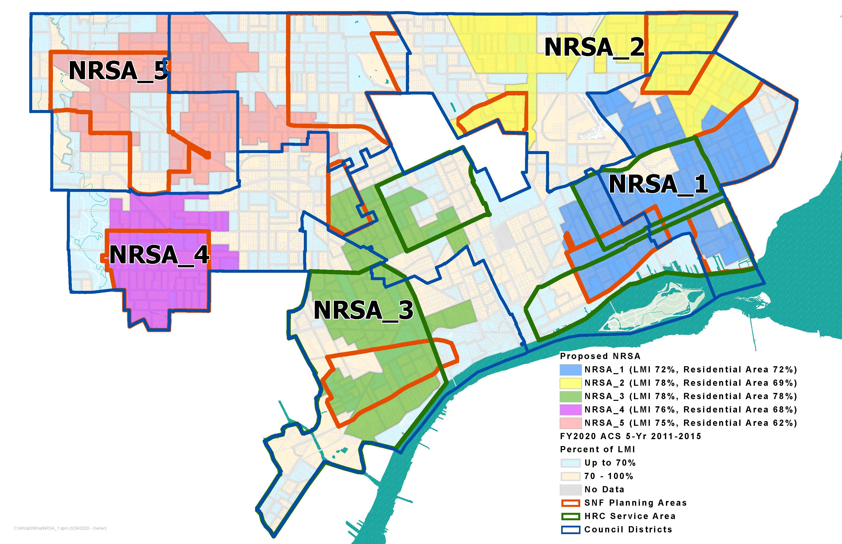
New 2020-2024 NRSAs

Slide 15
COMMUNITY RESOURCES
COMMUNITY RESOURCES

Slide 16

COMMUNITY RESOURCES
Coordinated Assessment Model (CAM) – 313-305-0311
Detroit Housing Resource Help Line – 866-313-2520
Renew Detroit
CDBG Home Repair related question contact: Anna Pinter email: pintera@detroimi.gov

Slide 17
CITY WEBSITE REFERENCES
www.detroitmi.gov/hrd

Slide 18
Public Participation
Question and Answer
Comments (Conplancomments@detroitmi.gov)

