Slide 1
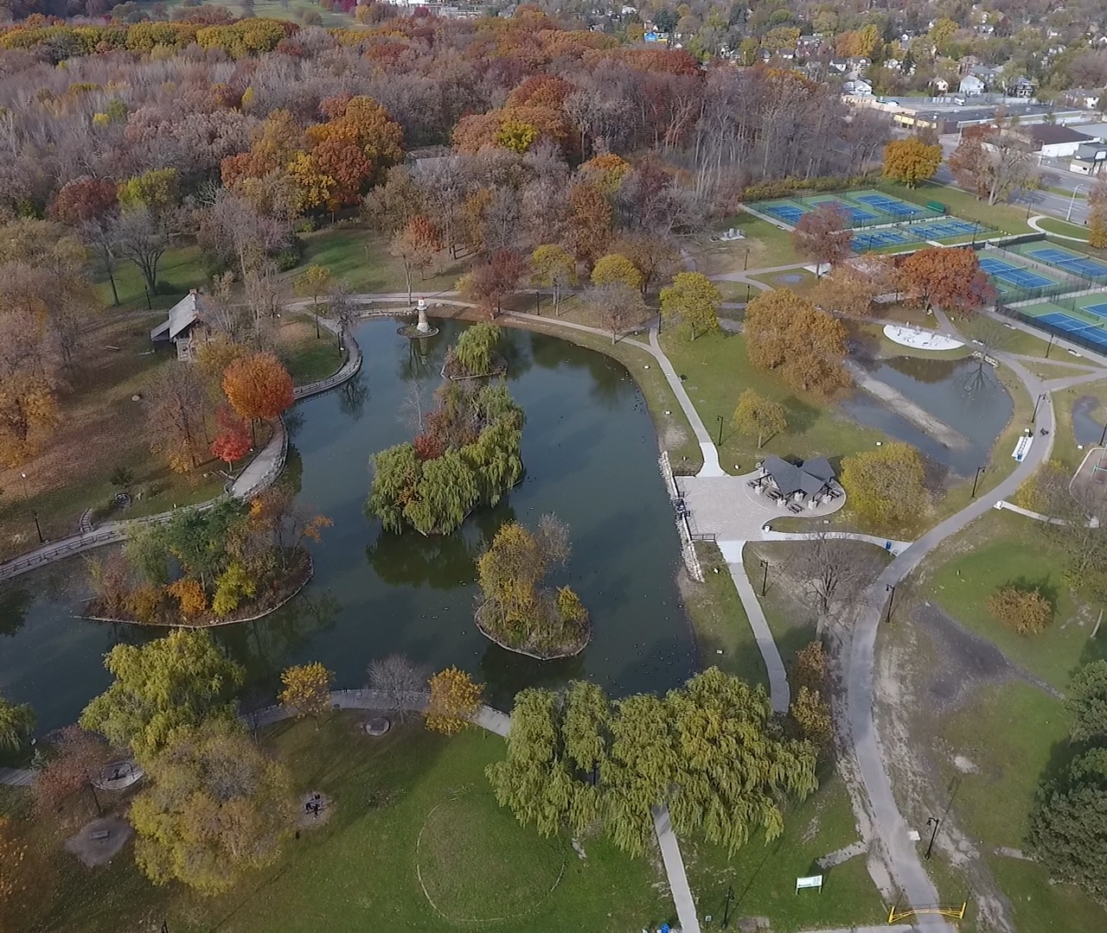
PALMER PARK HABITAT RESTORATION PROJECT
COMMUNITY MEETING
CONSTRUCTION KICKOFF
April 25, 2023
Notes:
Start with the entries to the park and what we’re connecting to
Improved entries within the new park; creating paths to activities and park features
Connect to neighborhoods

Slide 2
PALMER PARK HABITAT RESTORATION PROJECT
Notes:
Start with the entries to the park and what we’re connecting to
Improved entries within the new park; creating paths to activities and park features
Connect to neighborhoods

Slide 3
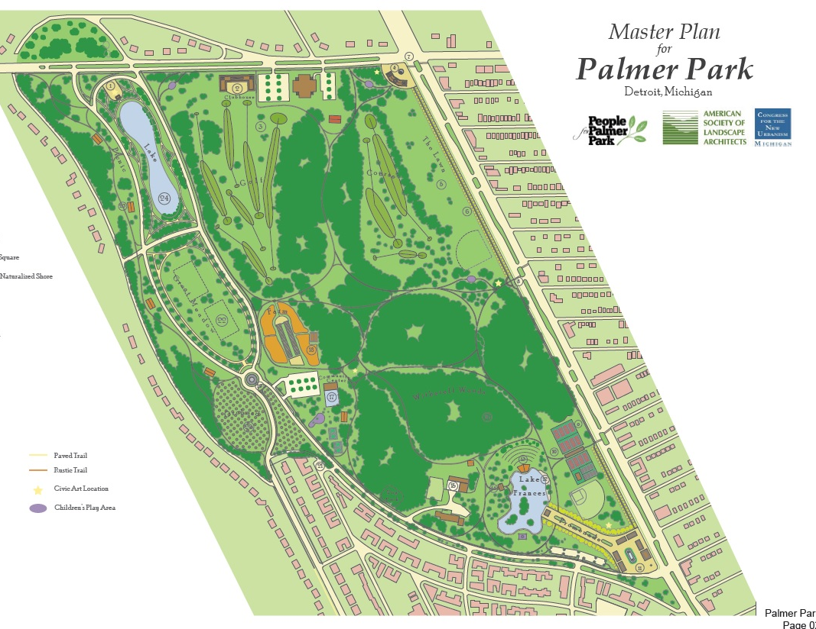
Historic Timeline Palmer Park Habitat Restoration Project
2012 People for Palmer Park Master Plan
2016 Kresge Foundation Grant
Transform the Park through an Ecologically Restorative Approach
Created a unified vision for the parks future as a public amenity embedded in an ecologically diverse and productive environment.
Provide Habitat
Retain Stormwater Run-Off
Helped in Determining Initial Costs
Provided a Framework for the Restoration of Lake Frances
Improve Water Quality
Remove Invasive Species
Historic Preservation Restoration and Ecological Innovation
Contemporary Best Practices within the established historical park context.
Notes:
*

Slide 4
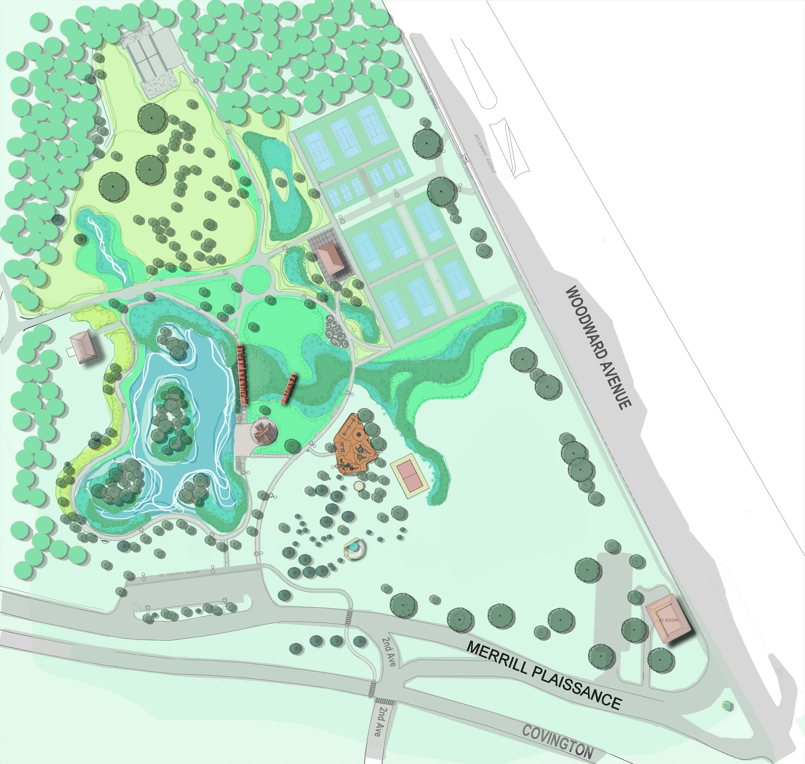
Historic Timeline Palmer Park Habitat Restoration Project
REFORESTATION PLAN
2018-2021 City, Grant and Partner Funded Improvements
BIO-RETENTION
TO MANAGE TENNIS COURT WATER
NATURALIZED UPLAND
LAKE FRANCIS
RESTORATION
EXPANDED NATURAL AREAS AND TURF AREAS
Tennis Court Complex
New Trails/Walkways and Grading
Kaboom Playground
Pavilion and Picnic Shelter
Volleyball Court
Island Beautification
Log Cabin and Light House Preservation and Restoration
Habitat Restoration Project
2021 - Current
LAKE BOARDWALK
Over 3M in Park Improvements
Notes:
*

Slide 5
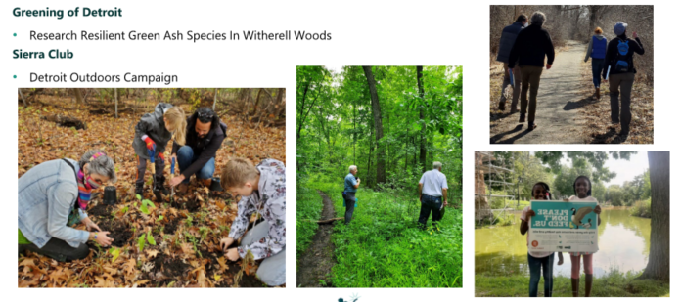
Collaboration/Community Engagement 2021 Palmer Park Habitat Restoration Project
Notes:
*

Slide 6
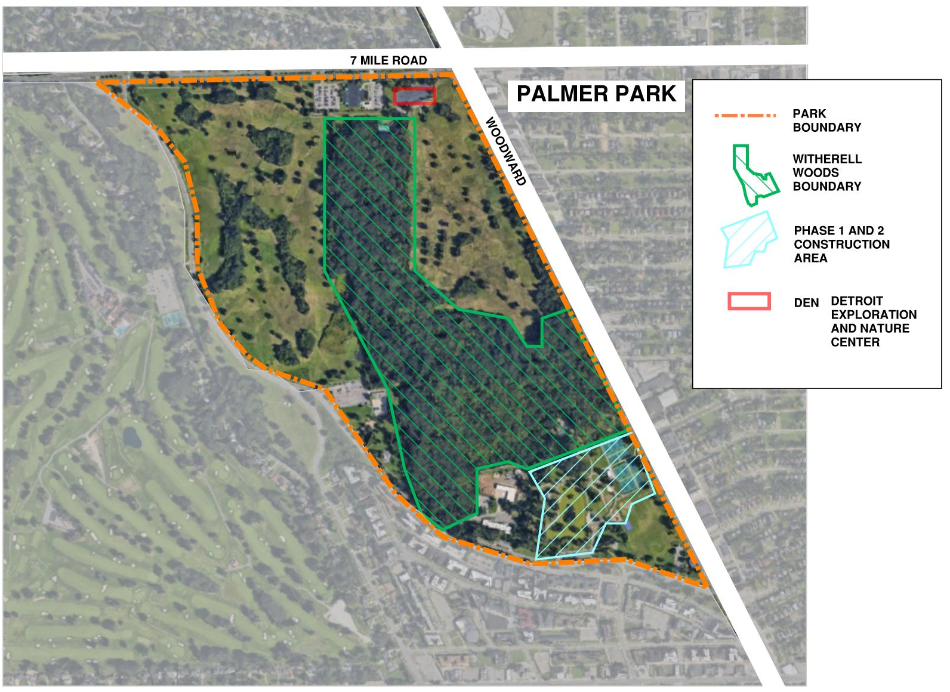
PROJECT AREA Palmer Park Habitat Restoration Project
Intended Outcomes
Provide an exciting/dynamic ecological setting, connecting park visitors to the park’s restored natural landscapes, through education, programs and activities.
Control Goose Population
Improve water quality and clarity of Lake Frances, and create an aquatic habitat to support it
Control Goose Population
Restore or re-create ecological habitats that connect Lake Frances and the surrounding areas to the adjacent Witherell Woods
Control Goose Population
Begin to restore the biodiversity and ecological integrity of the woods.
Notes:
Orient the user to the map.
RESTORE THE PARK THROUGH THE COMMUNITY AWARENESS, STEWARDSHIP PARTNERSHIPS AND PARTICIPATION.
The Master Plan – next slide

Slide 7
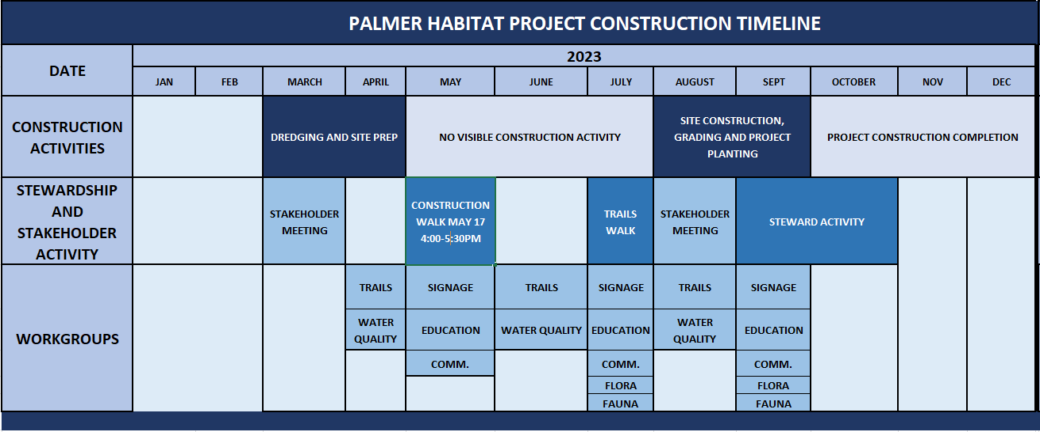
Project Construction Timeline Palmer Park Habitat Restoration Project
Notes:
No Visible Construction Activity – Plantings Dredge will by drying

Slide 8
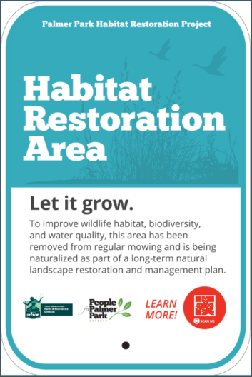
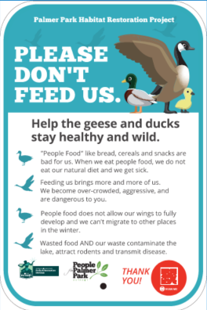
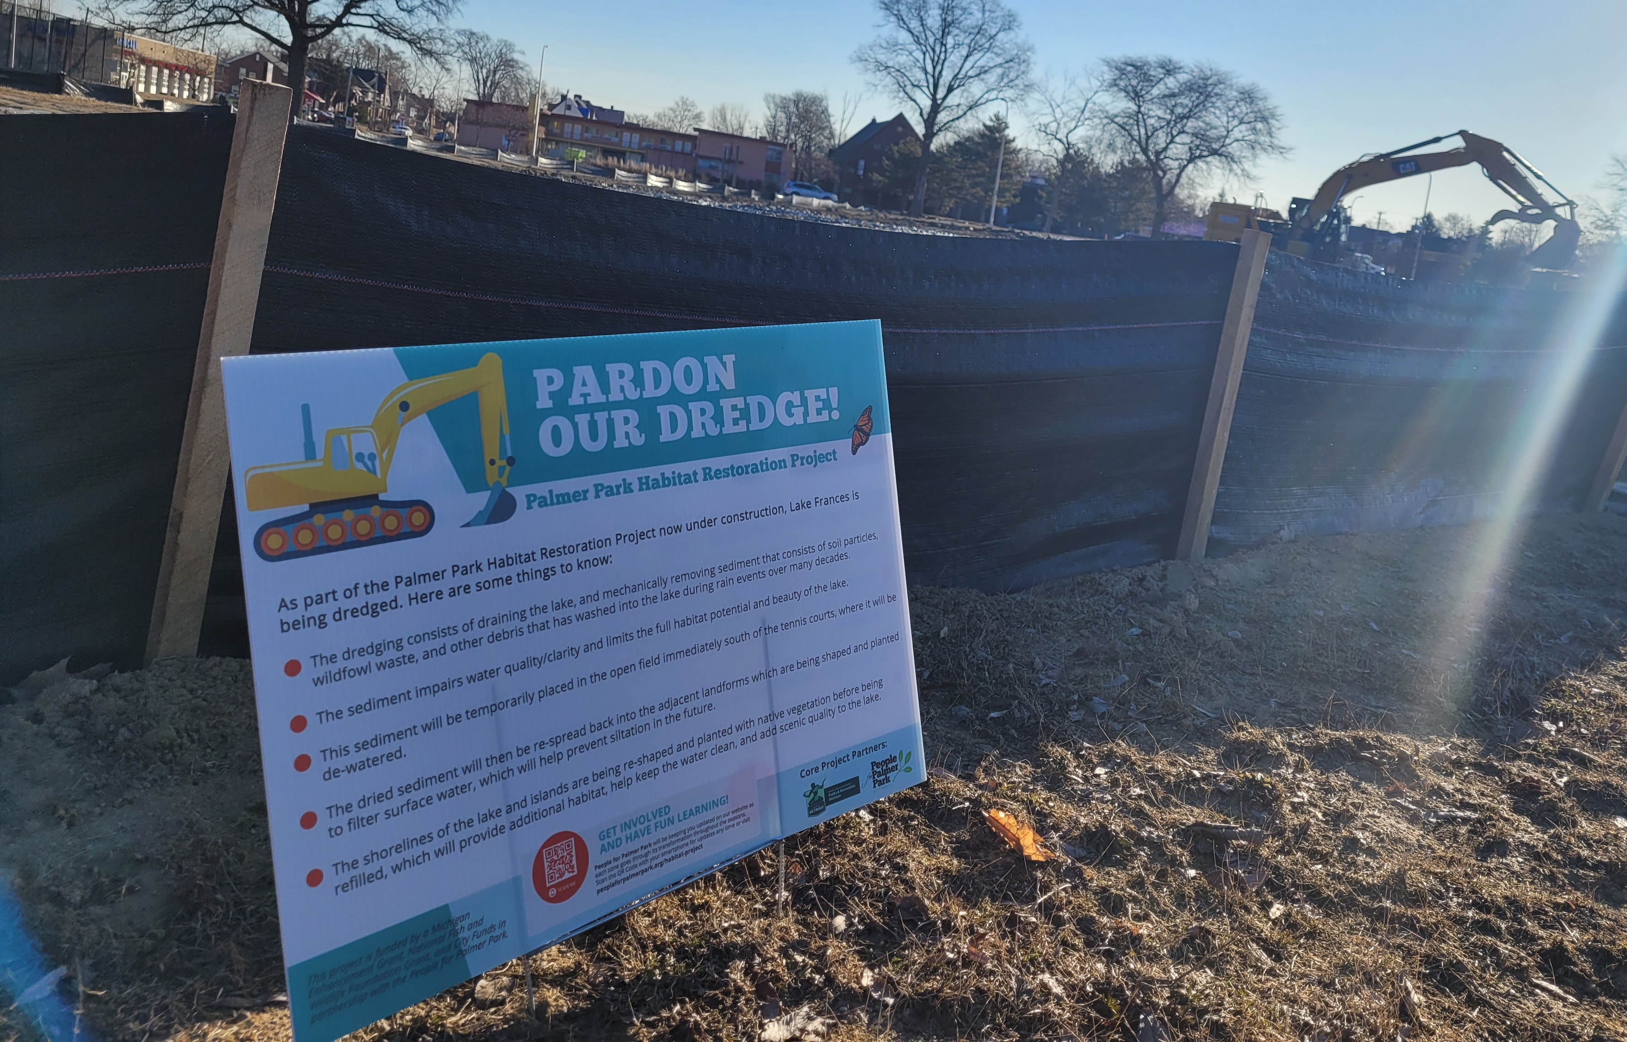
Current Photos Palmer Park Habitat Restoration Project
Notes:
*

Slide 9
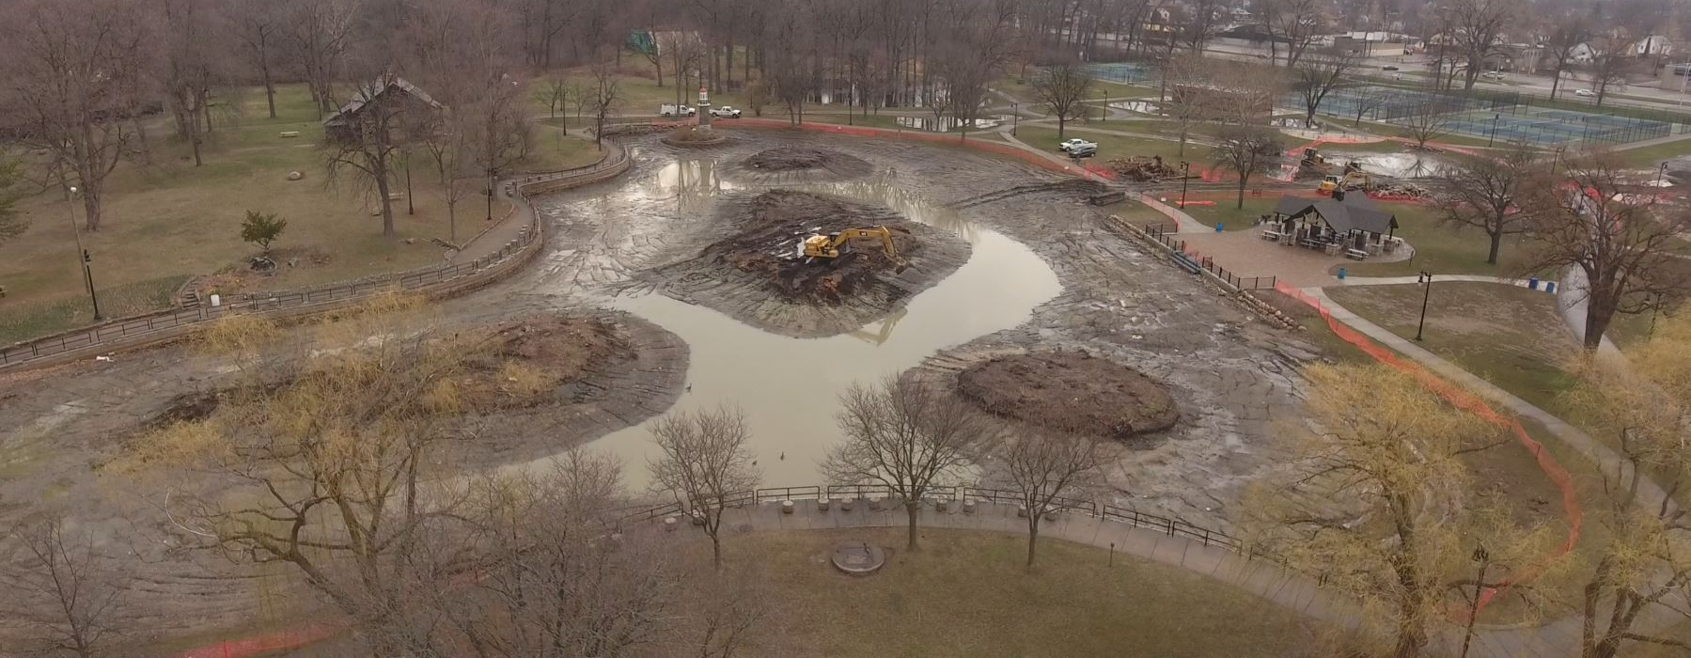
Current Photos Palmer Park Habitat Restoration Project
Notes:
*

Slide 10
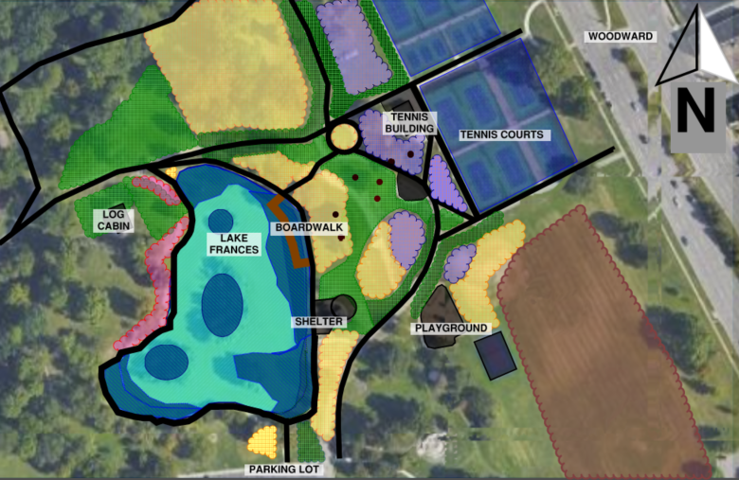
Improvement Goals Palmer Park Habitat Restoration Project
Improvement Goals for Lake Frances and Adjacent Areas
Drain and Dredge Lake Frances
Naturalize the Lake Shoreline
Demonstrate Green Practices Control Waterfowl Waste
Engage the Community and Educate
Signage
Construct Boardwalk
Create Additional Bioswales
Notes:
*

Slide 11
MASTER PLAN WALK THROUGH Palmer Park Habitat Restoration Project
Notes:
*

Slide 12
Improvement Goals Palmer Park Habitat Restoration Project
Improvement Goals for Witherell Woods
Engage the Community and Educate
Better connectivity through the woods.
Signage
Improve access to the woods
Establish ongoing stewardship to support long-term monitoring activities, seasonal care, and management.
Walkway Improvements
Cleaning and Clearing of Invasive Species
Notes:
*

Slide 13
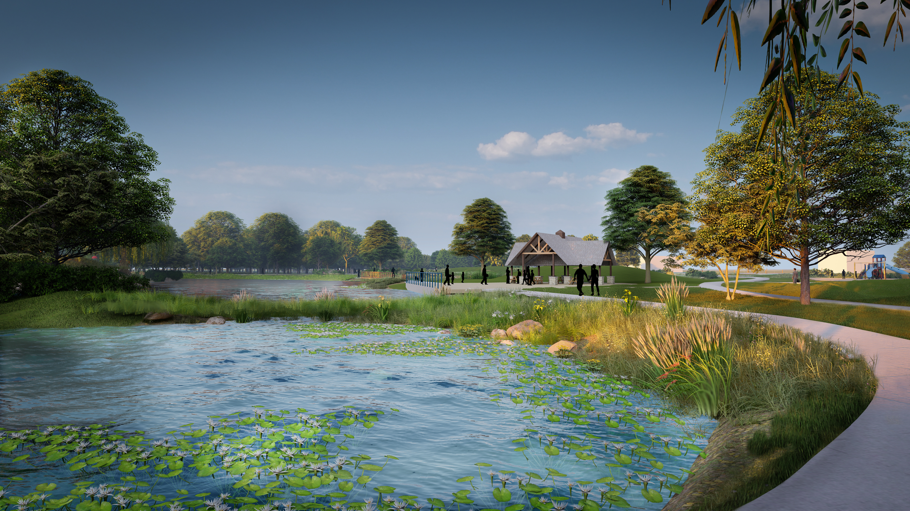
Get Involved Palmer Park Habitat Restoration Project
CONTACT: Jeff Klein kleinj@detroitmi.gov
Farhat Chaudhry chaudhry@detroitmi.gov
Kate Gymrek Kathleen.gmyrek@detroitmi.gov
JOIN A WORKGROUP!
THE LINK IS IN THE CHAT!
Trails
Signage
Education
Water Quality
Flora
Fauna
Communications
PROJECT CONSTRUCTION WALK
WEDNESDAY MAY 17th 4-5:30pm
Notes:
Start with the entries to the park and what we’re connecting to
Improved entries within the new park; creating paths to activities and park features
Connect to neighborhoods

