Slide 1
Denby/Whittier Neighborhood Framework Plan
Kingsville
Kelly St.
SPRING 2023
Hayes
Harper

Slide 2
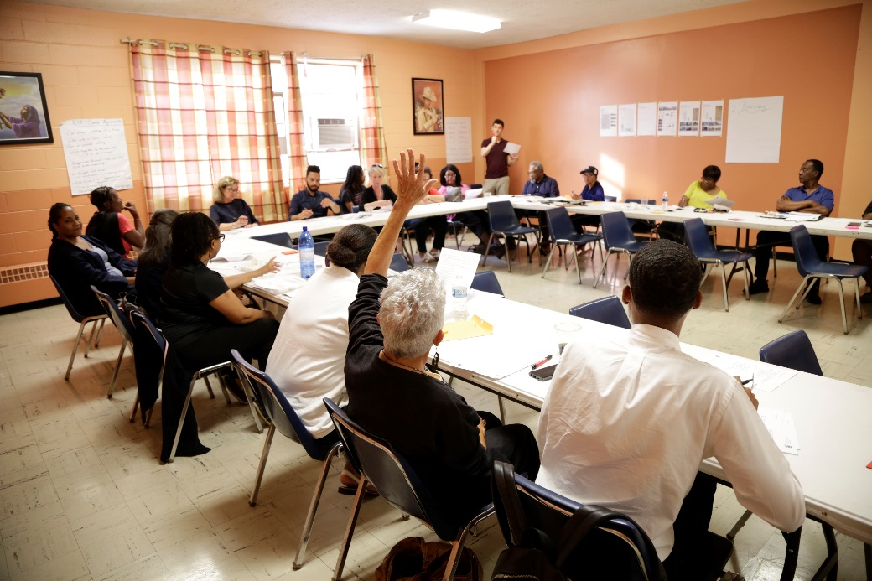
Denby/Whittier Neighborhood Framework Plan
What is a neighborhood framework plan?
Community Engagement
Framework Timeline
Next Steps

Slide 3
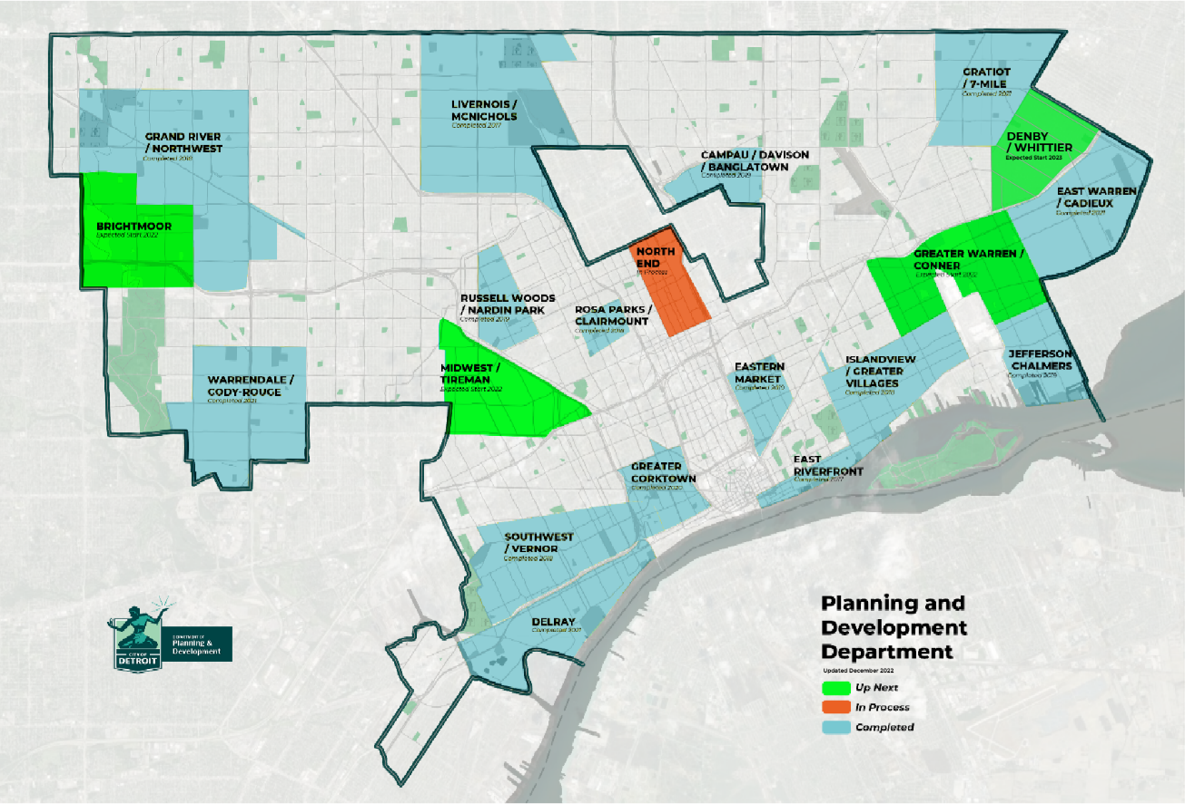
What is a neighborhood framework plan?
The neighborhood framework plan is a city-led initiative to build vibrant neighborhoods in Detroit.
The plan guides future investments and identifies priority projects to drive holistic neighborhood revitalization.

Slide 4
The Vision:
A HEALTHY AND BEAUTIFUL DETROIT, BUILT ON INCLUSIONARY GROWTH, ECONOMIC OPPORTUNITY, AND AN ATMOSPHERE OF TRUST.

Slide 5
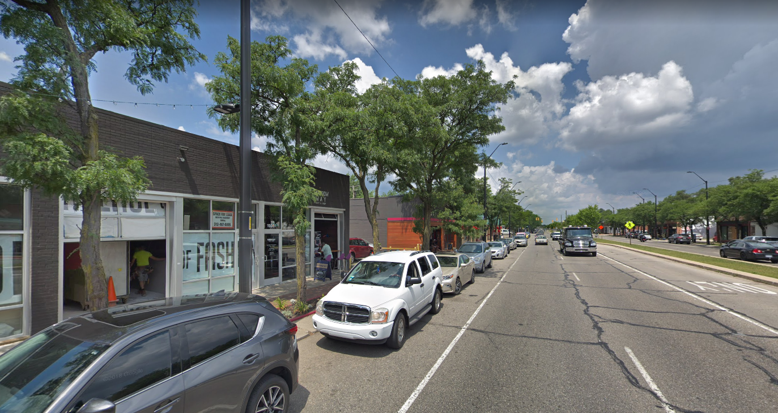
What we've accomplished:
LIVERNOIS AVE - BEFORE
Notes:
Take Livernois for example
it was a high-speed arterial with a pinched sidewalk and wasteful median

Slide 6
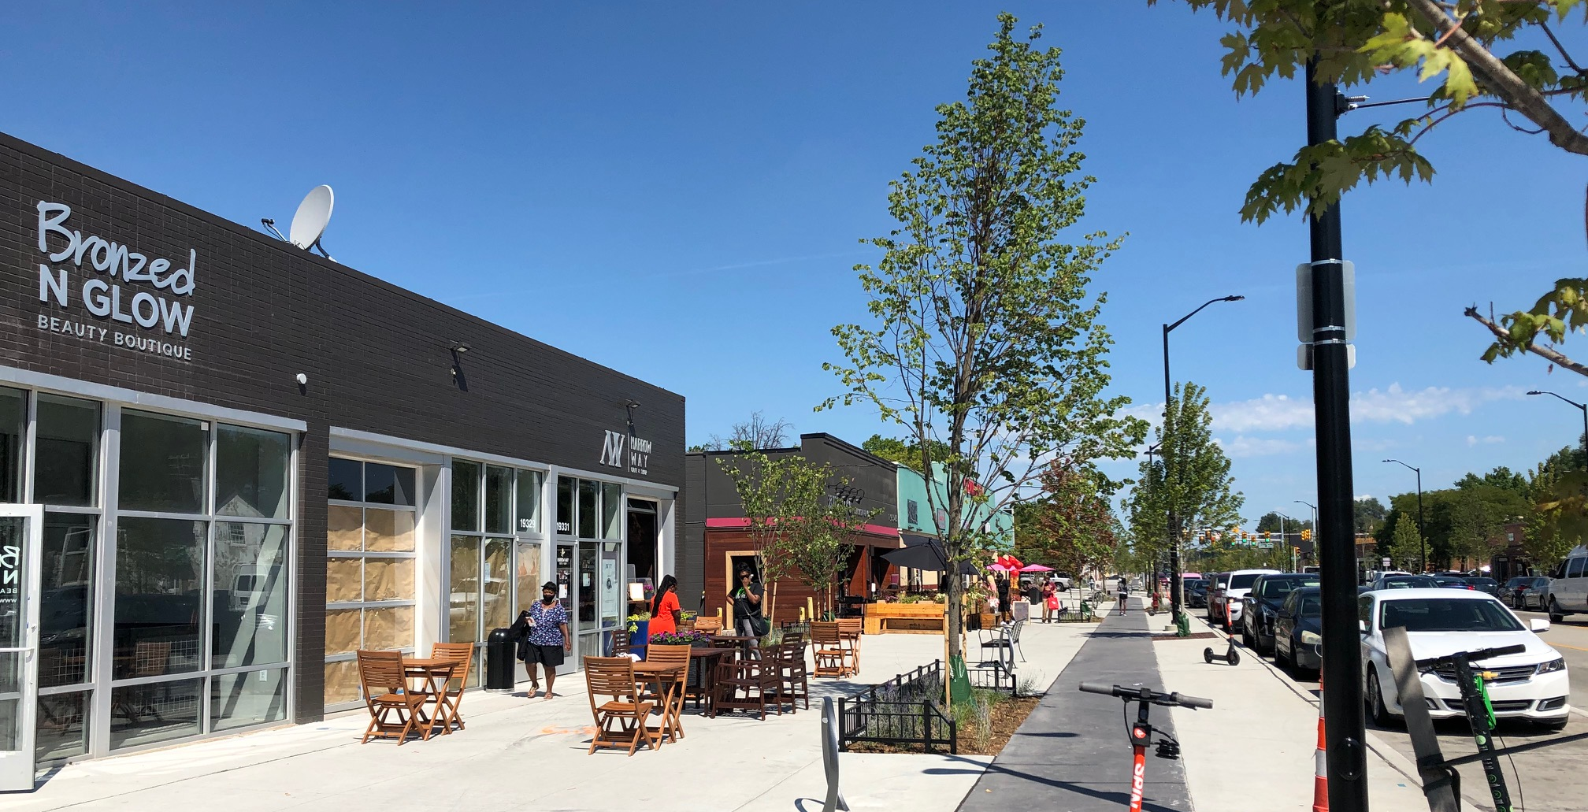
What we've accomplished:
$45K Motor City Match recipient
$45K Motor City Match recipient
LIVERNOIS AVE - AFTER
Notes:
we got rid of the median and put that space to the sidewalk
where it could be used for amenities like protected bike lanes and patio seating
patio seating expands the restaurants’ seating capacity and therefore revenue potential
creating a mutual incentive between walkable urbanism and business profitability
the City also had a hand in opening business along the corridor
Bronzed N Glow and Narrow Way Café each received $45k entrepreneurship grants

Slide 7
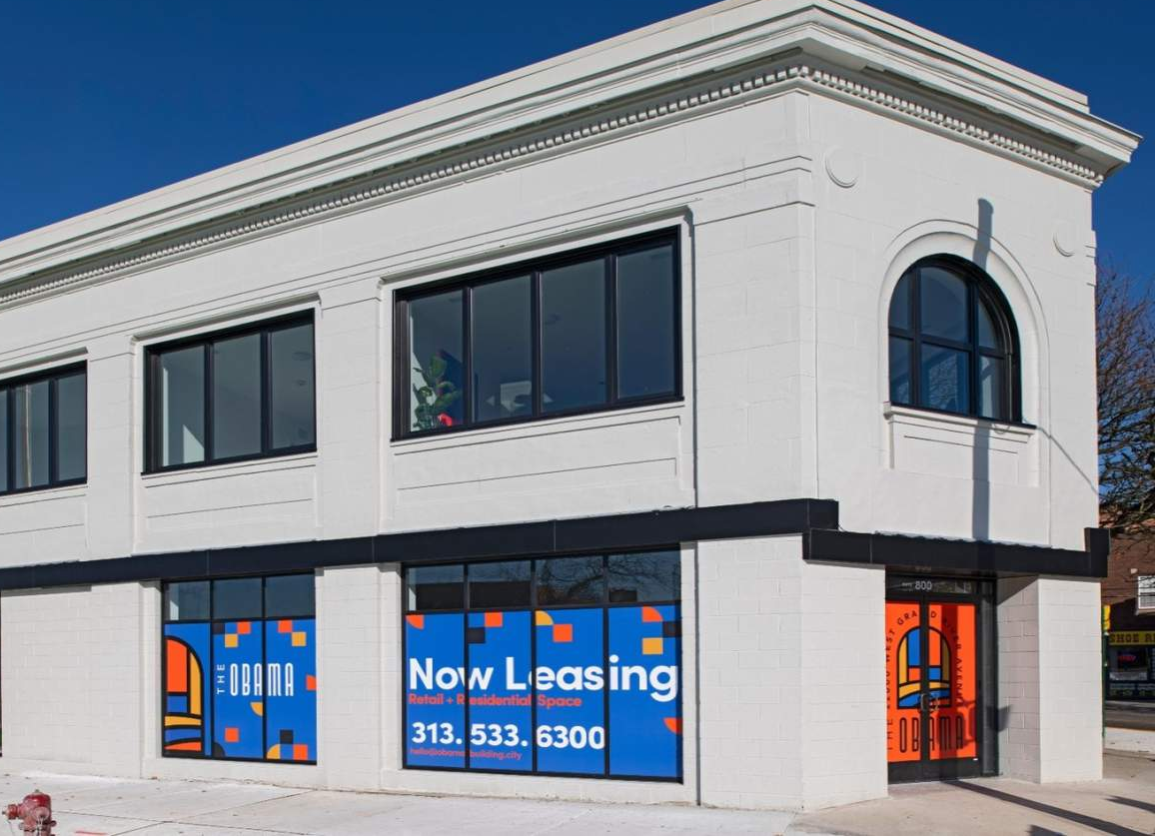
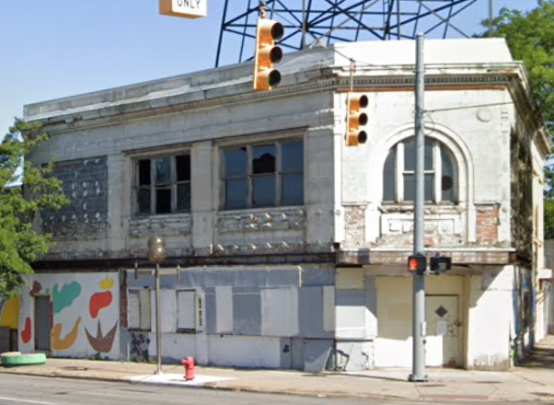
What we've accomplished:
OBAMA BUILDING – UNDER CONSTRUCTION
Brandon Hodges
Notes:
the scale of the project---$3.6 million, 13,000 SF---allows us to partner with local and emerging developers
like Brandon Hodges who project managed for the Platform, a local developer
all projects that the City contributes to achieve affordablility under our 20% affordable at 80% AMI policy
the Obama goes even further. it is renting at 60% to 75% of AMI, meaning rents starting at $775
https://detourdetroiter.com/detroit-obama-building-old-redford-community-benefits/

Slide 8
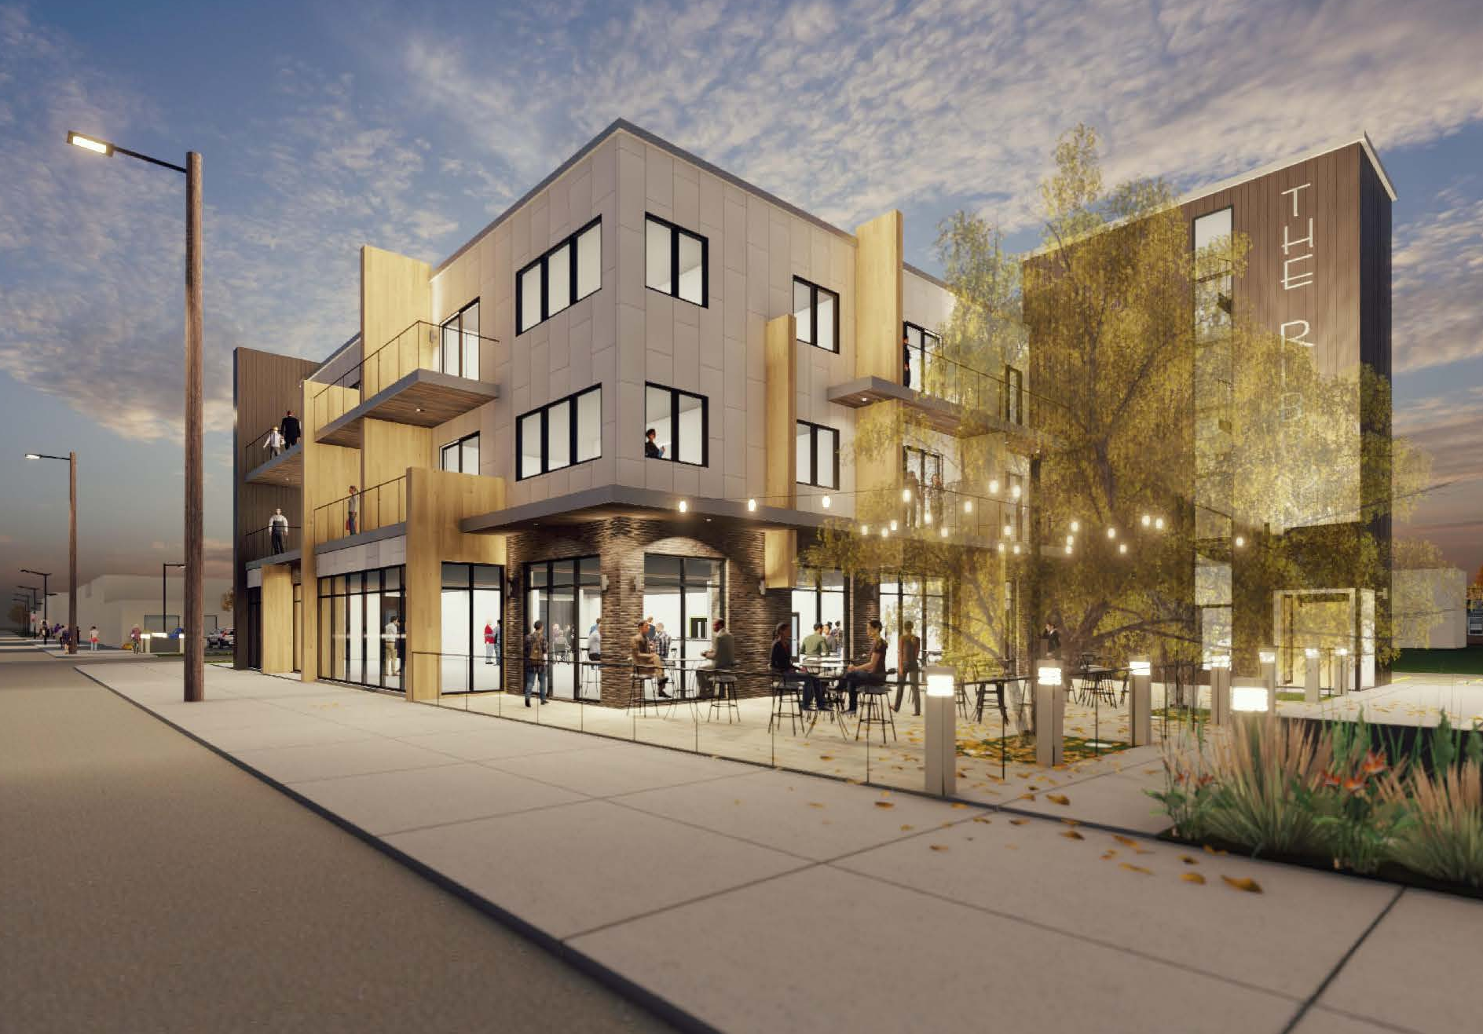
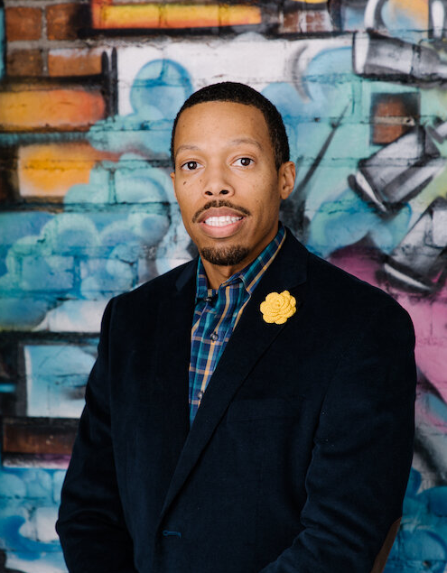
What we've accomplished:
THE RIBBON – UNDER CONSTRUCTION

Slide 9
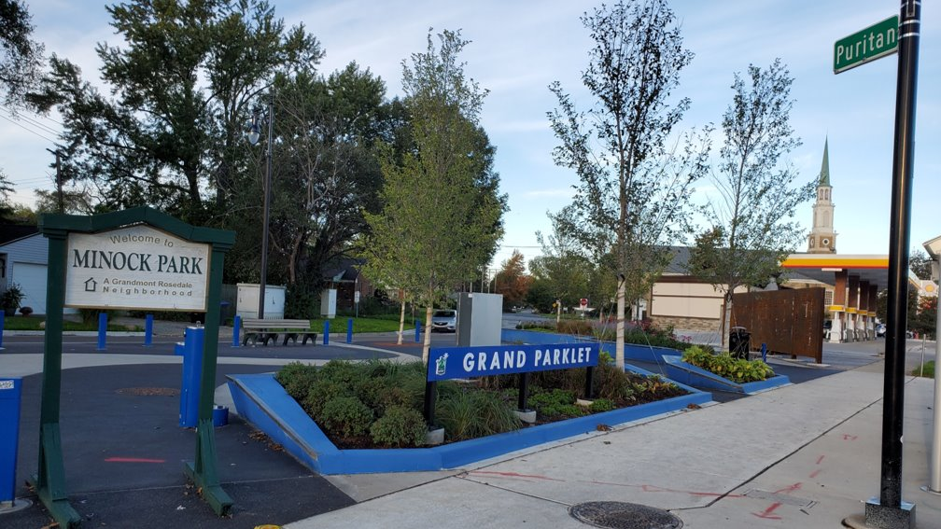
What we've accomplished:

Slide 10
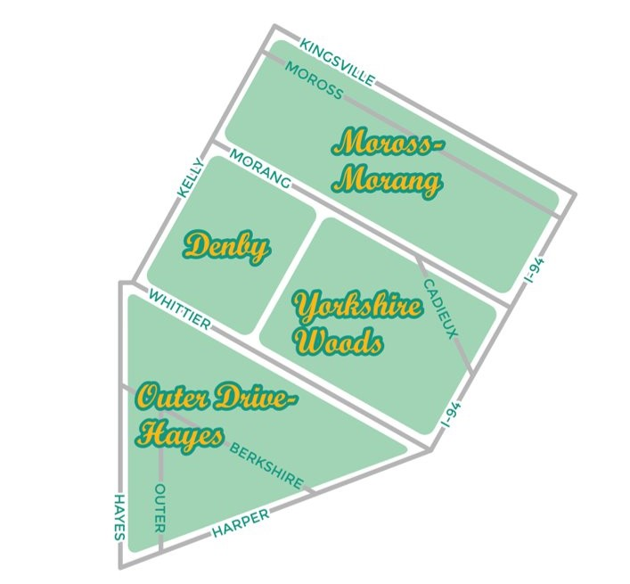
Denby/Whittier Framework Study Area:
The Denby/Whittier study area boundaries are Harper Woods (NE) – Kelly (NW) – Hayes (W) – I-94 (SE).
The study area includes the neighborhoods of Moross-Morang, Denby, Yorkshire Woods, and the eastern portion of Outer-Drive Hayes.

Slide 11
FOCUS AREAS
HOUSING & NEIGHBORHOODS
Analyze the housing market
Explore new development opportunities
Diversify housing options to meet the needs of all households
Identify programs to support homeowners and tenants
COMMERCIAL & ECONOMIC DEVELOPMENT
Analyze the commercial market
Revitalize Whittier and Kelly Corridors
Support small business development
ENVIRONMENT AND HEALTH
Analyze environmental conditions and the existing food system
Strengthen community infrastructure and networks
Act on the City’s “Sustainability Action Agenda”
MOBILITY & STREETSCAPES
Improve Whittier and Kelly streetscapes
Make it easier and safer to shop locally
Make it easier to get to work
Notes:
What we mean by Neighborhood Stabilization:
Recognizing that neighborhood homes are important for the community
Identifying homes that can be brought back to good repair and lived in again
Removing blighted vacant homes that can’t be rehabilitated and that are having a negative effect on the neighborhood

Slide 12
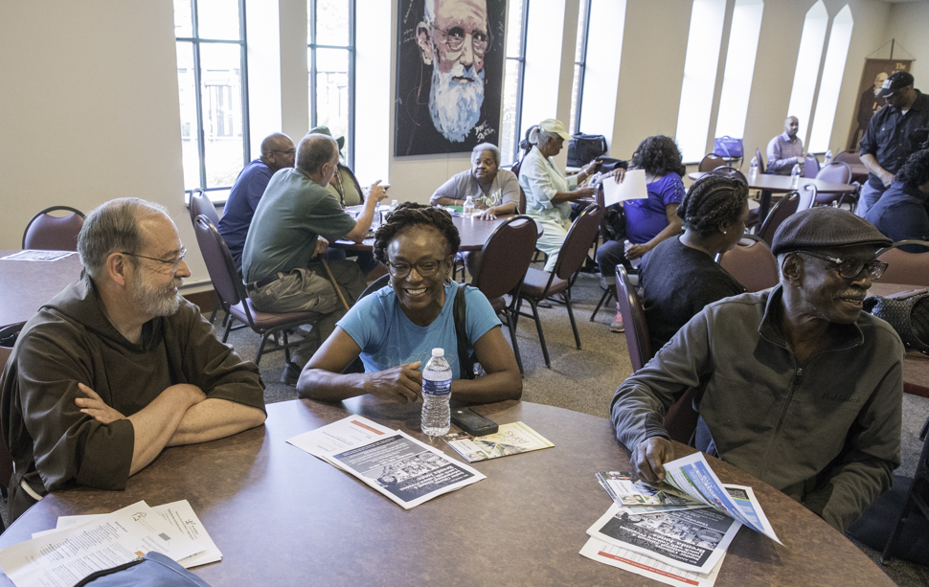
Planning with community
Center residents and community partners
Co-author a plan for the future of the neighborhood
Residents will know what to expect for their neighborhood in the years to come
Plan of action will identify opportunities for residents, community groups, and public and private partners to work together

Slide 13
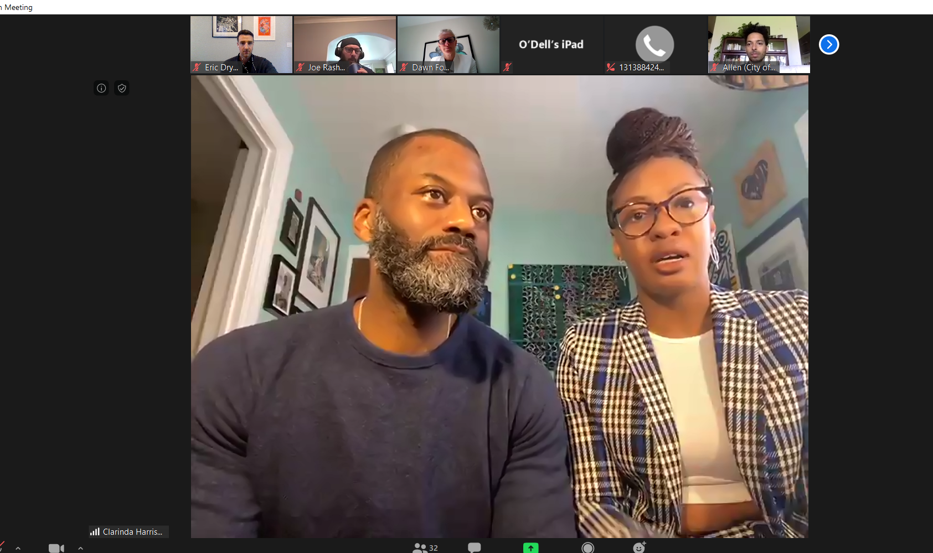
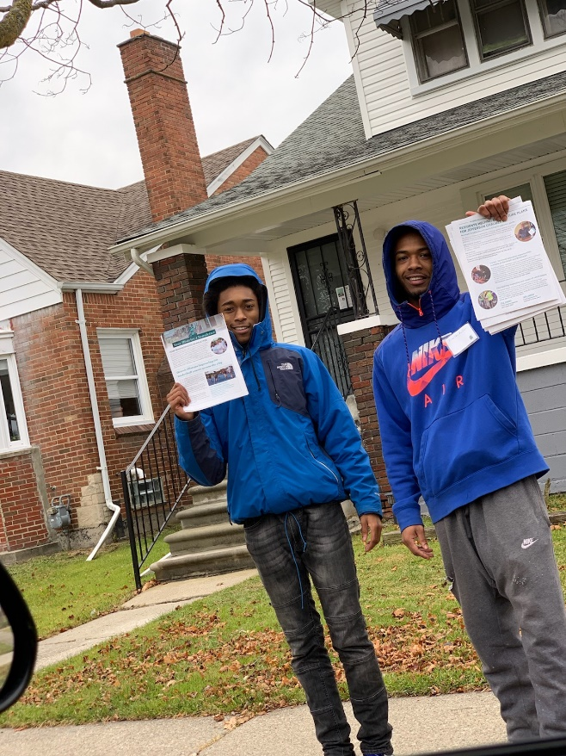
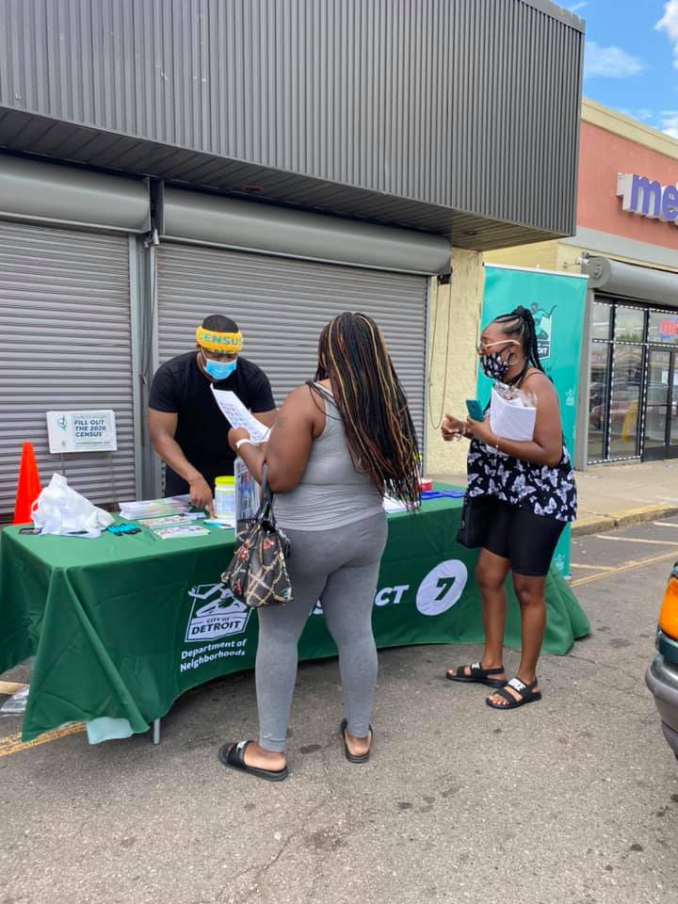
Engagement
Multiple Approaches: Using a mix of online and in-person engagements
Online: town-halls, website, electronic surveys, social media, e-mail, texting and phone calls
In-person: Outdoor activities, neighborhood walks, signs / flyers, canvassing, and information packets / stations
What do you suggest? Let’s get creative!

Slide 14
Anticipated Timeline
Summer
2023
Analysis of existing conditions and selecting a consultant team
Fall 2023
Project kick-off, begin community meetings
Winter
2024
Development of Preliminary Recommendations
Spring - Summer
2024
Finalize recommendations and launch pilot projects

Slide 15
How you can get ready :
Invite us to your community group gatherings
Tell your neighbors about the planning process
Share your existing community plans and ideas with us!

Slide 16
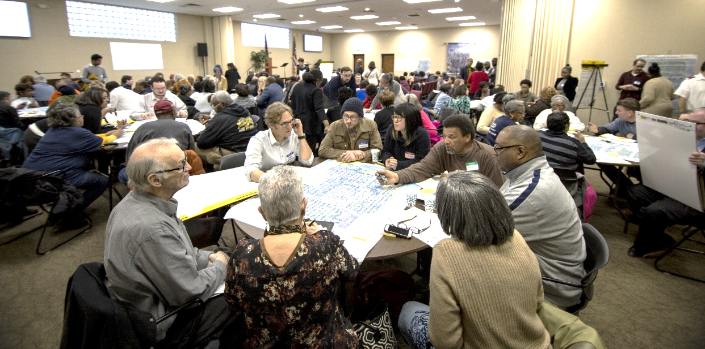
Contact us for more information and to get involved! denbywhittier@detroitmi.gov
Let’s stay in touch!
Visit our website to subscribe for updates:
https://detroitmi.gov/denbywhittier
Sara Elbohy
Urban Planner
313-224-1295 (o)
sara.elbohy@detroitmi.gov
Allen Penniman
East Region Director
313-224-1332 (o)
pennimana@detroitmi.gov
Notes:
Email sign up: https://public.govdelivery.com/accounts/MIDETROIT/subscriber/new?topic_id=MIDETROIT_433

