Slide 1
Business Licensing
Program Overview
March 30, 2023

Slide 2
Business Licensing Overview

Slide 3

Business Licensing
David Bell Kevin Johnson
Director Manager
Certain businesses are required to obtain a license from the Buildings, Safety Engineering, and Environmental Department or BSEED.
This presentation reviews the steps a business will need to take to get clearances from City departments in order to receive their license.

Slide 4
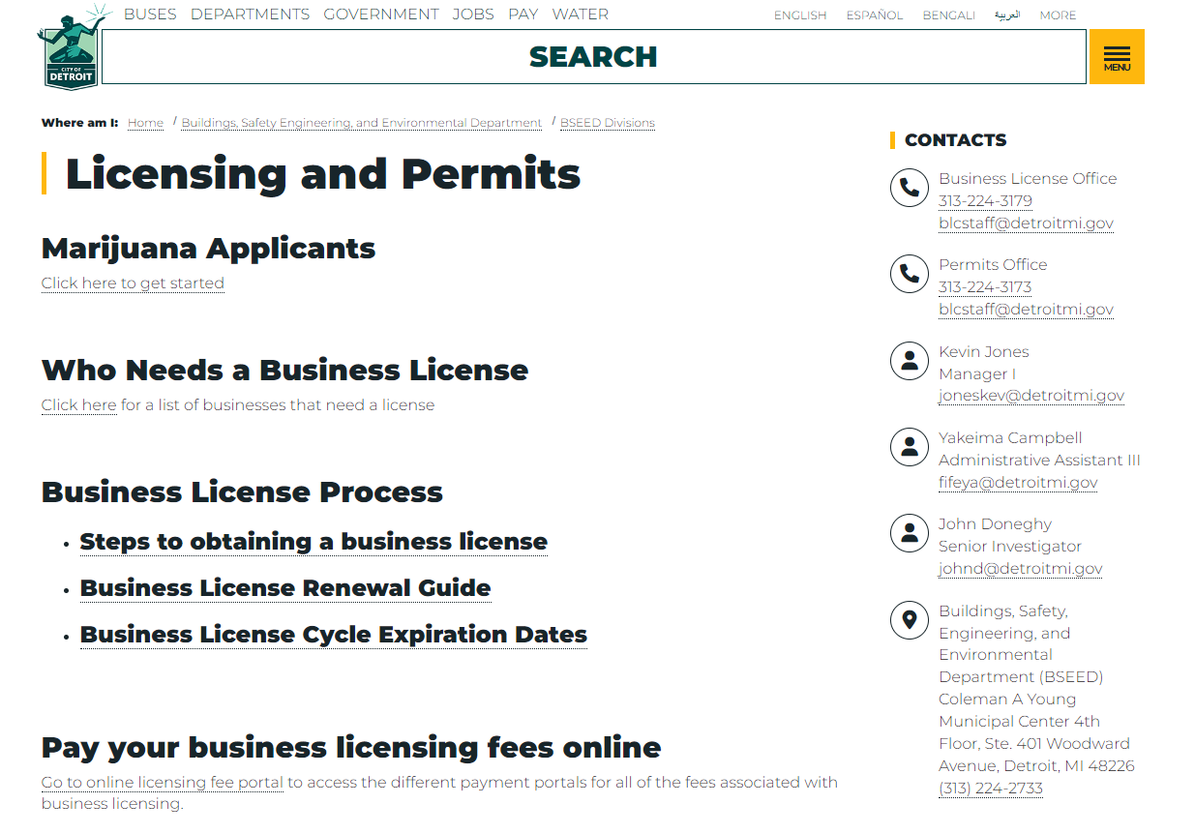
BUILDINGS, SAFETY ENGINEERING & ENVIRONMENTAL DEPARTMENT – LICENSING & PERMITTING (BSEED-LP)
https://detroitmi.gov/departments/buildings-safety-engineering-and-environmental-department/bseed-divisions/licensing-and-permits

Slide 5
BSEED – Property Maintenance Clearance

Slide 6
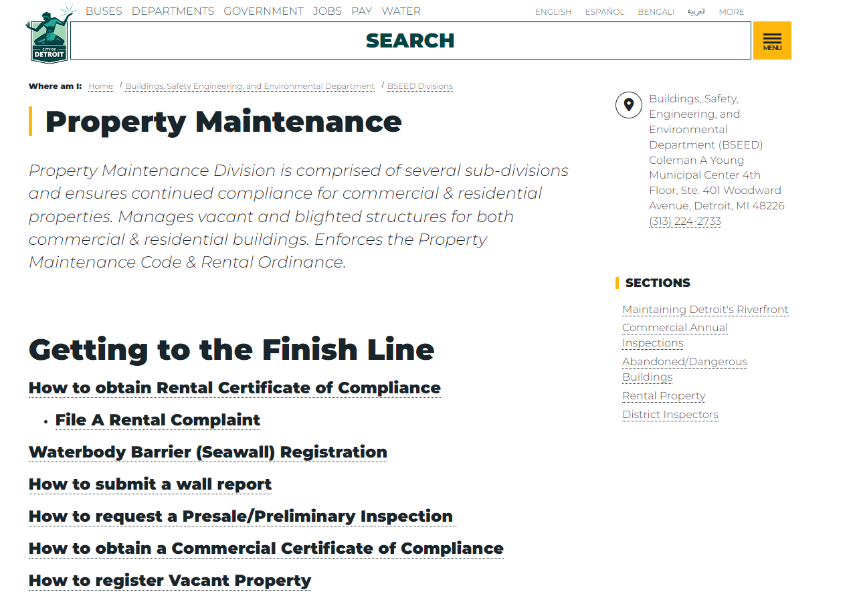
BUILDINGS, SAFETY ENGINEERING & ENVIRONMENTAL DEPARTMENT (BSEED PM)
William Veasy
Supervisor
Property Maintenance Division Commercial Properties
How to obtain your Certificate of Compliance for your Business License
https://detroitmi.gov/departments/buildings-safety-engineering-and-environmental-department/bseed-divisions/property-maintenance

Slide 7
BSEED PM: The Inspection Process
Step 1. Contact BSEED for annual inspection.
  To schedule your inspection call: (313) 628-2451 select option 1
Step 2. Correct ALL violations
Step 3. Schedule a re-inspection
Step 4. Pay inspection and/or blight violation fees:
Step 5. Certificate of Compliance will be issued and Property Maintenance Clearance will be approved

Slide 8
BSEED PM: Contact Information
Office Location & Contact
Coleman A. Young Municipal Center
2 Woodward, Detroit Mi. 48226
Suite 412
Email address – pm@detroitmi.gov
Phone number- 313-628-2451
Commercial Supervisor Contact Information:
Commercial Corridor- Alvin Nunn - Nunnalvin@detroitmi.gov
Scrapyard & Auto - Robert Watson - Watsonrob@detroitmi.gov
Waterbody & Annuals William Veasy – Veasyw@detroitmi.gov

Slide 9
BSEED PM: Blight Remediation Partnerships
DEPARTMENT​ | OBJECTIVE​ | PHONE #​
Department of Neighborhoods ​ (DON)​ | Community Liaison to City Departments by educating and assist with compliance within the neighborhoods​ | (313) 224-4415​
Detroit Economic Growth ​ (DEGC) ​ | Guide to opening a business in Detroit and assist with reaching business and property compliance​ | (844) 333-8249​
Department of Administrative Hearings ​ (DAH) ​ | Adjudication of blight tickets and holding responsible parties accountable to pay fines through collections​ | (313) 224-0098​
Law Department ​ | Escalated Enforcement through legal actions for blighted properties and unpaid fees ​ | (313) 224-4550 ​
General Services Department (GSD) ​ | Remediation of private property that remain heavily blighted and charged back to the owner​ | (313) 628-0900​
Department of Public Works (DPW) ​ | Schedule solid waste pick-up​ | (313) 876-0004​
Detroit Police Department (DPD) ​ | Blight ticketing and prosecution of illegal dumping ​ | (313) 267-4600​

Slide 10
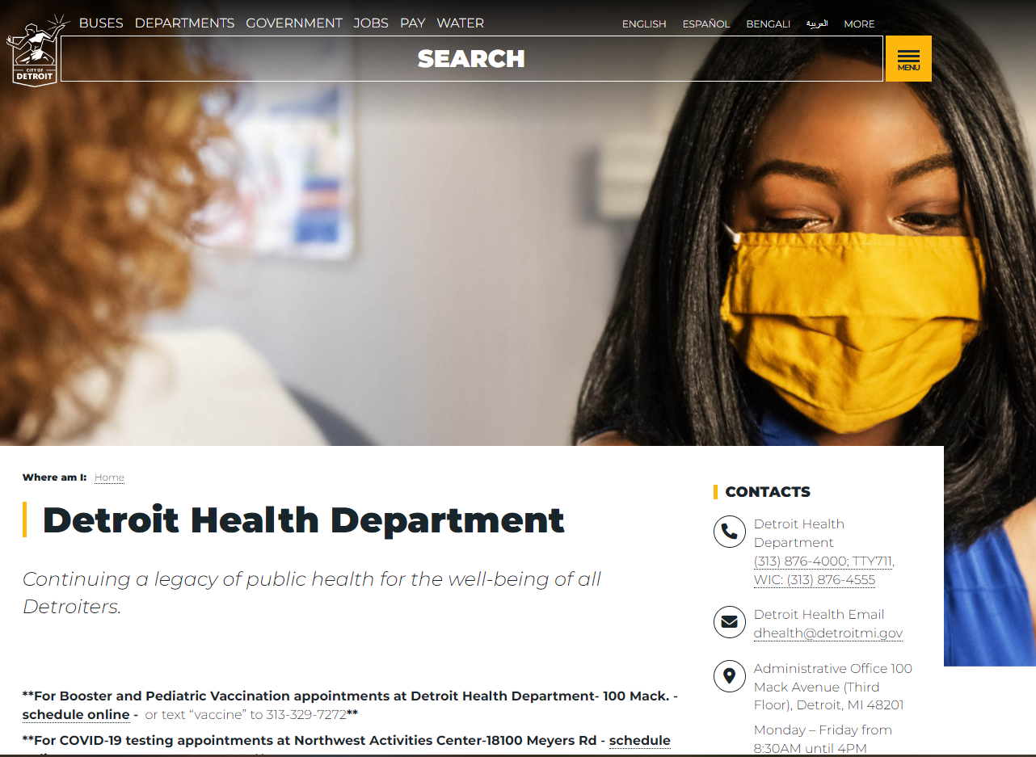
DETROIT HEALTH DEPARTMENT: ENVIRONMENTAL HEALTH FOOD SAFTEY LICENSING (DHD)
Sebrina Johnson
Environmental Health Specialist
Taija Woods
Environmental Health Specialist
https://detroitmi.gov/departments/detroit-health-department

Slide 11
Detroit Health Department (DHD) Clearance

Slide 12
DHD: Environmental Health Clearance
For most businesses that require an Environmental Health Clearance, in order to complete their city of Detroit Business license application, this will require paying an annual fee to the Detroit Health Department and passing an inspection (or correcting violations cited during the inspection).
Some businesses will require a State of Michigan license as well, including Child Care, Body Art, swimming pools, and foodservice establishments. For those, see the appropriate State web pages.
For all other businesses, you can pay the annual fee at: https://cod.divdatkiosknetwork.com/EnvironmentalHealth or call (313) 876-4715 to pay the fee and schedule the inspection
(note: some inspections may be unannounced)

Slide 13
DHD: Renewing a Food Service License
A renewal license application and bill will be sent to your mailing address in Mid-March.
Complete the application and make a payment. The application and payment may be submitted in the following ways:
  1. Pay online using the portal on our licensing website.
  Note : This is for renewals only!
  2. Come to the office at 100 Mack 3rd Floor to make a payment by check or credit card. Cash and American Express is not accepted.
Once payment and application is received and processed, we will go on the business license portal and approve your business license Health clearance.
An inspection is not needed for a business license clearance from Health.

Slide 14
DHD: New Establishment/New Owner for existing facilities
Licenses are not transferrable. A new license must be obtained every time there is a change in facility ownership.​
New Establishment /New Owners cannot pay online. The facility must be registered in our system before online payment is available.​
Documents needed for Existing Facilities:​
                New Establishment/New Owner Food Service License Application and Fees​
        Proposed menu​
        Standard Operating Procedures​
        Certified Food Manager certificate​
        Allergen training certificate (unless exempt)

Slide 15
DHD: Under New Construction/Remodeling
A completed plan review packet and Fees must be submitted
Per the Michigan Food Law 289.4103, we have 30 business days to respond back to the applicant once the complete packet has been received by our department.
Upload all paperwork to ProjectDox:
https://detroit-mi-us.avolvecloud.com/Portal/Login/Index/Detroit-MI
We strongly recommend that you also submit a plan review packet to Health at 100 Mack 3rd floor to help speed the review process along.
There is a lag time from applicants uploading to ProjectDox and Health receiving the project.

Slide 16
Detroit Fire Department (DFD) Clearance

Slide 17
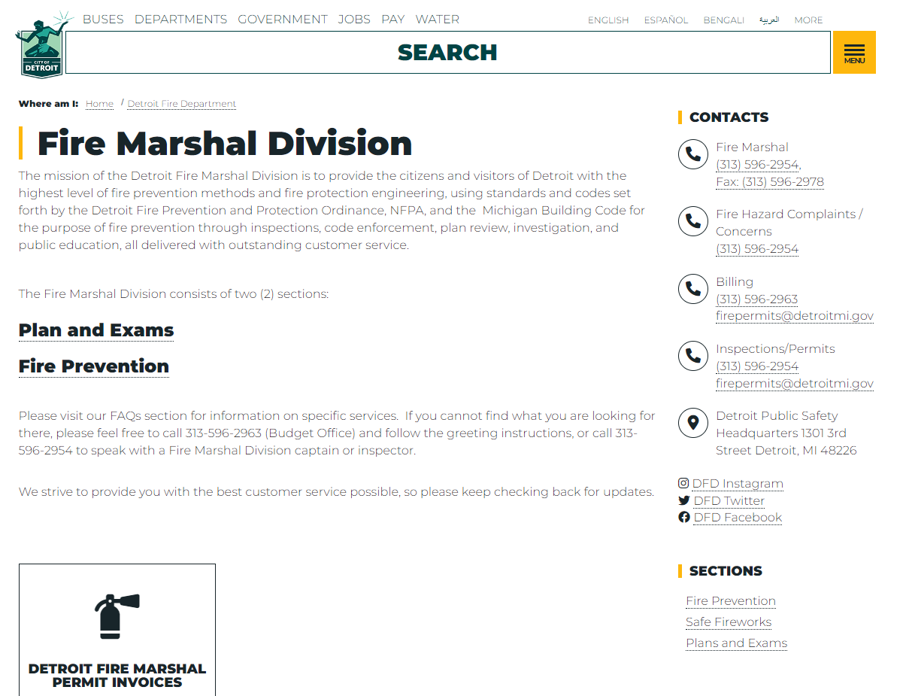
DETROIT FIRE DEPARTMENT INSPECTIONS (DFD)
Fire Marshal Division
Captain Terrence T. Lane
https://detroitmi.gov/departments/detroit-fire-department/fire-marshal-division

Slide 18
DFD: New Businesses
Contact 313-596-2954 to schedule appointment
Confirm date and time with inspector
Complete inspection – New billing for fire permit will be created
Pay invoice once created; call (313) 596-2963 to confirm invoice amount
Clearance called in or cleared via Accela workflow by FMD staff.
Process is complete

Slide 19
DFD: Existing Businesses
Pay invoice via electronic system using Customer # as identifier
Contact office to schedule appointment
Inspector will confirm time and date or visit during normal business hours
Inspection completed with no violations/ clear all violations
Clearance completed via Accela workflow update
Process complete

Slide 20
Office of the Chief Financial Officer (OCFO) Treasury Clearance

Slide 21
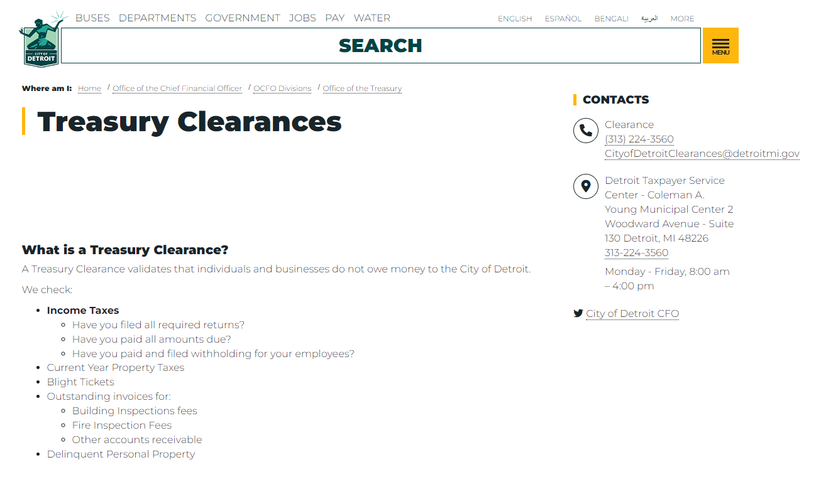
OCFO: Treasury
Rita Singleton
Supervisory Tax & Revenue Examiner
Treasury Clearances
https://detroitmi.gov/departments/office-chief-financial-officer/ocfo-divisions/office-treasury/treasury-clearances

Slide 22
Treasury: Do I need a Treasury Clearance
All Detroit based businesses that need a business license, and those individuals and business who conduct business directly with or in the city of Detroit will need a Treasury Clearance
e.
Do you need a business license?
Are you a vendor or a prospective vendor for the City?
Are you seeking a Detroit Based Certification?
Are you a contractual City employee?
If you answer YES to any of the above questions, you need a Treasury Clearance!!
https://detroitmi.gov/departments/office-chief-financial-officer/ocfo-divisions/office-treasury/treasury-clearances

Slide 23
Treasury: What exactly is a Treasury Clearance?
A Treasury Clearance validates that individuals and businesses do not owe money to the city of Detroit within our scope.
What do we check for?
Income Taxes
      Have you filed all required returns?
      Have you paid all balances due?
Property Taxes – both real, personal and delinquent
Blight Tickets
Outstanding invoices for:
  Building Inspections fees
  Fire Inspection Fees
  Other accounts receivable

Slide 24
Treasury: What is the process?
Gather some information
  Company name, address and tax ID number
  Tax filing type (individual, corporation or partnership)
  Do you have employees? If yes, do they receive a 1099 or W2 from you?
Fill out the application online at https://bit.ly/detroitclearances.
  Note: The application should be completed by someone who is familiar with your entity. Preferably an owner/principal with knowledge of the tax structure.
The Clearances team will process your application.
  If you are missing income tax or withholding returns or have a balance due to the city, you application will be denied.
  If all returns have been filed and no balances are due, your clearance application will be approved, and an approval email sent.
You will receive an email with the status of your clearance and information on how to remedy a denial, if applicable.

Slide 25
Detroit Police Departmet (DPD) Clearances

Slide 26
POLICE DEPARTMENT INSPECTIONS (DPD)
DPD works with BSEED to conduct:
Background and vehicle checks for parking valet attendants, horse-drawn carriages, and rickshaw vehicles
Background checks for secondhand stores
Business inspections and background checks for sexually oriented businesses and their employees
Video surveillance checks for gas stations
https://detroitmi.gov/departments/police-department

Slide 27
Business Licensing Recent Updates

Slide 28
Licensing Updates RECENT PAST and NEW
License Repeal
Auto Related Uses license requirement additions and amendments
Applications must be submitted online; email addresses mandatory
Interactive Web Page Development
Customers are urged to visit Business Licensing landing page
Pertinent information such as:
Who needs a license
License fees
License expiration dates
Required inspections
Accela link

Slide 29
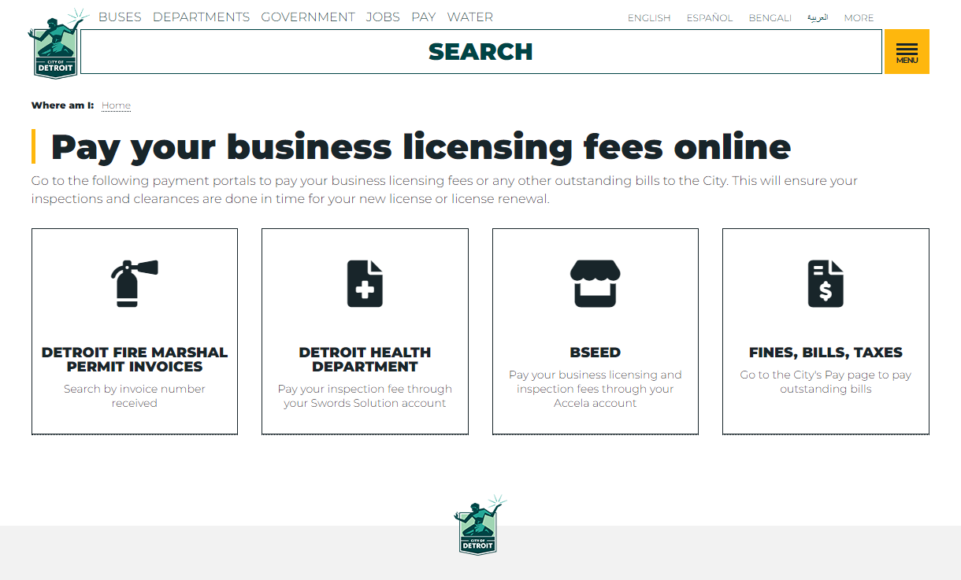
New Payment Page for All Clearances
https://detroitmi.gov/pay-your-business-licensing-fees-online

Slide 30
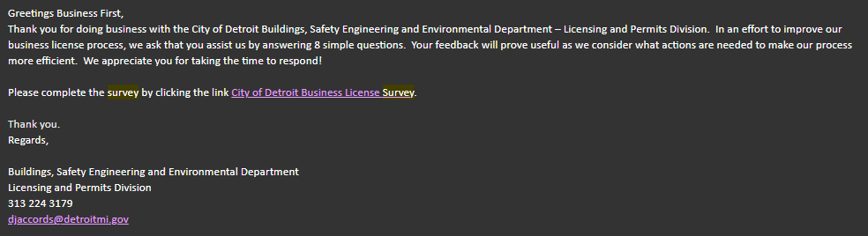
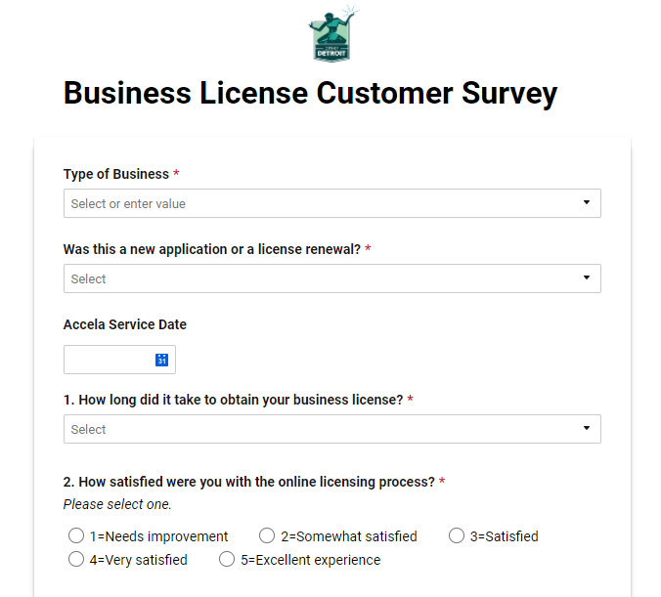
Please fill out BSEED's new Business License Customer Survey
Survey Link:
https://app.smartsheet.com/b/form/020380fd470f43a6962006b54a7b9f78

Slide 31
Business Licensing Additional Resources

Slide 32

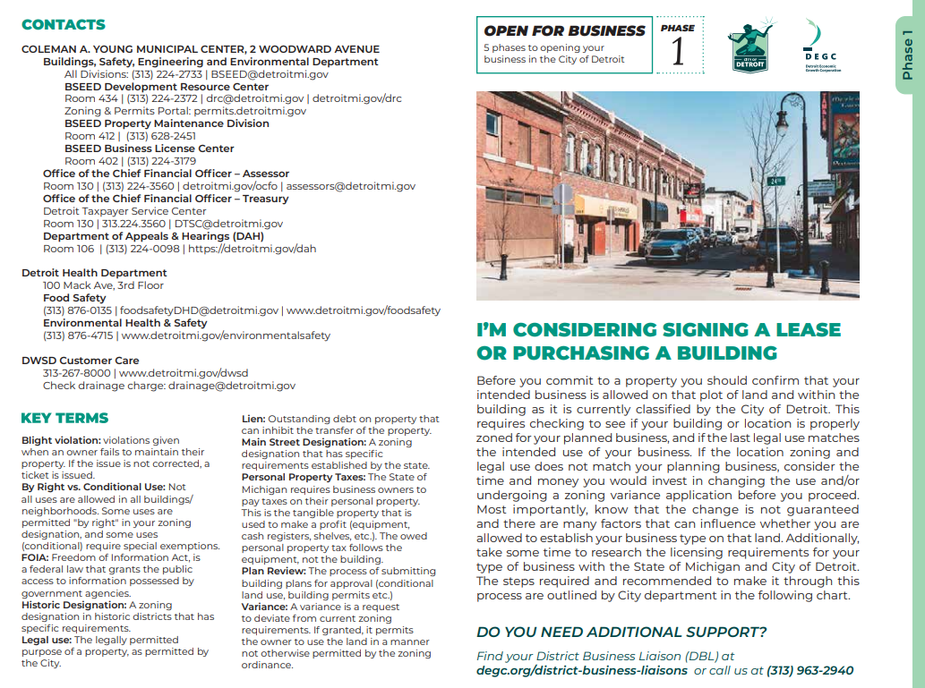
DEGC Resources for Businesses
https://www.detroitmeansbusiness.org/_files/ugd/a7a51b_d5d7a1e9695e4ca6ae502e04ae7a2167.pdf
https://www.degc.org/wp-content/uploads/2020/12/SmallBizBooks_Corrected.pdf

Slide 33
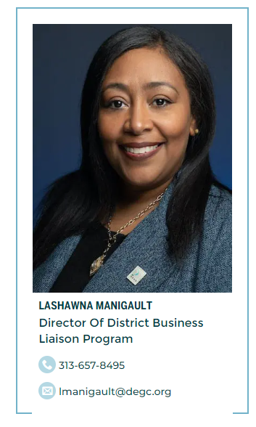
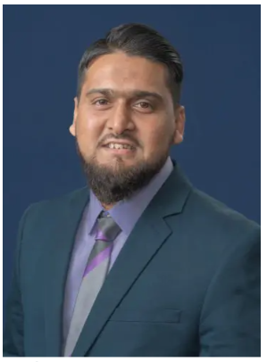
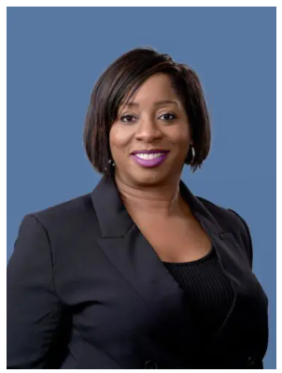
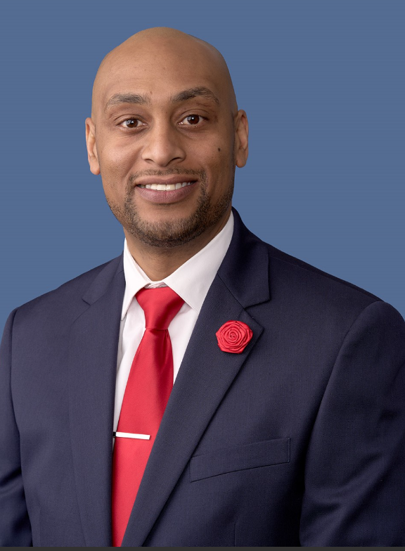
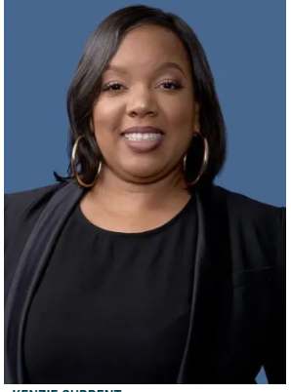
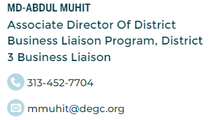

DEGC Team
BRYAN DAVIS
District 1 Business Liaison
Bdavis@degc.org
Notes:
Your district business liaisons are here to assist you at any time you have any questions about doing business in Detroit.

Slide 34
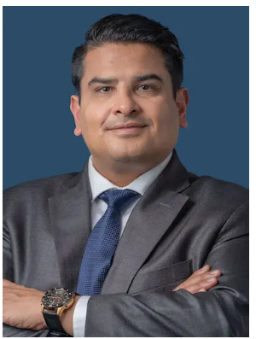

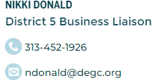

DEGC District Business Liaisons
BRYAN DAVIS
District 1 Business Liaison
Bdavis@degc.org
Notes:
Your district business liaisons are here to assist you at any time you have any questions about doing business in Detroit.

Slide 35
City Webpage Resources
https://detroitmi.gov/departments/buildings-safety-engineering-and-environmental-department/bseed-divisions/licensing-and-permits

Slide 36
City Department Contacts
BSEED – Licensing & Permitting | Kevin Jones & Yakeima Campbell | 313-224-3179 blcstaff@detroitmi.gov
BSEED – Property Maintenance | William Veasy | (313) 628-2451 PM@detroitmi.gov
Health | Sebrina Johnson & Taija Woods | (313) 876-0135 – Food Safety Division foodsafetyDHD@detroitmi.gov
Fire | Captain Terrence Lane | (313) 596-2954 Dfdfmdgeneral@detroitmi.gov
Treasury | Rita Singleton | 313-224-3560 ext 4 CityofDetroitclearances@detroitmi.gov
Police | Deputy Chief Franklin Hayes | (313) 596-2520 – Chief Neighborhood Liaison

Slide 37
Thank you!

