Slide 1
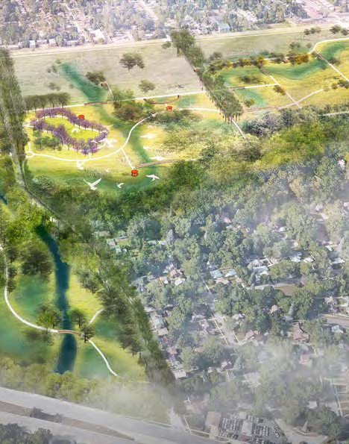
Welcome to our
Rogell Park
Open House
Tuesday, February 28, 2023

Slide 2
TONIGHT’S AGENDA
Meet the Project Team
Review Overall Rogell Park Project Timeline
Grand River Northwest Neighborhood Framework Plan
Rogell Park Master Plan
Rogell Park Phase 1 Improvements
Next Steps
Q&A Tables

Slide 3


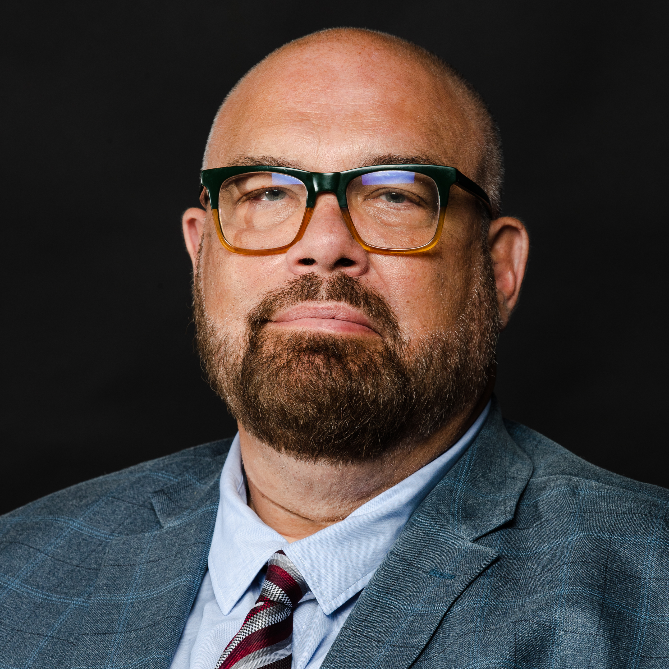
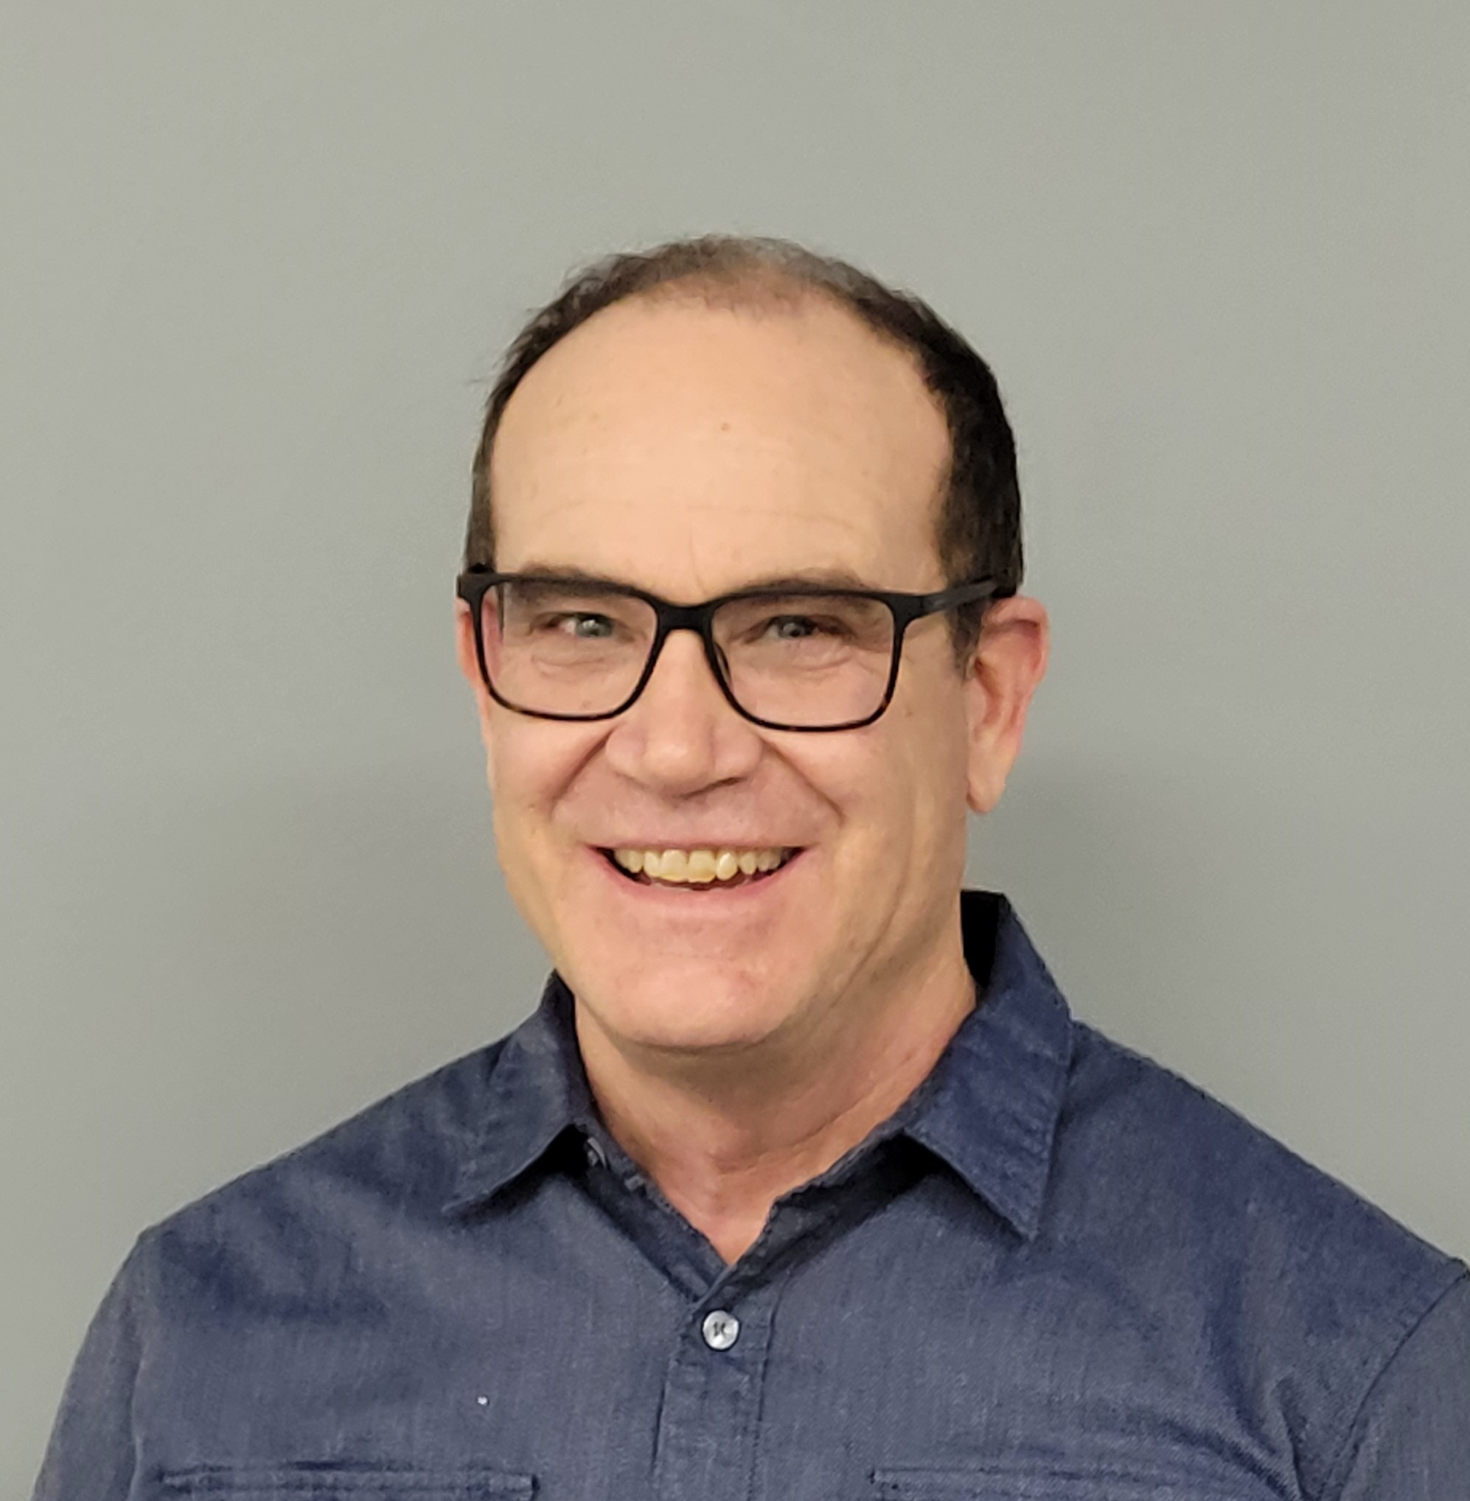
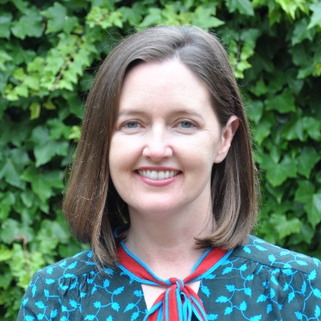
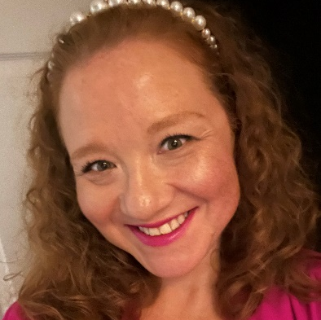


Rogell Park Project Team
James Tate
CITY COUNCIL PRESIDENT
PRO TEM, DISTRICT 1
^{CITY OF DETROIT DEPARTMENTS:}
^{Brad Dick}
^{Group Executive}
^{Tim Karl}
Chief of Landscape Architecture
^{PLANNING AND DEVELOPMENT}
^{Dave Walker}
^{Design Director, West District}
^{Dominique Boyer}
^{Planner- West District}
^{Michele Flournoy}
^{Urban Designer}
^{Julie Connochie}
Planner II, Design & Innovation Team
BUILDINGS, SAFETY ENGINEERING, AND ENVIRONMENTAL DEPARTMENT (BSEED)
^{Anita Harrington}
^{Environmental Specialist III}
^{Dara O’Byrne}
^{Chief Parks Planner}
^{Shamori Whitt}
^{Senior Parks Planner}
^{Jeff Klein}
^{Deputy Chief of}
^{Landscape Architecture}
^{Farhat Chaudhry}
^{Associate}
^{Landscape Architect}
DETROIT WATER AND SEWERAGE DEPARTMENT (DWSD)
^{Bryan Peckinpaugh}
^{Public Affairs Director}
^{Sonali Patel}
^{Special Projects Coordinator}
^{NEIGHBORHOODS}
^{Karla Williamson}
^{District 1 Manager}
^{Steele Hughes}
^{Deputy District Manager}
DETROIT ECONOMIC GROWTH CORPORATION (DEGC)
^{Catherine Frazier}
Associate Director of Real Estate
Notes:
Project keeps continuity between the Greater Corktown Neighborhood Framework Study, and brings forward the implementation team at GSD
Dara, Shamori, Jeff and John are the front line advancing the project.

Slide 4
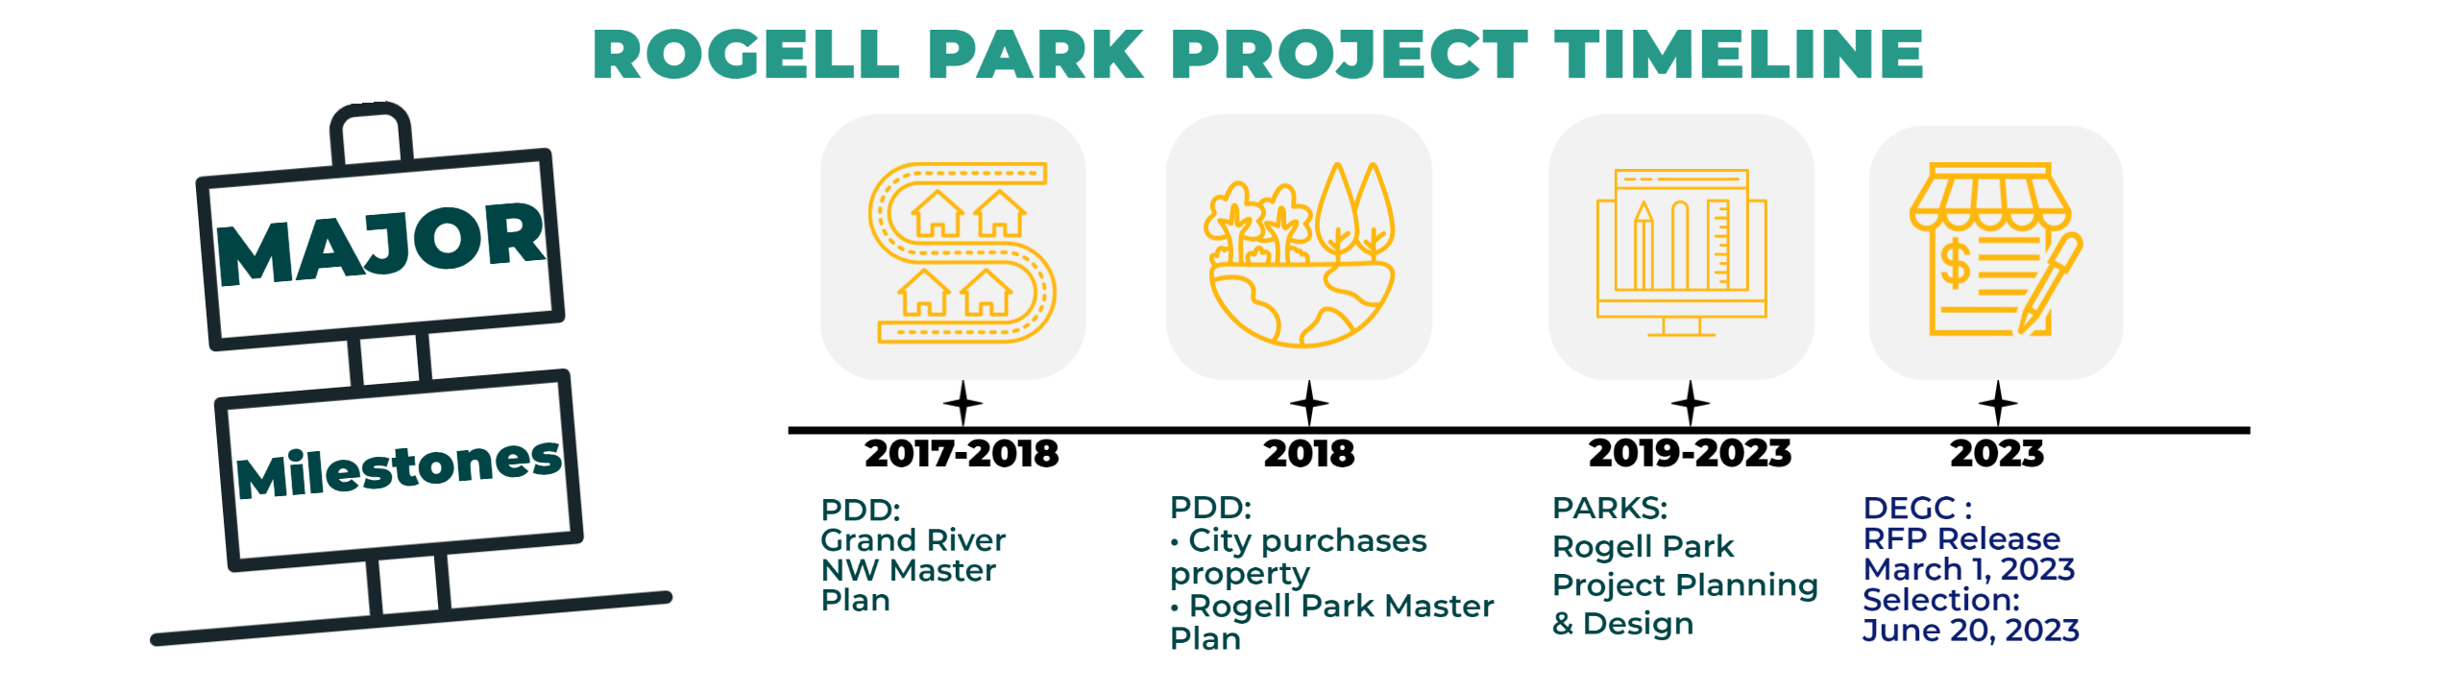

Slide 5
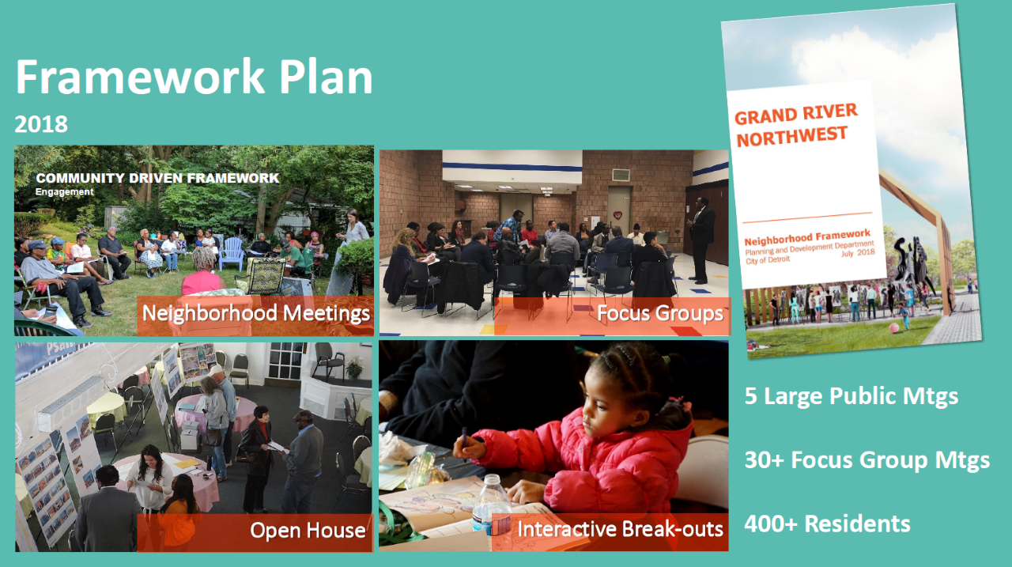
2017-2018 Grand River NW Neighborhood Plan

Slide 6
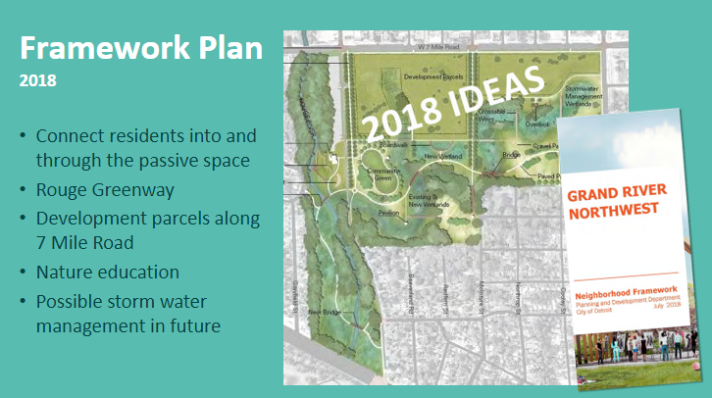

Slide 7
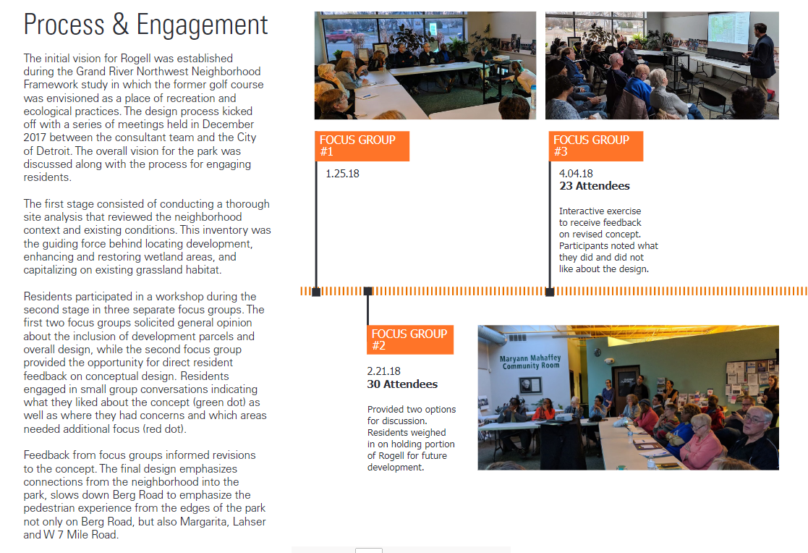
2018 Rogell Park Master Plan

Slide 8
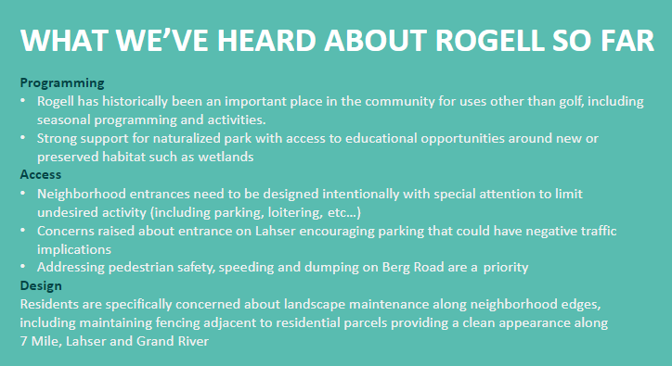
From 2018 Master Plan

Slide 9
Rogell
Park
Master
Plan
(2018)

Slide 10
Environmental Issues
Park redevelopment efforts required a Phase 1 Environmental Site Assessment
  Prepared site assessment that identifies potential or existing environmental concerns.
  Focused on historical land uses (golf course) as well as physical changes that have been made
Phase 1 Report concluded that soil testing was needed and a Phase 2 investigation was conducted to further identify areas of concern.
  Phase 2 work allowed better understanding of the contamination concerns and where issues were existing.
Based on the Phase 1 and 2 information, a Response Activity Plan (ResAP) to mitigate exposure will be submitted to Michigan Department of Environment and Great Lakes and Energy (EGLE)
  Plan explains how the City will protect the public from exposure to contaminants and make the site safe for public use.
City of Detroit is working with environmental consultants to complete the ResAP and submit to EGLE for approval.
  Submit to the State of Michigan by March 2023.
  Receive response from EGLE within 2 – 3 months, however the state can take up to 6 months.
  Expect ResAP will be approved, and start construction in Fall of 2023.
The types of mitigation we expect will be approved so the park can be used publicly will include:
  Excavating and removing contaminated soils,
  Using fencing to separate people from contamination, and
  Adding a dermal contact barrier on top of some contaminated areas.

Slide 11
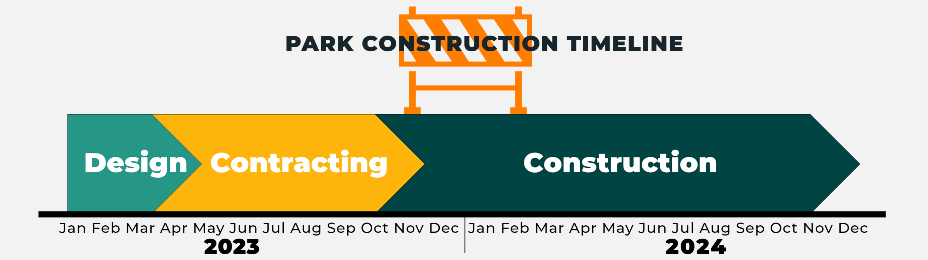
Rogell Park Improvement Project Timeline
We are here

Slide 12
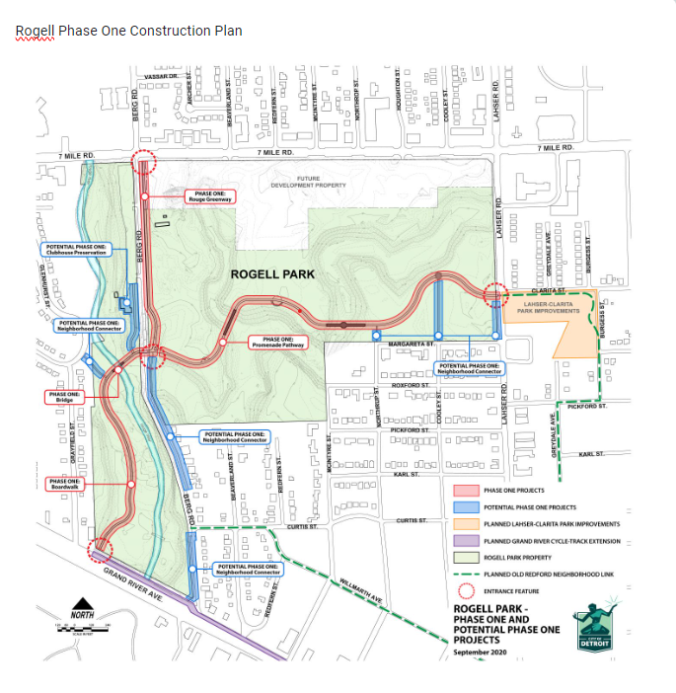
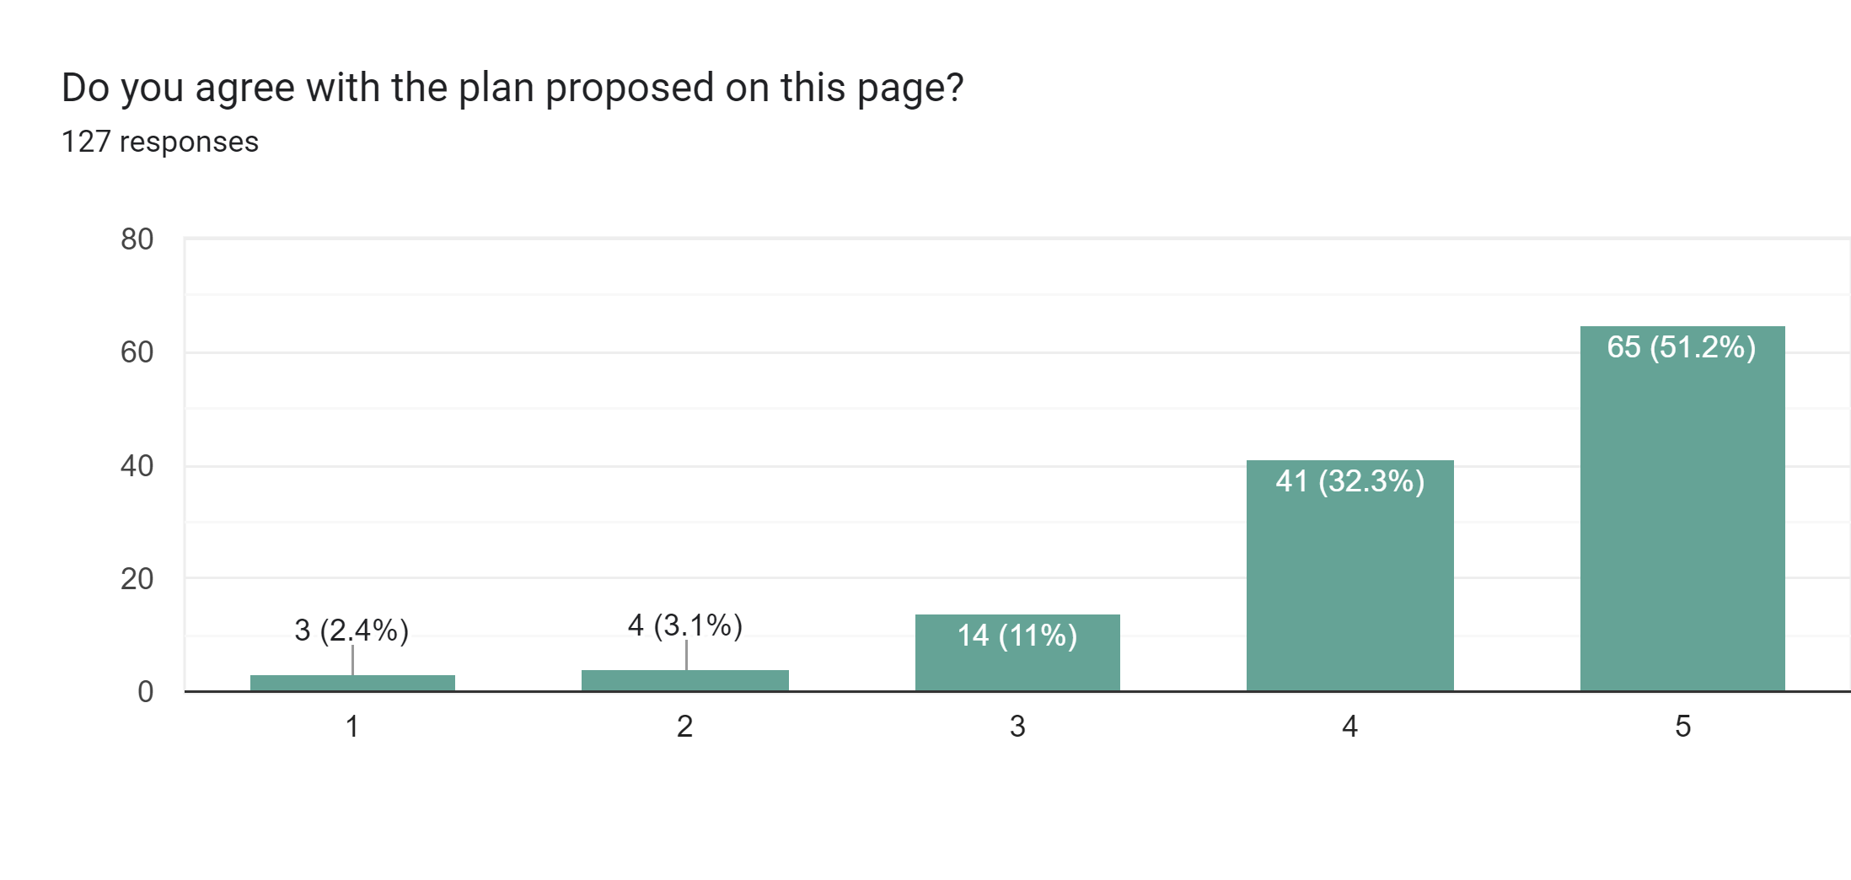
Park Improvement Survey Results
(conducted in September 2020)
84% Agree
Strongly Disagree
Disagree
Neutral
Agree
Strongly
Agree
Top activities that respondents wanted to do at Rogell Park
  Walking/Biking (95%)
  Relaxing in Nature (76%)
  Exercising (66%)
  Habitat Viewing (61%)
Top priorities for amenities at Rogell Park
  Nature/Multi-Use Trails (70%)
  Bathrooms (36%)
  Educational/Wayfinding Signs (33%)

Slide 13
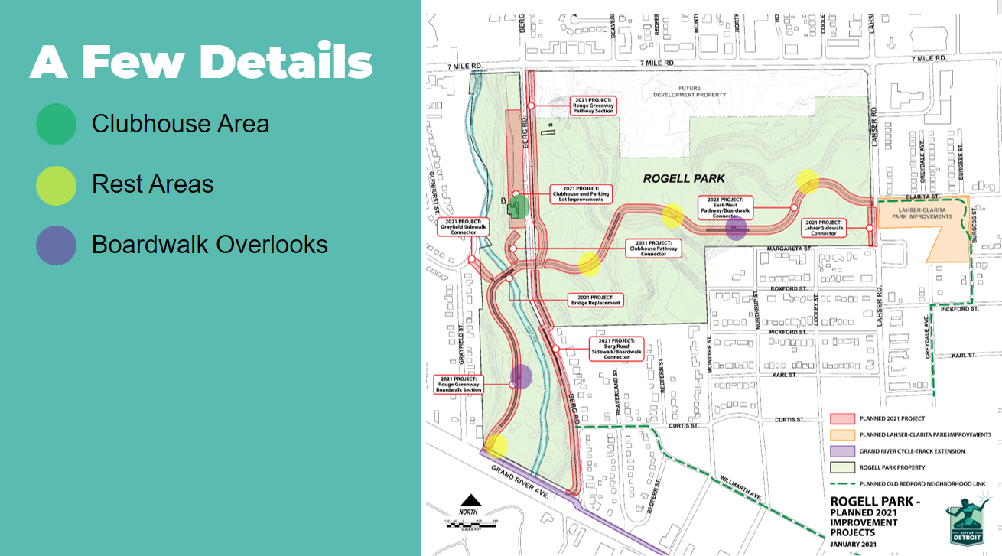
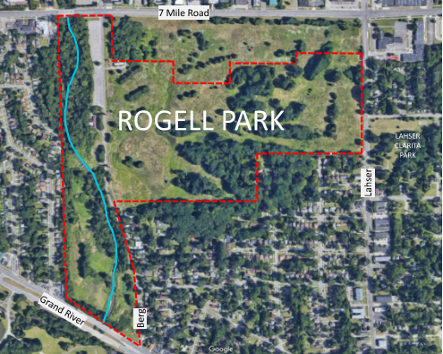

Slide 14
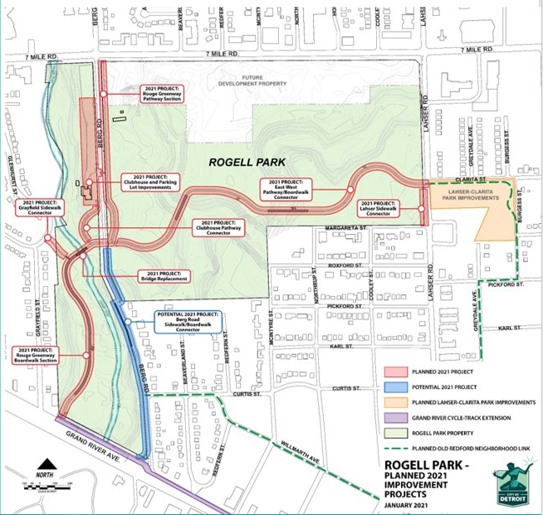
WHAT IS BEING CONSIDERED FOR CONSTRUCTION?
Connecting neighborhoods to and through the park with a series of asphalt trails, boardwalks, sidewalk and a bridge – RED
Cement Sidewalk - Safe route to school – BLUE
Vistas, Overlooks, and Benches.
Clubhouse porch updates and weatherizing the structure.
Final constructed items will be determined once we receive bids from qualified contractors.

Slide 15


Slide 16
Rogell Park Next Steps
Open House Newsletter
Project:
Res Ap Approval by Spring 2023
Project Bidding & Contracting:
Late Spring – Summer 2023
Construction Kick-Off:
Fall 2023
*Dates are subject to change

Slide 17
Q&A Tables
Parks
  Can answer questions on anything WITHIN the Rogell Park Boundary
Planning & Development (PDD)- Grand River Northwest Framework Plan
  Can answer questions about the NEIGHBORHOOD OUTSIDE park boundary & Master Plan
Buildings, Safety, Engineering, and Environmental Department (BSEED)
  Can answer questions about ENVIRONMENTAL issues in Master Plan area
Detroit Water and Sewerage Department (DWSD)
  Can answer questions about STORMWATER issues in Master Plan Area
Detroit Economic Growth Corporation (DEGC)
  Can answer questions about PRIVATE DEVELOPMENT SITE in Master Plan Area
FEEDBACK
  Leave us feedback on your experience & Make Note of any outstanding issues not addressed at the tables

Slide 18
Check the Rogell Park Webpage for Updates!
Detroitmi.gov/Rogell

