Slide 1
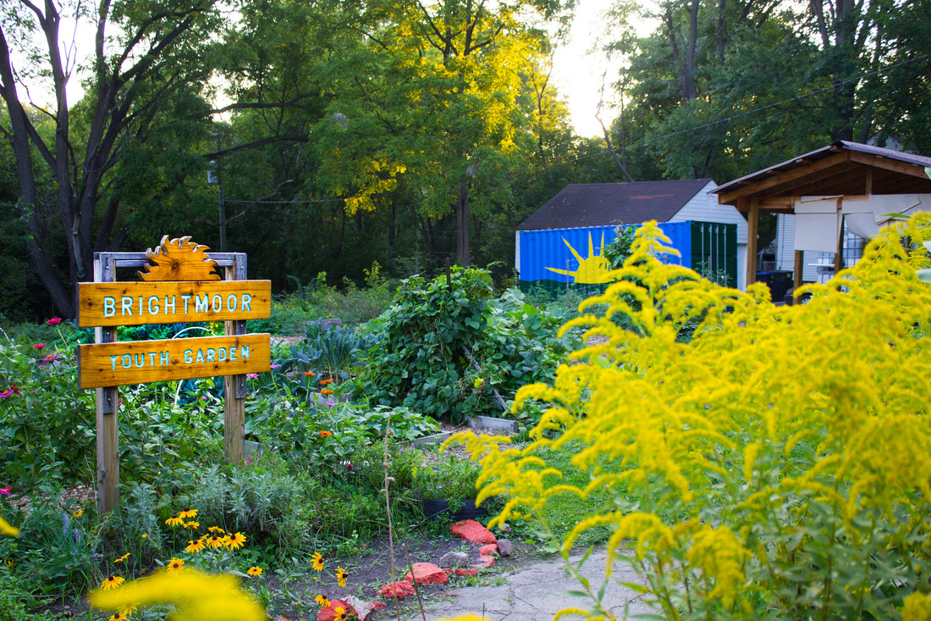
Brightmoor Framework Plan

Slide 2
AGENDA
NEIGHBORHOOD FRAMEWORK PLAN
FRAMEWORK PLAN PRIORITIES
NEXT STEPS

Slide 3
COMMUNITY OUTREACH ORDINANCE
The City of Detroit enacted the Community Outreach Ordinance to demonstrate the city's commitment to community outreach that promotes transparency and accountability and ensures community awareness on legislation, contracts, agreements, and resolutions related to various city-wide proposals and neighborhood proposals.

Slide 4
NEIGHBORHOOD FRAMEWORK PLAN
DEFINITION
MISSION
DURATION
The neighborhood framework plan is a city-led initiative to build vibrant and growing neighborhoods in Detroit.
We aim to restore neighborhoods by investing in the existing strengths and aligning all resources available to drive significant and holistic neighborhood revitalization in each area.
The planning process typically takes 12 – 18 months
Implementation of selected projects typically occurs within a 3 – 5 year time span.

Slide 5
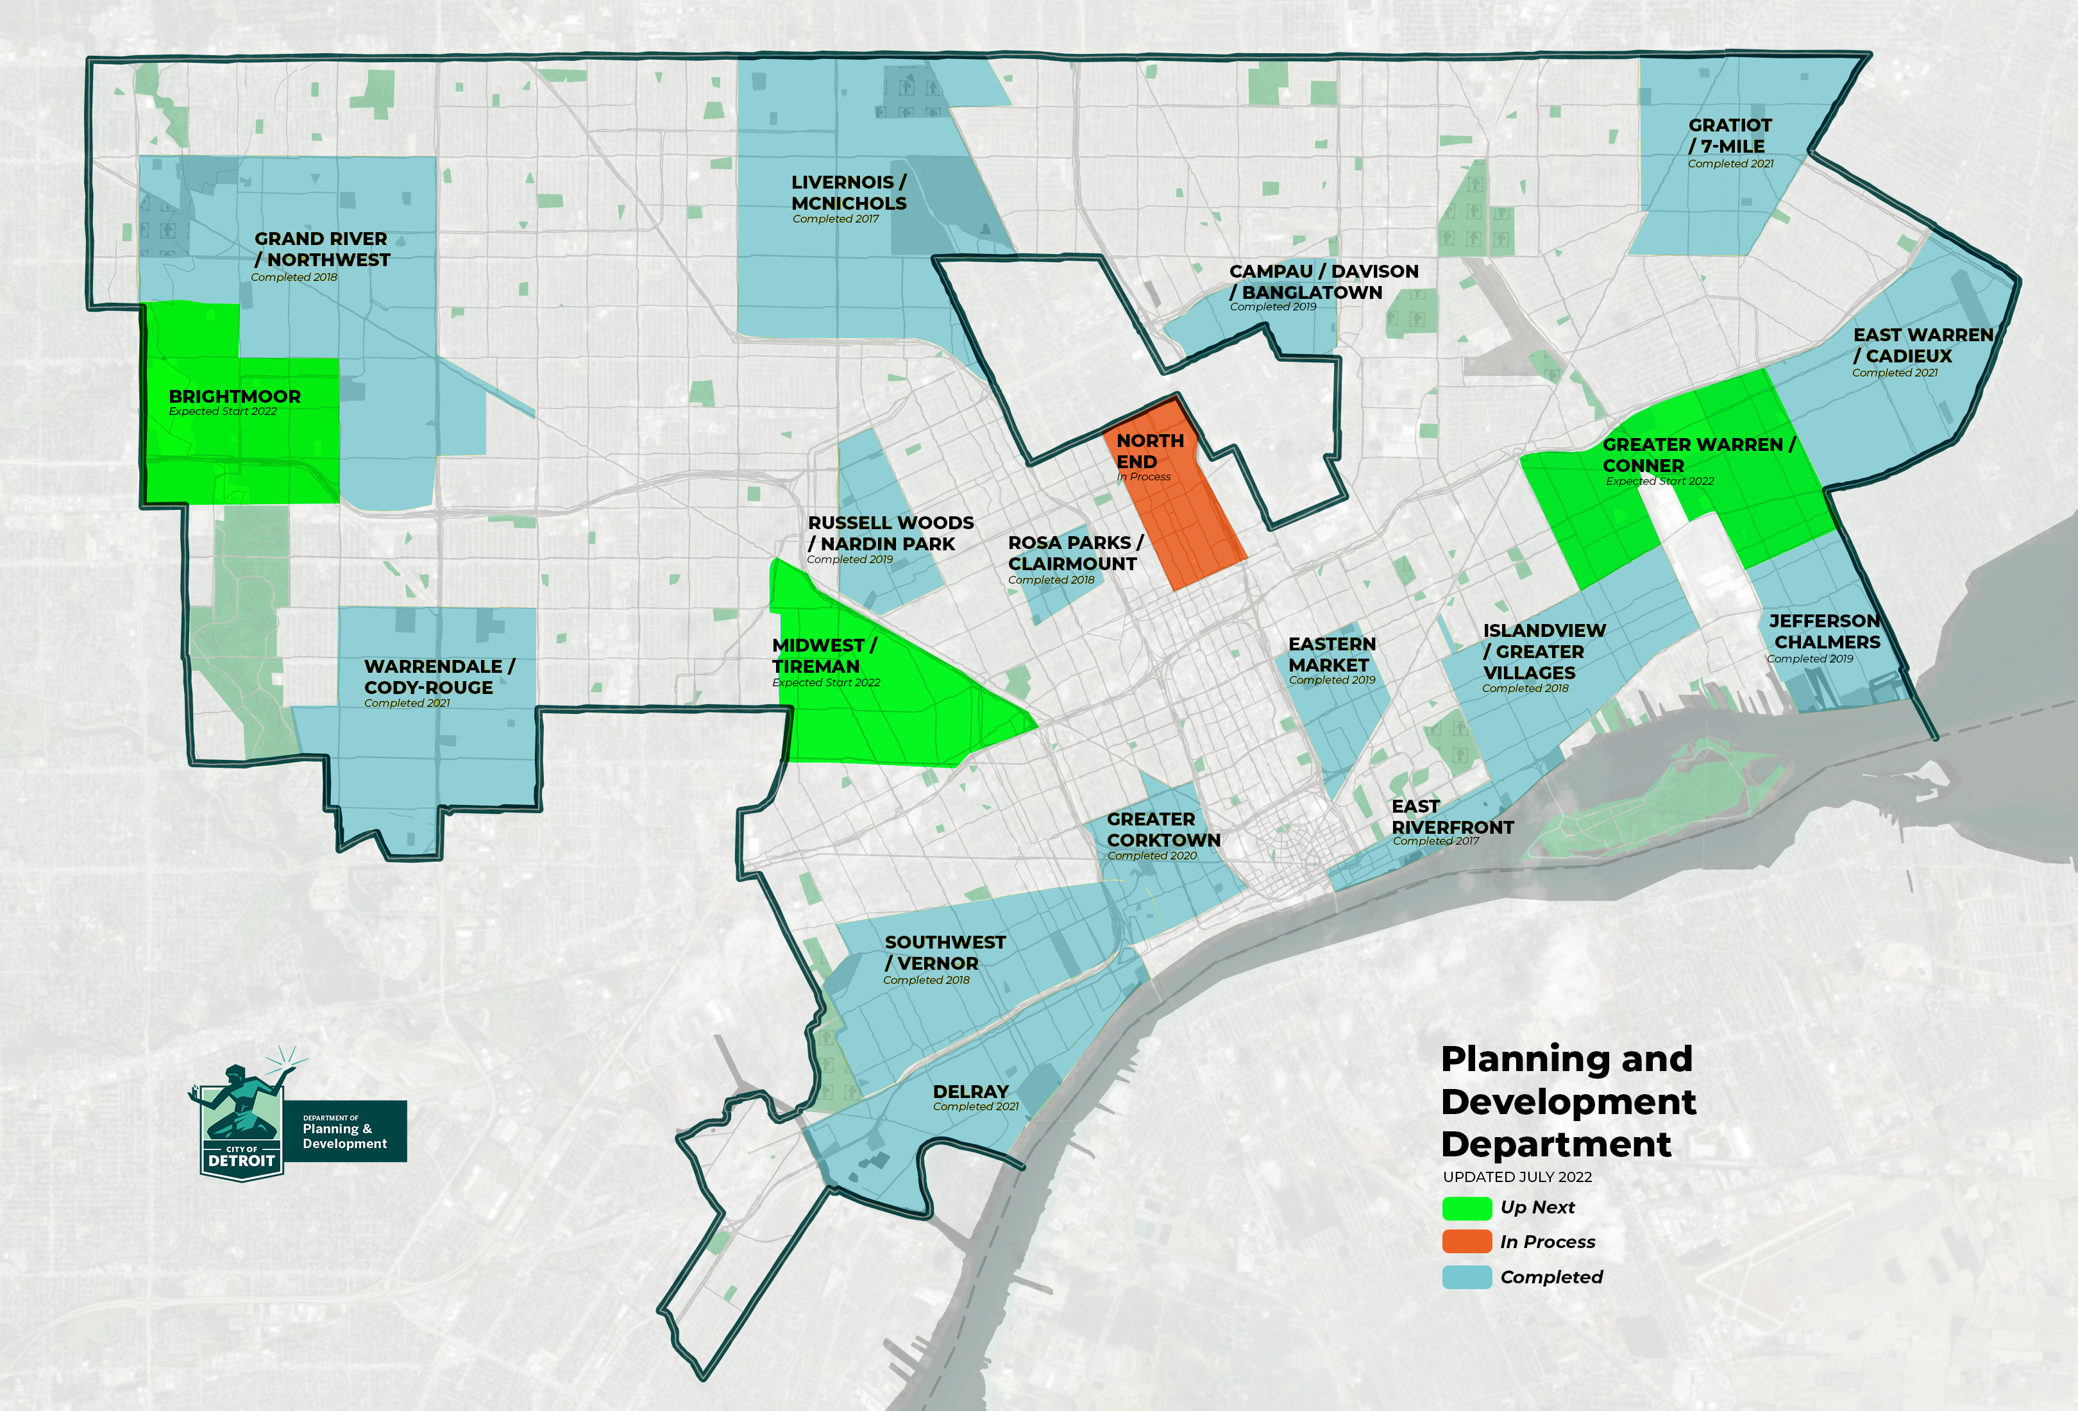
NEIGHBORHOOD FRAMEWORK PLAN AREAS

Slide 6
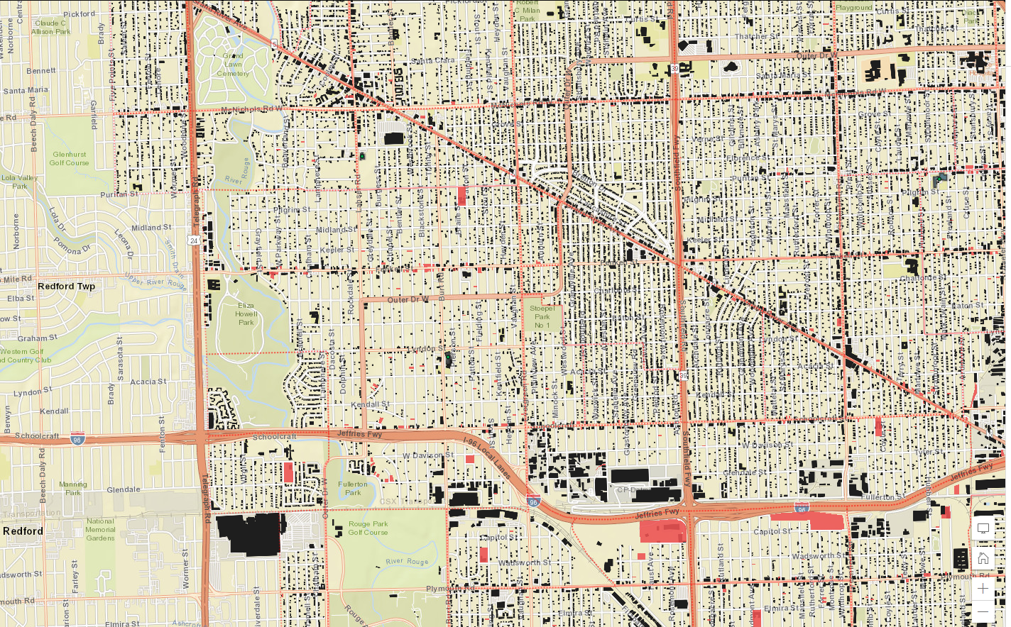
BRIGHTMOOR AREA PROJECT BOUNDARY
Evergreen
Telegraph
MCNICHOLAS EVERGREEN
SOUTH OF SIX
RIVERDALE
MILLER GROVE
Puritan
MINOCK PARK
BRIGHTMOOR
ROSEDALE PARK
Fenkell
WESTWOOD PARK
ELIZA HOWELL
I-96
SCHOOLCRAFT IMPROVEMENT ASSOCIATION
CASTLE ROUGE
Fullerton

Slide 7
Vacancy
Water & Land
Parks
Housing
Streetscapes
MAIN PRIORITIES

Slide 8
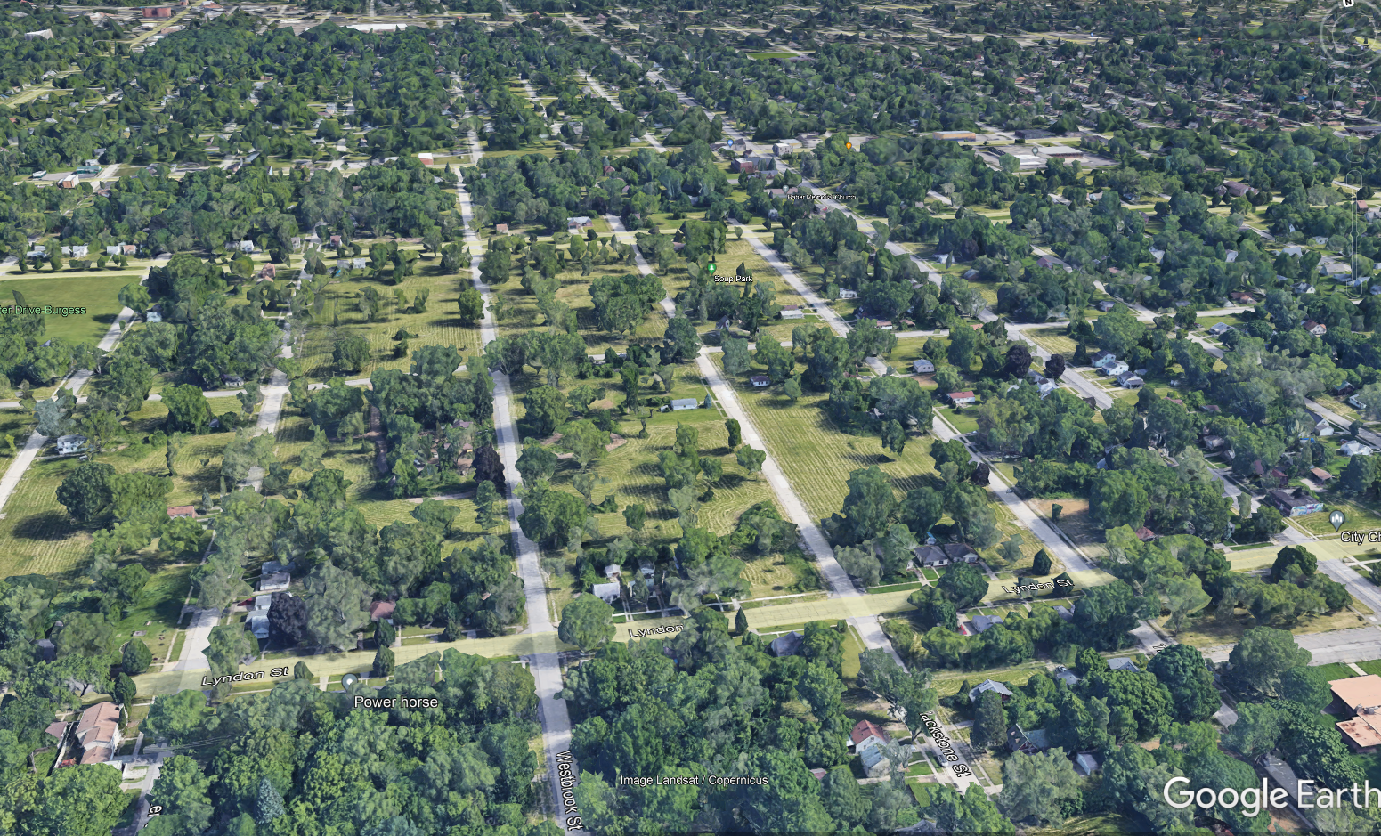

VACANCY
Notes:
Each powerpoint should start off with a title slide, which includes an outline of your mapped region. This can be found in the J: Drive under PDD\2.Library\D. Graphics\ 2. Templates\ Map Outline. If you need to recreate this simply drag a png of the map behind the colored background and turn the opacity down to 60%-85% (whatever looks best).

Slide 9
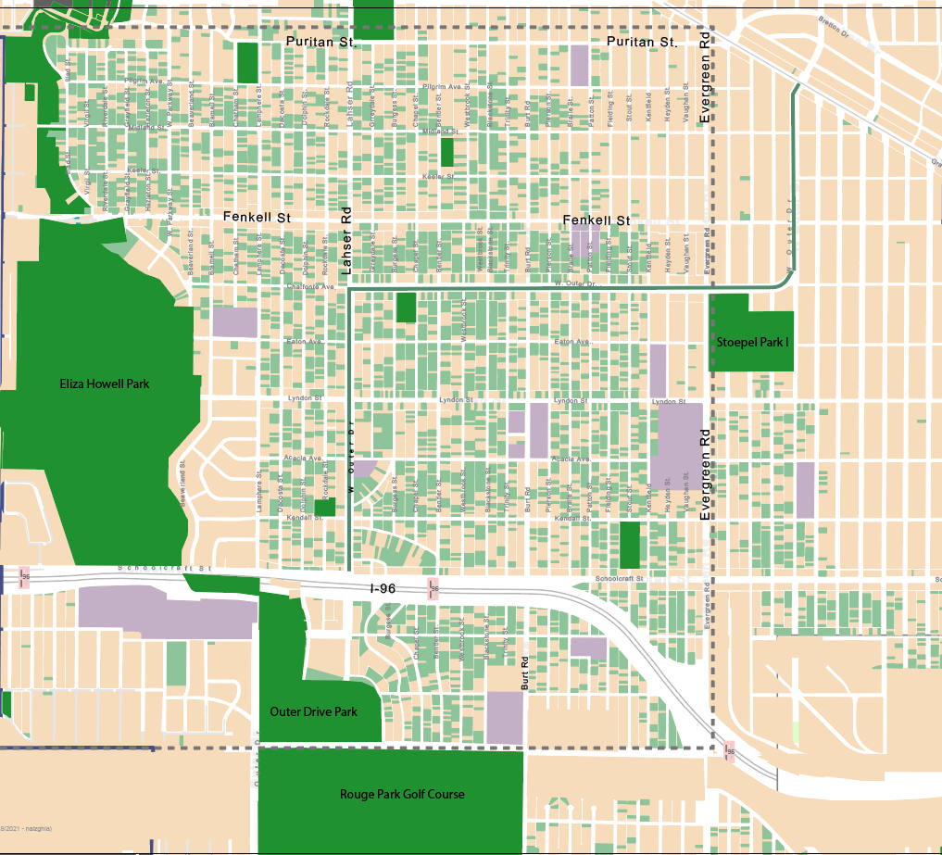
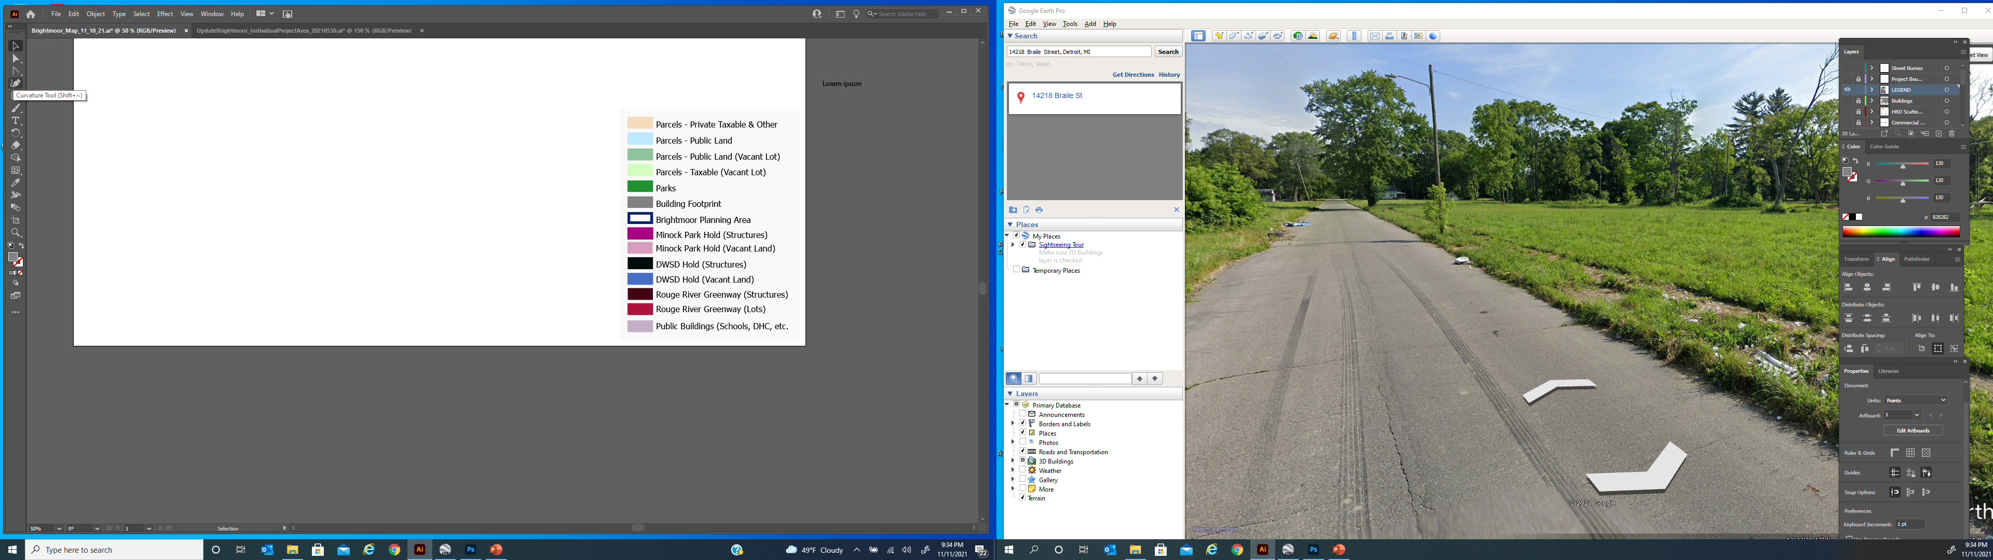
VACANT LAND
)

Slide 10
Beautification
Maintenance
Demolition
VACANT LAND

Slide 11
WATER + LAND
Notes:
Each powerpoint should start off with a title slide, which includes an outline of your mapped region. This can be found in the J: Drive under PDD\2.Library\D. Graphics\ 2. Templates\ Map Outline. If you need to recreate this simply drag a png of the map behind the colored background and turn the opacity down to 60%-85% (whatever looks best).

Slide 12
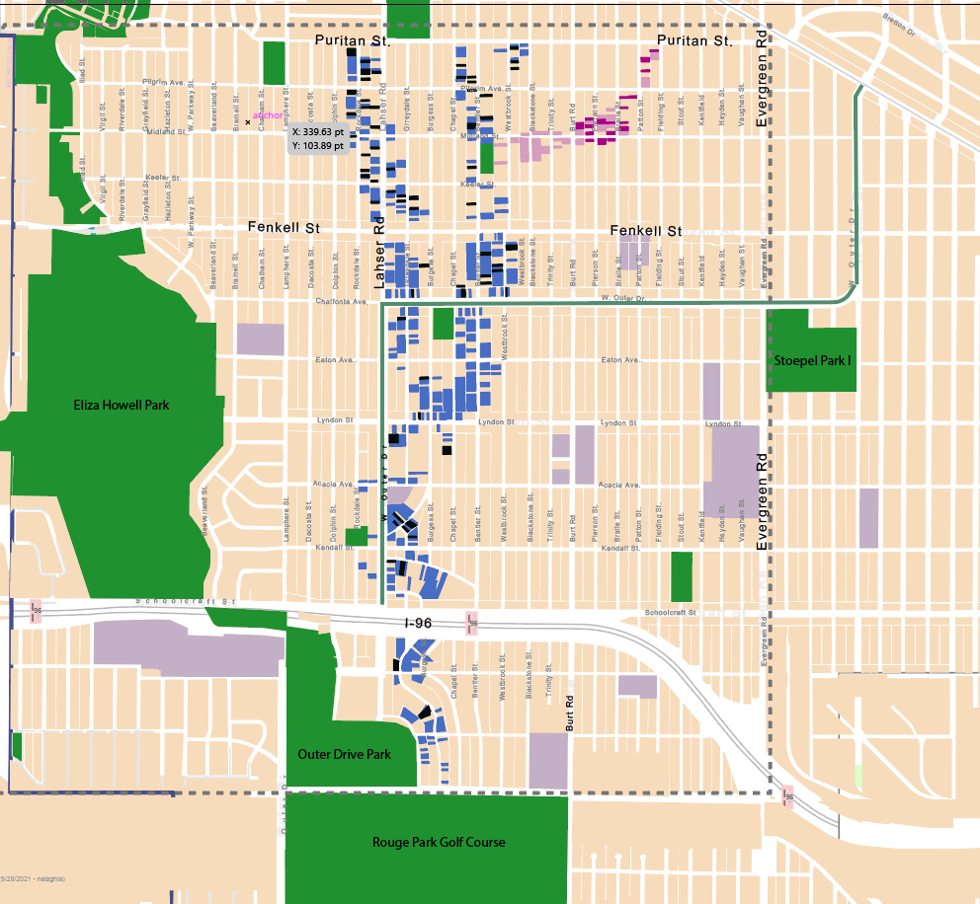
DWSD HOLD AREAS

Slide 13
DWSD Hold Areas
Stormwater Resilience
Greenway Connections
WATER & LAND

Slide 14
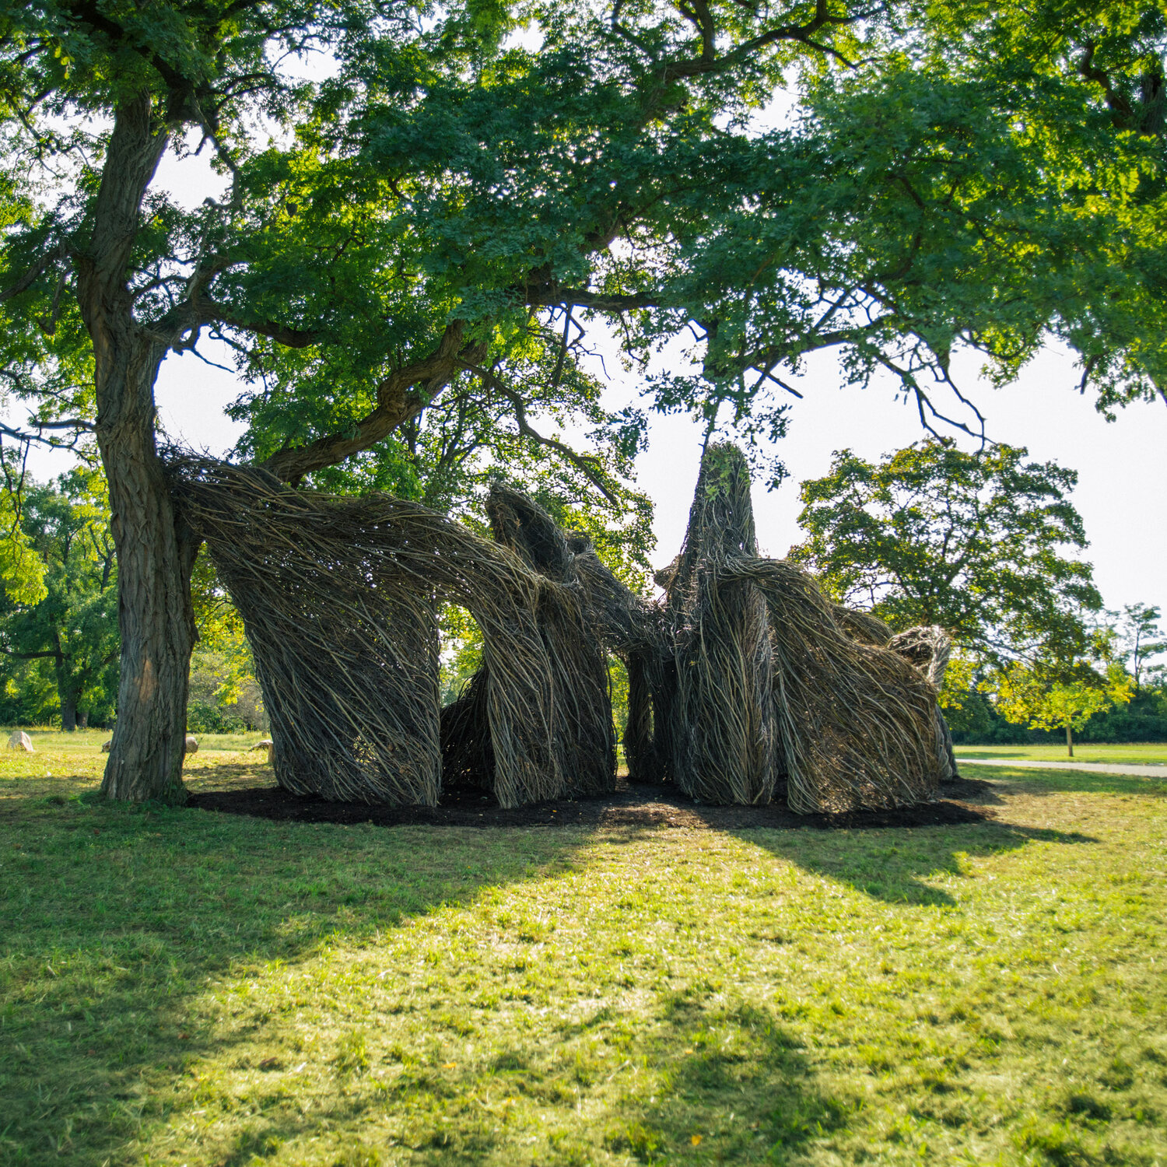
PARKS
Notes:
Each powerpoint should start off with a title slide, which includes an outline of your mapped region. This can be found in the J: Drive under PDD\2.Library\D. Graphics\ 2. Templates\ Map Outline. If you need to recreate this simply drag a png of the map behind the colored background and turn the opacity down to 60%-85% (whatever looks best).

Slide 15
Connectivity
Park Improvements
Park Access
PARKS
Notes:
`Closeness to residents (walking distance)

Slide 16
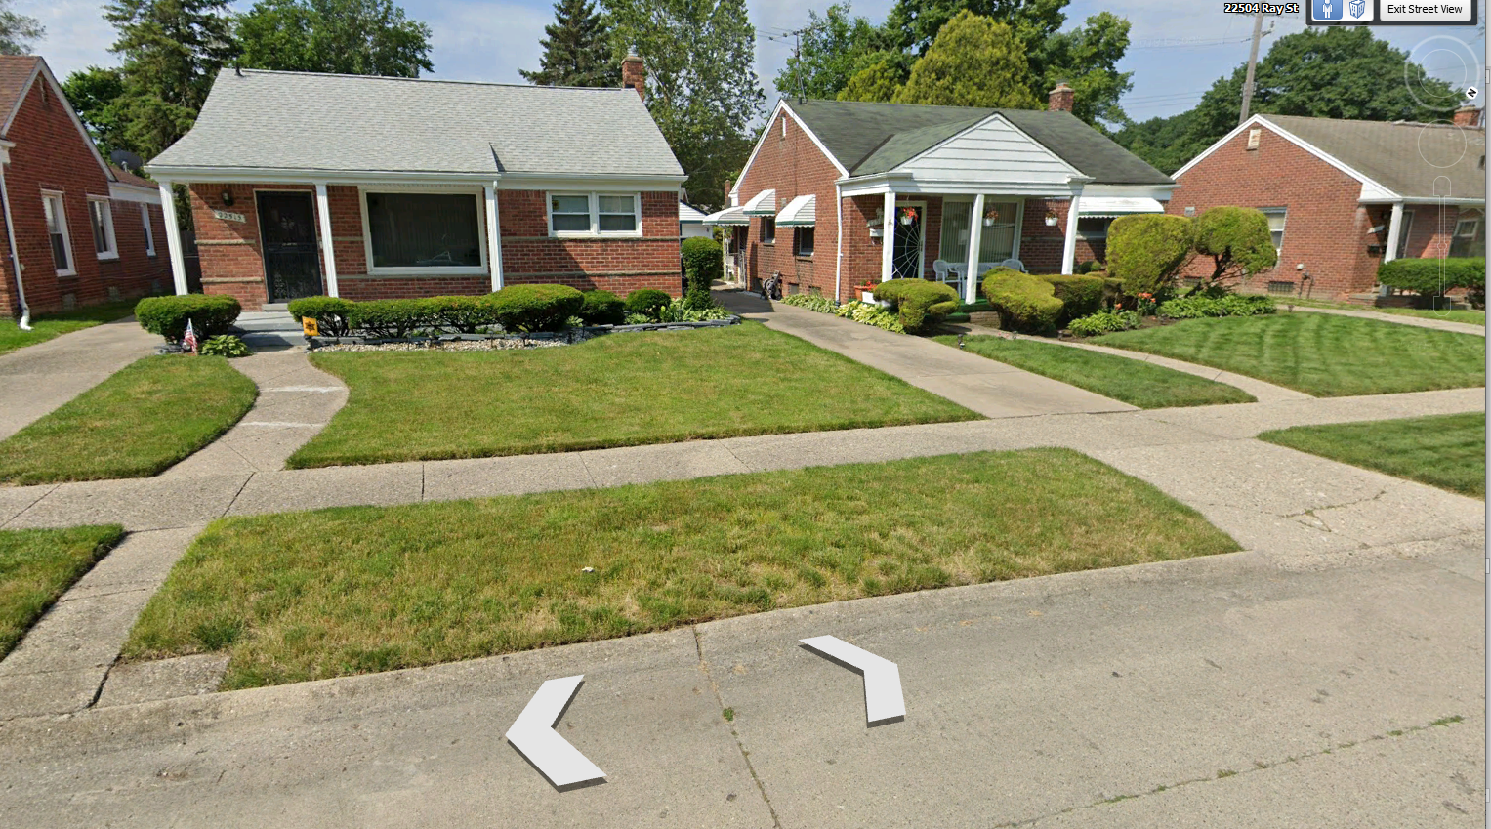
HOUSING
Notes:
Each powerpoint should start off with a title slide, which includes an outline of your mapped region. This can be found in the J: Drive under PDD\2.Library\D. Graphics\ 2. Templates\ Map Outline. If you need to recreate this simply drag a png of the map behind the colored background and turn the opacity down to 60%-85% (whatever looks best).

Slide 17
Housing Opportunity
Mixed Income Housing
Stabilization
Diversity
HOUSING
Notes:
`Closeness to residents (walking distance)

Slide 18
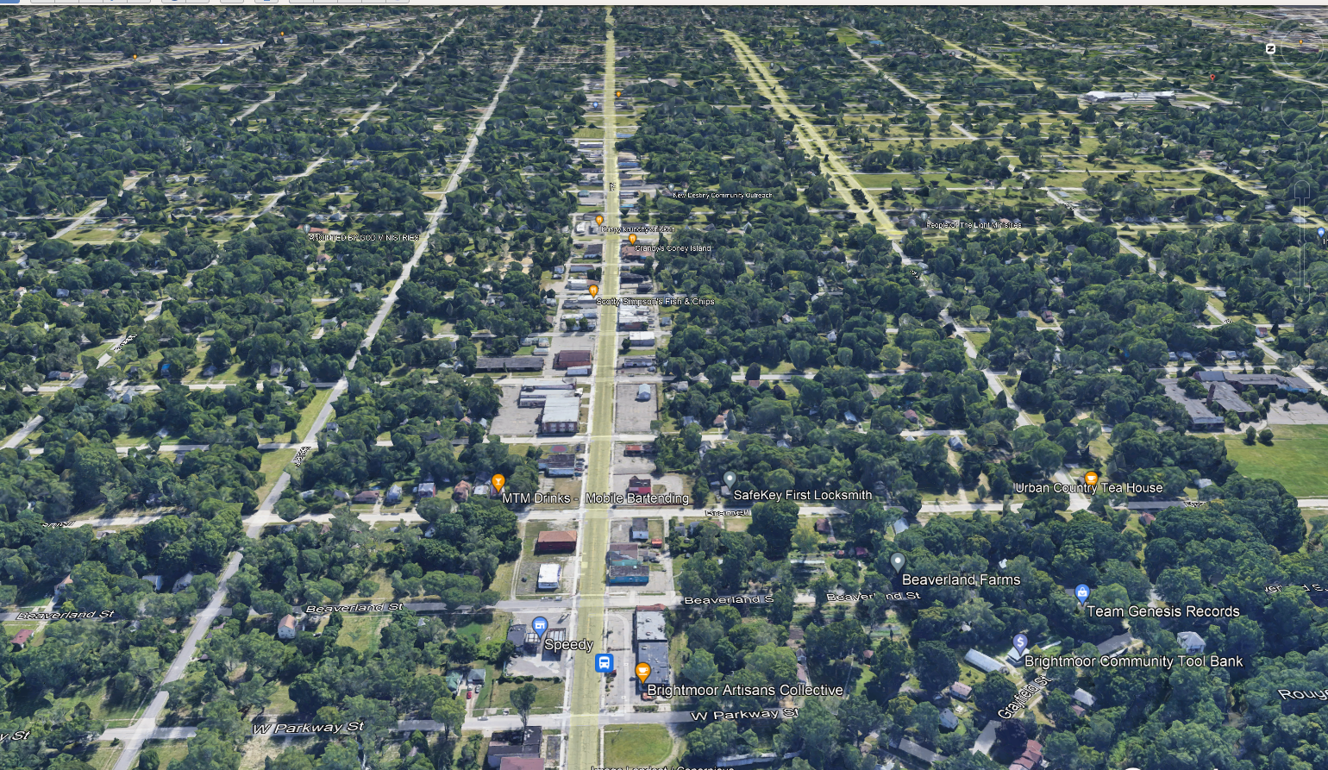
STREETSCAPE
Notes:
Each powerpoint should start off with a title slide, which includes an outline of your mapped region. This can be found in the J: Drive under PDD\2.Library\D. Graphics\ 2. Templates\ Map Outline. If you need to recreate this simply drag a png of the map behind the colored background and turn the opacity down to 60%-85% (whatever looks best).

Slide 19
Economic Development
New Businesses
Existing Businesses
Street Improvements
STREETSCAPE
Notes:
`Closeness to residents (walking distance)

Slide 20
NEXT STEPS
Request For Proposal Released - mid to late June
Request For Proposal Open - 4 weeks
Consultant Chosen – Early September 2022
City Council Decision – Quarter 4 2022
Framework Study Begins – Quarter 4 2022
TIMELINE

Slide 21


THANK YOU!
CONTACTS
Dominique Boyer
District 1 – Project Manager
Dominique.boyer@detroitmi.gov
Dave Walker
West Region Design Director
walkerdav@detroitmi.gov

