Slide 1
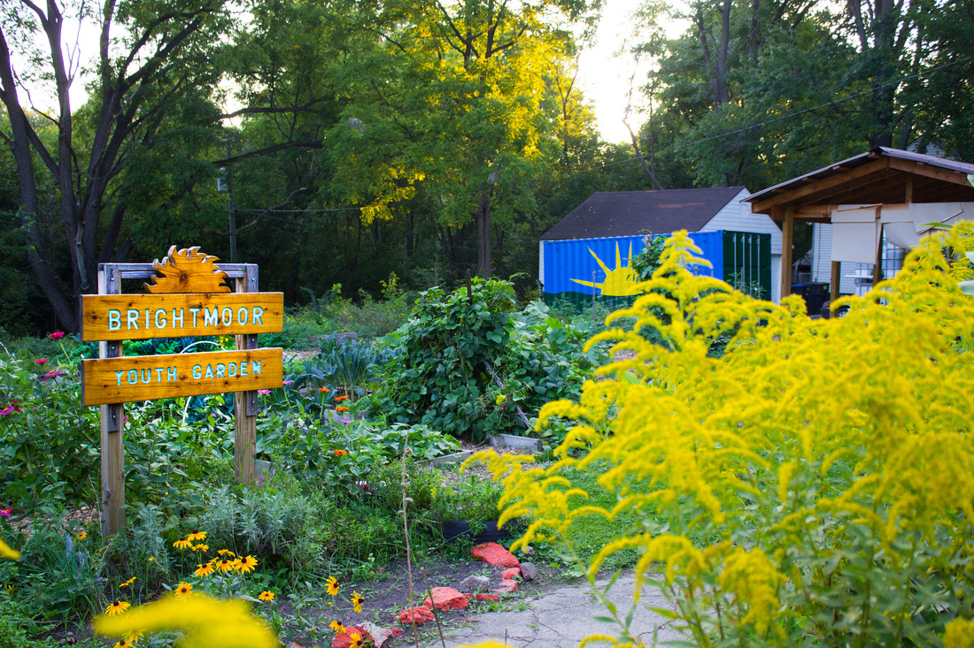
Brightmoor Framework Plan

Slide 2
AGENDA
SNF PROCESS (RFP)
BRIGHTMOOR PROJECT AREA
NEXT STEPS

Slide 3
COMMUNITY OUTREACH ORDIANCE
The City of Detroit enacted the Community Outreach Ordinance to demonstrate the city's commitment to community outreach that promotes transparency and accountability and ensures community awareness on legislation, contracts, agreements, and resolutions related to various City-Wide Proposals and Neighborhood proposals.

Slide 4
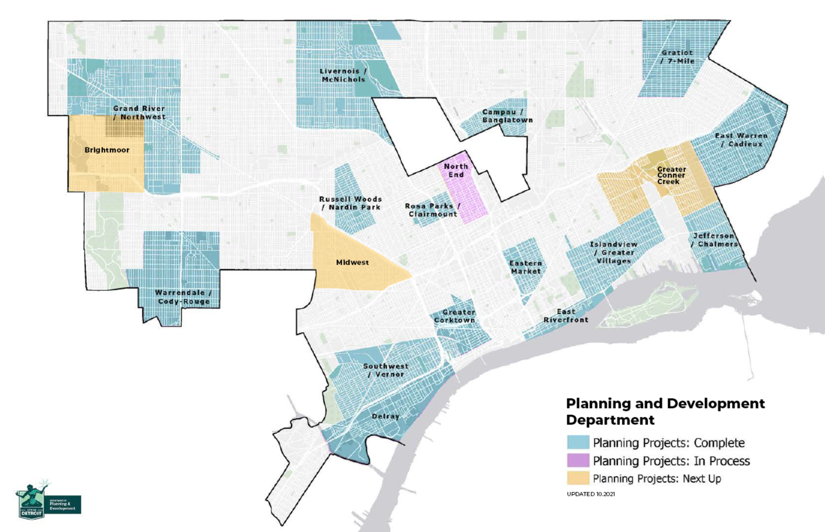
FRAMEWORK AREAS

Slide 5
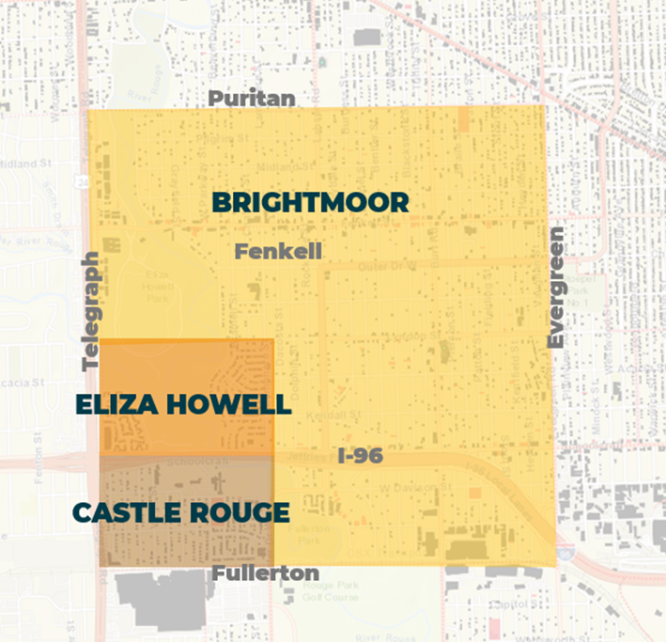
PROJECT BOUNDARY
Puritan Ave to the North
Evergreen Rd to the East
Fullerton Ave to the South
Telegraph Rd to the West

Slide 6
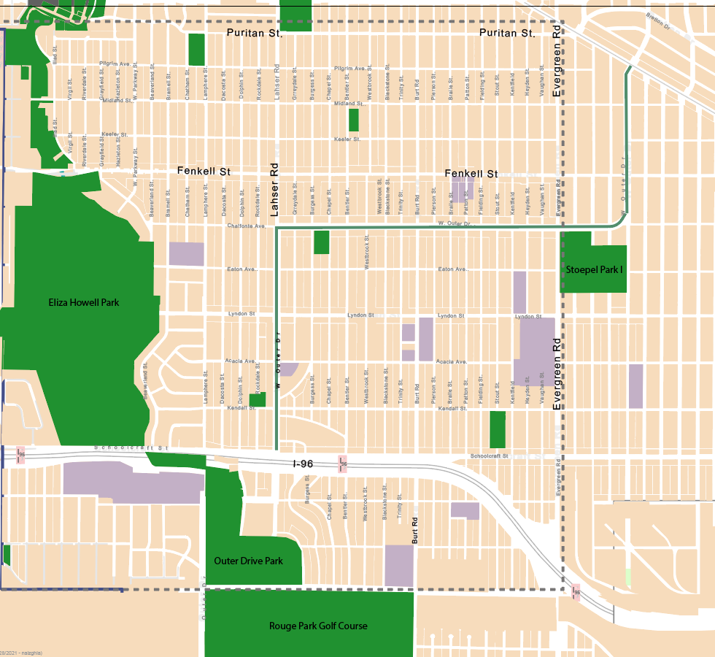
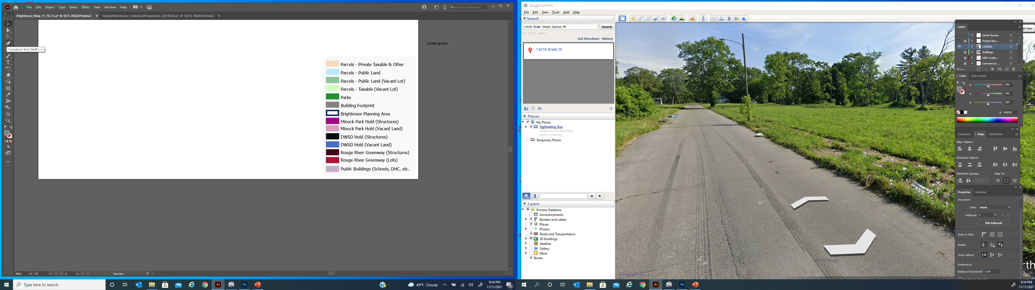
PROJECT BOUNDARY

Slide 7
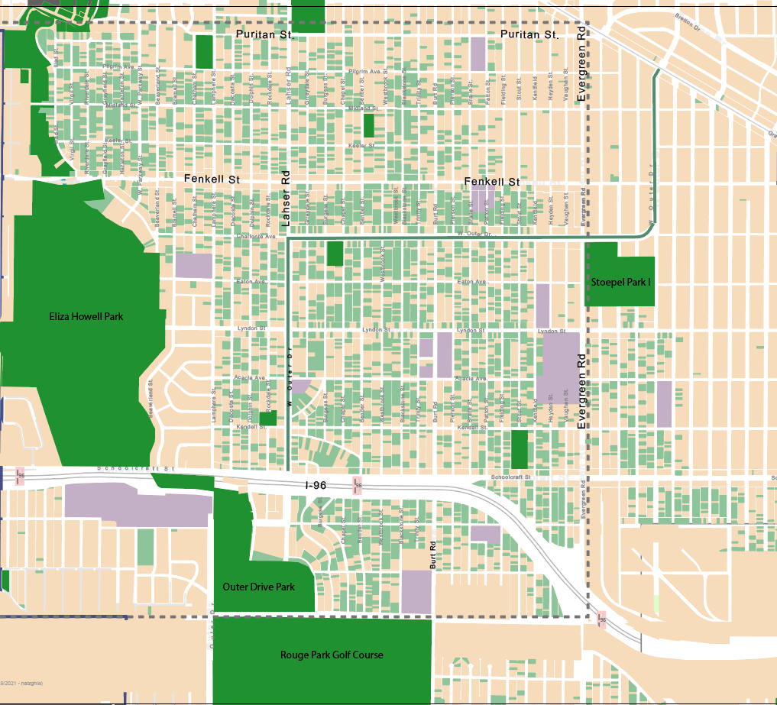
VACANT LAND

Slide 8
Vacancy
Water & Land
Parks
Housing
Streetscapes
MAIN PRIORITIES

Slide 9
NEXT STEPS
RFP Released - mid to late June
RFP Open - 4 weeks
Consultant Chosen – Late August 2022
City Council Decision– September 2022
Framework Study Begins - September 2022
TIMELINE

Slide 10


THANK YOU!

