Slide 1
Adopt-A-Park Stewardship Program
General Services Department
2023 Season

Slide 2
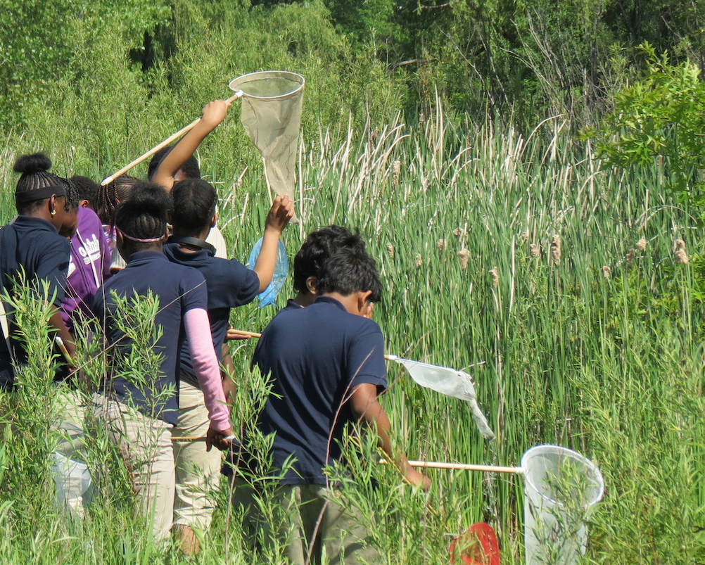
Adopt-A-Park Stewardship Program
The Adopt-A-Park Stewardship Program is a re-launched park stewardship program, where community groups can apply to become stewards of their local park and take an active role in beautifying and activating the park for the upcoming year.

Slide 3
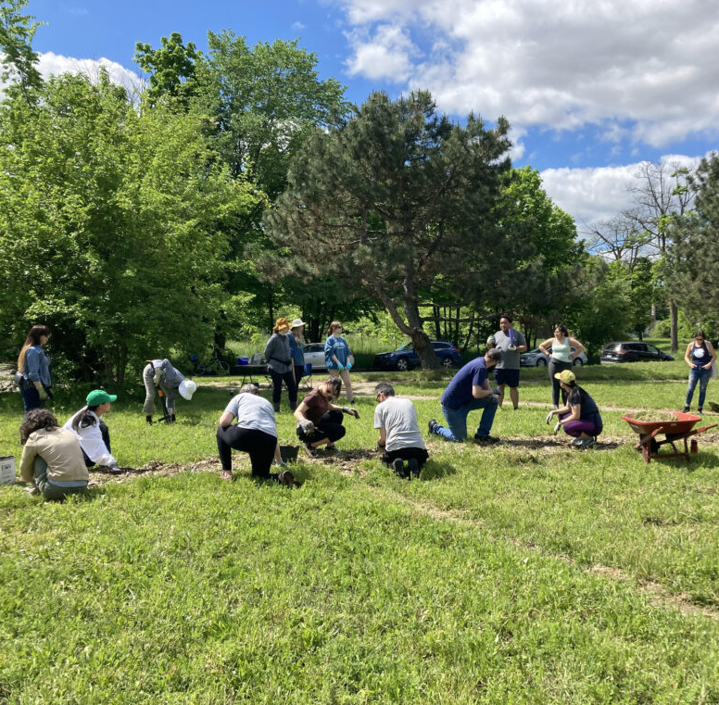
Adopt-A-Park Stewardship Program: What’s New?
Shift from mowing to stewardship
Park Stewards will help activate parks through programs & events and foster stewardship through clean-up events
Park Stewards get to bundle and submit park event permits early, before it opens to the public
The City will provide resources, such as clean up supplies and assistance in getting mini grants to support park programs
The 2023 Adopt-A-Park Stewardship Program season will run from February-December 2023
Bryant-Vermont Park clean up event, Detroit Audubon

Slide 4
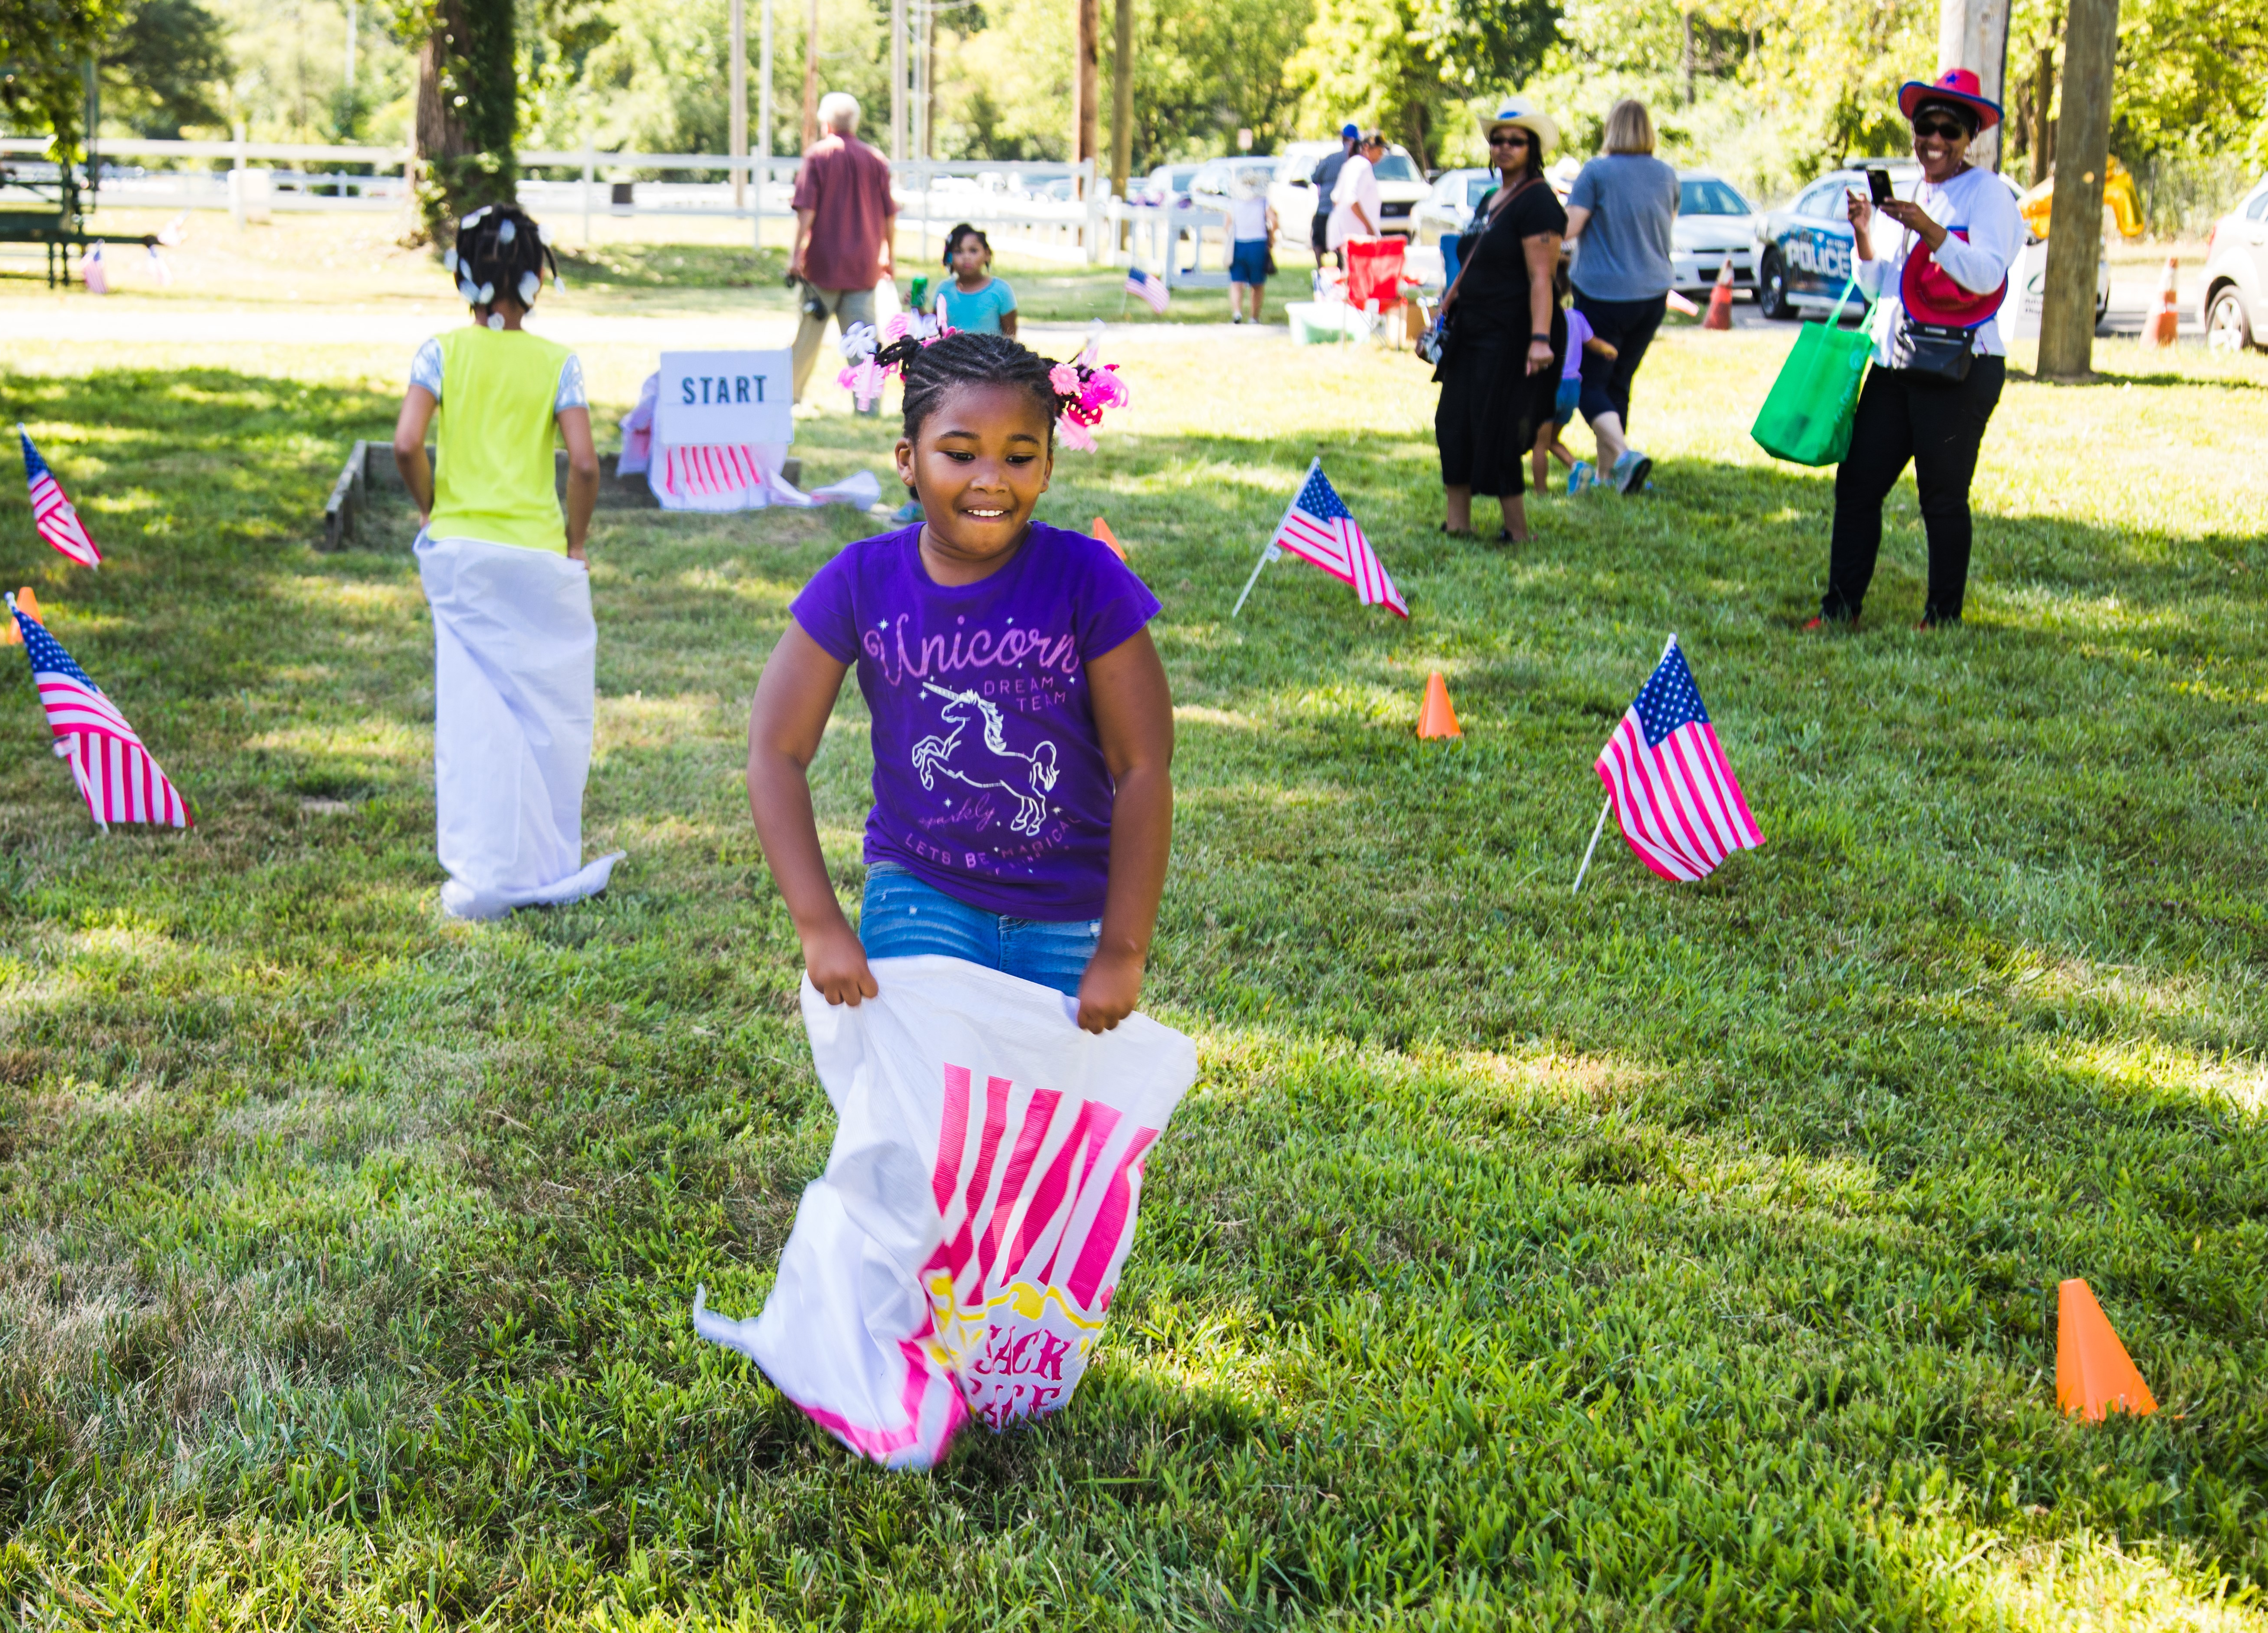
Adopt-A-Park Stewards Responsibilities
Complete at least 2 clean-ups per year, the City will help provide cleaning supplies (gloves, bags)
Program at least 2 events in the park per year with the City assisting with streamlining the event permitting process.
Assist Parks & Rec Marketing with getting the word out in our parks, including park announcements
Encourage and fostering respect of the park and stewardship within the community

Slide 5
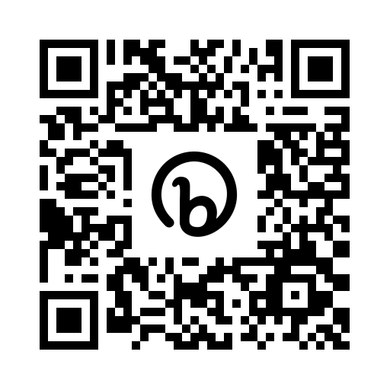
Adopt-A-Park Stewardship Program: the Application Process
The Park Stewardship application will open Monday January 16, 2023
And close two weeks later Monday January 30, 2023
The review period will be 2-3 weeks
Please note adopt-a-park approvals can precede event approvals, which may take longer
Link to the Application will be on the website: bit.ly/detroit-adopt-a-park

Slide 6
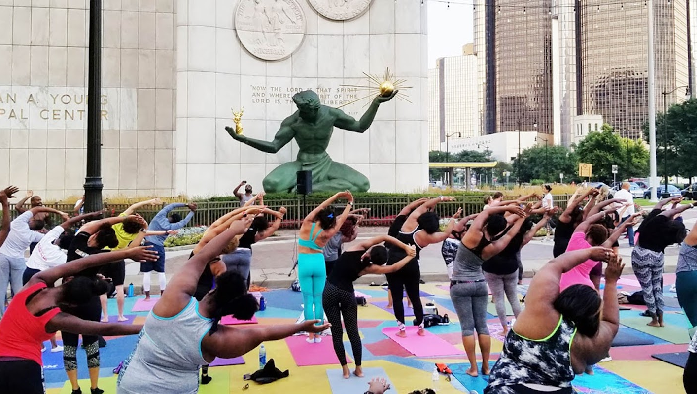
Thank You
Look out for the Adopt-A-Park Stewardship Program relaunch next Monday Jan. 16th!
Find out more information at: bit.ly/detroit-adopt-a-park

