Slide 1


Neighborhood Beautification Grant Program Now Accepting Applications
NBP will have 3 main eligible project areas: Clean
Up Activities, Community Gardens, and Public Space Activities.
Grant award amounts will be between $500 and
$15,000. Limited to one (1)
project per organization based on funding
availability.
APPLICATION PROCESS
The application process starts with reviewing the guidelines.
During the 2022-2023 Program year, Wayne Metro will host virtual
Proposal Workshops on June 23 and June 30, 2022, to help acquaint
applicants with the application process. Opportunities will be made
available to provide information and assistance to applicants in completing
the application on Wayne Metro’s website. Paper applications are not
Encouraged.
Attend an Information Session
  June 30th 6:00 p.m. – 7:00 p.m.
  TO REGISTER AND FOR MORE INFORMATION
  VISIT DETROITMI.GOV
CITY OF DETROIT

Slide 2

FORD FIREWORKS
IN CASE OF RAIN:
FIREWORKS WILL PROCEED ON THE FOLLOWING DAY, JUNE 28TH
PARKING
The Municipal Parking Department will not enforce parking meters after 5 p.m.
Parking Facilities MPD will offer parking at the following City-owned garages.
Ford Underground Garage
30 E. Jefferson
24 hours $10
Millennium Garage
432 W. Congress
24 hours $10
Joe Louis Arena Garage, 900 W. Jefferson Avenue, will be CLOSED.
CURFEW
EMERGENCY CURFEW
17 and under: 8PM-6AM
For the area bounded by the Detroit River, Third Street, Lodge Freeway, Fisher Freeway, the extension of Fisher Freeway east to Gratiot A venue, Gratiot Avenue, Vernor Highway, Chene Street, Atwater Street and Chene Park.
QUESTIONS?
Visit detroitmi.gov
Or, call our office at (313) 224 -1027
email councilmembertate@detroitmi.gov

Slide 3
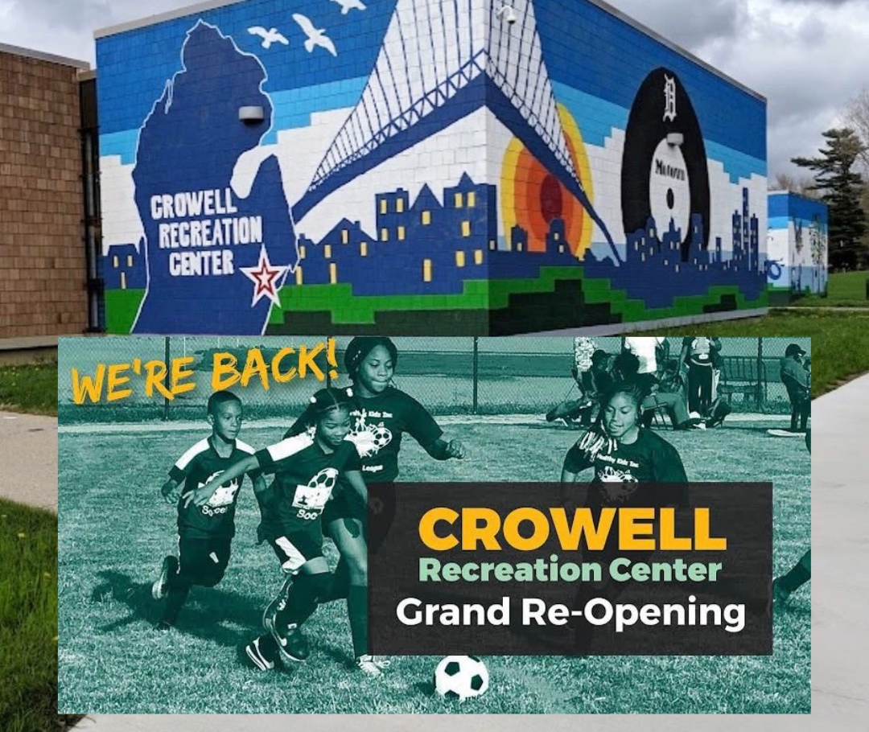
CROWELL IS OPEN!
16630 Lahser Rd, Detroit, MI 48219

Slide 4

Panelists’ Contact Information
Methodist Childrens Home Society
Jacqueline Moore, Motivational Speaker
Phone: (313) 918.9050
Email: jmrpresentations@yahoo.com

Slide 5
Panelists’ Contact Information
Methodist Childrens Home Society
Jacqueline Moore, Motivational Speaker
Phone: (313) 918.9050
Email: jmrpresentations@yahoo.com

Slide 6
Panelists’ Contact Information
Tim Karl
City of Detroit – Chief Landscape Architect
Email: tkarl@detroitmi.gov

Slide 7
Panelists’ Contact Information
Mario Morrow & Associates, LLC
Mario Morrow, Owner/Operator
Website: www.mariomorrow.com
Phone: (313) 800-5973
Email: cwright@mariomorrow.com

Slide 8
Contact Us
To learn more about the new district maps, polling sites and district candidates go to :
https://detroitmi.gov/departments/office-chief-financial-officer/ocfo-divisions/office-budget
Or, call our office at (313) 224 -1027
email councilmembertate@detroitmi.gov

