Slide 1


How Black Communities Develop STEM Leaders
DeLean Tolbert, PhD
Notes:
.

Slide 2
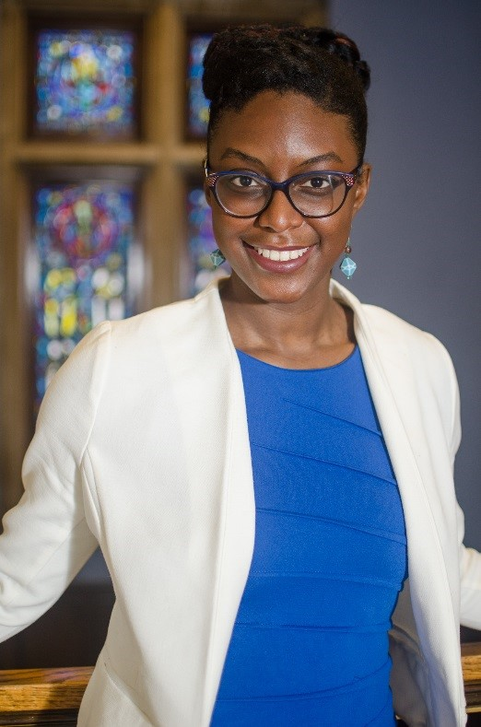
Dr. DeLean Tolbert Smith
“Dr. Dele”
Asst. Prof. – UM-Dearborn
Ph.D. Engineering Education - Purdue University
Masters Industrial Engineering – UM- Ann Arbor
B.s.E. Electrical Engineering - UM-Dearborn

Slide 3
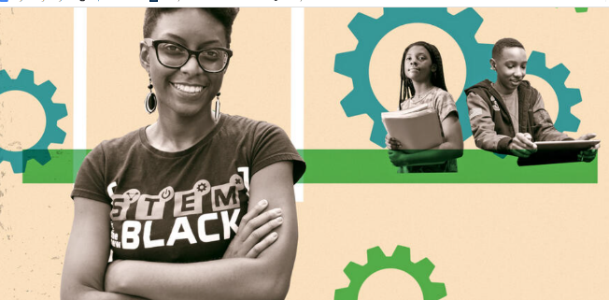
Other Titles:
Coach Dele
Mrs. Smith
Engineering and College Access advocate
Henry Ford High School. Asst. Volleyball Coach
Wife and Rosedale Neighbor

Slide 4

NSF CAREER: Investigating Black Youths’ Engineering, Innovation, and Design Practices at the Intersection of Museum and Home/Family Learning

Slide 5
Research Focus
Awarded a prestigious award worth $720k award
Collaborate with Henry Ford Museum and the Detroit-Area Pre-College Engineering Program (DAPCEP),
To engage youth and families of color in informal science education programming, with culturally relevant contextual frameworks, to broaden their participation in STEM and enhance further STEM career aspirations.

Slide 6

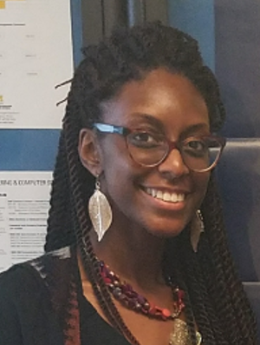

Family Invention Course
A 6-week course for families with 6th grade children
Saturdays, starting January 15th, 2022
via zoom*
9:00 am-12:00 pm
Parents are asked to commit to attending atleast 3 sessions with their child and help record during the week
Inventing History is a Family hands-on DAPCEP class where we learn about the Invention Stories of Black Inventors and Innovators as families create their own inventions! Between classes, students will video record their weekly progress and share the video updates with the instructors for guidance and feedback. This DAPCEP course includes weekly meetings led by an Engineering professor and a college STEM student mentor. We will are excited to help you and your child develop Inventions and participate in the March 2022 Invention Convention. All skill levels are welcome!
Who should join? African American/Black Families with 6th graders!
Registration for the special DAPCEP class is required: https://dapcep.asapconnected.com/#CourseID=256498
Course registration is $25 and there are scholarships available if needed. Once registration closes a member of the instruction/research team will contact you with additional information.
Families will receive access to the Henry Ford Museum, mentorship from college students, and practical skills that they can apply to future STEM experiences. The project is funded by the National Science Foundation.
DeLean Tolbert Smith, PhD
Inventing History Instructor
University of Michigan – Dearborn
Assistant Professor
Questions?
dtolbert@umich.edu
By participating in this project you will:
Learn how to think like an Inventor
Learn Black History
Enjoy hands-on workshops for children and parents
Receive family access to the Henry Ford Museum
Learn how to support an inventive child!
Visit http://deleantolbert.weebly.com/
Notes:
Featured in the Grandmont Monitor

Slide 7
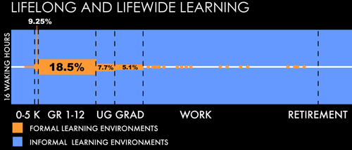
Out-of-School and informal Learning

Slide 8
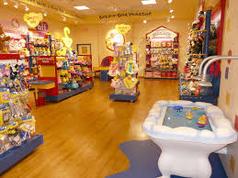
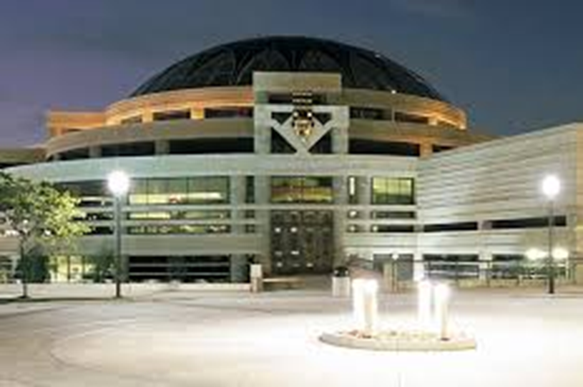
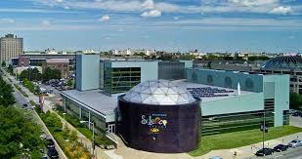
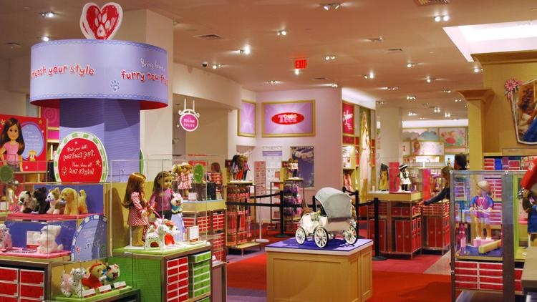
Local Learning Settings
  Museum of African American History
  Build a Bear Workshop
  Science Center
  American Girl Retail Store

Slide 9
Strong Analytical Skills
National Academy of Engineering description
Even though the scientific knowledge that defines operating principles is expected to be more fluid and more complex, the core analysis activities of engineering design—establishing structure, planning, evaluating performance, and aligning outcomes to a desired objective—will continue.^{[1]}
  Basketball, Dominoes, and Card playing
    Basketball provides opportunities to engage in analytical thinking activities: classifying, sequencing, comparison, description and persuasion (Mahiri, 1991)
    Basketball as an opportunity to link practice-linked statistical concepts to formal mathematics learning (Nasir, 2008)
Notes:
In Mahiri’s ^{[13]} ethnographic investigation of the relationship between discourse features of African American male youth and basketball,

Slide 10
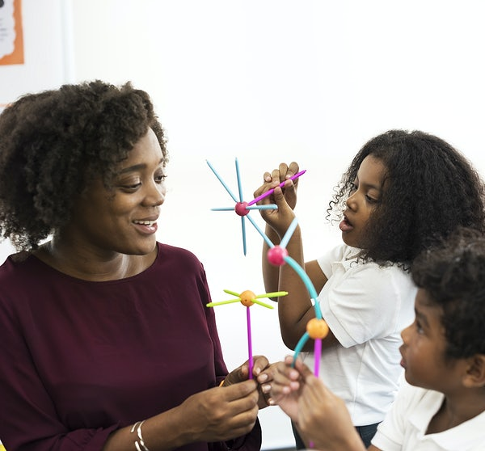
How Can Black Families and communities Develop STEM Leaders?
Model flexible and strong coping skills,
Encourage strong education and academic progress,
Reinforce and model a culture of Strong work ethic
Provide emotional, mental, psychological, and motivational support,
Support and encourage of Science, Technology, Engineering and Math,
Encourage and support with planning for the future,
Encourage and support at transition points (I.e., middle to highschool, highschool to college, etc.)
Reinforce positive identity (Racial, ethnic, cultural, professional, other, gender, faith, etc..)

Slide 11
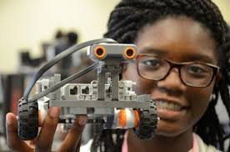
Lauren and Mom working together
Lauren’s mom provides her with many resources and opportunities to engage with designing, building, creating and STEM concepts. Her mom notices that “[Lauren’s] not afraid of Information Technology and Computers. She’s installing software on her laptop. She’s had a laptop since she was four; like a real laptop not like a Barbie one like a real laptop. You know what I mean? So she has a very high aptitude of using technology.”

Slide 12
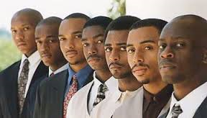
What do Black College Students Say?
He [Dad] noticed real early that I really liked Legos, I was really good at math. He would like, test me in different situations and kind of gave me a real-world perspective on stuff. We would go through the grocery store, and he would let me try to calculate the price for everything in my head before we got to the counter. I got really good at it. - Granville

Slide 13

How did they respond?
Envisioned themselves as Engineers
Joined professional engineering clubs and organizations
Learned to identify and leverage support groups with shared educational values
Sought out and become role models in the community

Slide 14
How can I help you?
What are some ways that this information can help you?
What resources do you need from me?
How can I share this with families like you?

Slide 15


Thank
You
Dtolbert@umich.edu
http://deleantolbert.weebly.com/
Assistant Professor| Compassionate Researcher| Community Change Agent

