Slide 1

SPECIAL PROJECTS
NOTICE OF FUNDING AVAILABILITY
July 2021
Notes:
All font should be Montserrat
Text within content blocks should be 12pt font
To edit Department in the lower right corner, click Slide, Edit Master. In top “Master” slide edit Department name in footer

Slide 2
NOFA OBJECTIVE
The City of Detroit Housing and Revitalization Department (HRD) is pleased to release this Notice of Funding Available (NOFA) to provide developers and owners the opportunity to apply for financial support for commercial projects that are shovel-ready. These commercial projects could include historic structural renovations, mixed-use developments, food businesses and redevelopment of brownfield and historic preservation sites located in the Targeted Investment Area Map areas.

Slide 3
PROJECT QUALIFICATIONS
To be considered for funding projects must meet the following qualifications:
Proposed projects should benefit low to moderate income populations (as defined as 80% Area Median Income or less). Example projects include:
  Community Grocery Store
  Retail Store
  Health Clinic
  Historic Preservation activities
  Adaptive Reuse / Rehabilitation
  Office Space
  Mixed-Use Development
  High Impact developments in Strategic Neighborhoods Fund
Projects must have a commercial component and also meet one at least of the following conditions:
  Be in a Historic District
  Rehab of a blighted or functionally obsolete building (i.e adaptive reuse of a building)
  New Construction
  Affiliated with a neighborhood and commercial corridor food initiative / Strategic Neighborhood Funds
3
The proposed investment must meet a CDBG National Objective and Eligible Activity per 24 CFR part 570.
Project should be “shovel ready”. All other funders participating in the project should be confirmed with a Letter of Intent and ready to break ground within 6 months of award.
1
4
2

Slide 4
APPLICATION & AWARD TIMELINE
EVENT | DATE
NOFA Published | July 12, 2021
HRD Pre-Submission Public Meeting | July 26, 2021 at 1:30 PM
Intake Application (Part I) | August 6th, 2021 at 12PM, for this years CDBG fiscal year consideration (August 2021 to May 2022) Intake applications will be accepted on a rolling basis for future CDBG program years
Program Compliance Information Meeting | August 17, 2021
Full Application (Part II) Invitation | Based on funding availability
Letters of Interest Issued | Letters of Interest for projects that apply by August 6th will be issued October 1st. For projects that submitted after August 6th, they will be issued on a rolling basis after October 2021 for future fiscal year consideration.

Slide 5
FUNDING LIMITS & RESTRICTIONS
Effective at the release of this NOFA, the following restrictions will be placed on funding allocations:
  Award Amount: there is no hard cap on award size, but requests for less than $500,000 will be considered first; Larger awards may be granted on a case-by-case basis
  Maximum outstanding awards per developer: 1 – Applicants of this program may not receive more than 1 award in any grant year
  Funding Source: Community Development Block Grant Program (CDBG) through HUD

Slide 6
COMPLIANCE REQUIREMENTS
Davis Bacon and Related Acts Requirements; Prevailing Wages
Section 3 Requirements
Construction & Rehabilitation Standards
Energy Standards
Cost Certification
PROGRAM COMPLIANCE MEETING WILL BE ON AUGUST 17th FOR MORE DETAILS

Slide 7
NEXT STEPS & APPLICATION PROCESS
Complete Intake Application by August 6th 2021
  Familiarize yourself with the application and requirements for the intake application
RSVP for the Program Compliance Information Meeting held on August 17th 2021
For questions, contact us at: HRDNOFA@detroitmi.gov

Slide 8
INTAKE APPLICATION REQUIREMENTS
INTAKE APPLICATION REQUIRED SUBMITTAL INFORMATION
Developer Team and Project Narrative
  Executive Summary
  Developer Experience / Team Narrative
  Program Scope and Feasibility Narrative
  Board of Directors Information (if applicable)
  Special Projects NOFA Self-Score
Readiness to Proceed
  Project Timeline
  Evidence of Site Control
  Site Plan Approval (For New Construction Only)
  Evidence of Historic Designation
  Preliminary Plan Review
  Zoning Documents
Financial Documentation
  Development Proforma
  Letters of Intent / applications for all funding sources
Construction and Environmental Documentation
  Trade Payment Breakdown (TPB)
  Building/Site Images
  Tentative Construction Schedule
  ASTM Phase I - Environmental Site Assessment (ESA)
  Additional environmental due diligence documents

Slide 9
FULL APPLICATION REQUIREMENTS
FULL APPLICATION REQUIRED SUBMITTAL INFORMATION (BY INVITATION ONLY)
Financial Documentation
  Financial Statements of Sponsor/Guarantor
  Real Estate Owned (REO) Schedule
  Evidence of Anchor Tenant Leases
  Rent Roll (Currently Occupied and Operating Projects Only)
  Development Financial Statements
Environmental & Construction Documentation
  AIA Document A305-1986 Contractor’s Qualification Statement
  Detailed Scope of Work or Plans & Specs
  Letter of Confirmation of City Approvals and Permits
  Site Survey
  Site Utility Plan
  Market Study
  Capital needs assessment
Program goals and Documentation
  Section 3 Documentation / Experience
  Proof of certificate as a Minority/Women Owned Business Enterprise
  City of Detroit approval as a Community Housing Development Organization (CHDO)
  Community-Based Development Organization (CBDO) Certification
  Targeted Investment Area / Alignment with City Goals
  Green Building Initiatives

Slide 10
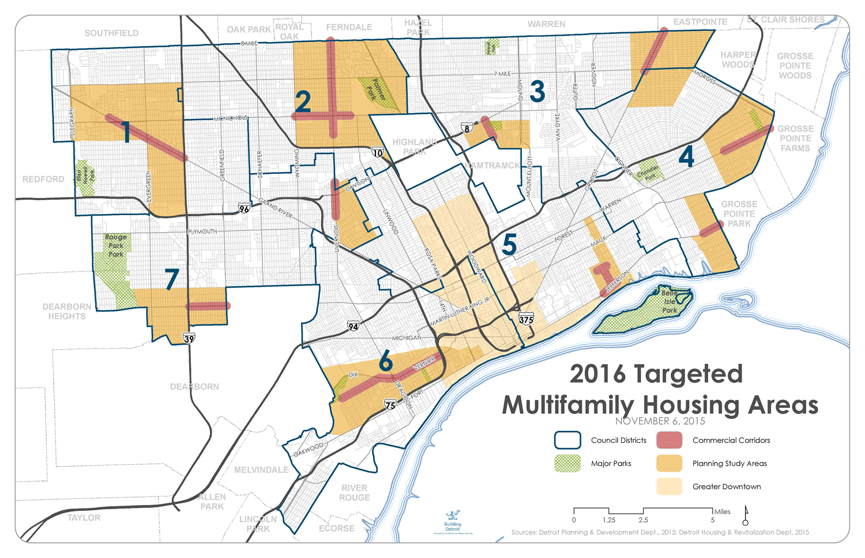
TARGETED INVESTMENT MAP
Targeted Investment Map

