Slide 1

Good evening District 2,
Please join us for another District wide call on Wednesday, March 25th at 6pm. We have also attached materials to help you to receive the latest information and updates, as well as a few helpful links.
Most of the information shared can be found at https://detroimi.gov/departments/Detroit-health-department/programs-and-services/communicable-disease/coronavirus-covid-19
Parents and those providing care for our youth can find additional informational at https://www.goaldetroit.org/blogs/post/Keeping-each-other-safe-and-healthy-a-message-regarding=COVID-19
Lastly, for the small business owners who may receive this correspondence, additional resources can be found at https://www.michiganusiness.org/covid19/
Stay safe, stay well and of course reach out should you require additional or unrelated information.
Kim Tandy Sean Davis
District 2 Manager Deputy Manager
City of Detroit – Mayor’s Office City of Detroit – Mayor’s Office
Department of Neighborhoods Department of Neighborhoods
Coleman A. Young Municipal Center Coleman A. Young Municipal Center
2 Woodward Avenue, Suite 1126 2 Woodward Avenue, Suite 1126
Detroit, MI 48226 Detroit, MI 48226
Office: 313-224-4415 Office: 313-224-4415
Cell: 313-236-3494 Cell: 313-236-3489
tandyk@detroitmi.gov davisse@detroitmi.gov
Michael E. Duggan, Mayor

Slide 2
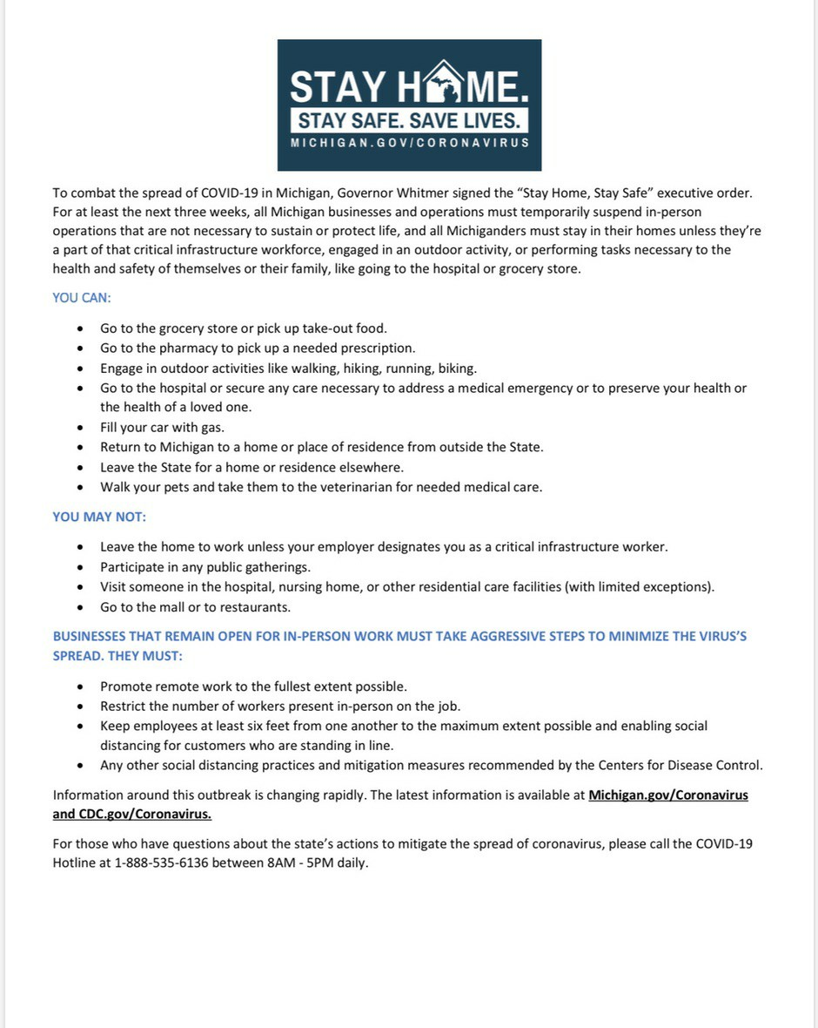
Detroit COVID-19 Response - Updates for 3/23/2020
Today Governor Whitmer instituted Executive Order No. 2020-21, which states that to suppress the spread of COVID-19, it is reasonable and necessary to direct residents to remain at home or in their place of residence to the maximum extent feasible. This order takes effect on March 24, 2020 at 12:01 am, and continues through April 13, 2020 at 11:59 pm.

Slide 3
COVID 19 RESOURCES: DETROIT’S GOT YOU COVERED
If you suspect you have COVID-19
If you are feeling sick please stay at home and call your primary care doctor or local hospital hotline (see list below)
If you have a fever and a cough AND are experiencing any of the following go immediately to the emergency department or call 911 for EMS:
  Difficulty breathing
  Confusion
  Weakness
  Chest pain
If you have a cough and no fever or are concerned that you may have been exposed to someone who has been diagnosed with COVID-19:
  Contact your primary care physician by phone (don’t go unannounced) or
  Seek a telemedicine evaluation or
  Visit an urgent care center or
  Contact a regional hotline or
  Visit a drive-through screening site
If you have a cough WITHOUT difficulty breathing AND no chronic medical conditions*
  Drink fluids
  Take over the counter remedies for fever and mild discomfort (e.g., Tylenol)
  Stay at home and try and stay at least six feet away from others without symptoms
*Chronic medical conditions include: diabetes, congestive heart failure, chronic obstructive pulmonary disease, cancer or heart disease.
Hospital Emergency Rooms are still open for emergency medical care. For all other ambulatory care or office appointments, please call the location to get up-to-date information on hours and scheduling an appointment.
There will be continued updates to the public with additional regional resources as they become available. You can find a list of available hospital services on the city of Detroit’s website.

Slide 4
Detroit Health Department Hotline
Call the Detroit Health Department at (313) 876-4000 for guidance on next steps if you are:
A healthcare provider with a possible COVID-19 positive patient
An individual who suspects they have COVID-19
The call center is operational 24 hours a day. For additional information, visit DetroitMI.gov/coronavirus.
Hospitals across the area have set up special hotlines for the coronavirus questions. Details on each are below:
Michigan Department of Health and Human Services - 888-535-6136
Ascension - 833-978-0649
Beaumont Health - 800-592-478
Henry Ford Health System - 313-874-7500
In need of Food?
The City of Detroit’s Recreation Department is providing meals for children at the following sites from 8:30 AM until 1:30 PM Monday - Friday:
Adams Butzel Recreation Center, 10500 Lyndon
Farwell Recreation Center, 2711 E. Outer Drive
Kemeny Recreation Center, 2260 S. Fort Street
Parents and children can pick up two meals (Breakfast and Lunch) Monday through Thursdays. On Fridays, they can request additional meals to get them through the weekend.
As the need for food grows, the City of Detroit is working with Gleaners and Forgotten Harvest to provide alternative sites where families can get groceries. Starting this week, Gleaners will begin providing groceries to families with children at two additional Recreation Centers:
Roberto Clemente Recreation Center, 2631 Bagley
  2:30 PM – 5:30 PM, Every other Wednesday starting March 25
Coleman A. Young Recreation Center, 2751 Robert Bradby Drive
  1:30 – 4:30 PM, Every other Saturday starting March 29
More sites are expected to come online soon. Gleaners and Forgotten Harvest are still providing groceries through their existing partners across the region. They are listed at on the city’s website at www.detroitmi.gov/coronavirus.
Also the Detroit Area Agency on Aging is providing frozen meals for seniors ages 60 and up. Seniors can pick up 5 days worth of meals every Wednesday from 11:30 AM – 1:00 PM at the following City of Detroit Recreation Centers:
Adams Butzel Recreation Center, 10500 Lyndon
Farwell Recreation Center, 2711 E. Outer Drive
Patton Recreation Center, 2301 Woodmere
Joseph Walker Williams Recreation Center, 8431 Rosa Parks Blvd.

Slide 5
Bus Schedules: Reduced Service
Due to the reduction in businesses that can operate under the Governor’s new order, and the expected drop in transit usage, DDOT will be reducing its weekday schedule and suspending some its “express” routes. Service will be maintained Monday through Friday on a standard Saturday schedule. Weekend service will not change at this time. On Monday-Saturday, most lines will run hourly, although major spokes, such as Michigan Avenue, Gratiot and Grand River, will run approximately every 20-30 minutes. During the day, Woodward will run every 10 minutes. Schedules are available on the city’s website, as well as at the Rose Parks Transit Center and State Fair Transit Center.
To provide the highest level of service possible on its most heavily traveled routes, DDOT will be temporarily suspending service on “express” routes, which include:
#40 Russell
#42 Mid-City Loop
#46 Southfield
#80 Villages Direct
#89 Southwest Direct
#92 Rosedale Express
#95 Ryan Express
#96 Joy Express
If you have any questions, contact Customer Service at (313) 933-1300.
Need your Water Turned on?
Detroiters who need their water turned on can sign up for DWSD’s Water Restart Plan, and if you sign up before April 9, you don’t have to put any money down. Just come in, sign up and turn your water on. Since the $25 Water Restart Plan was announced on March 9, more than 1,400 customers have taken advantage of it.
679 completed service restorations
264 avoided a planned shut off by contacting DWSD
178 active restoration work orders (DWSD has 10 crews out today)
325 additional households where the occupant was not home or that require significant work before restoration can take place. These are expected to be completed by the end of this week.
To help with some of the more difficult restorations, where more systemic issues exist, the city has partnered with Plumbers Local 98 to provide additional workers.
All DWSD Customer care centers will be closed at this time. Customers can call the Customer Service Call Center at (313) 267-8000 or pay bill at detroitmi.gov/paymywaterbill.
How to apply
Residents without water, or who have received a notice they are at risk of service interruption, will only need to call Wayne Metro at 313-388-9799 to make an appointment. Customers also must make a monthly minimum payment of $25 during the time there is a risk of outbreak in Detroit to avoid service interruption. The amount of each customer’s arrearage will be deferred until after the COVID-19 situation is under control. At that time, residents will be transitioned to the WRAP or a 10-30-50 Payment Plan, both of which will keep their water service on as long as they remain current.

Slide 6
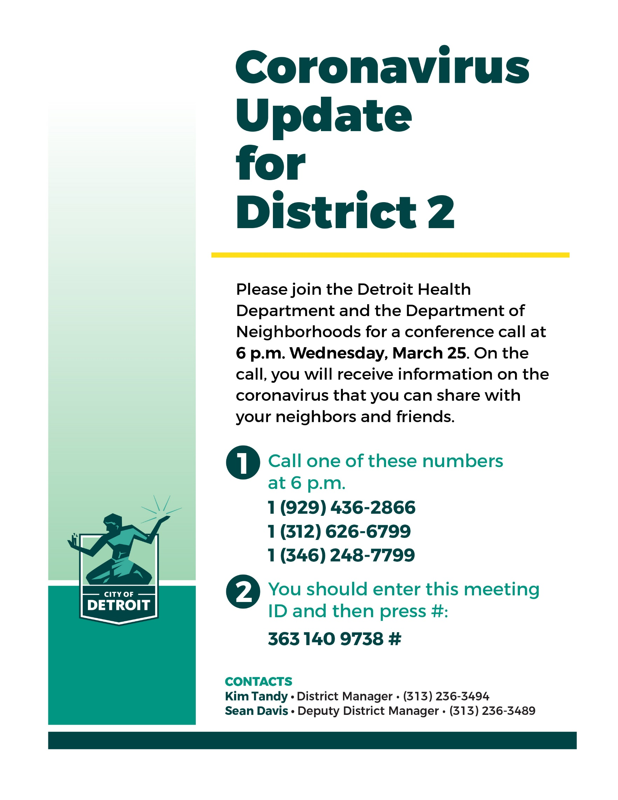

Slide 7
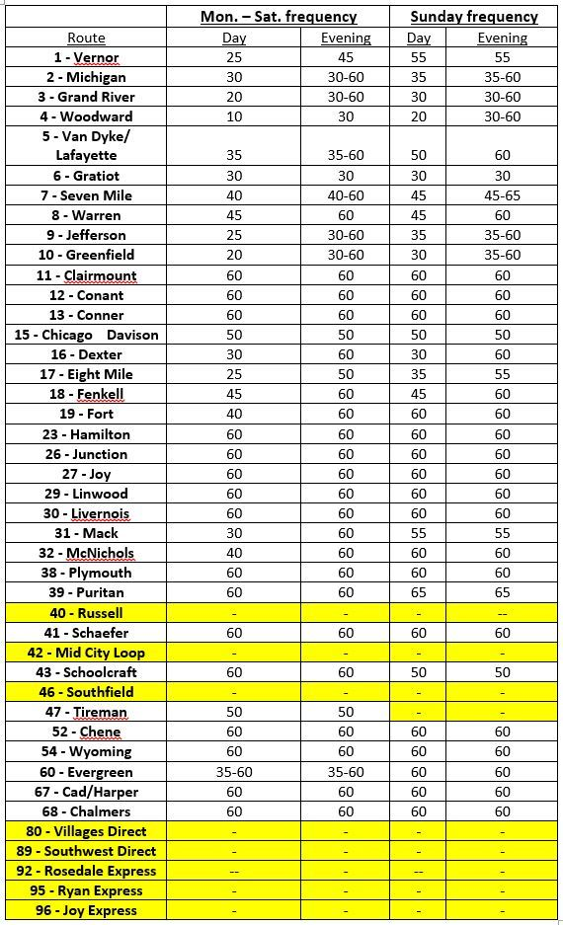
Temporary DDOT schedule – Effective 3/23/2020
Primary routes will be operating throughout the week on a Saturday schedule. Sunday will remain the same. (Highlighted) “Express Route” service will be suspended until further notice. Schedules are available online at http://www.detroitmi.gov/ddot

Slide 8
Help for the Homeless
The city and its partners have been working to expand shelter capacity to accommodate the need for social distancing and isolation of individuals with symptoms. In the last week, the City has identified over 200 new, temporary shelter spaces and City is working to identify another 250 new temporary spaces to shelter individuals.
The need for space is both for motel style-units (shared sleeping and bathroom space) and Dormitory style (separate units with shared bathrooms). The city's contractors will be providing security and screening at each of these facilities. Individuals who have space that may be appropriate for this use should contact Housing & Revitalization Department Director Donald Rencher at rencherd@detroitmi.gov.
The City also is accepting donations of the following items to support its vulnerable population:
toiletries (soap, toothbrushes, toothpaste, deodorant)
hand sanitizer and wipes and
new recreational supplies (such as games, books, playing cards, and other activities to keep people comfortable while in isolation)
These items can be dropped off Monday, Tuesday and Wednesday of this week between 9-5 at 100 Mack Avenue. If you are interested in volunteering for 4 hours number of hours, to help monitor one of the facilities go to (website).
Looking for Work?
All major services you need from Detroit at Work—looking for a job, help with your resume, understanding where to file for unemployment—are all available online at Detroit at Work.com, or by calling 313-962-WORK.
Detroit Parks & Recreation officials wants to encourage safe park usage during COVID-19
Recent evidence suggests that the COVID-19 virus can live for several days on surfaces such as playgrounds and other “high touch” areas in public spaces. For this reason, Parks & Recreation officials are encouraging residents to refrain from using playgrounds or other park amenities, such as playscapes, exercise equipment or other recreation equipment, and instead focus on taking long walks or bike rides and practice social distancing of at least 6 feet from other individuals.
Take these precautionary steps when visiting your local park:
Do not use parks or trails if you are exhibiting symptoms. Instead call the Detroit Health Department at 313-876-4000 for guidance.
Be prepared for limited access to public restrooms or water fountains.
Observe CDC’s minimum recommended social distancing of 6” from other persons at all times.
Follow CDC’s guidance on personal hygiene prior to visiting parks or trails.
To reduce the spread of COVID-19, the City of Detroit has closed all of its recreation centers through April 5, 2020. Park facilities such as clubhouses, community centers, and public restrooms will also remain closed during this time. Park maintenance and trash pick-up will continue at all city parks weekly as scheduled.
All facility rentals and park permits through April 5, 2020 have been cancelled with full refunds. Facility rentals and park permits will be accepted for April 6th and beyond.

Slide 9
Income Tax Deadline now July 15
Following the Federal and State decisions to push back the filing deadline for income taxes to July 15, the City of Detroit has pushed back the deadline for residents and non residents who must file city income taxes to July 15th as well.
City asking more city employees to work from home
· All police, fire, EMS, Health, DDOT & trash collection services will continue unaffected
· Some city offices to provide limited hours and staff
Effective March 20, the City of Detroit will be reducing the number of people in city buildings to protect employees who must be in the building to effectively serve citizens and the City of Detroit, Mayor Mike Duggan announced today. Those who can do their jobs remotely are being asked to do so.
All Police, Fire, EMS, Health department and DDOT employees, with the limited exception of some clerical positions, will still report to work as normal. Those clerical staff that do not report to the office will be asked to work from home. Trash collection and recycling services will continue normally and Department of Public Works Traffic Safety workers will continue to address safety issues with traffic signs and signals.
Here is a breakdown of departments and offices that still will have limited public accessibility:
Building Safety, Engineering & Environmental Department
Office hours will be modified to 8am – 2pm with limited staff. Citizens will be able to come to the office during those hours to ask questions or process permits and licenses, however most of these services can be conducted online at www.detroitmi.gov/bseed.
All BSEED and Department of Administrative Hearings for blight tickets have been postponed until further notice.
Residential permit inspections on occupied properties, with the exception of emergency issues, are suspended for the time being.
Office of Chief Financial Officer
The OCFO will operate with minimal onsite staff.
Services to the public that will be available include the assessor’s office and board of review for applying for the Homeowner Property Tax Assistance Program and property tax appeals for those without internet access. Applications also are available online at www.detroitmi.gov by clicking the “Help With Property Taxes” icon. · For payment activities those can be done online or at https://detroitmi.gov/how-do-i/pay-fine-bill-or-tax, payments can also be done at a local kiosk, to search kisok by zipcode visit codkiosk.com. The Treasurer’s office will also continue to respond to property tax inquires via phone at 313-224-3560 or by email at treasuryinfo@detroitmi.gov
Detroit Water & Sewerage Department
Repair and water restoration crews will continue to work.
Individuals without internet access with customer service needs are encourage to call 313-267-8000. For requests that cannot be completed by phone or online, the east side service center at 13303 E. McNichols will remain open from at 8m – 5pm on weekdays.
Temporarily, DWSD will allow new service to be initiated over the phone instead of in person.
If you have any questions, contact Customer Service at (313) 933-1300.

Slide 10
Homeowners Property Tax Assistance Program (HPTAP) Extension
The City has eliminated deadlines for applications and will now approve them on an on-going basis. If residents submit their HPTAP by May 1st, beyond the March Board of Review Meeting, it will be reflected on their summer tax bill. No further action is needed after residents are approved for the HPTAP until they hear from the Wayne County Treasurer’s Office.
The PAYS program eliminates penalties, interest and fees associated with delinquent taxes, and allows residents to enter into affordable monthly payment plans over three years to manage delinquent debt. Both PAYS and HPTAP work to eliminate financial burdens for residents and provide a comprehensive plan to homeowner stability.
Applications are available online at detroitmi.gov/pays. The City will also have staff available at the Board of Review and the Assessor’s Office M-F 8:30 am - 4:30 pm to assist with applications. Residents can also call (313) 224-3030 for more assistance.
For more information, visit www.detroitmi.gov/pays.
Wayne County Treasurer halts tax foreclosures
The Treasurer has announced there will be no foreclosures for the remainder of the year. Residents are urged to continue paying their bills as interest will continue to accrue. Due to ongoing efforts, foreclosures of owner-occupied homes were expected to be limited to just a few hundred.
36th District Court eviction process also halted
36th Dist. Court Chief Judge Bill McConico announced he is halting all current eviction proceedings.
Efforts to assist Detroit’s Homeless Population
The City is working closely with the 31 shelter providers in Detroit to ensure they have necessary personal protective equipment. It has also set up a 125-bed facility in partnership with the Detroit Rescue Mission Ministries to expand the system’s capacity and provide additional space where homeless individuals at shelters who are exhibiting symptoms such as fever can be isolated.
Blight Ticket Hearings postponed
The Department of Appeals and Hearings is postponing all hearings until a future date, effective Tuesday 3/17/20.
A notice to appear with the new hearing date will be mailed with directions for a rescheduled hearing.
IMPORTANT: How to respond to a postponed “Notice to Appear”
You will receive a Notice to Appear in the mail with the adjourned hearing date.
You can pay your ticket prior to the hearing date and receive a 10% fine discount.
You can pay with a credit card via:
  Phone at (313) 224-0098
  Online at App.DetroitMI.gov:8443/DAHOnline/
  Pay via credit card, check or cash at DivDat payment kiosks. Find one of over 75 locations at Divdat.com/location/
Get Blight Ticket information online at App.DetroitMI.gov:8443/DAHOnline/

Slide 11
City initiatives to support residents and businesses:
Restaurant Carryout Zone Program
Tuesday March 17, 2020, Mayor Mike Duggan announced the Restaurant Carryout Zone program, which allows any restaurant that has parking meters in front of their establishment to petition

Slide 12
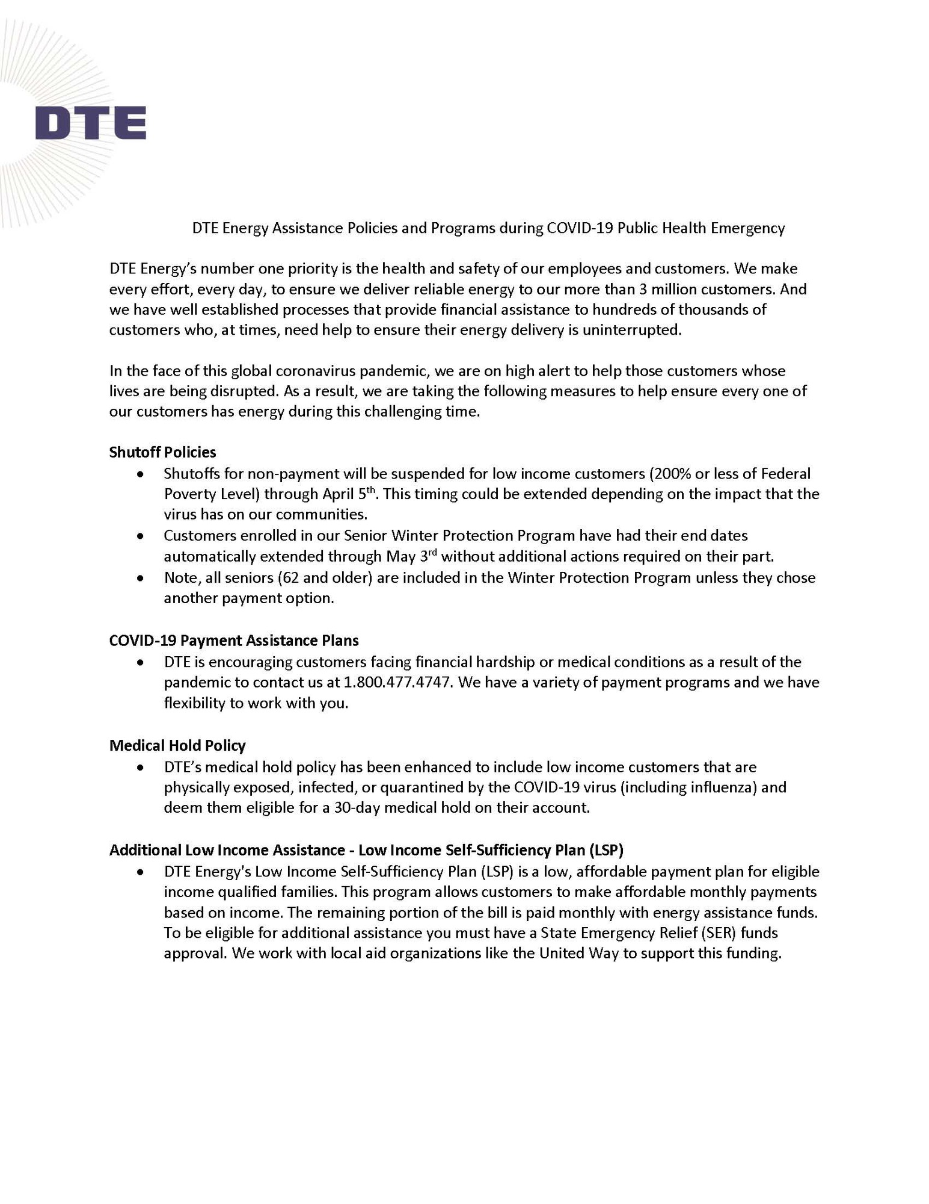
Follow the City of Detroit on Facebook, Twitter, or NextDoor to get the latest news on what's happening across the city and in your neighborhood. Unsubscribe Now Update your subscriptions, modify your password or email address, or stop subscriptions at any time on your Subscriber Preferences Page. You will need to use your email address to log in. If you have questions or problems with the subscription service, please visit subscriberhelp.govdelivery.com. This service is provided to you at no charge by City of Detroit, Michigan.
This email was sent to tandyk@detroitmi.gov using GovDelivery Communications Cloud on behalf of: City of Detroit, Michigan · 2 Woodward Avenue, Suite 1126 · Detroit, MI 48226

Slide 13


MIDETROIT DISTRICT 2
To 468311
C I T Y O F D E T R O I T * D I S T R I C T 2

